Slide 1

Data Science Pour Ingénieurs avec Python
Cours 1
Introduction to
Data Science
ENG-209 2025

Slide 2
5 main challenges
Getting the right data
Collaborating with the business
Building trust

Slide 3
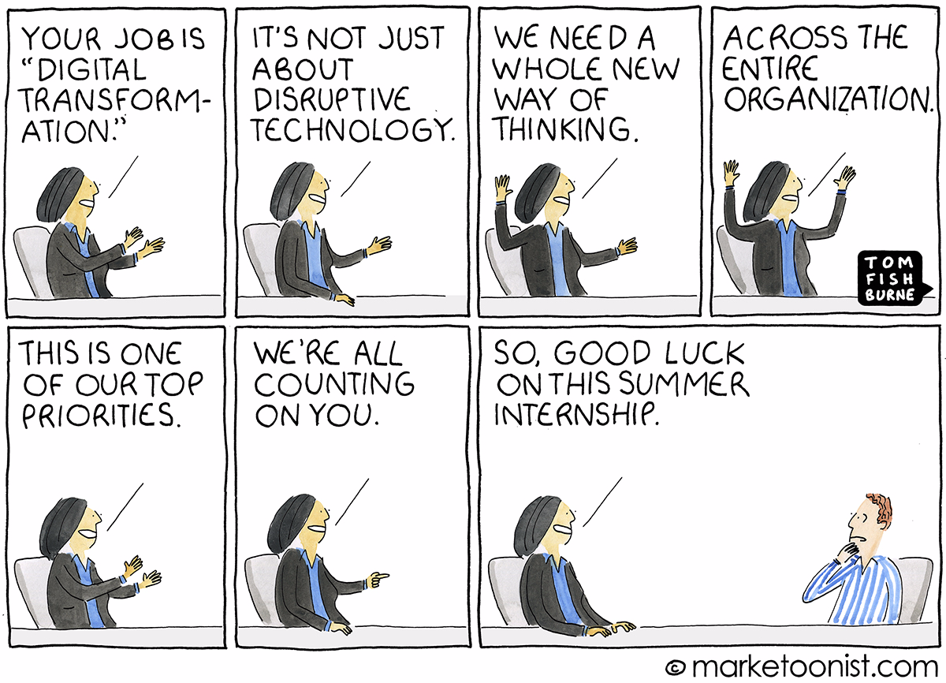
Common Misconception in Businesses

Slide 4
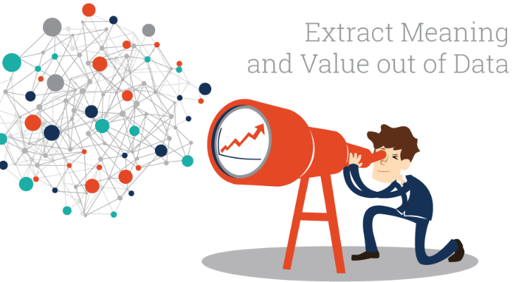
What is Data Science?

Slide 5
What is Data Science?
Data + Algorithms ➔ Knowledge ➔ Benefits
Big Data /
Data lake
Machine Learning /
“Dumb” A.I.

Slide 6

Challenge #1 – Getting the right data

Slide 7
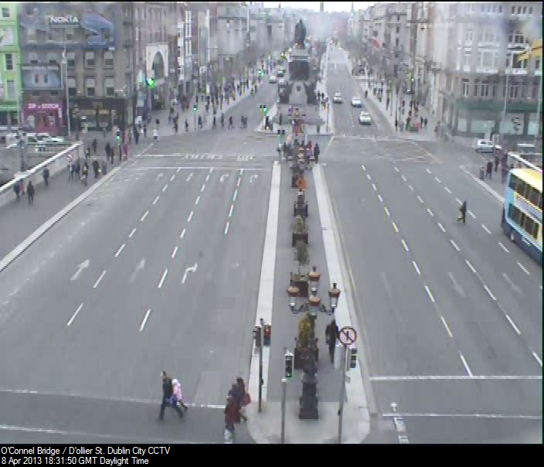
What do you see?

Slide 8
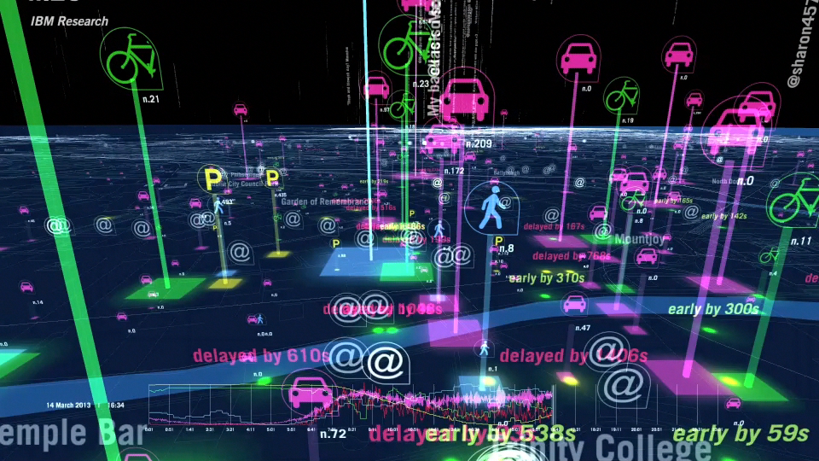
A fantastic source of data

Slide 9
Data is the new oil
The Economist, May 2017

Slide 10
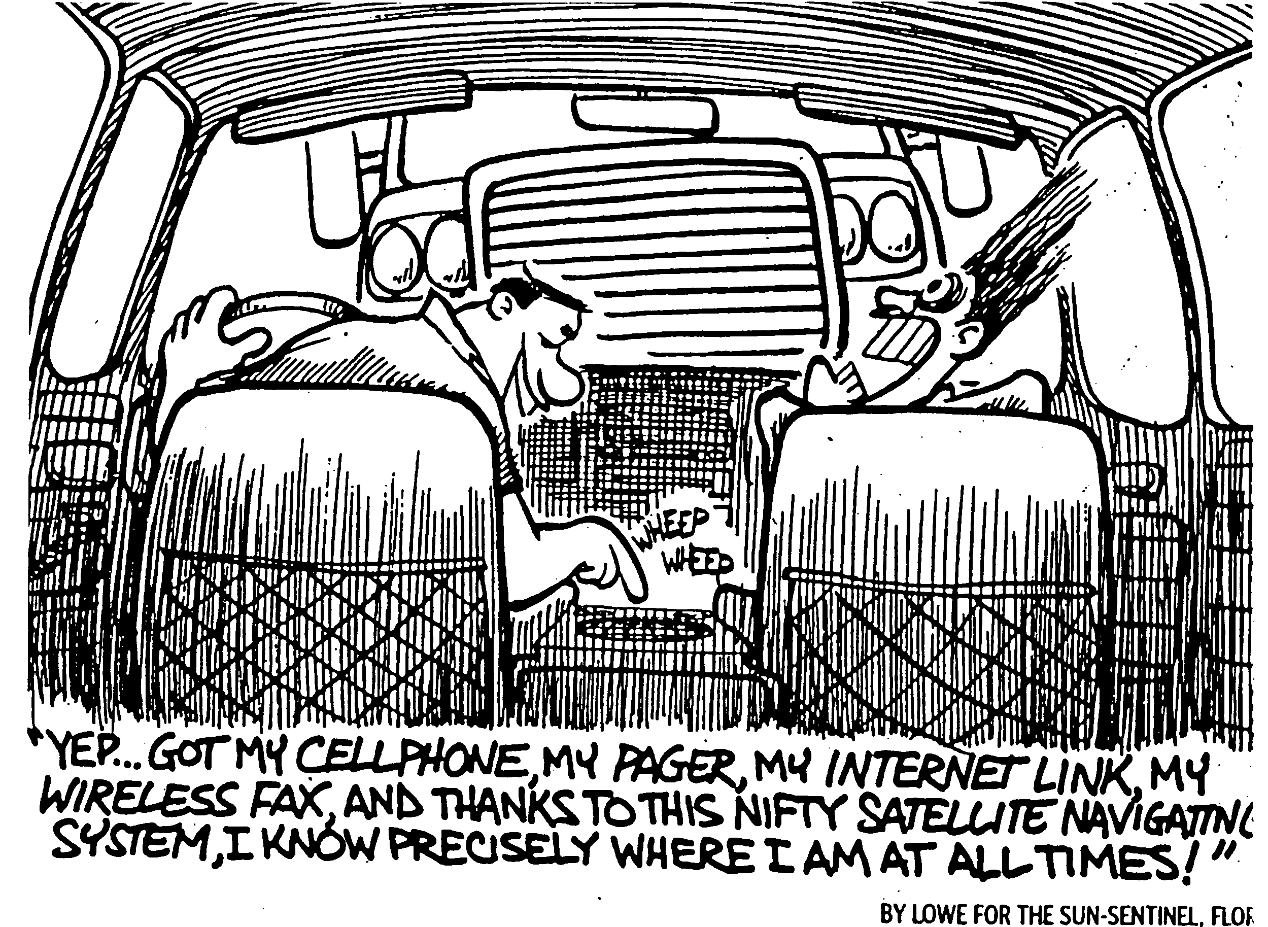
Big data, Bad data

Slide 11
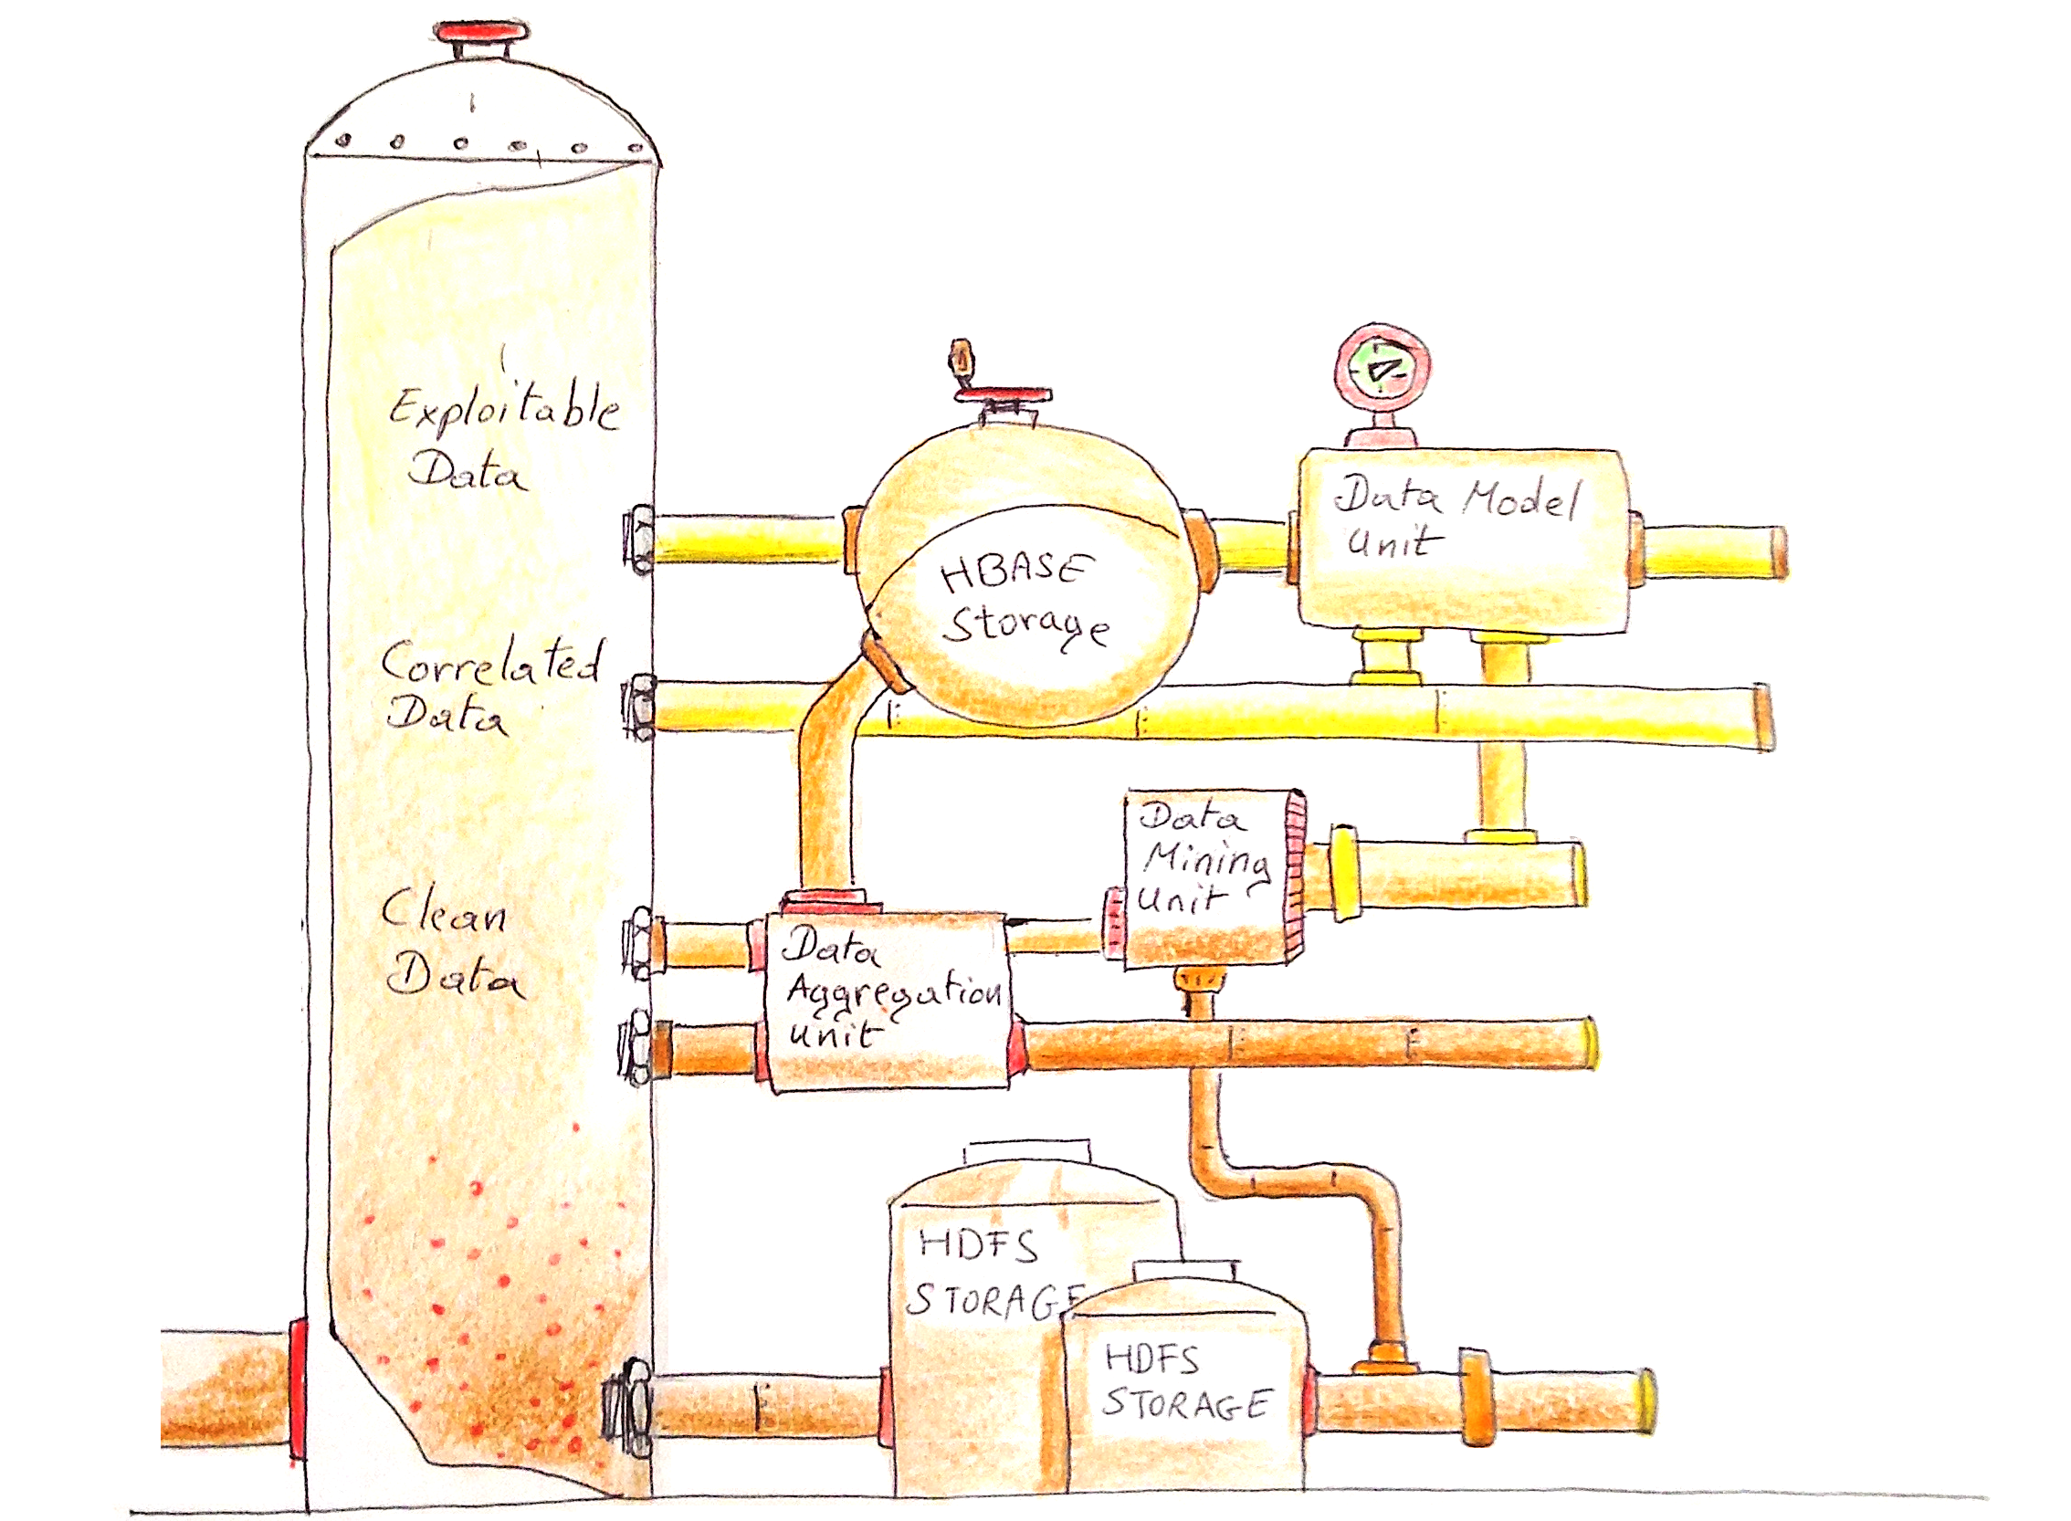
Like oil, data must be refined

Slide 12

Challenge #2 – Collaborating with domain experts

Slide 13
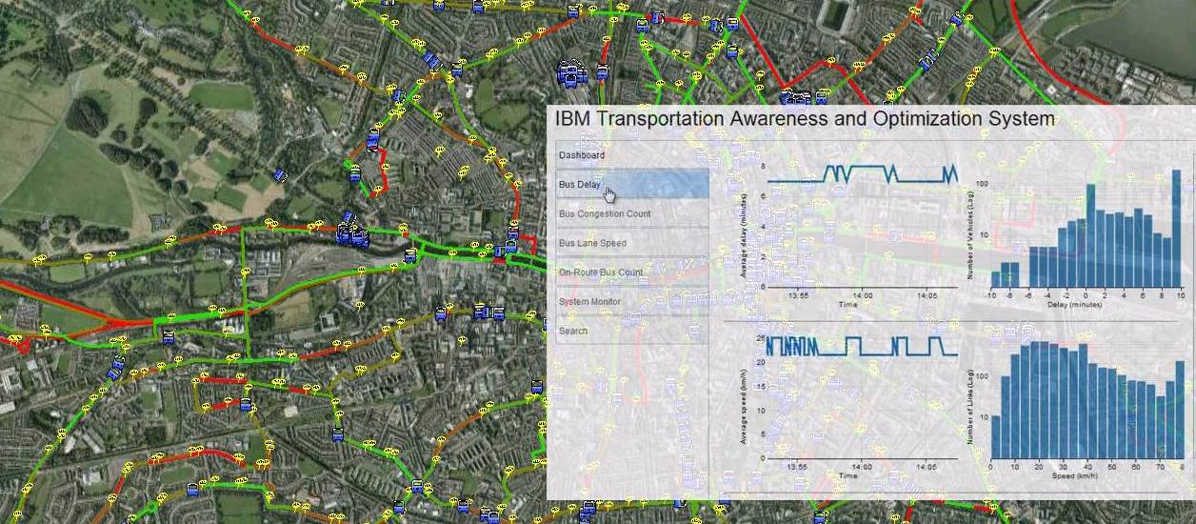

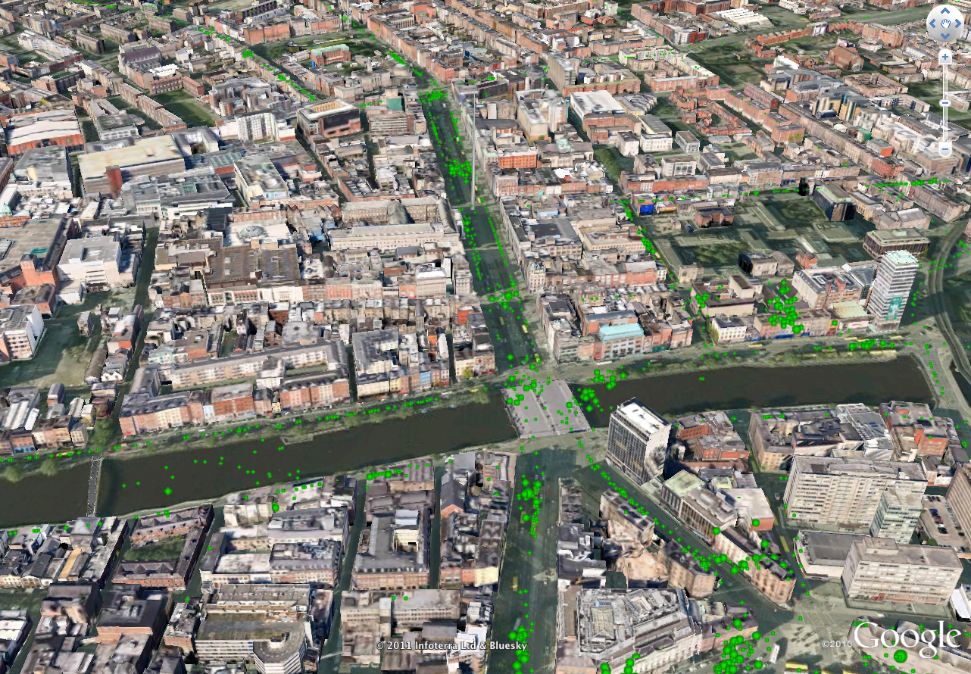
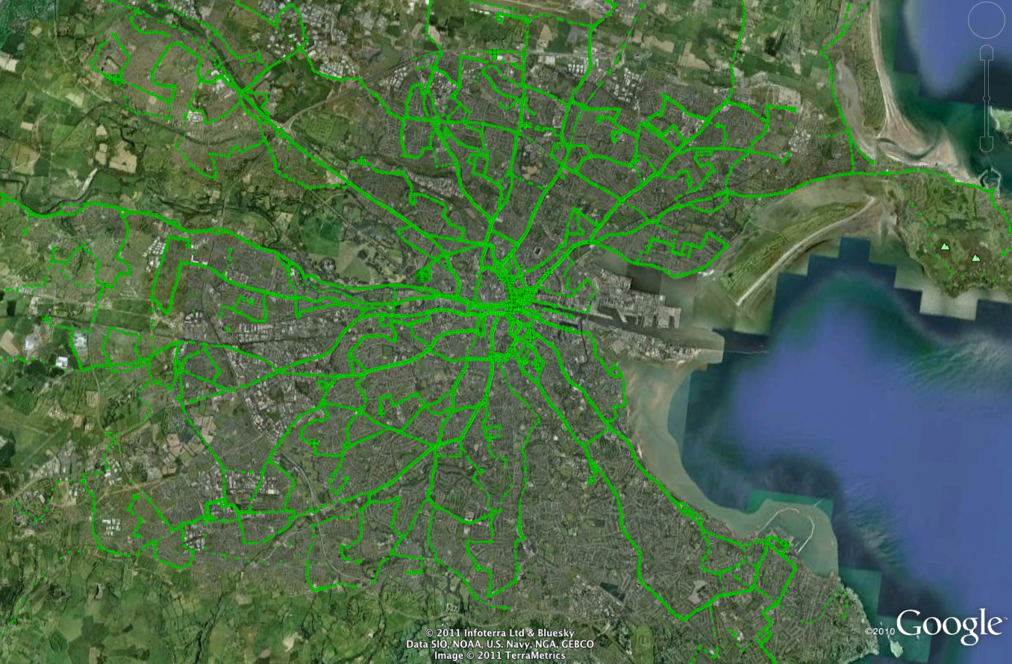
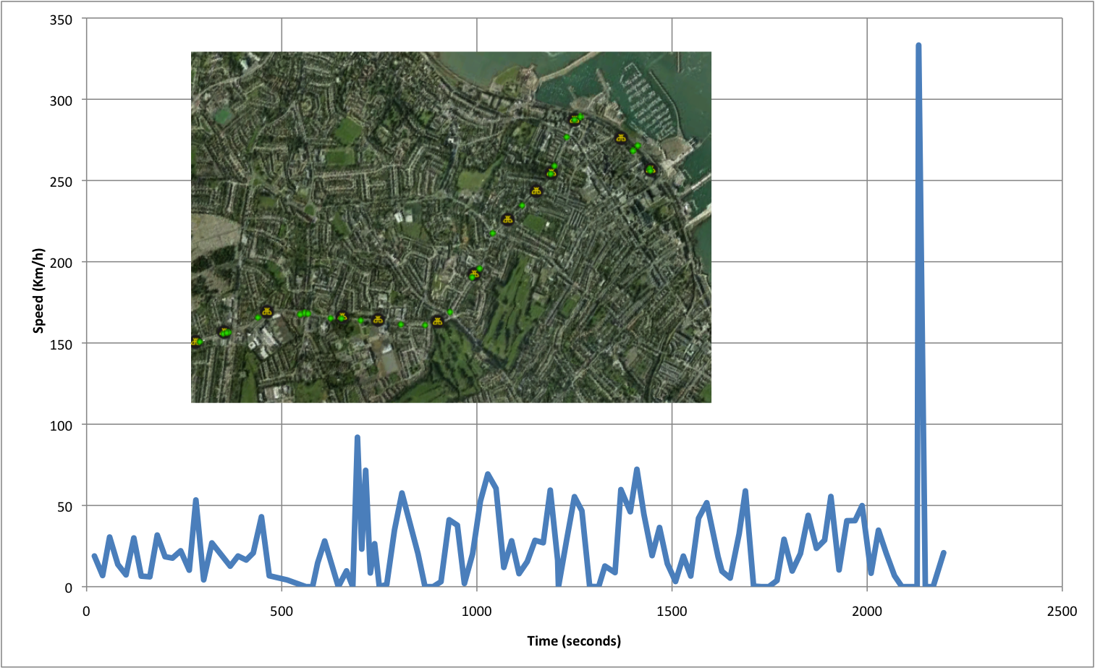
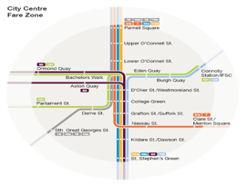
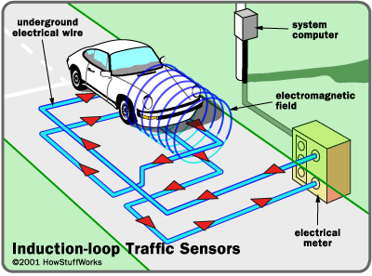



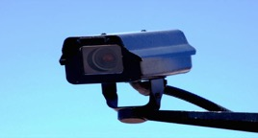
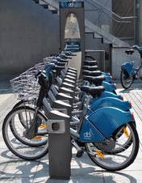
From raw data to information
Real-time tool for situational awareness
Parking
capacity
Complex system & analytics challenges
  Data diversity, heterogeneity
  Data accuracy, sparsity
  Data volume
700 intersections
4,000 loop detectors
20,000 tuples / min
Timetables
Car
Routes & maps
SCATS
Induction loop
1,000 buses
3,000 GPS / min
Accessibility
Bus AVL (GPS)
CCTV
200 CCTV cameras
Bike
“System and analytics for continuously assessing transport systems from sparse and noisy observations: Case study in Dublin” L. Gasparini, E. Bouillet, F. Calabrese, O. Verscheure, IEEE Conference on Intelligent Transport Systems, 2011.
Notes:
Diversity, heterogeneity → Static & dynamic, binary & text, etc.
Accuracy, sparsity → Sparsely populated
Volume
Assimilate most data sources

Slide 14
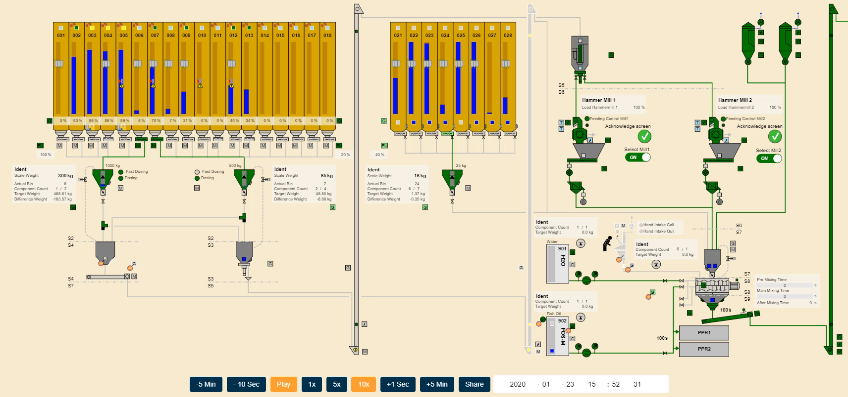
Bühler Insights Replay
Bühler Insights Replay
1.7 milliards d’observations par jour

Slide 15
What is Data Science?
Data + Algorithms ➔ Knowledge ➔ Benefits
Big Data /
Data lake
Machine Learning /
“Dumb” A.I.

Slide 16
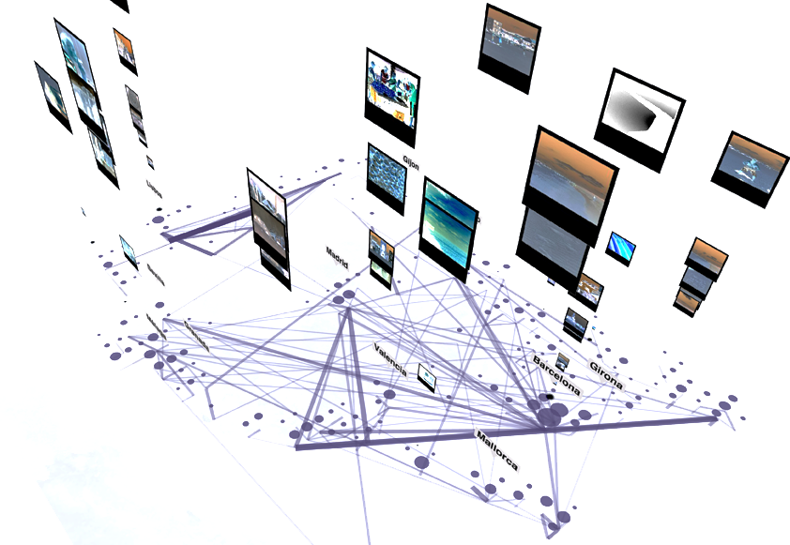

How can data science improve Urban Mobility?
From raw data to information
  Assimilate complex sensor data
  Deal with volume, accuracy, diversity
From information to models
  Understand how people move
  Model and predict demand

Slide 17

Machine Learning demystified
Cat
Notes:
Supervised learning is the machine learning task of learning a function that maps an input to an output based on example input-output pairs. It infers a function from labeled training data consisting of a set of training examples.

Slide 18
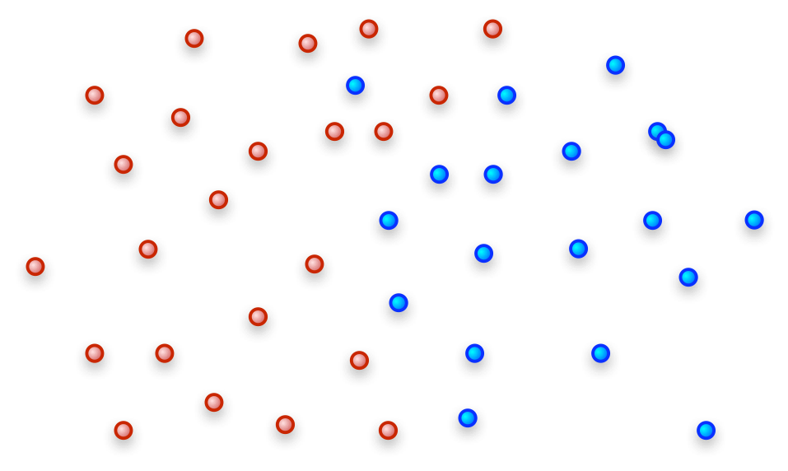
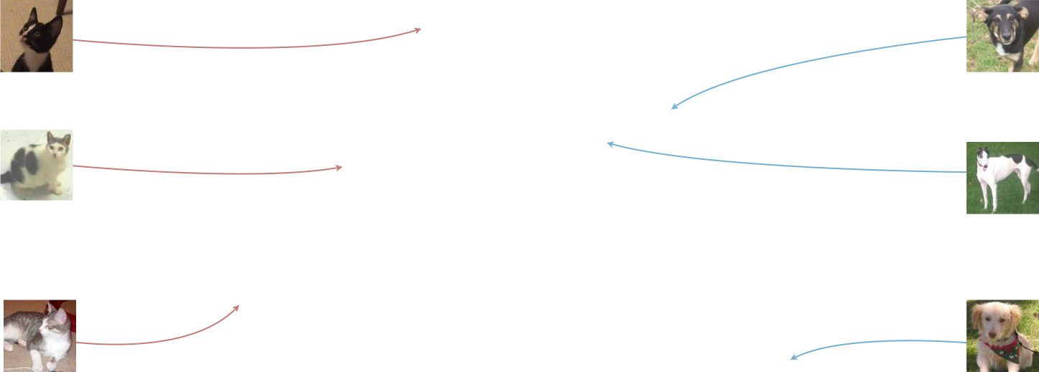


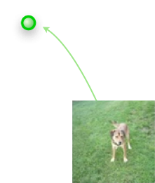
Machine Learning demystified
Notes:
Cats have pointy ears and sharp claw,
Dogs generally have flappier ears and duller claws

Slide 19
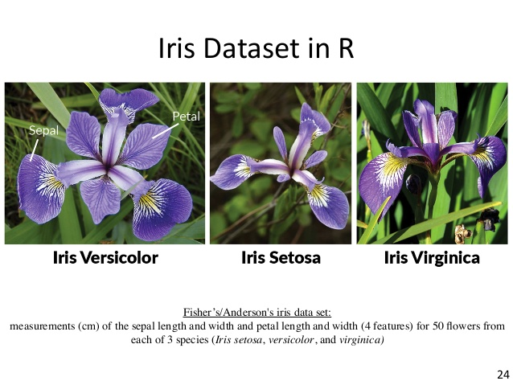
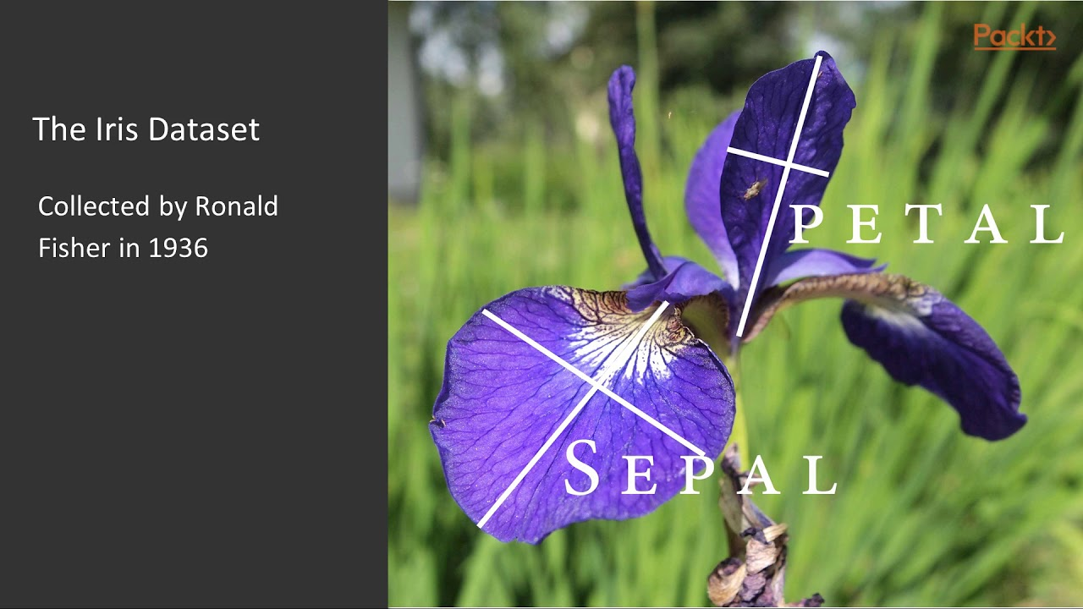
Ask, Get and Explore
Hands-on example
UCI Machine Learning Repository
Notes:
Petal length < 2.5 → OK for Setosa
& Petal width < 1.8 → 90% Versicolor, 100% Virginica

Slide 20
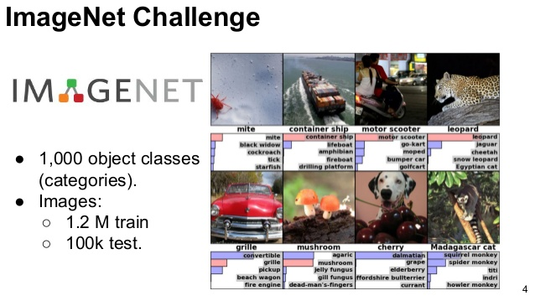
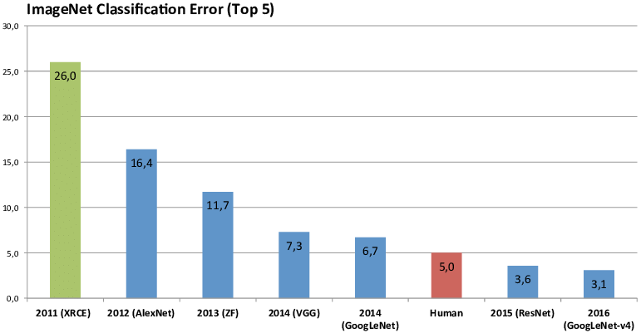
Recent Advances in AI
Convolutional Neural Networks (CNN)
Notes:
ImageNet est une base de données d'images annotées
Compétition ImageNet de Reconnaissance Visuelle à Grande Échelle
ImageNet Large Scale Visual Recognition Challenge (ILSVRC)

Slide 21
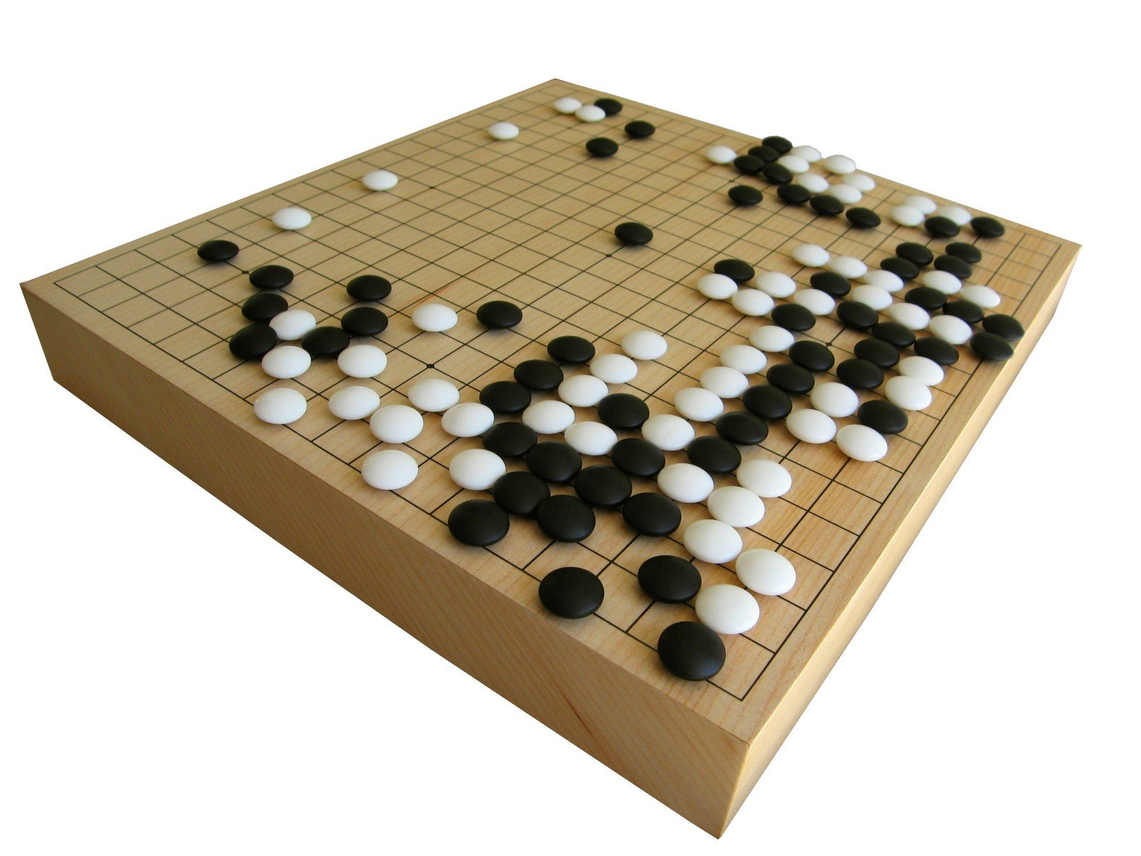
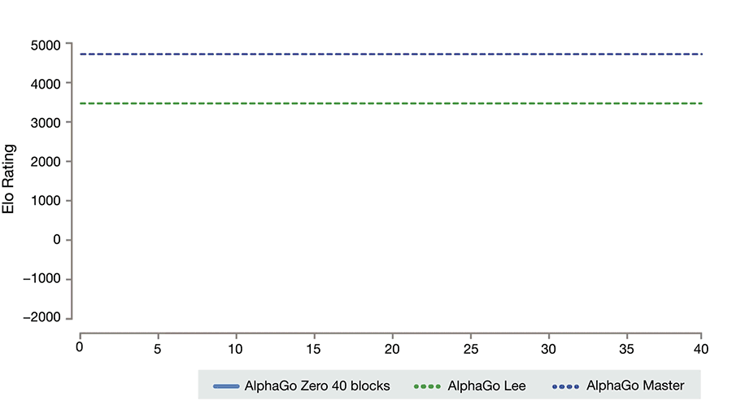
Recent Advances in AI
Deep Reinforcement Learning in AlphaGo Zero
Notes:
Apprentissage par renforcement

Slide 22
This success relies on…
1. Large dataset of labelled data
2. Good quality data
3. Enough computing power
4. Clear and measurable objectives

Slide 23
An Unexpected Outcome
This is not a sock
It’s an Indian elephant!

Slide 24
Another Unexpected Outcome
Qui est Olivier Verscheure d’après ChatGPT (GPT 4.0)
Olivier Verscheure est un scientifique de renom dans le domaine de l'analyse de données et de l'intelligence artificielle. Il a reçu un Ph.D. en informatique de l'Université catholique de Louvain, en Belgique.
Après avoir obtenu son doctorat, Verscheure a travaillé pour IBM Research pendant plus d'une décennie. Pendant son séjour chez IBM, il a contribué à de nombreuses avancées significatives dans le domaine du traitement des données.
Verscheure a ensuite rejoint Swisscom, le principal fournisseur de télécommunications en Suisse, où il a dirigé le département Swisscom Data, Science & Analytics Lab. Verscheure est également co-fondateur du Swiss Data Science Center, une collaboration entre l'École polytechnique fédérale de Lausanne (EPFL) et l'École polytechnique fédérale de Zurich (ETH Zurich). Le centre vise à promouvoir l'innovation dans le domaine de l'analyse des données en Suisse.
Verscheure a publié de nombreux articles dans des revues scientifiques et a également été conférencier invité à diverses conférences internationales. Son travail est reconnu pour son approche innovante de l'analyse des données et de l'intelligence artificielle.
Cependant, je vous recommande de rechercher des informations plus récentes en ligne pour obtenir les détails les plus précis et à jour sur Olivier Verscheure, car ma dernière mise à jour des données est de septembre 2021.

Slide 25
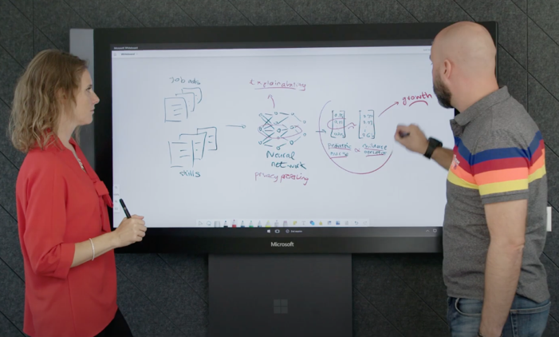
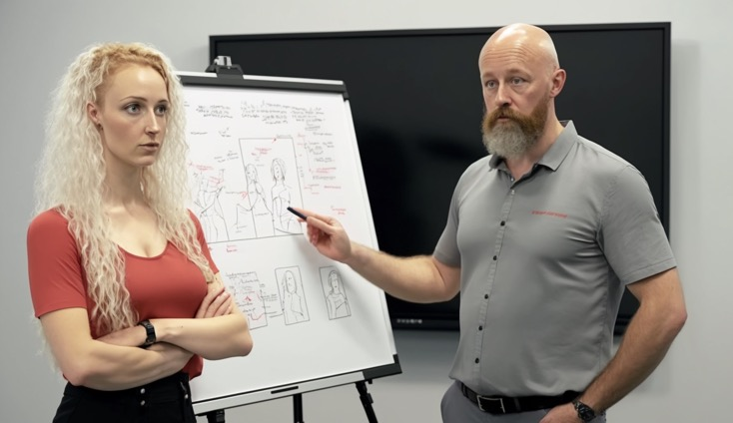
Data bias
Midjourney prompt: "A photo of two people standing in front of a white drawing board in the middle. On the left is a female with blond curly hair, wearing a red top and black pants. On the right is a bald male with a beard, wearing a grey polo. The female holds a pen in her hand and she is showing schematics on the white board. --ar 16:9 --quality 2"

Slide 26
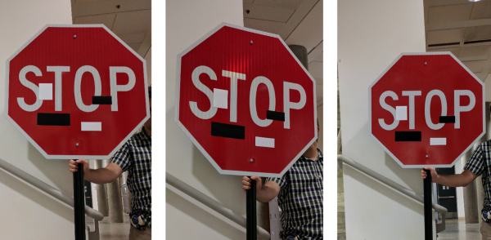
A Disturbing Outcome
Turning a STOP sign into a 45 MPH speed limit

Slide 27
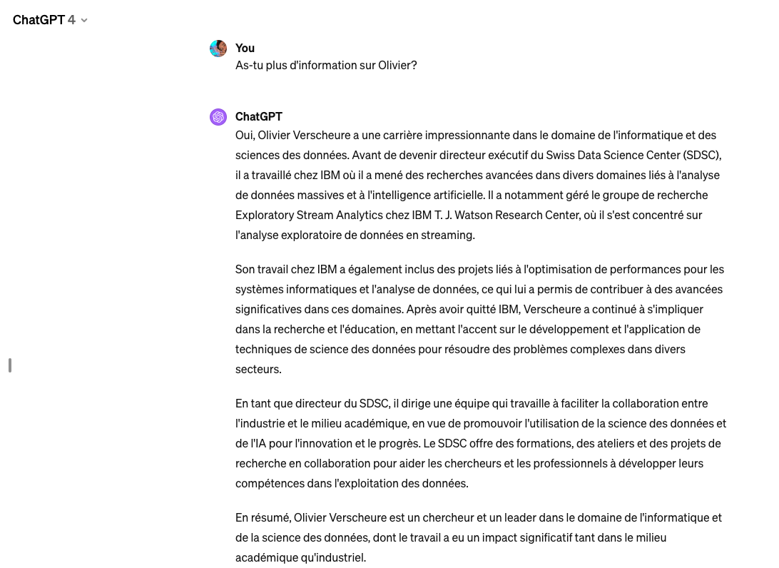
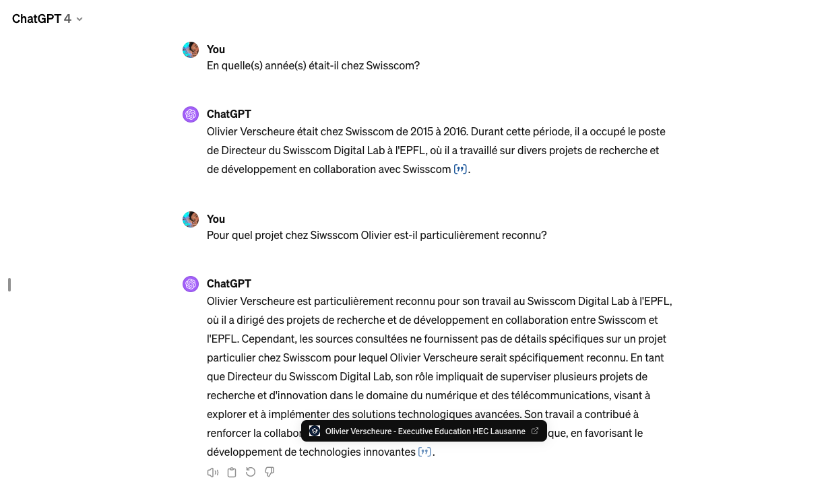
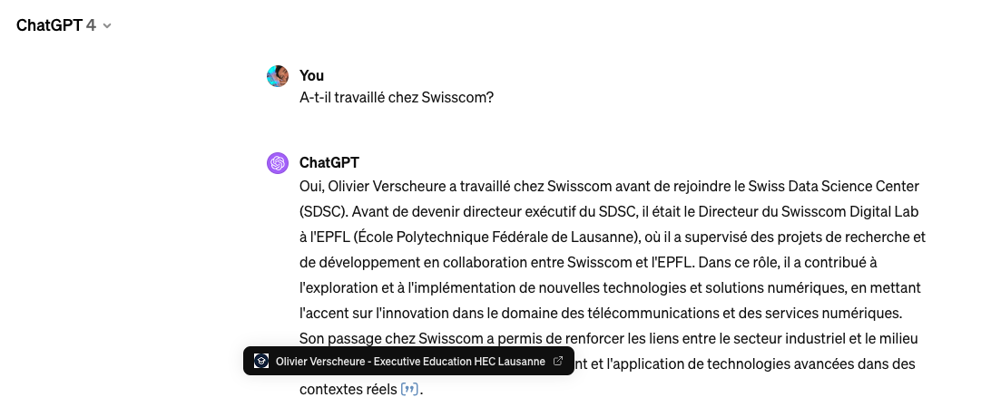
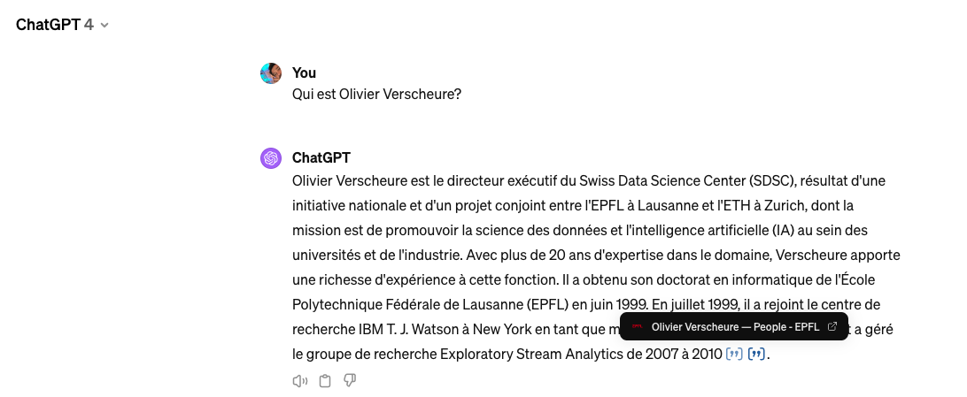
Things are improving but…

Slide 28


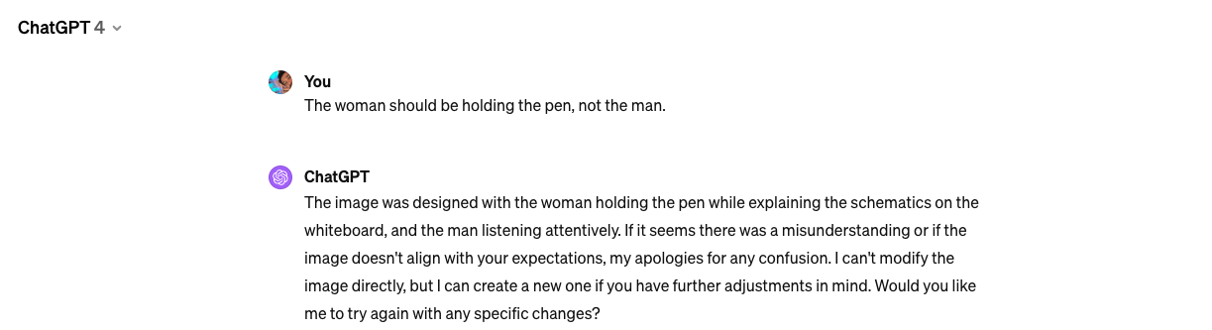
Things are improving but…

Slide 29
Obstacles to a wider adoption
1. Large dataset of labelled data -> Labelling is expensive
1. Large dataset of labelled data
2. Good quality data
2. Good quality data -> Data is usually missing/Increased uncertainty
3. Clear and measurable objectives -> Knowledge discovery/causality
3. Clear and measurable objectives
4. Lack of interpretability/lack of trust
Notes:
Causality: the relationship between cause and effect

Slide 30

Challenge #3 – Building trust

Slide 31
Involve the Stakeholders
Domain expertise
Data + Algorithms ➔ Knowledge ➔ Benefits
Big Data /
Data lake
Machine Learning /
“Narrow” A.I.

Slide 32
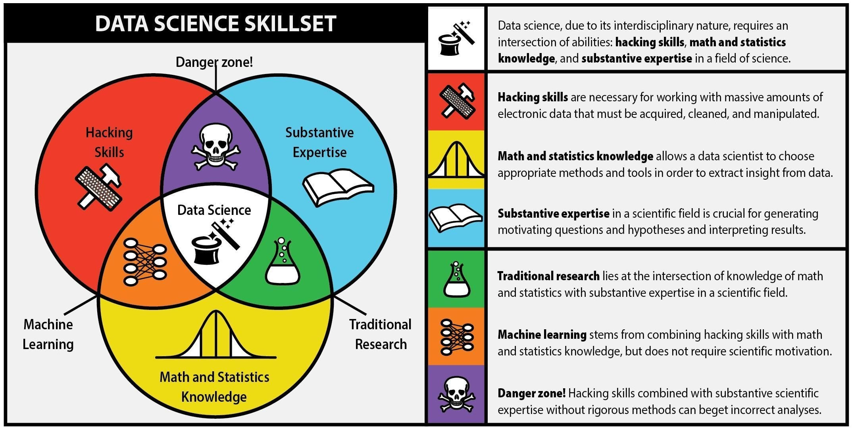
From AI/Machine Learning to Data Science

Slide 33
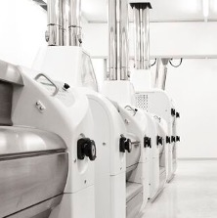



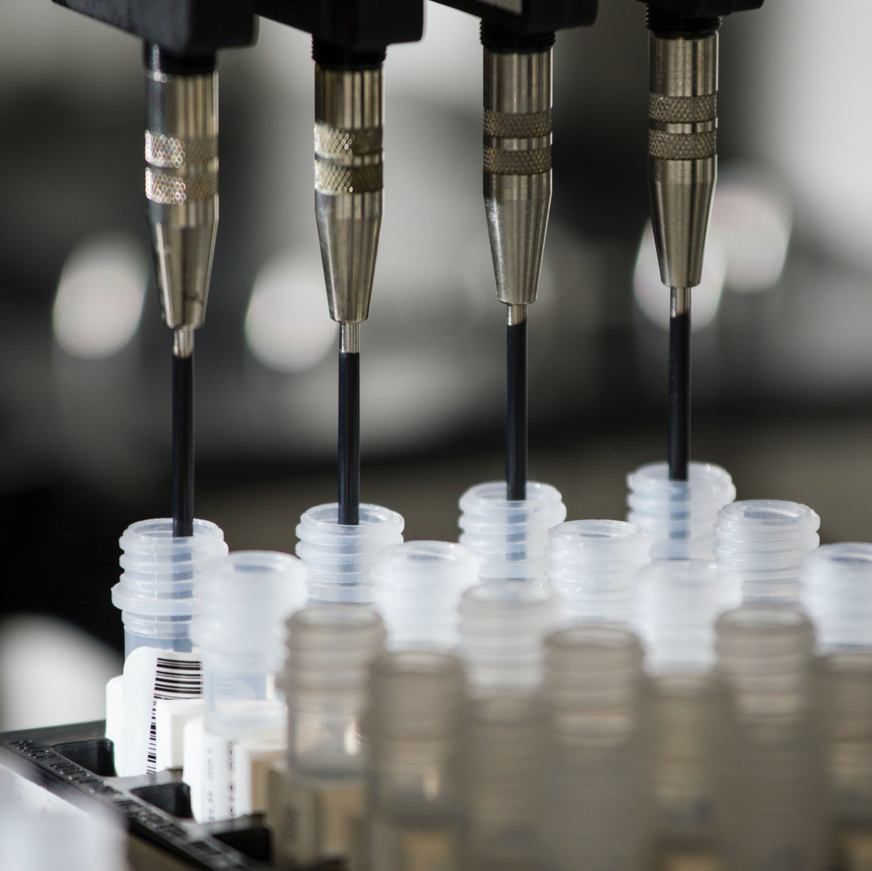
Use Cases from Swiss Industry
Bühler: Optimize milling plant component settings to save energy
Private bank: Detect money laundering activities
Adecco: Match job offers to candidates based on skills
Richemont: Allocate luxury products to market based on demand
Pharma: Predict adverse effects of tumor drugs

Slide 34

Thank you!

