Slide 1
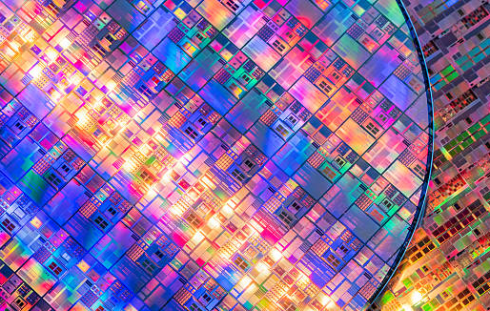
The recycling of CMOS technology
Aspects of quantum science and sustainability
Mohamed Khaled Miraoui
Sven Vibert

Slide 2
Summary
What is the cost of making a silicon chip and why should we recycle?
Industry sustainable strategies
How to actually recycle ?
  Rare earth elements
  Silicon
  Main challenges encountered
Conclusion

Slide 3
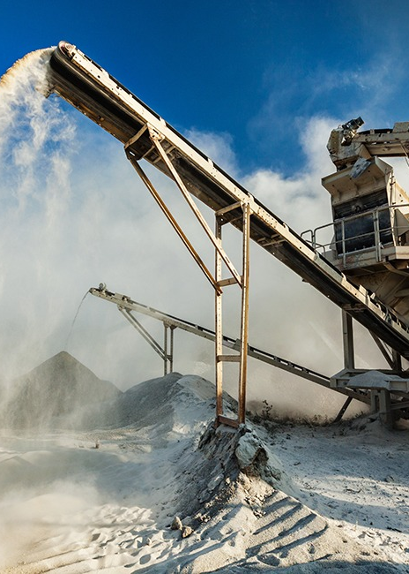
What is the cost of making a silicon chip and why should we recycle ?

Slide 4
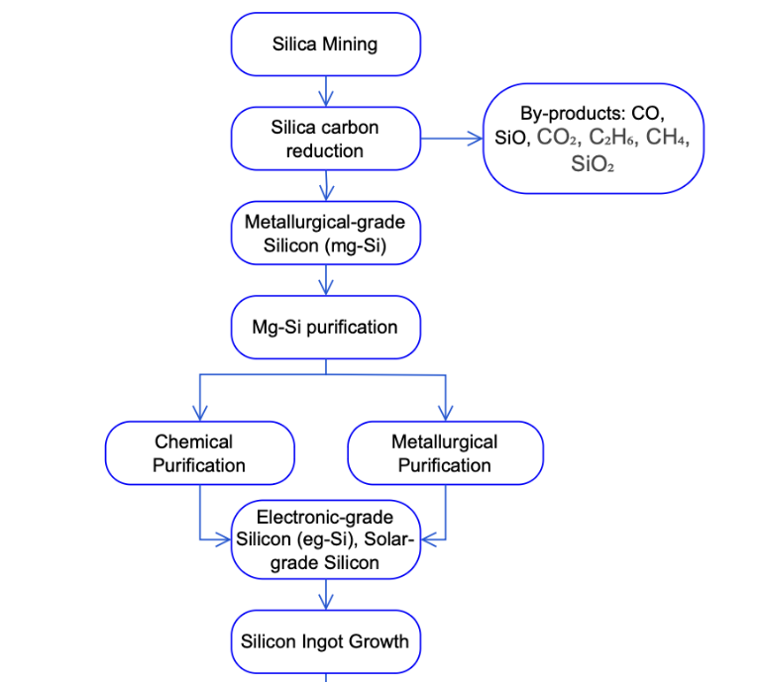
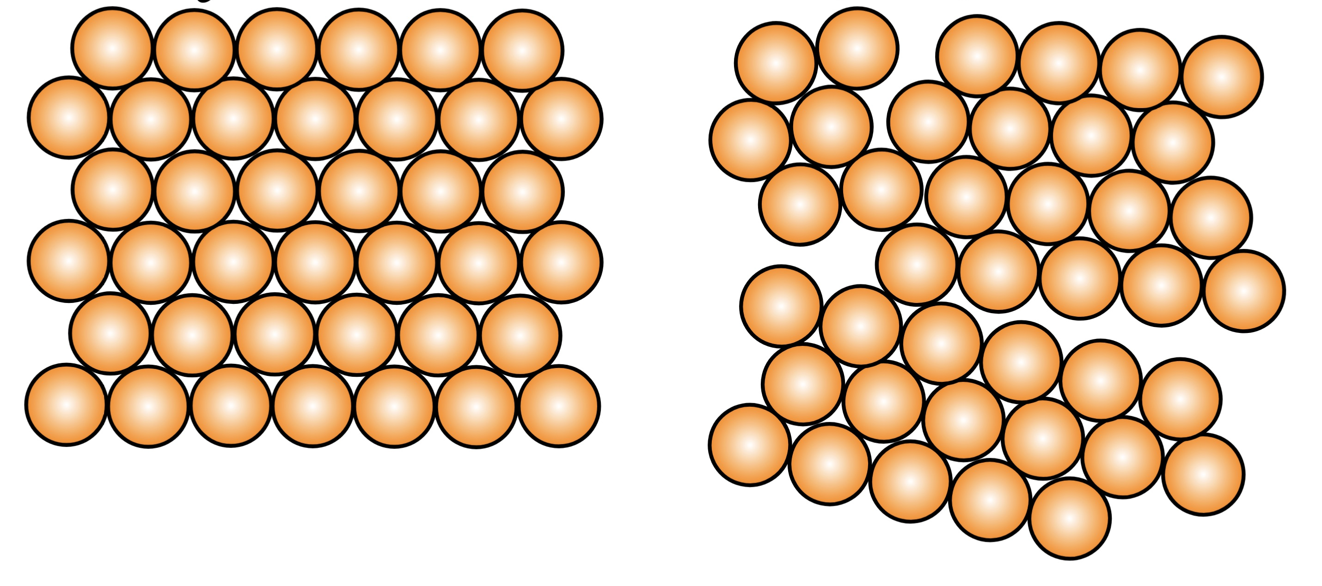
Life cycle of silicon
SiO2 + 2C → Si + 2CO
Figure 2 Silicon Production Process Flow Diagram of (1)

Slide 5
Life cycle of silicon
SiO2 + 2C → Si + 2CO
Figure 2 Silicon Production Process Flow Diagram of (1)

Slide 6
Life cycle of silicon
SiO2 + 2C → Si + 2CO
98%
Figure 2 Silicon Production Process Flow Diagram of (1)

Slide 7
Life cycle of silicon
SiO2 + 2C → Si + 2CO
Figure 2 Silicon Production Process Flow Diagram of (1)

Slide 8
Life cycle of silicon
SiO2 + 2C → Si + 2CO
Figure 2 Silicon Production Process Flow Diagram of (1)

Slide 9
Life cycle of silicon
SiO2 + 2C → Si + 2CO
Figure 2 Silicon Production Process Flow Diagram of (1) page 11

Slide 10
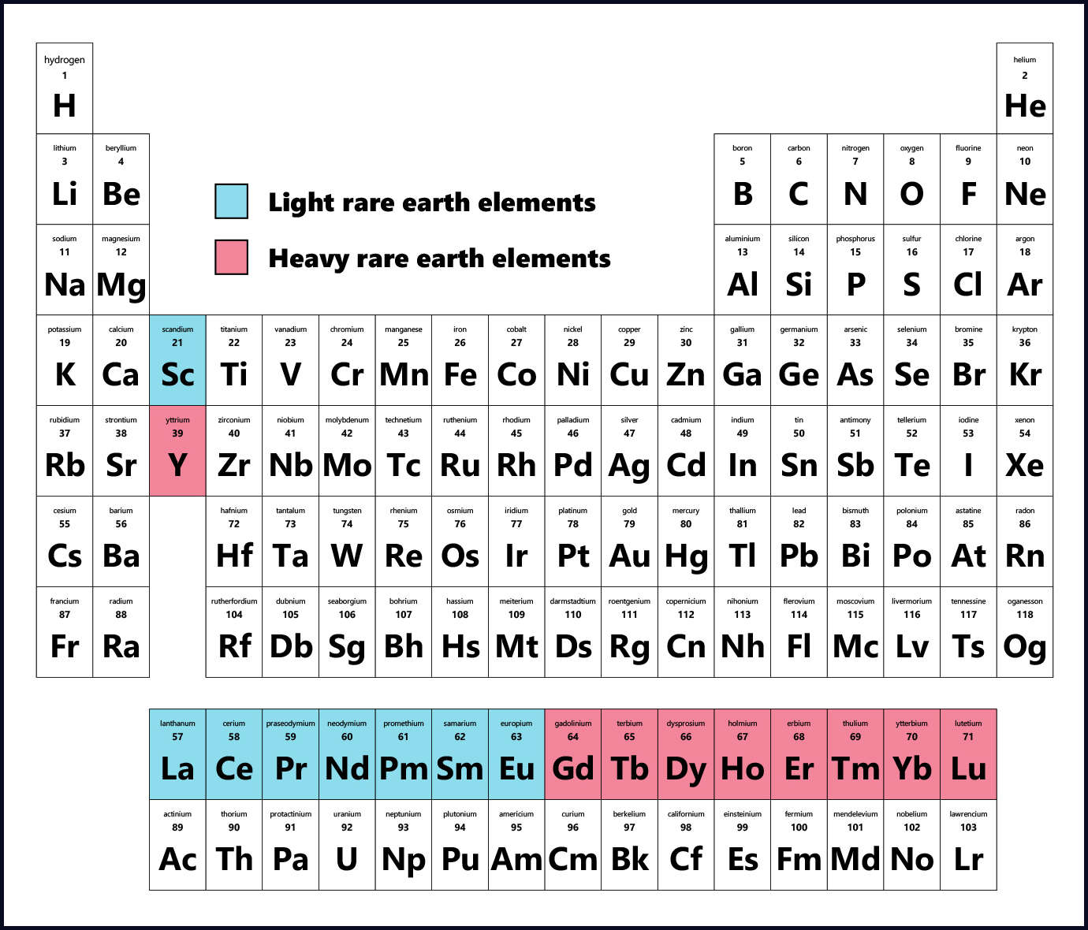
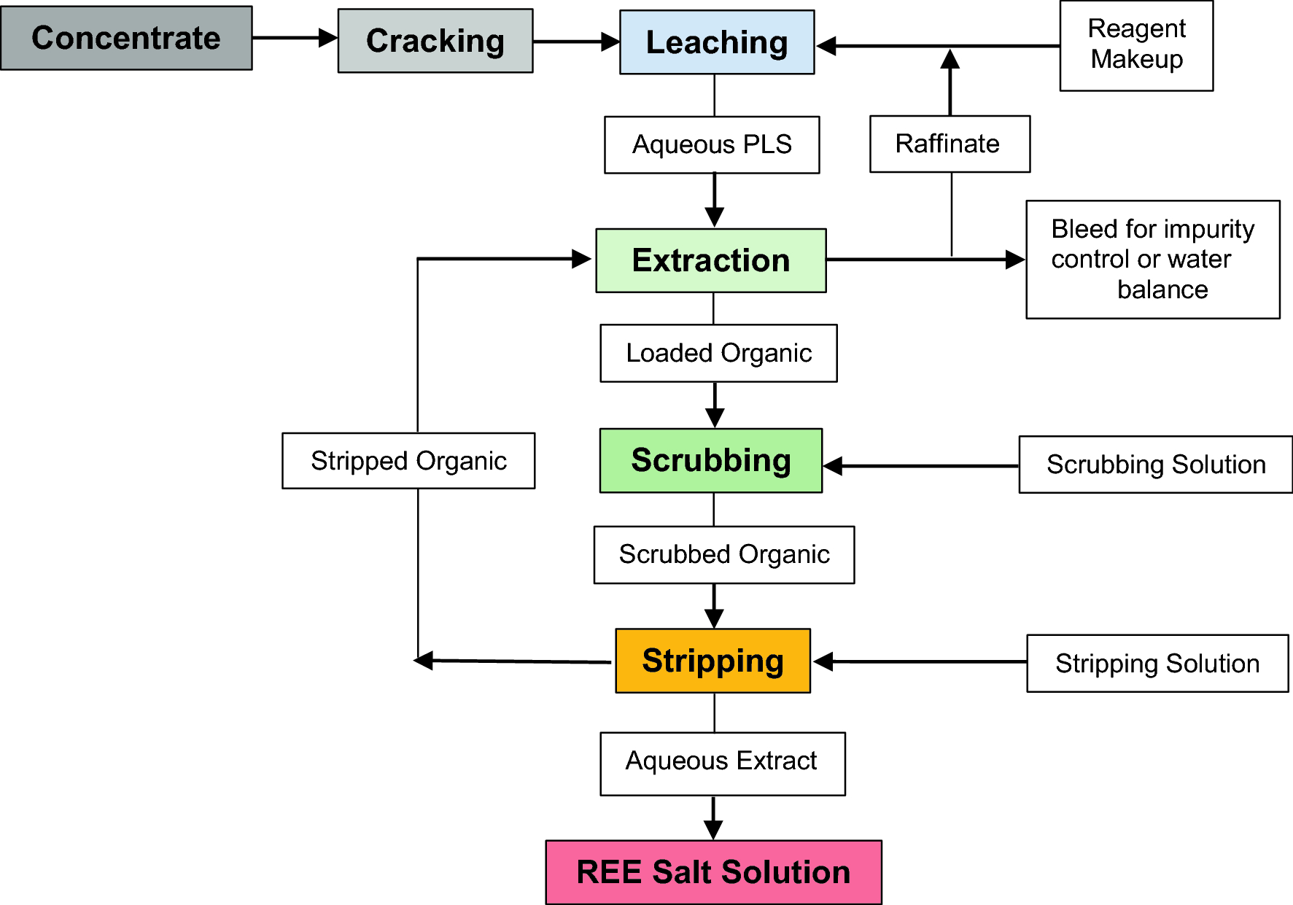
Rare earth and metal
Figure 3 of Processing the ores of rare-earth elements, McNulty T.

Slide 11
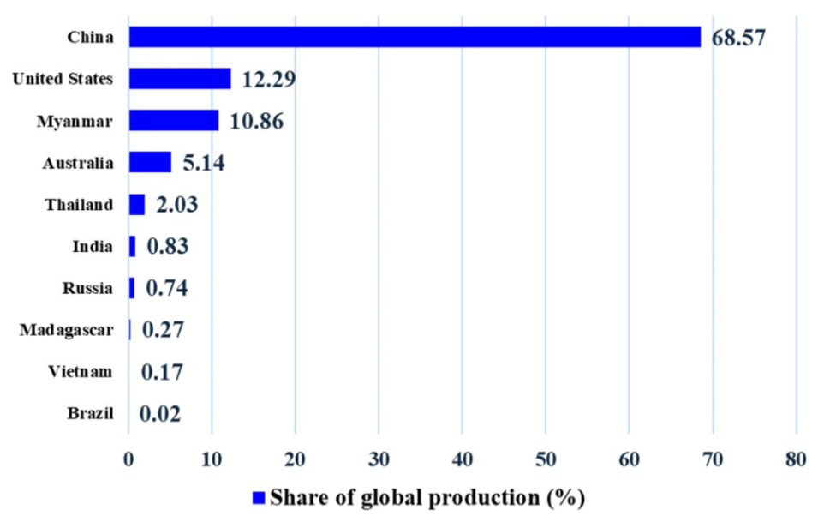
Geopolitical dimension of Rare earth
Fig. 1 Global distribution of rare earth element production by country as of 2023 of (2)

Slide 12
Why recycled
Mining
Purification
Recycled
Fabrication
Use

Slide 13
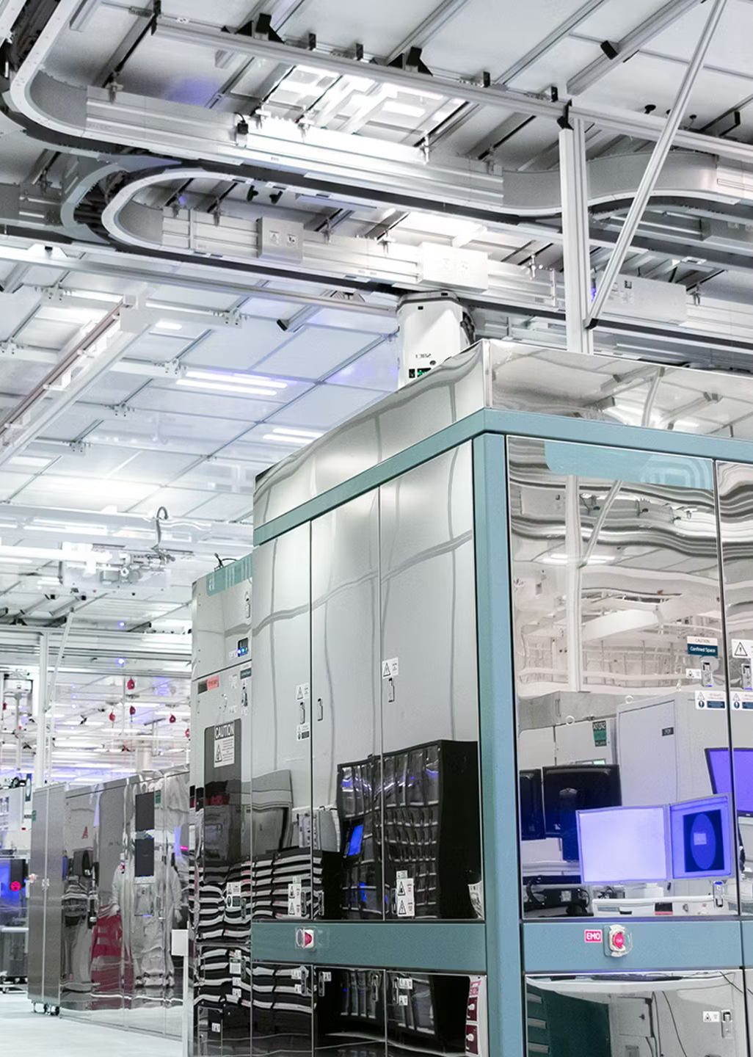
Industry sustainable strategies

Slide 14




Chip binning
What is the difference ? (the color gradient of the box ?)
Intel Processor
Core | 4 | 6-14 | 12-20 | 16-24
Price | 100-200 | 200-300 | 300-400 | 400-800
Same wafer
Same fabrication process

Slide 15
Silicon Lifecycle Management
Improve reliability, efficiency and lifespan
Very complex
Monitoring
Fabrication
Operation
Maintenance
End-of-life

Slide 16
Monitoring and Stress tests
Stress test
  Burn-in test
  Stress to constant voltage
Systeme level testing
Sensors
  Temperature
  Voltage
  Timing
  Power
Digital twins

Slide 17

How to actually recycle REEs, and Si?

Slide 18
Why recycle REEs ?
Rare-earth elements are essential in modern electronics and clean technologies.
E-waste is a secondary source of REEs, especially from magnets, batteries, phosphors, LCDs, and PCBs.
Recycling reduces the dependancy on mining and purification, which is costly and bad for the environment
Tipycal materials found :
  NdFeB magnets: hard drives, electric motors, wind turbines ( Nd, Pr )
  phosphors: lighting and displays ( Y, Eu, Tb )
  Printed circuit boards: mixed REEs + precious metals ( Dy Au/Ag/Pd/Pt )

Slide 19
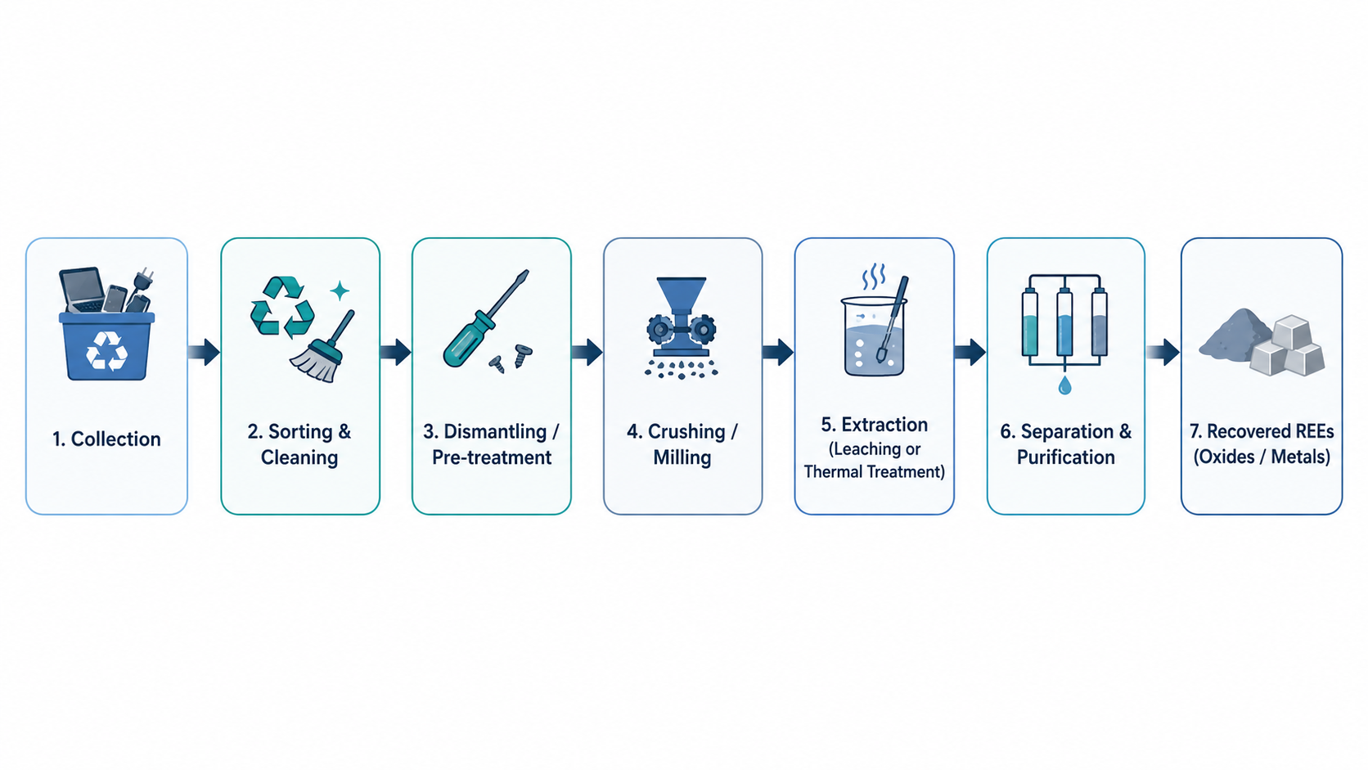
The general recycling pipeline
First, e-waste is collected and sorted.
REE-rich components are dismantled: magnets, lamps, batteries, screens, boards.
Materials are crushed or milled to increase surface area.
REEs are extracted using chemical, thermal, biological, or electrochemical methods.
Final products are purified as rare-earth oxides, salts, or metals.

Slide 20
Main recycling techniques
Hydrometallurgy / acid leaching : Dissolves REEs into solution using acids. Targets magnets, phosphors, batteries, LCDs.
Precipitation : Converts dissolved REEs into solid compounds, often oxalates, then into rare-earth oxides.
Pyrometallurgy : Uses high-temperature smelting, roasting, or melting. Targets PCBs, magnets, and batteries.
Solvent extraction : Separates specific REEs from mixed solutions using organic extractants
Bioleaching : Uses microorganisms or organic acids to dissolve metals from low-grade e-waste.

Slide 21
Some metrics on the mentionned techniques
Method | Best target | Efficiency
Acid leaching | NdFeB magnets, phosphors, LCDs | Often 90–99% for Nd, Dy, Y, Eu
Precipitation | REE-rich leachates | Eu, Tb, Y up to 97%
Bioleaching | PCBs / low-grade waste | Around 40–70% for several REEs
Solvent extraction | Ni-MH batteries / mixed solutions | Ce 90.75%, Nd 85.97%

Slide 22
Why recycle silicon?
Silicon is the dominant material in semiconductors and photovoltaic devices.
It is used in about 90% of wafers for PV panels and microelectronics.
Producing high-purity silicon is energy-intensive, so recovering it can save energy and reduce raw material demand.
Main waste sources :
  Ingot top-cut scraps
  Wafer-sawing slurry
  Damaged or rejected wafers

Slide 23
Silicon Preprocessing :
The first Silicon recycling pipeline goes as follows :
  Disassembly : Solar panels and integrated Circuits are dismantled, chips and wafers are separated from glass metals and packaging
  High-temperature roasting : the stacks is heated to over 850 C, to help remove sealing materials
  Granulation / crushing : The device is broken into smaller parts, facilitating access to Silicon and other valuable materials
After these pre-processing steps, Silicon is mainly recovered via 2 techniques.

Slide 24
First technique : Hydrometallurgical leaching
How it works :
  Silicon containing waste is placed in chemical baths
  Metals dissolve into liquid solution
  Silicon remains as the valuable solid material to recover
Comment reagents :
HF ( Hydrofluoric acid ) : effective but very toxic and environmentally problematic.
KOH + HNO₃ double reagent process :
    KOH removes Aluminum and Oxide layers
    HNO₃ removes silver and lead layers (Pb and Ag)

Slide 25
Second technique: molten salt etching
Main idea : use hot molten salts to remove surface layers from silicon cells
Process : A mixture of NaOH and KOH is heated
It removes :
  Silver wires
  Aluminum back layers
  Silicon nitride anti-reflective coating
The Silicon wafer is then recovered after etching

Slide 26
Recycling Metrics: potential vs current Reality
Material | Metric | Reported value | What is reported
PV modules | Projected global end-of-life PV waste by 2050 | 60–78 million tonnes | Estimated cumulative mass of discarded PV panels worldwide by 2050
PV modules | Total material recovered from 1 ton of c-Si PV waste using FRELP | 908 kg / tonne | Mass of recoverable materials from PV modules: mainly glass, Al, Si, Cu, Ag
Rare earth elements | Current end-of-life REE recycling rate | <1% | Approximate global recycling rate of rare earth elements from end-of-life products ( pretty bad for now )

Slide 27
Main challenges in recycling
Low recycling rates: most Si- and REE-containing e-waste is still not properly recycled.
Hard collection and sorting: materials are dispersed across chips, PV panels, magnets, batteries, PCBs and displays.
Complex purification: recycled Si needs very high purity; REEs are hard to separate from each other.
High cost: many methods remain expensive or only proven at lab scale.
Environmental trade-offs: recycling can still require acids, solvents, heat and energy.
Limited industrial scale: the full chain from collection to high-purity reuse is not mature yet.

Slide 28
Sources
(1) Silicon Lifecycle and Recycling in the Semiconductor Industry, Vivi Haapamäki
(2) Rare earth element recycling: a review on sustainable solutions and impacts on semiconductor and chip industries, Abdulhammed K. Hamzat
(3) Circularity in Intel’s Semiconductor Manufacturing: Recovery and Reuse, Kathleen Fiehrer
(4) Semiconductor Design for Sustainability, Linking Design to Manufacturing for a Sustainable Semicon, Michael Munsey

