Slide 1
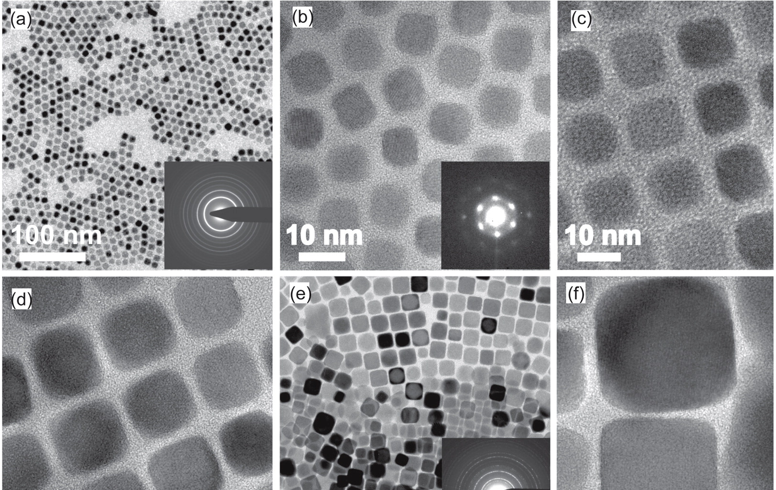
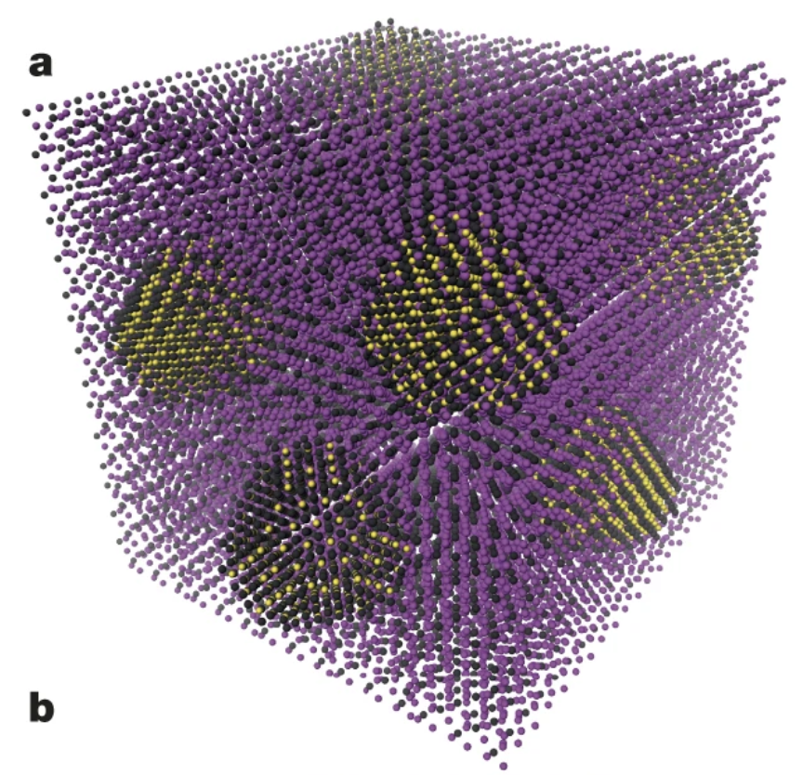
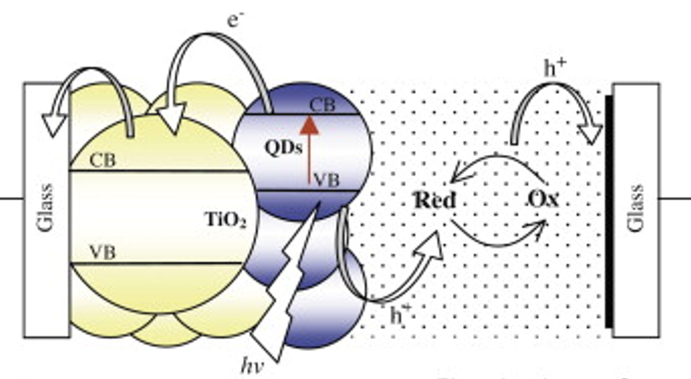
Aspects of quantum science and sustainability
Quantum Dot Engineering for High-Efficiency Photovoltaics
22.06.2025
Solal Després, Julien Tubiana Warin

Slide 2
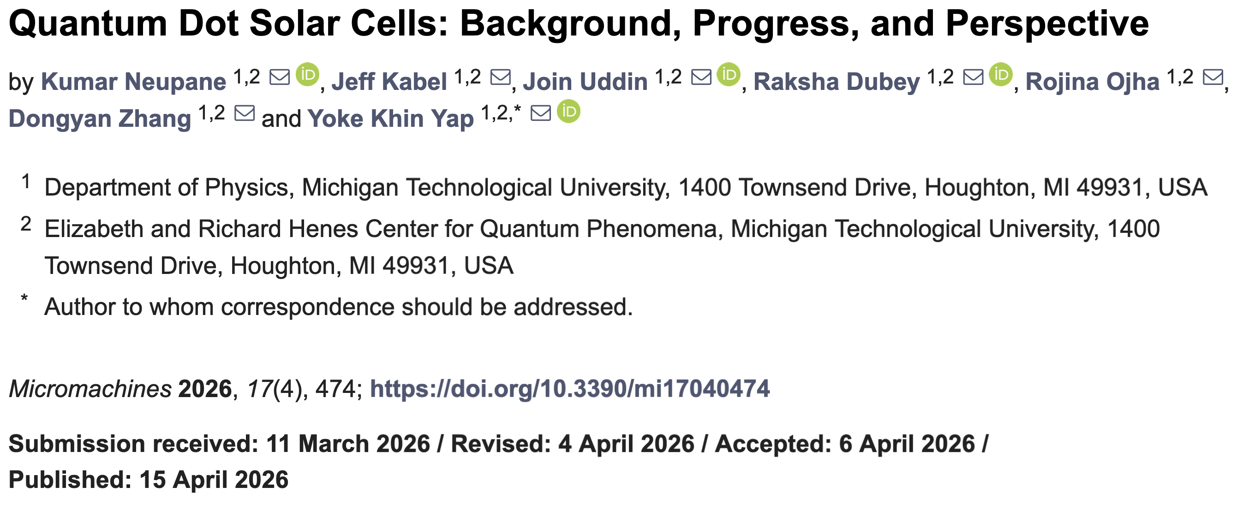
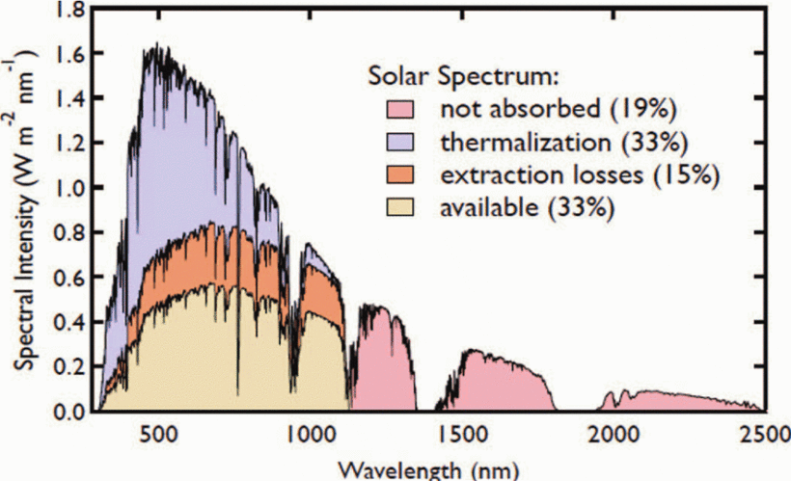

Overview
Quantum dots solar cells
Notes:
2 main papers used for this
Important to harness solar power for
a more renewable source of energy
easy access to power in remote locations
individuals energetic independance
Performance of bulk SI solar cells, there is a lot of room for improvement

Slide 3

Solar Cell Basis
https://ar.inspiredpencil.com/pictures-2023/solar-cells-pictures

Slide 4
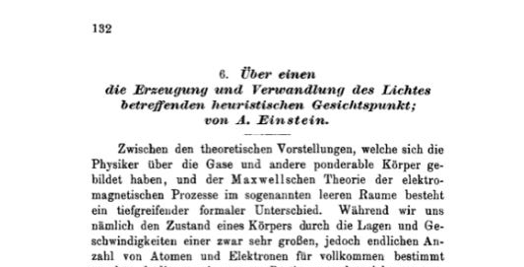
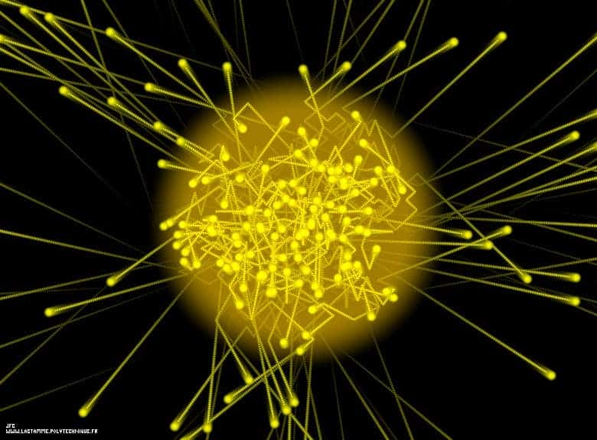
The photoelectric effect
Einstein's 1905 paper on light and matter
Light being quantized
Wave-particle duality
Photon, the discrete unit of light
  Massless but carrying Energy and Momentum
  Localized and able to interact with matter
https://aboutradiation.blogspot.com/2019/01/all-electromagnetic-radiation-consists.html

Slide 5
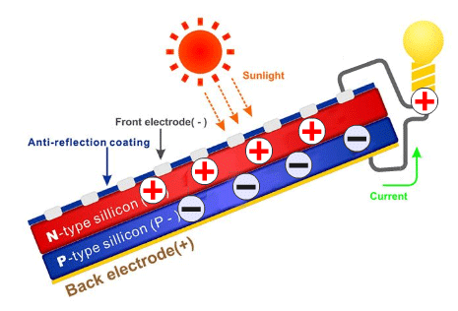
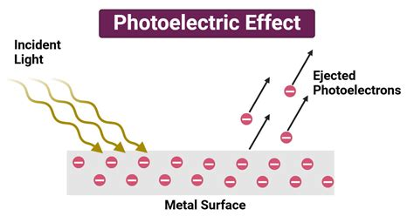
Photon and electron interaction
Solar Pannel basic architecture
First studied for metals it later revealed to be much more of use in semiconductors
Why ?
Metals = all electrons in conduction band ie no bandgap, once hit the electrons are easily ejected from material surface and the charges are quickly redistributed
Semiconductors = a valence and a conduction band creates an energy difference where electrons lie, the electron leaving leaves a hole and starts drifting

Slide 6


















Semiconductor devices
Electrons flow inside the semiconductor due to the photons at surface

Slide 7






Why Semiconductors and not Metals ?
The "work function" in red is what the electron must overcome to leave the material
In metals it is close to conduction band
Two steps (first conduction band has to be reached) for semiconductors
Using p-n junctions makes it even harder to "escape"

Slide 8














P-N junctions
The goal is to keep electrons inside so to create a potential difference and thus current flowing
Fermi level is in fact an indication of the electron/ hole population
Quantum dots solar cells
Notes:
Then electrons and holes each recombine if connected to an external circuit so the population stays fixed but for a brief moment electrons left and holes appeared in the n-region (and the opposite for p)
The E field is opposite to the current and the flow of electron thus

Slide 9
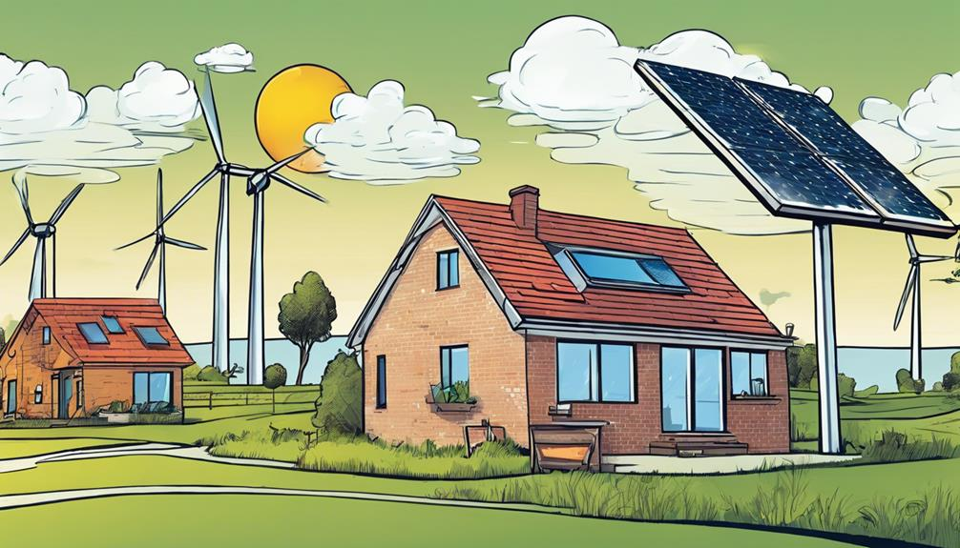
Limitations of Solar Cells
twogreenleaves.org

Slide 10

Intermittency and Energy Storage
Dependence on sunlight
Current solutions
Irregular energy production
Performance losses at night, during cloudy weather or in winter conditions
Hard to match the grid demand => grid losses
Battery storage systems
Smart electrical grids
Combining solar with other energy sources (ideally renewables)
Still very challenging, technologically for storage and logistically for grid optimization AND expensive
Quantum dots solar cells

Slide 11
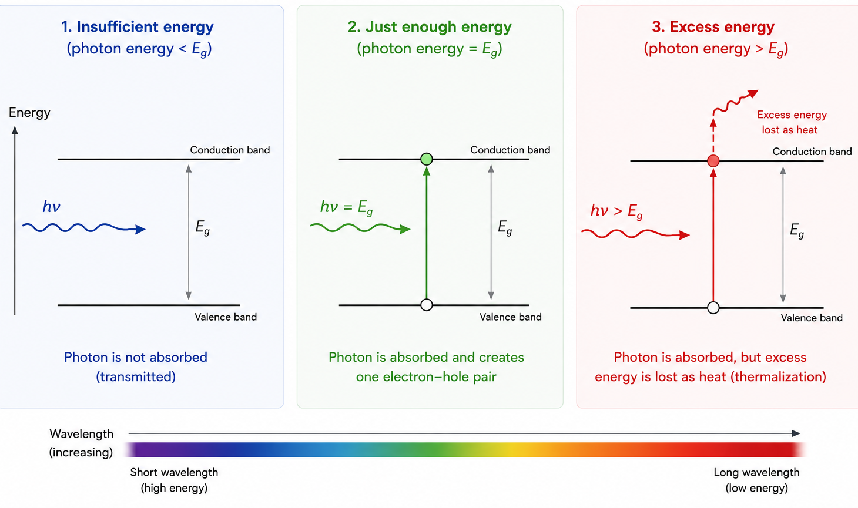
Efficiency Limits
In silicon solar cells, only photons with enough energy to cross the semiconductor band gap can generate electricity​
Excess photon energy is often lost as heat​
Most commercial Silicon-based solar pannels operate at 20-25%
Why solar cells are not perfectly efficient
=> Can't convert all sunlight energy to electricity
AI generated image
Quantum dots solar cells
Notes:
Light can be reflected away, absorbed as heat or not enough energy to excite

Slide 12
Shockley–Queisser limit
33.7% is the theoretical limit of reachable efficiency for a solar pannel under sunlight with ideal bandgap
The ideal bandgap comes from a compromise:
    Small band gap, absorbs many photons but loses lots of energy as heat
    Large band gap has little heat loss but many photons are not absorbed
Sunlight is a broad spectrum of wavelength => the optimal bandgap has been computed to be 1.34 eV (close to Silicon)
Quantum dots solar cells
Notes:
Efficiency is incoming solar power / electrical power produced --> output power is # photons absorbed times bandgap!

Slide 13
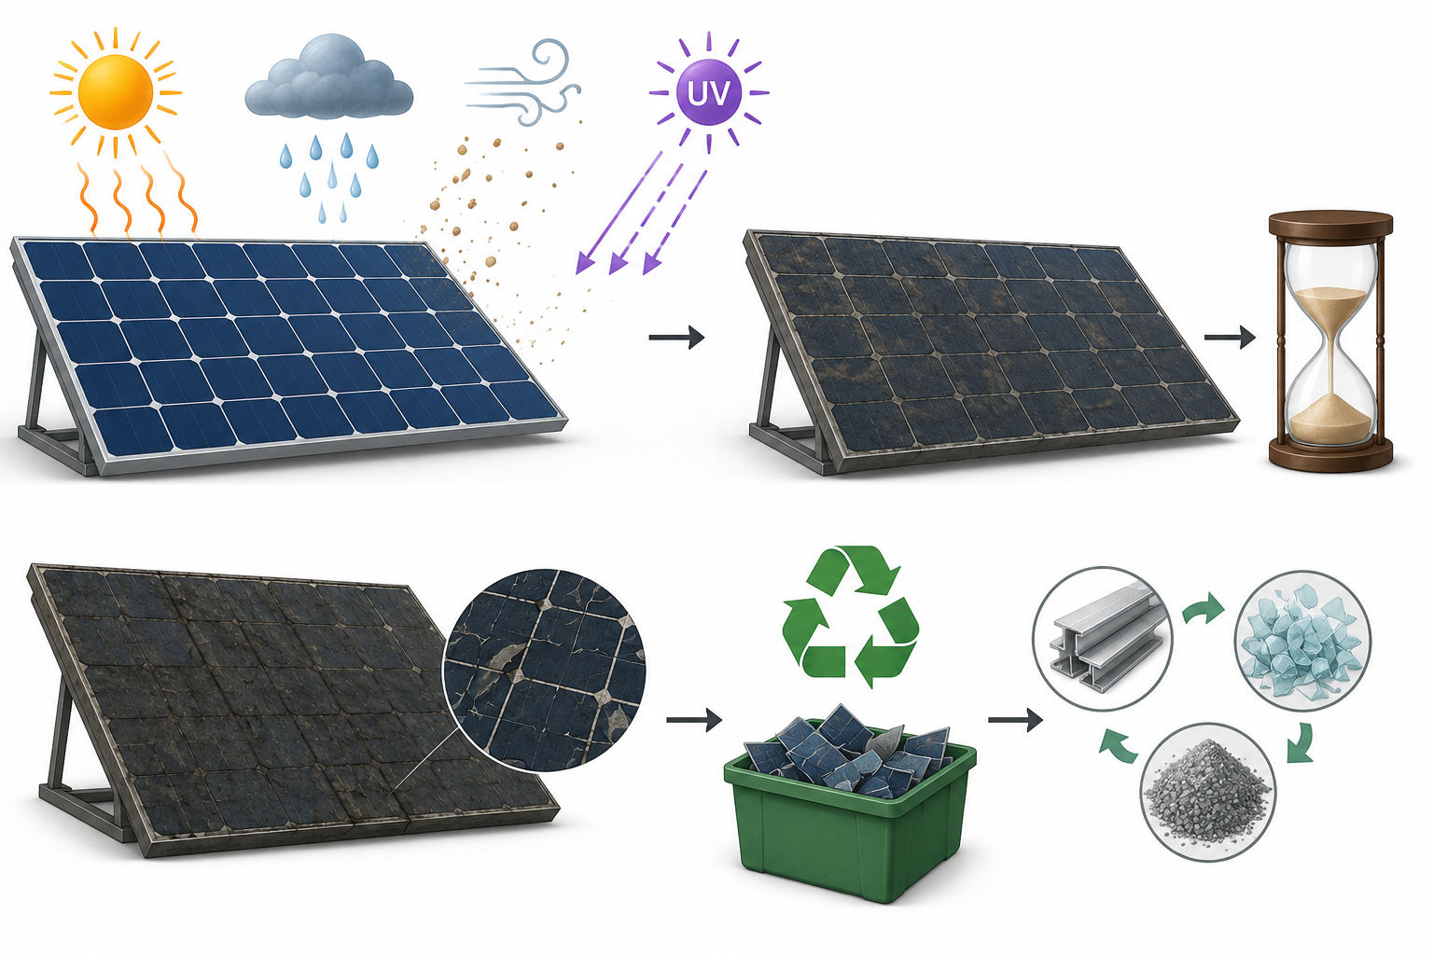
Long-term performance issues
Degradation over time
Heat, humidity, dust, and ultraviolet radiation reduce efficiency.
Around 25 years lifespan
Improve recycling methods
AI generated image
Quantum dots solar cells

Slide 14
Quantum dots
Quantum dots solar cells
Notes:
What are quantum dots ? It can refers to defects in solids but in our case not, only particles
- Many different kinds, but they all behave as semiconductor nanocrystals of a few nm in diameter, sometimes with different layers and protection
Image, TEM of different size PbSe and PbTe QDs

Slide 15
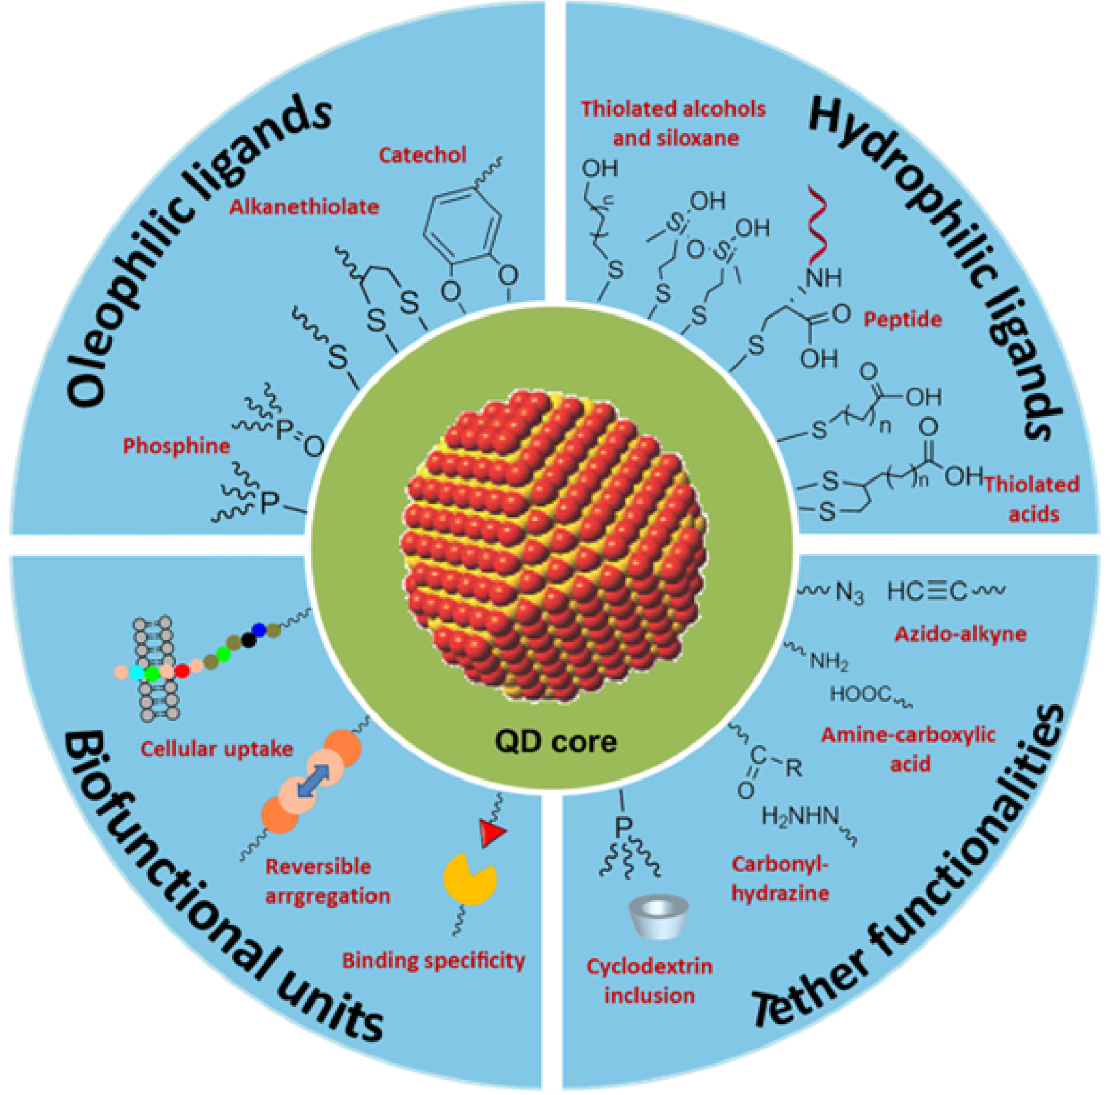
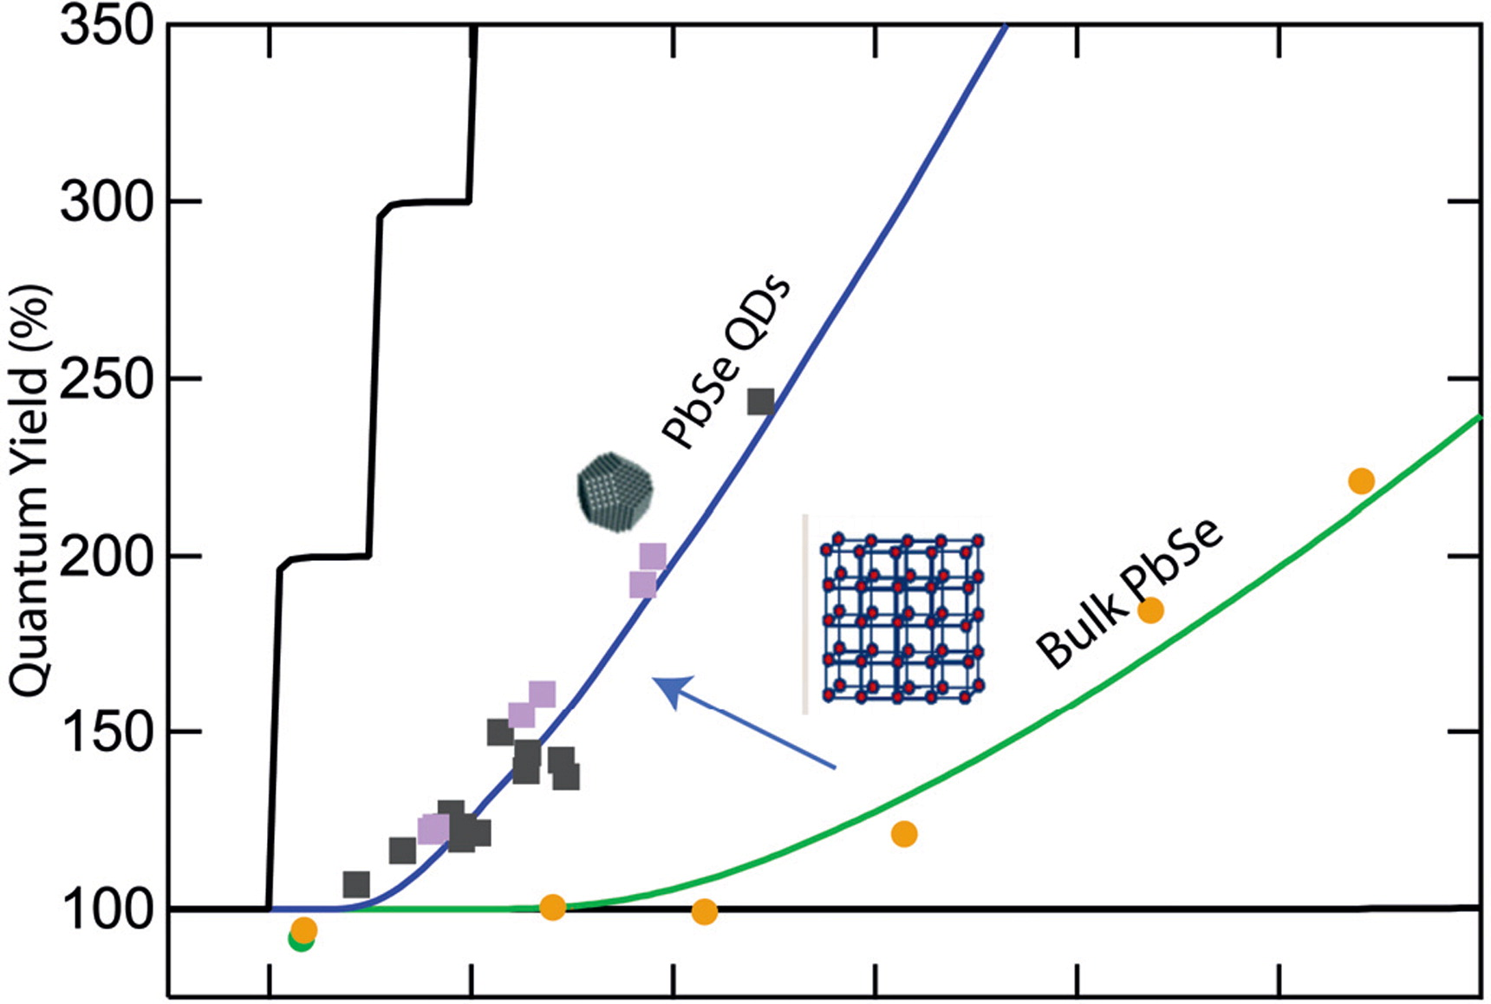
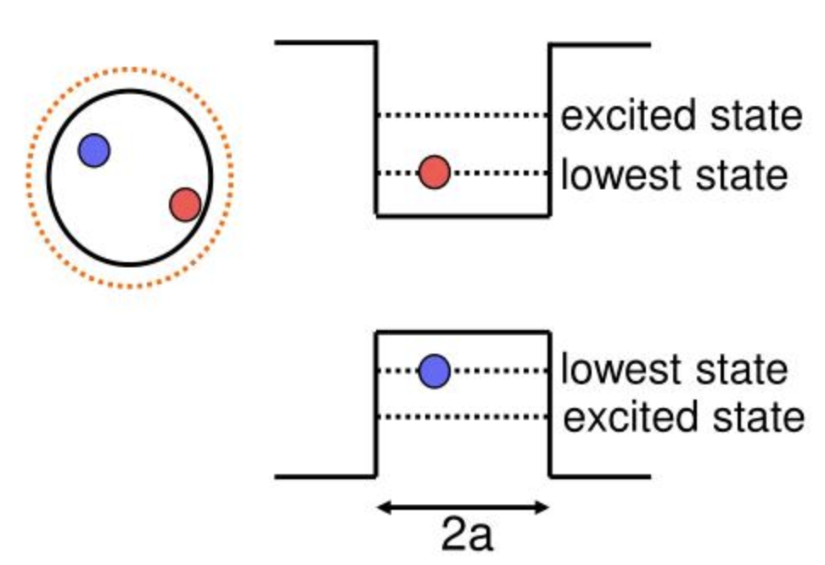
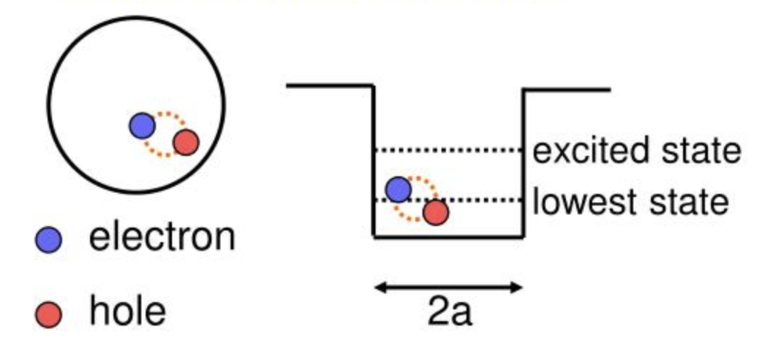
Main properties
Notes:
Organic ligans attached can be chosen for stability and shape control
Semiconductors begin to display quantum confinement at sizes close to the de Broglie wavelenght, 10-100 nm for most. Implies discrete energy levels and band gap inversly related to QD size. At small sizes the generated excitons stay close enough to continue to interact (basically squeezing the semiconductor widen the energy difference between bandgaps)
Multi electron generation: driven by quantum confinement (2-3 times more than bulk material for PbSe), not fully understood, might be that crystal momentum doesn’t need to be conserved.
Image, quantum yield versus hv/Eg for PbSe

Slide 16
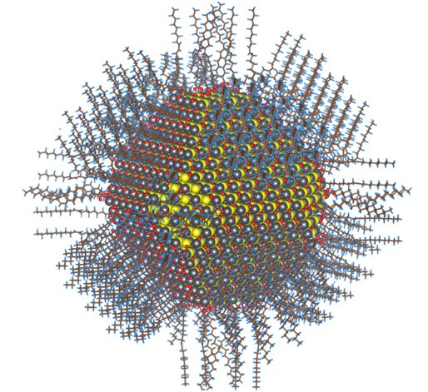
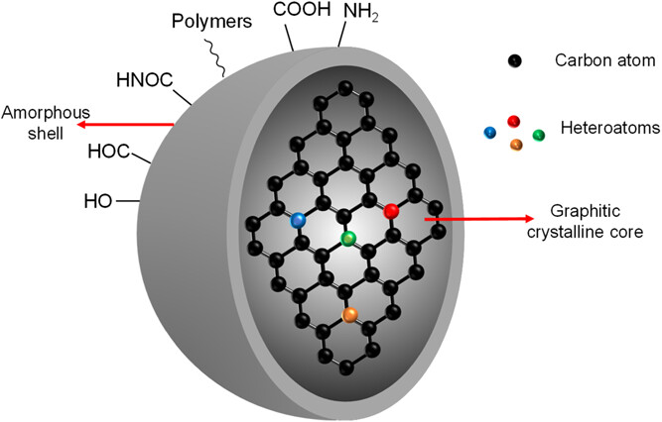
Types of quantum dots
Lead- and Cadmium-Based Quantum Dots
Carbon Quantum Dots
Perovskite Quantum Dots
Notes:
Pb/CaX, X = S, Se, or Te, well known properties and synthesis, used in other fields for imaging, sensors, … + affordable, simple to make and flexible. Still the main focus for QDS C due to good air stability, toxic though (us + env.), deposited in films usually
Carbon QDs, discovered along carbon nanotubes, biocompatible, quasi-spherical, less than 10 nm, coated w. functional groups that give good solubility + reactive regions. Initialy used in liquid junction but not efficient enough. Research now turned to solid state integration.
Perovskites QDs, opposed to thin film QDs, use them as discretized building blocks. Excellent integration of QDs, with defect tolerance and carrier migration. Increase control over thickness and morphology. + multi exciton effect. However very sensible to temperature and humidity.
Synthesis

Slide 17
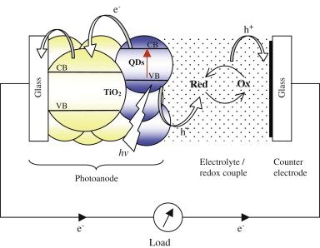
Quantum Dots Solar Cells

Slide 18
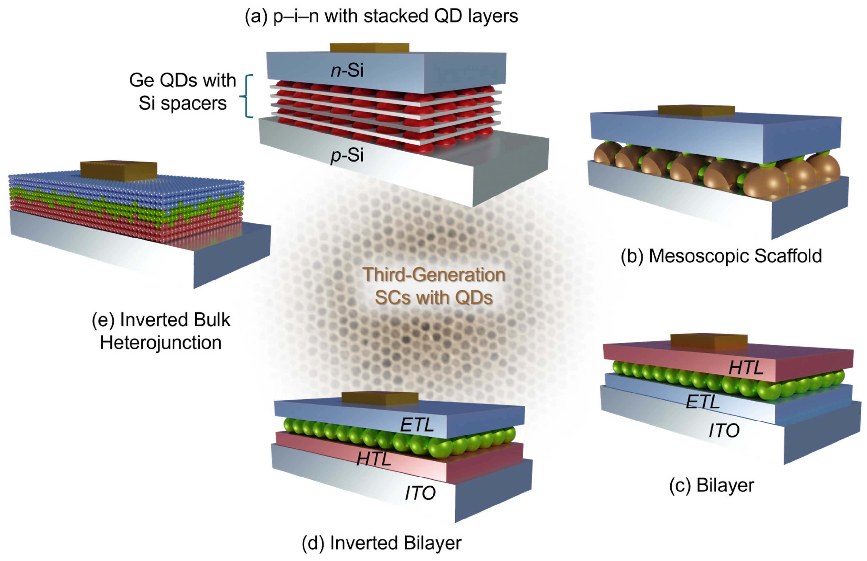
Architectures
Notes:
Epitaxial (crystal growth) pin, enhance photocurrent by embedding QDs within the intrinsic region (gives sub-bandgap absorption), 50-100 layers, hindered by localised states recombination and QD flexibility
Mesoscopic scaffolds, use large surface area particles (TiO2, ZnO) as scaffold to support QDs and ETL, very high transfer rate. Limited by QD stability and high trap density
Heterojunctions, film of QDs between HTL and ETL, hard to find balance between limited absorption and charge transfer
Same
Bulk heterojunction, co-deposition of QDs w. semiconductor to blend them, difficult to control and reproduce morphology
Overall, a good evolution of the design but no clear better option. Lots of development still going on

Slide 19
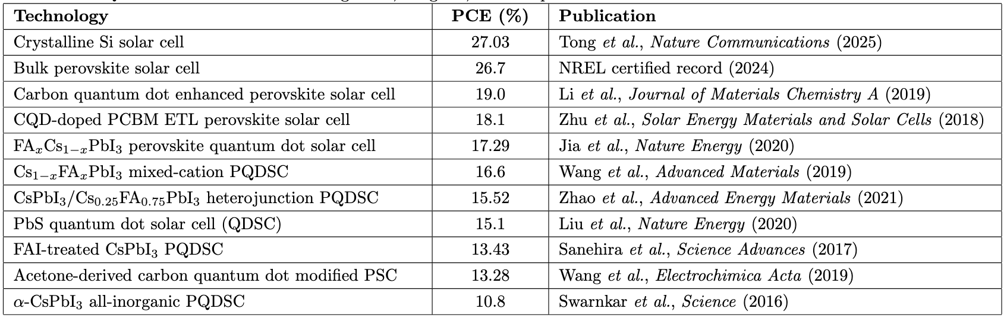
Performances
Notes:
Crystalline Si, most solar panels today
Improving but stability issues
Different ratios of QD perovskites
Heterojunctions
Overall, not there yet in term of performance and stability but huge potential

Slide 20

Perspectives
Implementation in housing
  Flexibility in wavelength
Cost-efficient
  Q. dots may reduce cost while increasing efficiency
  But, toxic materials and rare elements exctraction
What does it bring to society ?
  Increase energy independence
  Worldwide access to electricity

Slide 21
References
Thank you for listening
Einstein, A. (1905). On a Heuristic Viewpoint Concerning the Production and Transformation of Light.
E. Matioli, Semiconductor Devices I, EPFL course material
Shockley, W., & Queisser, H. J. (1961). Detailed Balance Limit of Efficiency of p–n Junction Solar Cells. Journal of Applied Physics.
Neupane, K.; Kabel, J.; Uddin, J.; Dubey, R.; Ojha, R.; Zhang, D.; Yap, Y.K. Quantum Dot Solar Cells: Background, Progress, and Perspective. Micromachines 2026, 17
Que, Meidan, Yuan Xu, Qizhao Wu, Jin Chen, Lili Gao and Shengzhong (Frank) Liu. “Application of advanced quantum dots in perovskite solar cells: synthesis, characterization, mechanism, and performance enhancement.” Materials horizons (2025).
H.K. Jun, M.A. Careem, A.K. Arof, Quantum dot-sensitized solar cells—perspective and recent developments: A review of Cd chalcogenide quantum dots as sensitizers, Renewable and Sustainable Energy Reviews
Octavi E. Semonin, Joseph M. Luther, Matthew C. Beard, Quantum dots for next-generation photovoltaics, Materials Today
Liu, AA., Cui, R., Zong, X. et al. Live-cell synthesis of biocompatible quantum dots. Nat Protoc 20, 1884–1914 (2025)
Isomeric organic–inorganic indium bromide single crystals with delayed and dual colour emission, Haichao Zhou, Kiyonori Takahashi, Takuya Okamoto, Jianguo Pan and Vasudevanpillai Biju, Mater. Horiz., 2026, 13, 2802, DOI: 10.1039/D5MH02322J
W.You, W.Zou, S.Jiang, J.Zhang, Y.Ge, G.Lu, D. W.Bahnemann, J. H.Pan, Carbon Neutralization2024;3:245–284

