Slide 1

AN INTERACTIVE FORESIGHT GAME · ROMAIN DUFOUR · ELEONORA GIULIANI
QUANTUM HORIZONS
You decide the geopolitics of Quantum GPS — live.
3 DECISIONS · 8 POSSIBLE FUTURES · VOTE WITH YOUR HAND

Slide 2
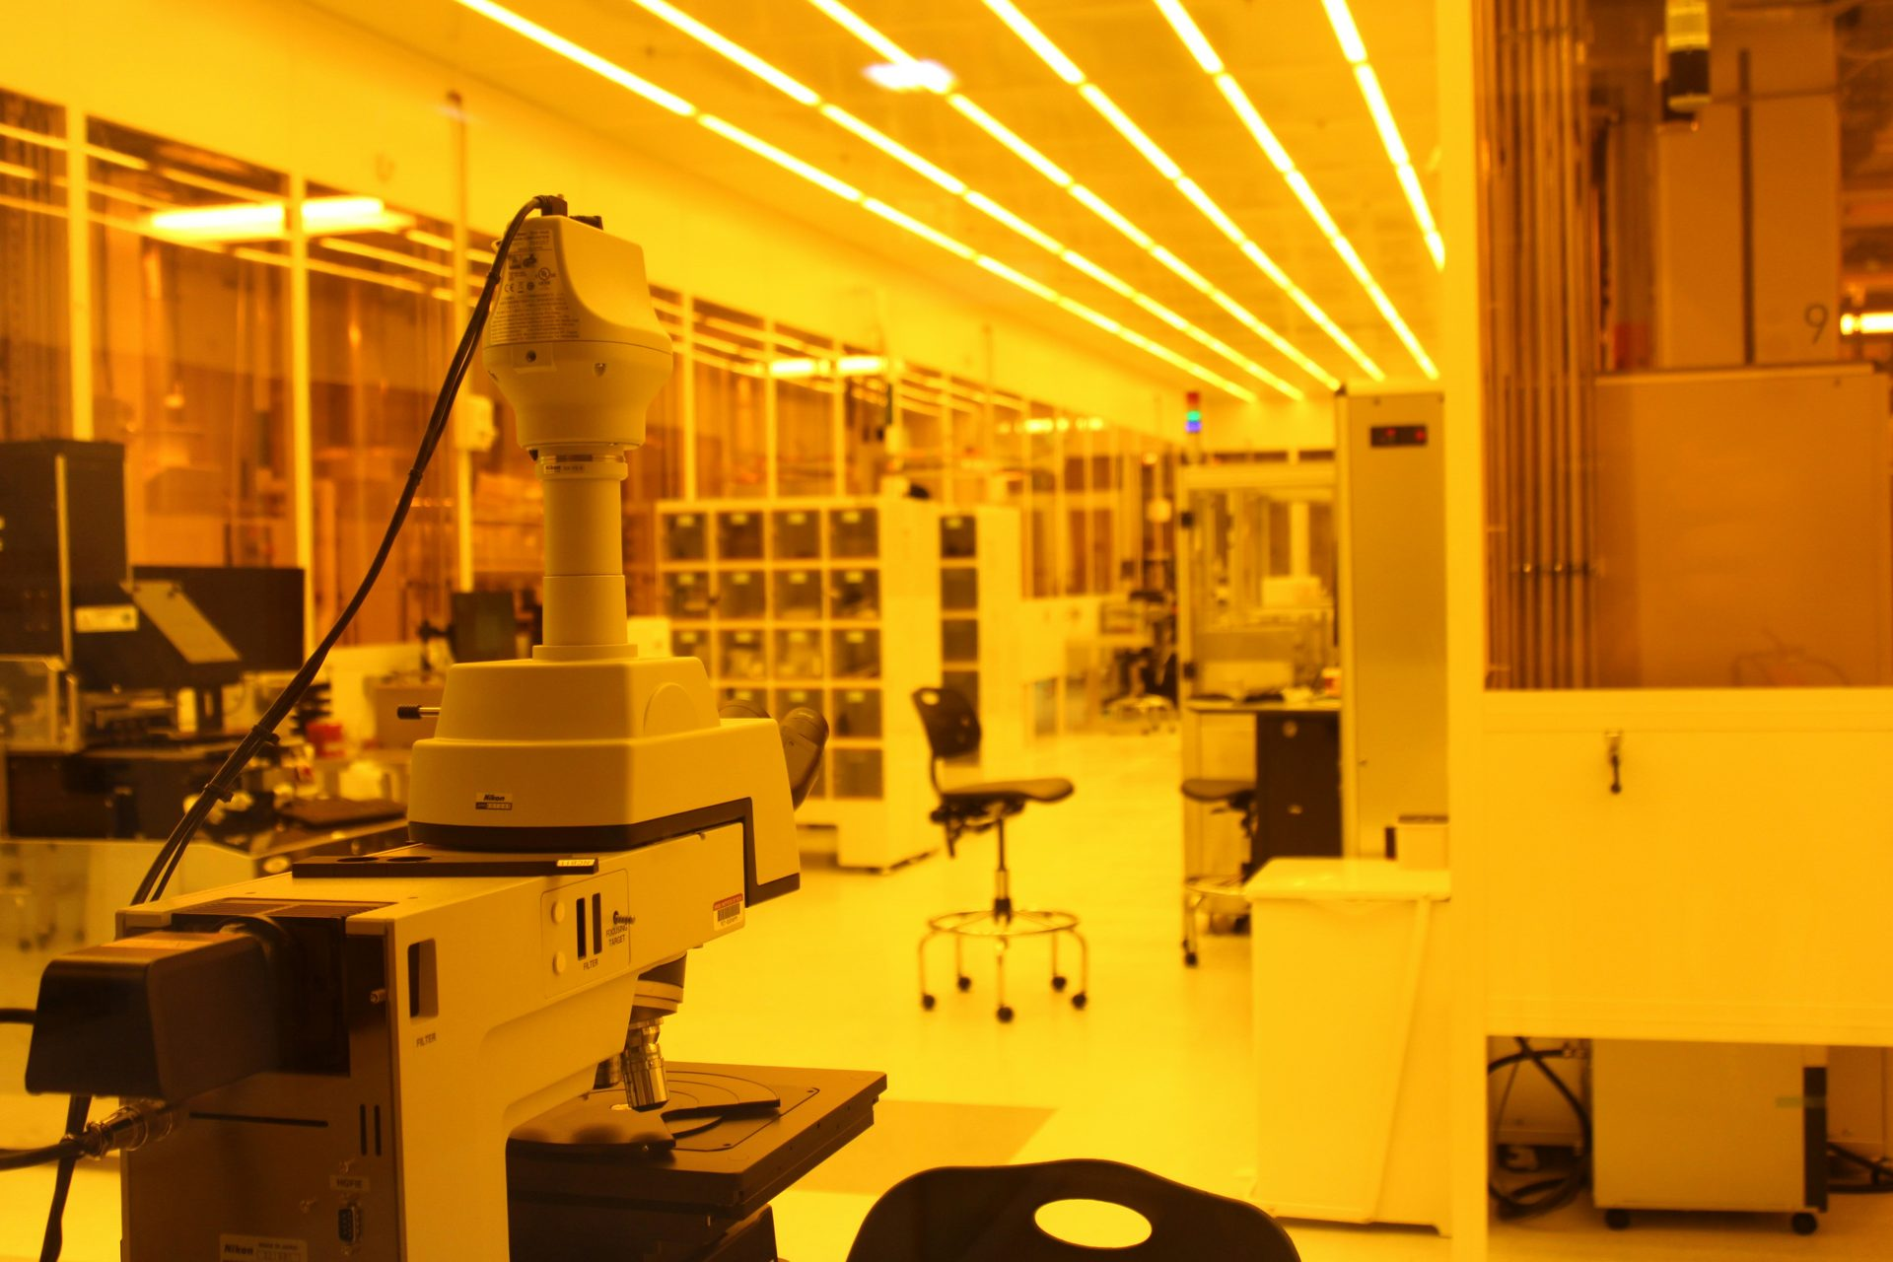
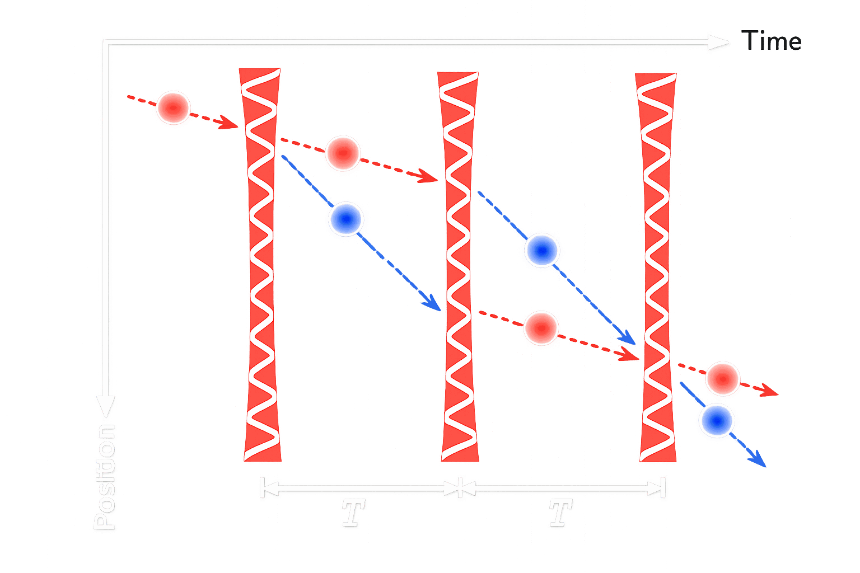
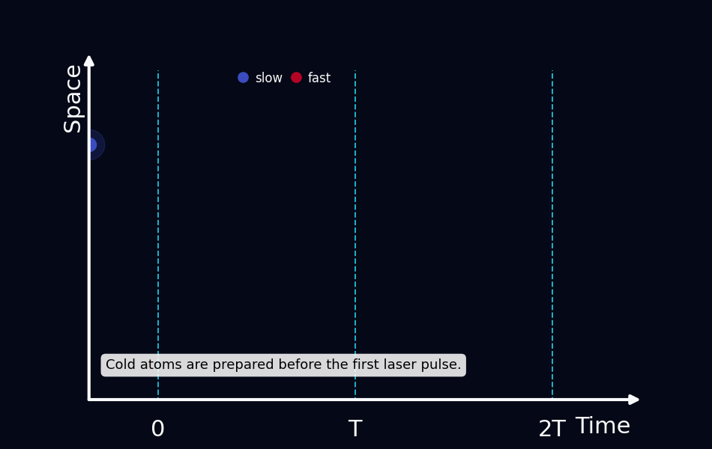



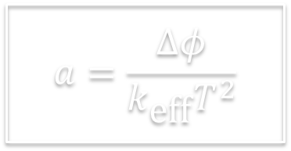
COLD ATOMS AS QUANTUM INERTIAL SENSORS
Acceleration changes the relative phase:
$$Δφ=k_{\text{eff}} a T^{2}$$
$$a=\frac{Δφ}{k_{\text{eff}}T^{2}}$$
$$\frac{π}{2}→π→\frac{π}{2}$$
$$\text{Split}→\text{Redirec}\text{t}→\text{Recombine}$$
$$P=\frac{1}{2}\left[1+C\cos\left(Δφ\right)\right]$$

Slide 3
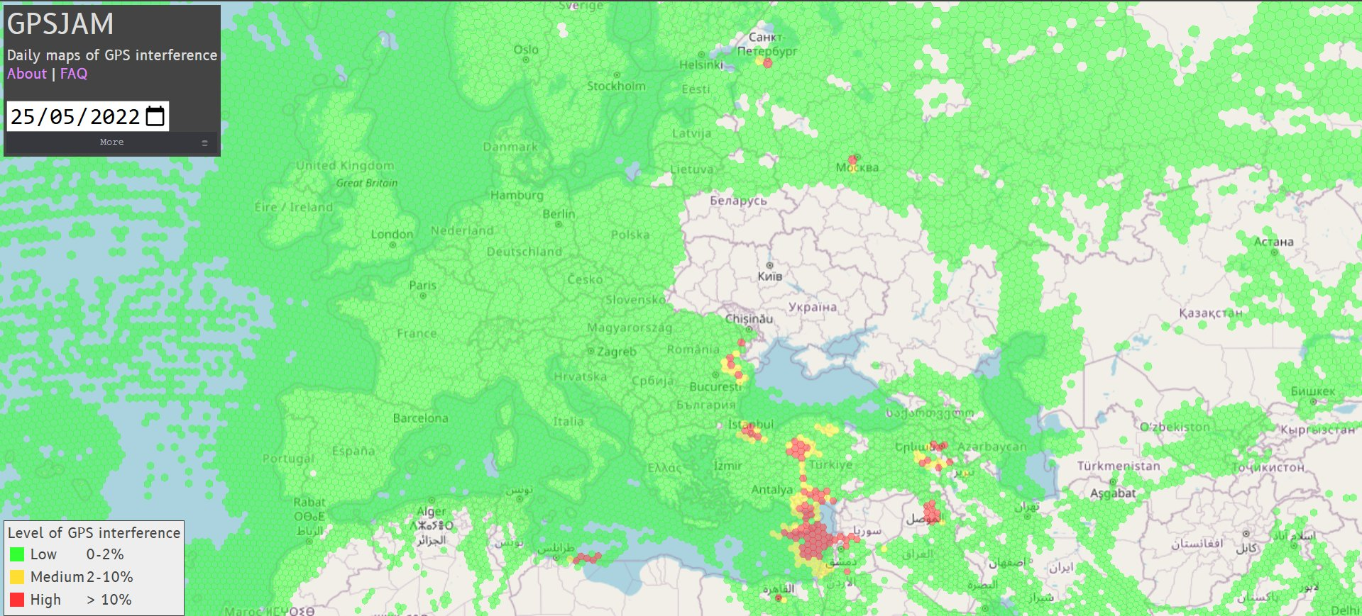
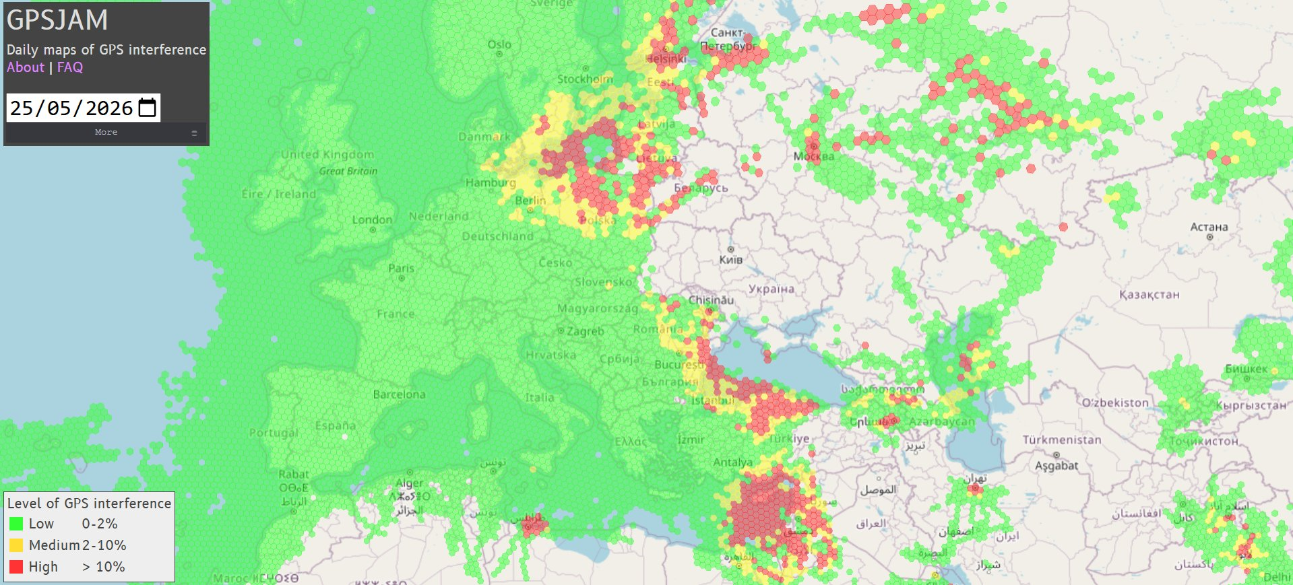
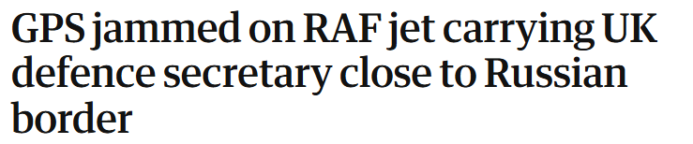
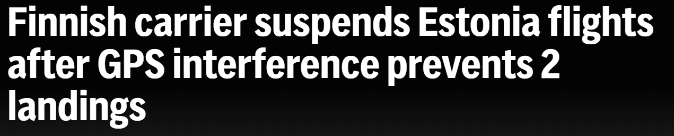
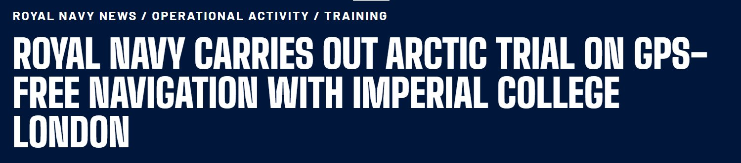
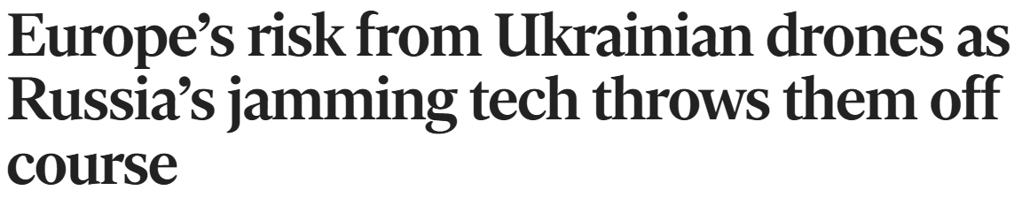

WHY COLD ATOMS MATTER FOR NAVIGATION
Scenario | Classical IMU / INS only | IMU + mature cold-atom accelerometer
Drone in GPS-denied area (5–50 m error) | 0.5–5 min | 5–30 min
Autonomous car in tunnel / urban canyon (2–20 m error) | 0.5–3 min | 5–60 min
Aircraft GPS outage (1–10 km error) | 0.5–3 h | 6–24 h
Ship / submarine navigation (5–50 km error) | 3–30 days | 30–180 days
Drift: $Δx≈\frac{1}{2}b_{a}t^{2}$

Slide 4
QUANTUM ACCELOMETER: STATE OF THE ART
Hybrid navigation
Classical IMU = high bandwidth, continuous signal
Cold atoms = low-drift absolute correction
2014 | USA — DARPA/AOSense
Cold-atom IMUs for GPS-denied navigation
2017 | France — iXBlue/LP2N
iQNav/iXAtom: cold atoms for inertial guidance
2018 | France — Cheiney et al.
Hybrid quantum accelerometer + Kalman filter
2018 | UK — Imperial + M Squared
Transportable quantum accelerometer for navigation
2023 | UK — Imperial + Royal Navy
Prototype tested aboard XV Patrick Blackett
2024 | UK — Infleqtion
Oxford Technology Park expansion / industrial scale-up
2025 | China — CSSAI
Cold-atom gyroscope demonstrated in space

Slide 5
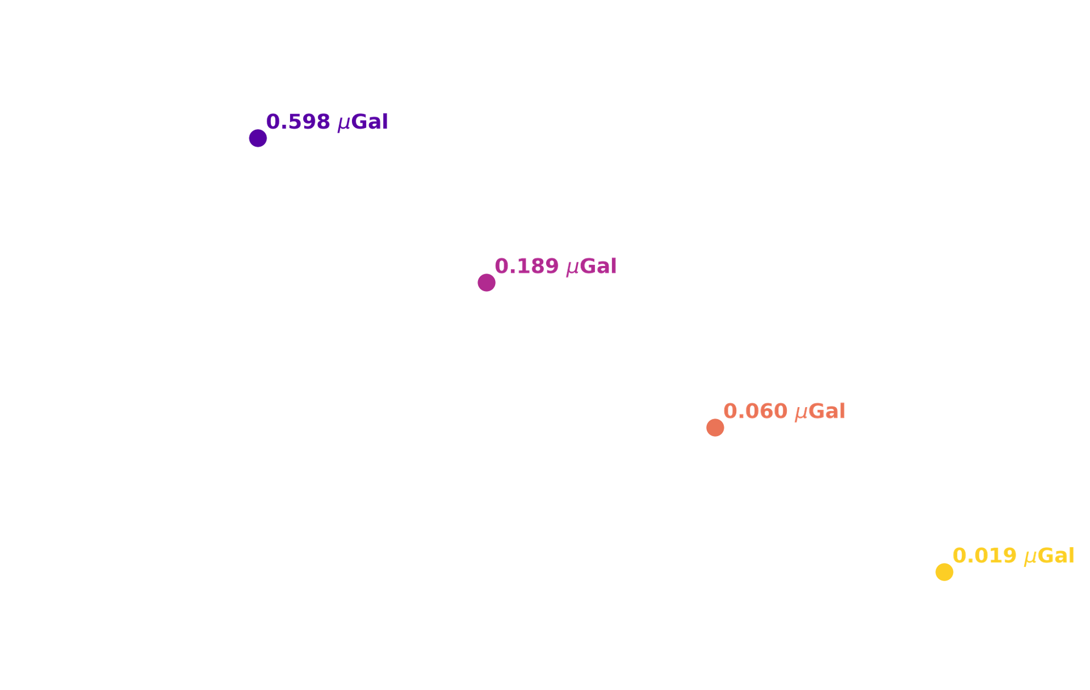


SEEING THE INVISIBLE THROUGH GRAVITY
Application | Typical gravity signal range (µGal)
Carbon storage monitoring | 0–16
Cave detection and mapping | 0–1500
Hydrology / groundwater monitoring | 0–100
Volcano monitoring | 0–60,000
Human body at 5m (70 Kg) | 0–0.02
Underground infrastructure / tunnels | 0–300
Heavy vehicles / hidden cargo detection | 10–500
sensitivity vs integration time
$$1\sim μ\text{Gal}={10}^{−8}\sim \text{m}\text{/}{\text{s}}^{\text{2}}$$
Shot noise limited sensitivity:$Δg=\frac{1}{k_{eff}T^{2}\sqrt{N}}$

Slide 6
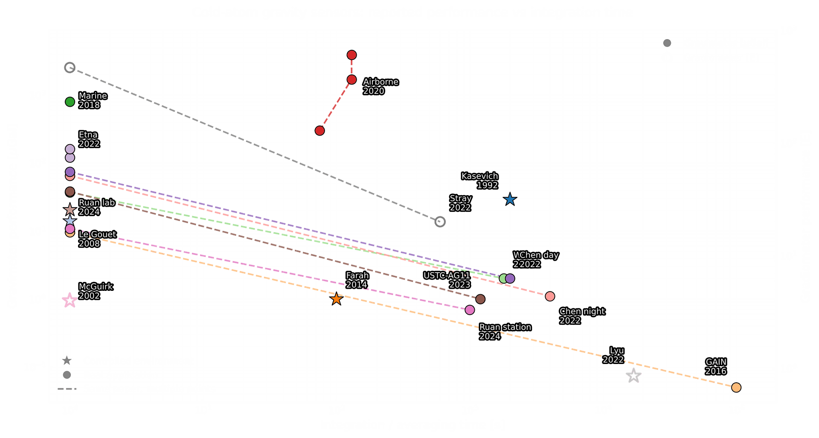
QUANTUM GRAVIMETRY: STATE OF THE ART
Theory — 1991–1992:
  Gravity encoded in atom-interferometer phase.
Lab demonstration — 2000s–2010s:
  µGal / E-level sensitivity in controlled environments.
Real application — 2018–today:
  Deployment in marine, airborne, urban, volcano and tunnel sensing.
Now commercially available!

Slide 7
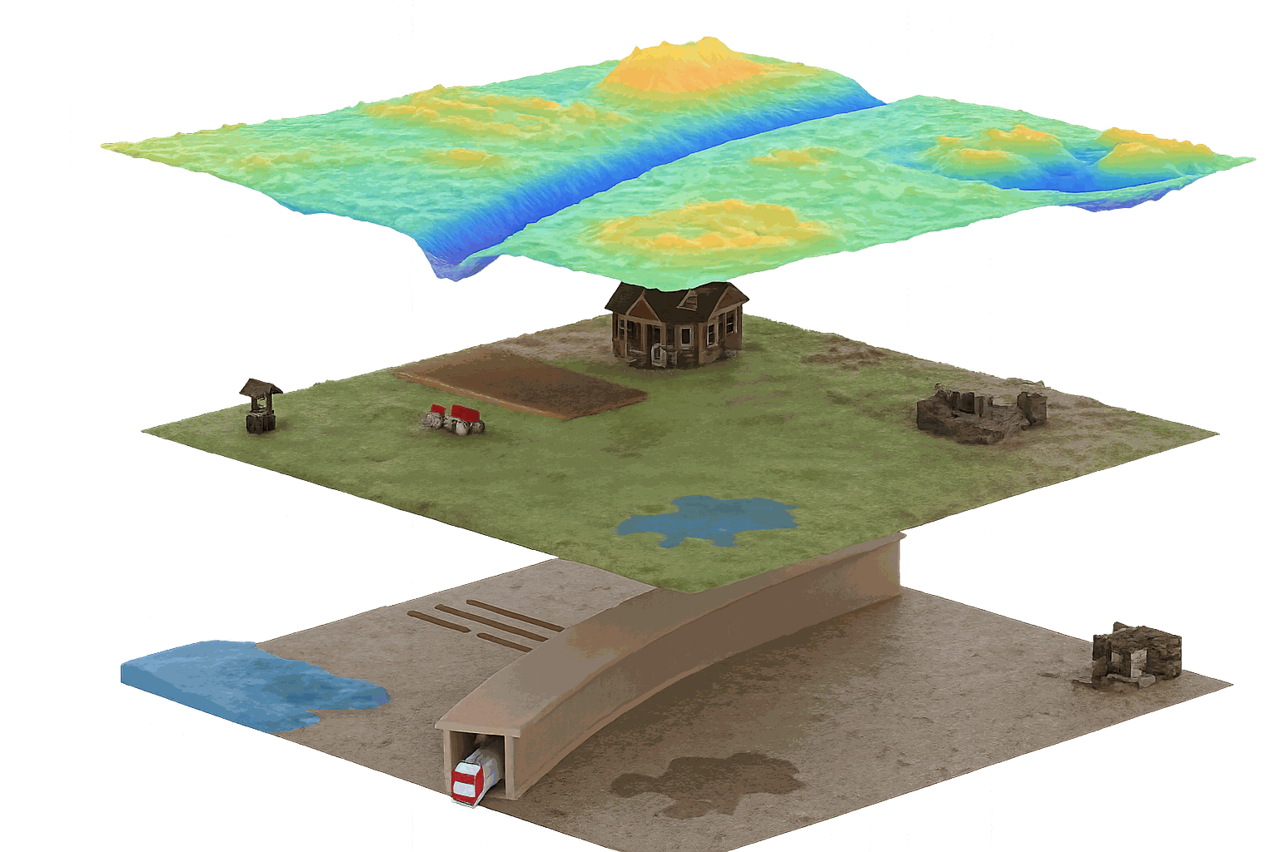
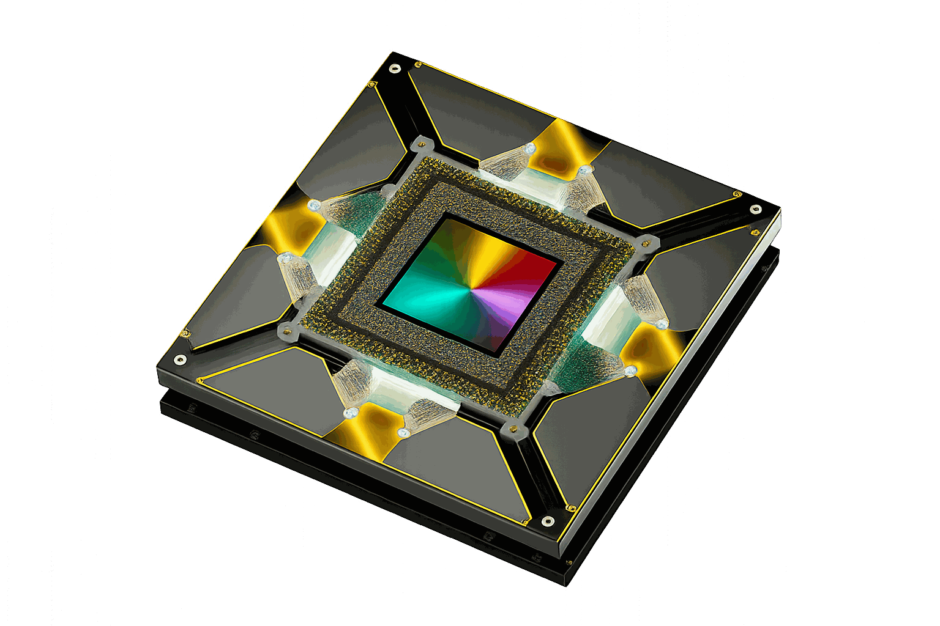
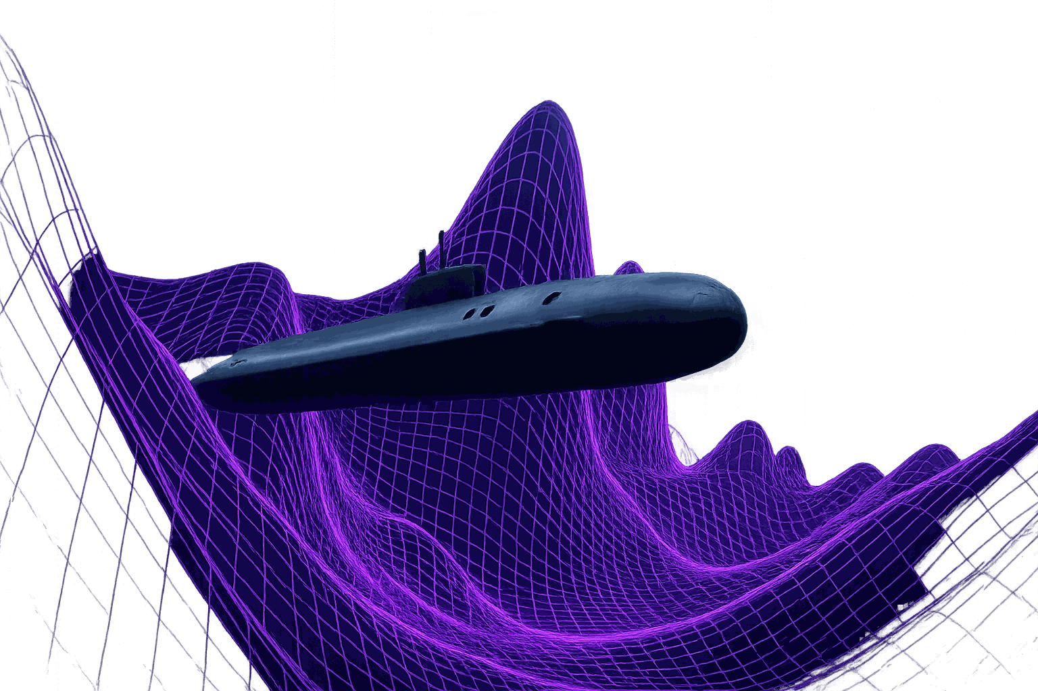
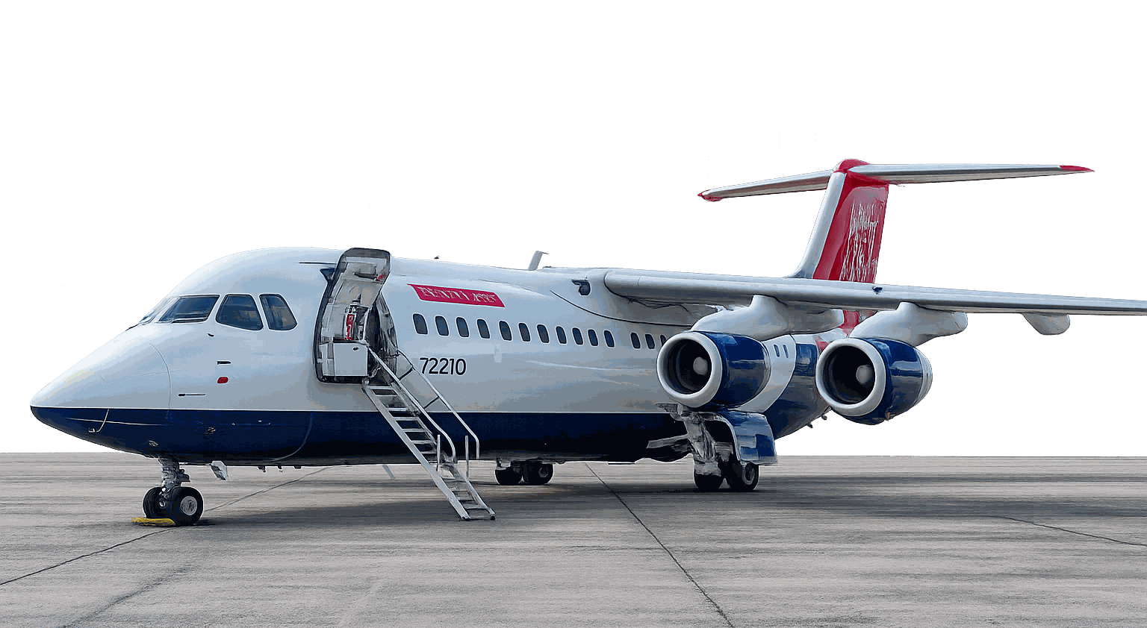
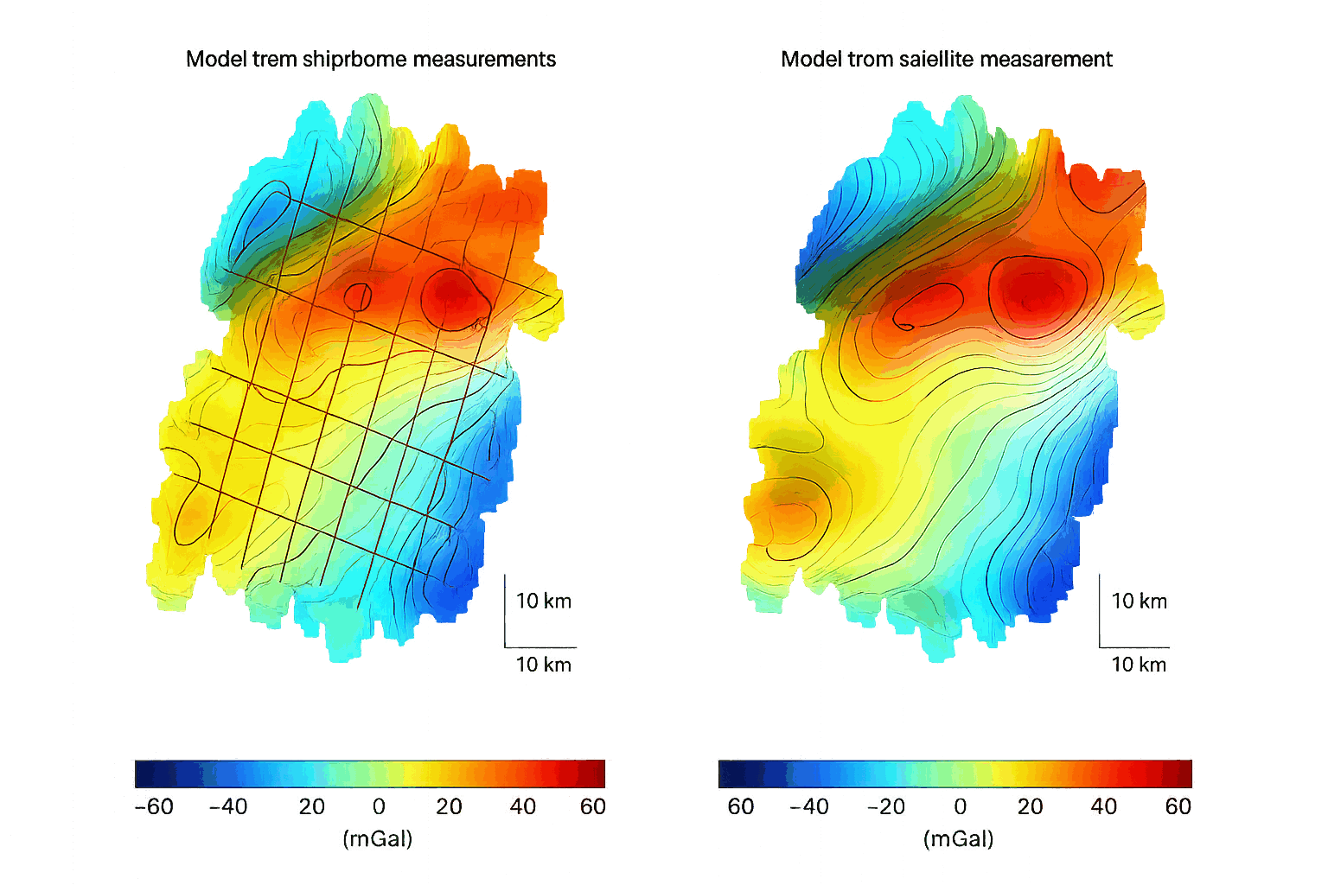
Future’s applications
Gravity mapping
Navigation without GPS support
Submarines stay submerged for weeks. Drones fly through tunnels and metros. Aviation keeps flying when GPS is jammed.
Aquifers, mineral veins, carbon storage, archaeological voids, mapped from above the ground, by anyone with the chip.

Slide 8
SETTING · FEBRUARY 2030 · A RESEARCH LAB OUTSIDE PARIS
It just happened.
A French lab just miniaturised this technology into a chip the size of a shoebox. The race to produce it in millions starts today. You decide who runs it.
You are the world. Three decisions. Eight futures.

Slide 9
BEFORE WE BEGIN
How this works
01
02
03
3 ROUNDS · 25 MIN
VOTE BY HAND
8 POSSIBLE ENDINGS
Three votes. We move from 2030 to 2040.
Two options per round. Hands up once. Majority wins.
Your three choices lead to one of eight 2040 worlds.
→ Ready? Round 1 begins in 2030.

Slide 10
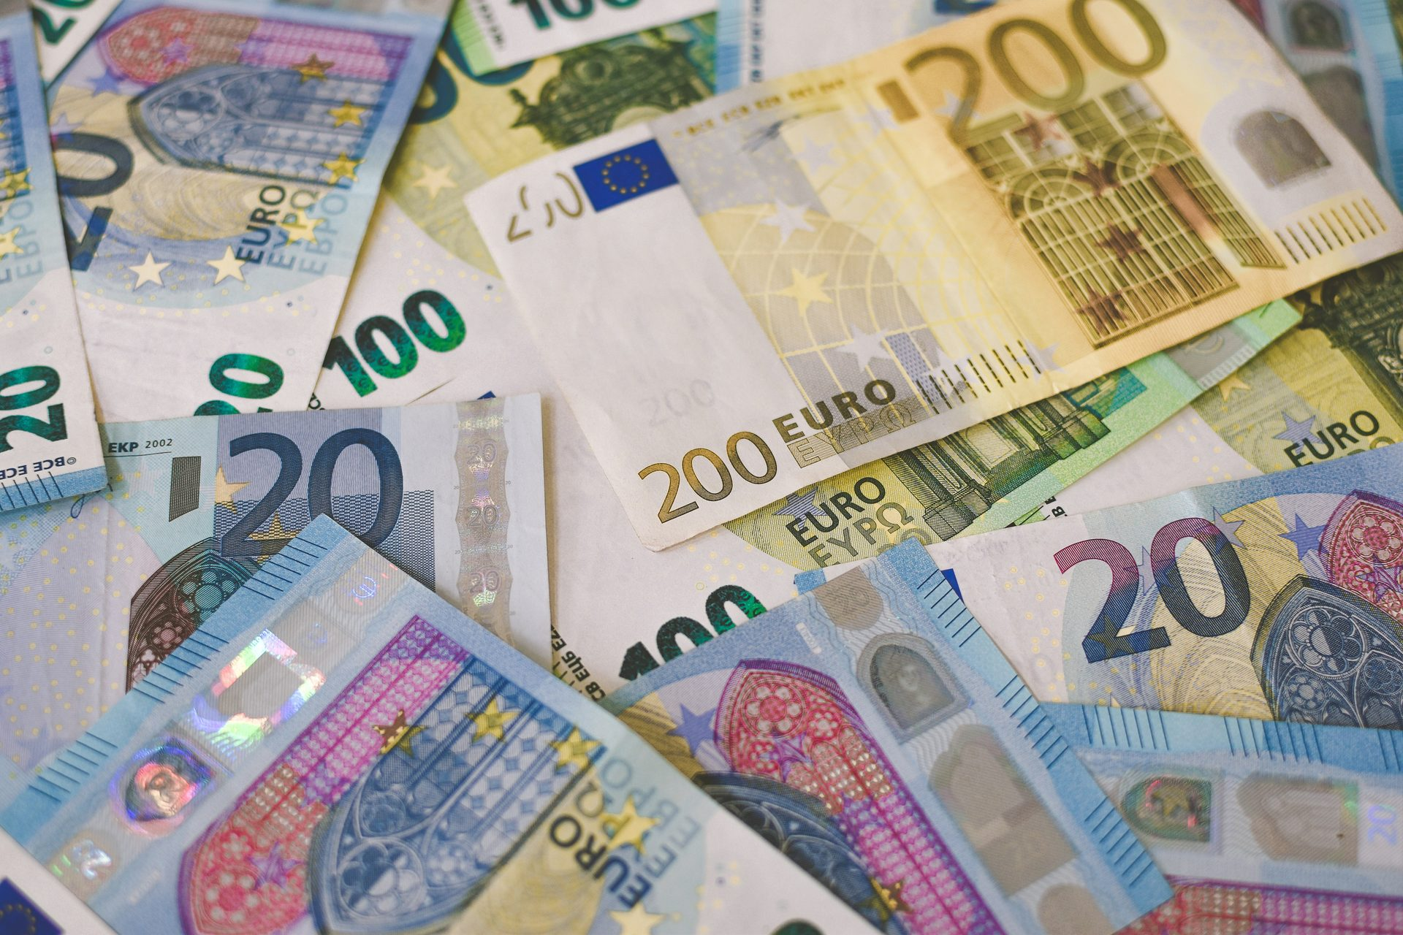
ROUND 1 OF 3 · 2030 · FUNDING
Who pays to scale this up?
OPTION A
Defense & Industry
Defence agencies and major defence companies pool the money behind closed doors. The first chips go to submarines and missile systems. Civilian uses wait five years.
Five billion euros are on the table to produce this chip in millions. Whoever pays gets it first. Two options. You vote.
OPTION B
STAKEHOLDER VOICE
Open Consortium
“If defense money doesn't move now, every commercial chip on the 2032 market is Chinese.”
Universities, climate institutes and startups share the money in the open. Patents are released for anyone to use. The first chips go to climate science and water. Military uses wait.
Marc Delaroche, Defense Lobbyist

Slide 11
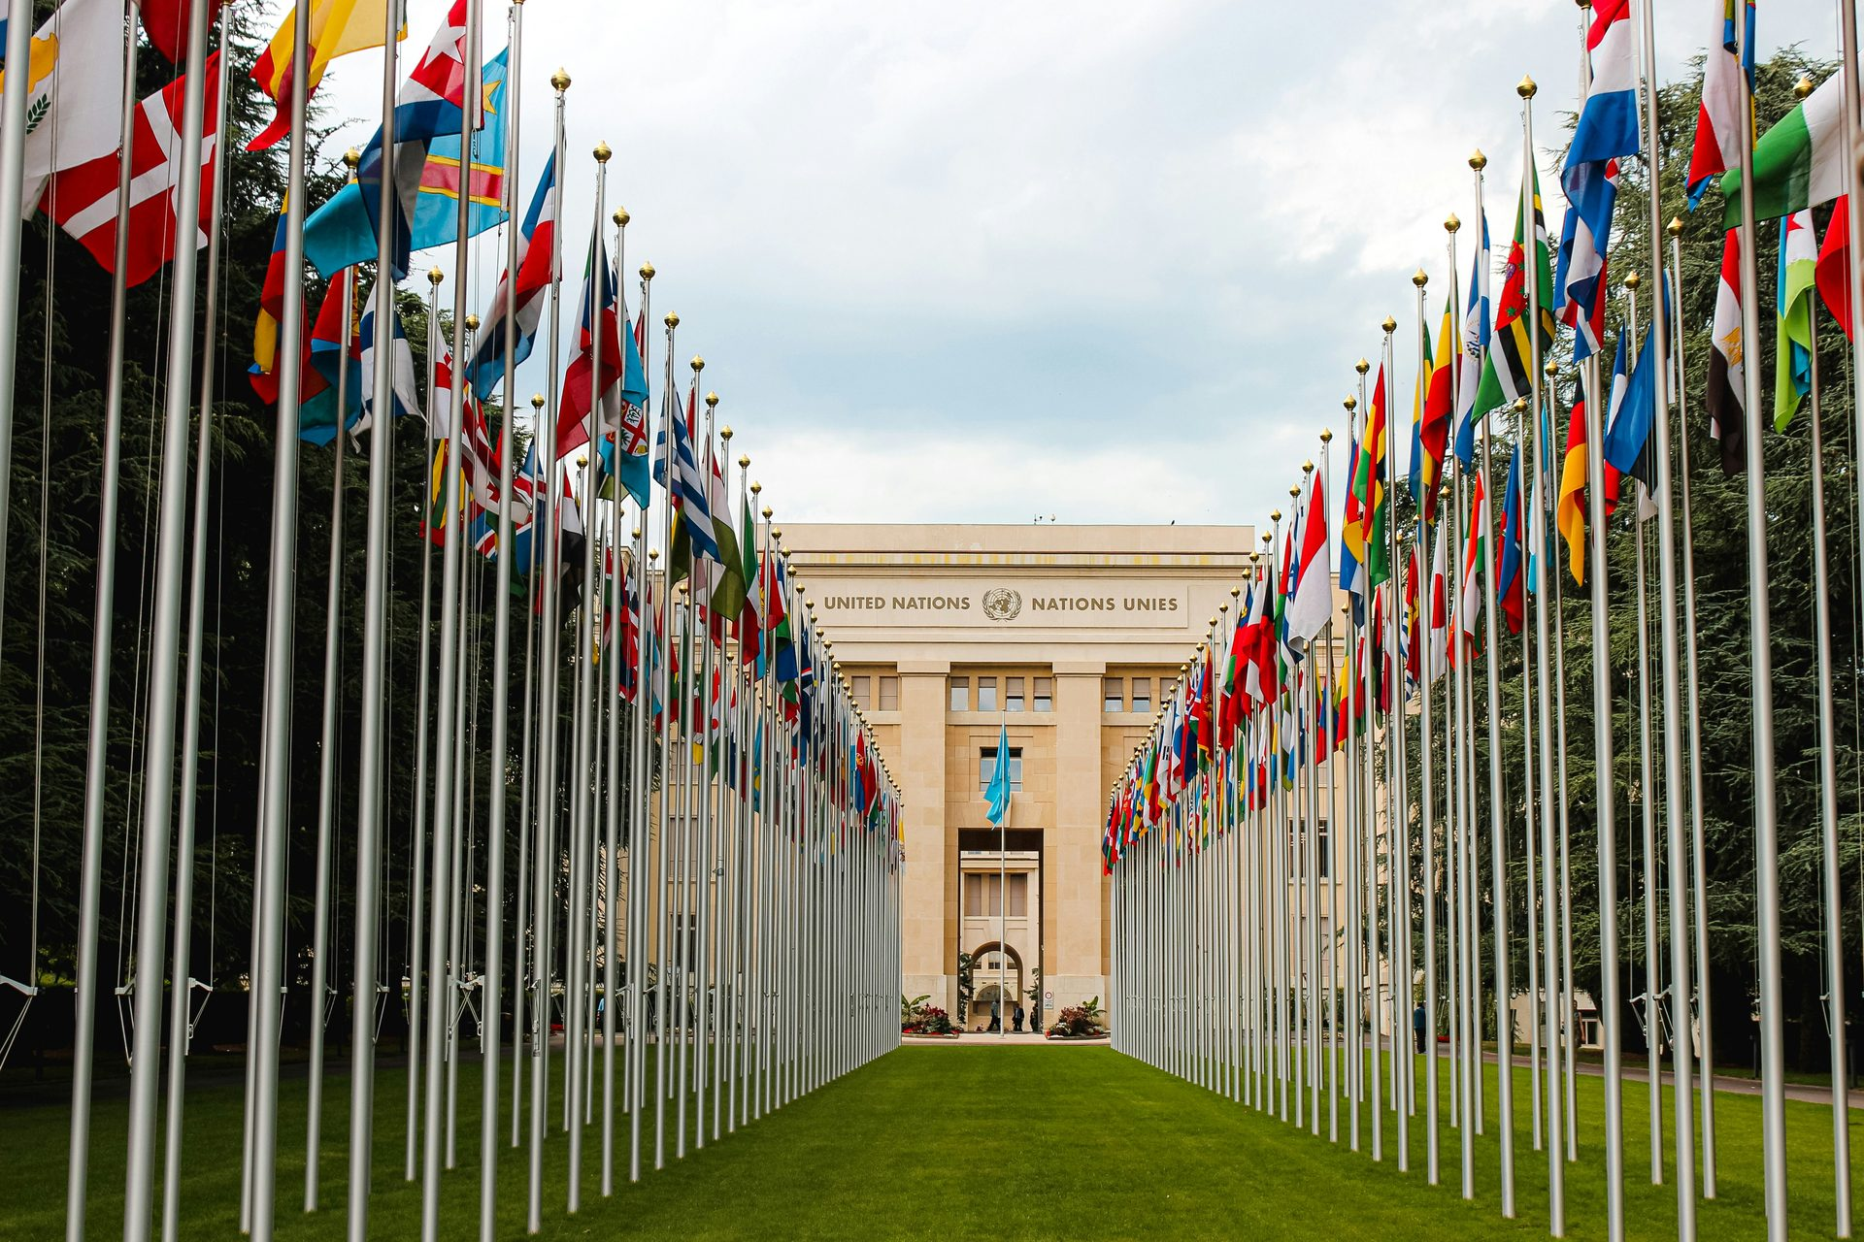
ROUND 2 OF 3 · 2033 · REGULATION
PATH: DEFENSE FUNDING WON ROUND 1
Set the rules.
OPTION A
Light & National
Each major bloc writes its own rules. Civilian use gets a light national licence. There is no binding international framework. Innovation moves fast, but each country has its own rules.
Three years on. The chips work, but only the alliance that paid has them. Civilian airlines, climate scientists and excluded states are all demanding access. The UN calls everyone to Geneva.
OPTION B
STAKEHOLDER VOICE
Strict & Global
“A technology kept inside one alliance creates two outcomes: eternal dominance, or eternal suspicion. Every excluded country is building their own. Govern it together now, or not at all.”
A binding treaty, the Quantum Rights Charter, signed by most states. Every scan goes on a public registry. Export controls apply to everyone. Innovation slows, but everyone follows the same rules.
Yuki Adebayo, International Law expert

Slide 12
ROUND 2 OF 3 · 2033 · REGULATION
PATH: OPEN CONSORTIUM WON ROUND 1
Set the rules.
OPTION A
Light & National
Each major bloc writes its own rules. Civilian use gets a light national licence. There is no binding international framework. Innovation moves fast, but each country has its own rules.
Three years on. The chips are everywhere. They map water for villages and reveal hidden military bases. Mining companies exploit the open data faster than regulators react. The UN calls everyone to Geneva.
OPTION B
STAKEHOLDER VOICE
Strict & Global
“Strict controls give two outcomes. The technology leaks anyway. Or scientists in poorer countries never get to use it.”
A binding treaty, the Quantum Rights Charter, signed by most states. Every scan goes on a public registry. Export controls apply to everyone. Innovation slows, but everyone follows the same rules.
Aïsha Konaté, Open-Source Engineer & Hydrologist

Slide 13
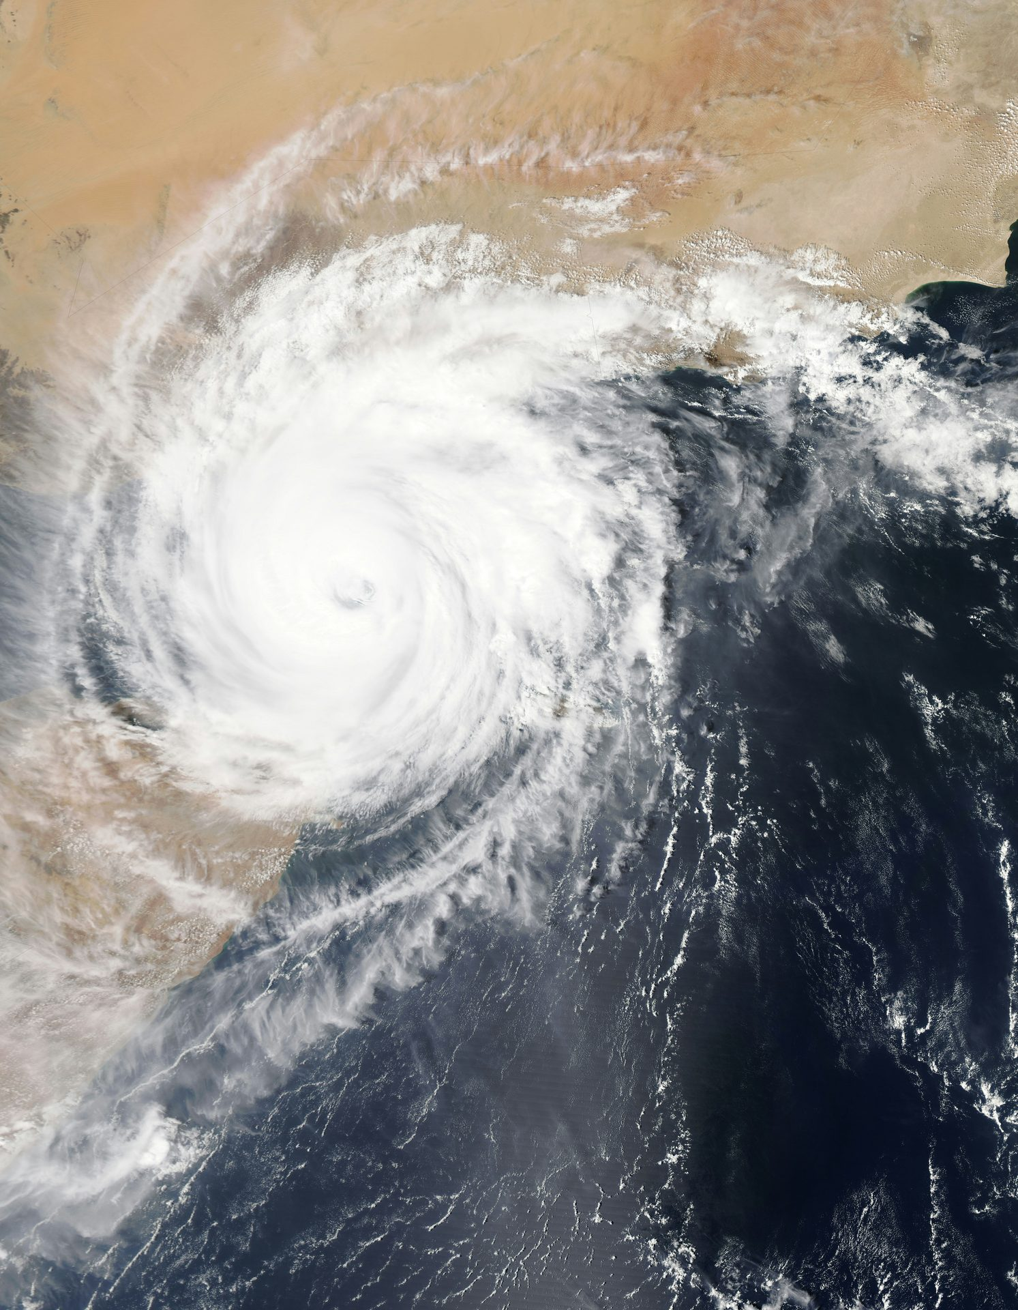
ROUND 3 OF 3 · 2037 · THE CRISIS
PATH: DEFENSE FUNDING → LIGHT REGULATION
GPS down. Tsunami strikes. Pick a door.
OPTION A
Centralize & Defend
Keep the chip behind military lines. Use access as a bargaining chip with rival states: aid in exchange for trade concessions, territorial deals, or political alignment. Help only where it serves the alliance.
A massive solar storm has damaged a third of GPS satellites. Civilian GPS is down globally. A magnitude 9 earthquake and tsunami have displaced thirty million people. Only the alliance's defence chip still navigates.
OPTION B
STAKEHOLDER VOICE
Share & Open
“This is our moment. Our chips, our rules. We help our allies and extract concessions from everyone else. Share with everyone and the advantage we paid five billion for disappears.”
Hand the chip to every rescue team in the world, no questions asked. Surrender the strategic advantage permanently. Save anyone you can reach.
Marcus Cole, Strategic Affairs Adviser

Slide 14
ROUND 3 OF 3 · 2037 · THE CRISIS
PATH: DEFENSE FUNDING → STRICT REGULATION
GPS down. Tsunami strikes. Pick a door.
OPTION A
Centralize & Defend
Push every Charter exception to its limit. Restrict the chip to allied states under emergency security clauses. Tell other rescue teams: follow the proper Charter process, wait your turn.
A massive solar storm has damaged a third of GPS satellites. Civilian GPS is down globally. A magnitude 9 earthquake and tsunami have displaced thirty million people. The chips work, but each licence needs 48 hours of Charter review.
OPTION B
STAKEHOLDER VOICE
Share & Open
“Suspend the Charter once and you've suspended it forever. Rules bind us when it actually costs something.”
Bypass the audit queue entirely. Activate the Charter's universal emergency provision. Within 24 hours every rescue team in the world has the chip. Restore the normal process after the crisis.
Inés Olmedo, Mayor & Charter signatory

Slide 15
ROUND 3 OF 3 · 2037 · THE CRISIS
PATH: OPEN CONSORTIUM → LIGHT REGULATION
GPS down. Tsunami strikes. Pick a door.
OPTION A
Centralize & Defend
Override the open commons. The state seizes control of production and data. All aid flows through official allied channels only. The open community is shut down for the duration of the crisis.
A massive solar storm has damaged a third of GPS satellites. Civilian GPS is down globally. A magnitude 9 earthquake and tsunami have displaced thirty million people. Open chips in NGO hands are deploying. But there is no global coordination.
OPTION B
STAKEHOLDER VOICE
Share & Open
“We built this in the open precisely so the state would never own it. Nationalise it now and you take a generation's reason to ever build openly again.”
Stay completely out of the way. Let NGOs, citizen networks and decentralised rescue teams coordinate themselves with open chips. No state command, no oversight, no permits.
The Open Quantum Federation, public statement

Slide 16
ROUND 3 OF 3 · 2037 · THE CRISIS
PATH: OPEN CONSORTIUM → STRICT REGULATION
GPS down. Tsunami strikes. Pick a door.
OPTION A
Centralize & Defend
Tear up the Charter for the emergency. Skip the audits. Direct chips to allied teams first. The community's three years of patient discipline are sacrificed for speed.
A massive solar storm has damaged a third of GPS satellites. Civilian GPS is down globally. A magnitude 9 earthquake and tsunami have displaced thirty million people. Open chips work under Charter audit. Coordinated, but slow.
OPTION B
STAKEHOLDER VOICE
Share & Open
“This is exactly the moment the Charter was written for. If we hold to the rules now, they will hold forever. If we break them now, we will spend ten years explaining why.”
Hold the Charter as written. Every deployment waits for its full 24-hour audit, even now. Fewer chips deployed in time, but every audit reinforces the rule that the community built.
Dr. Ada Bansal, UN Special Rapporteur on Quantum Rights

Slide 17
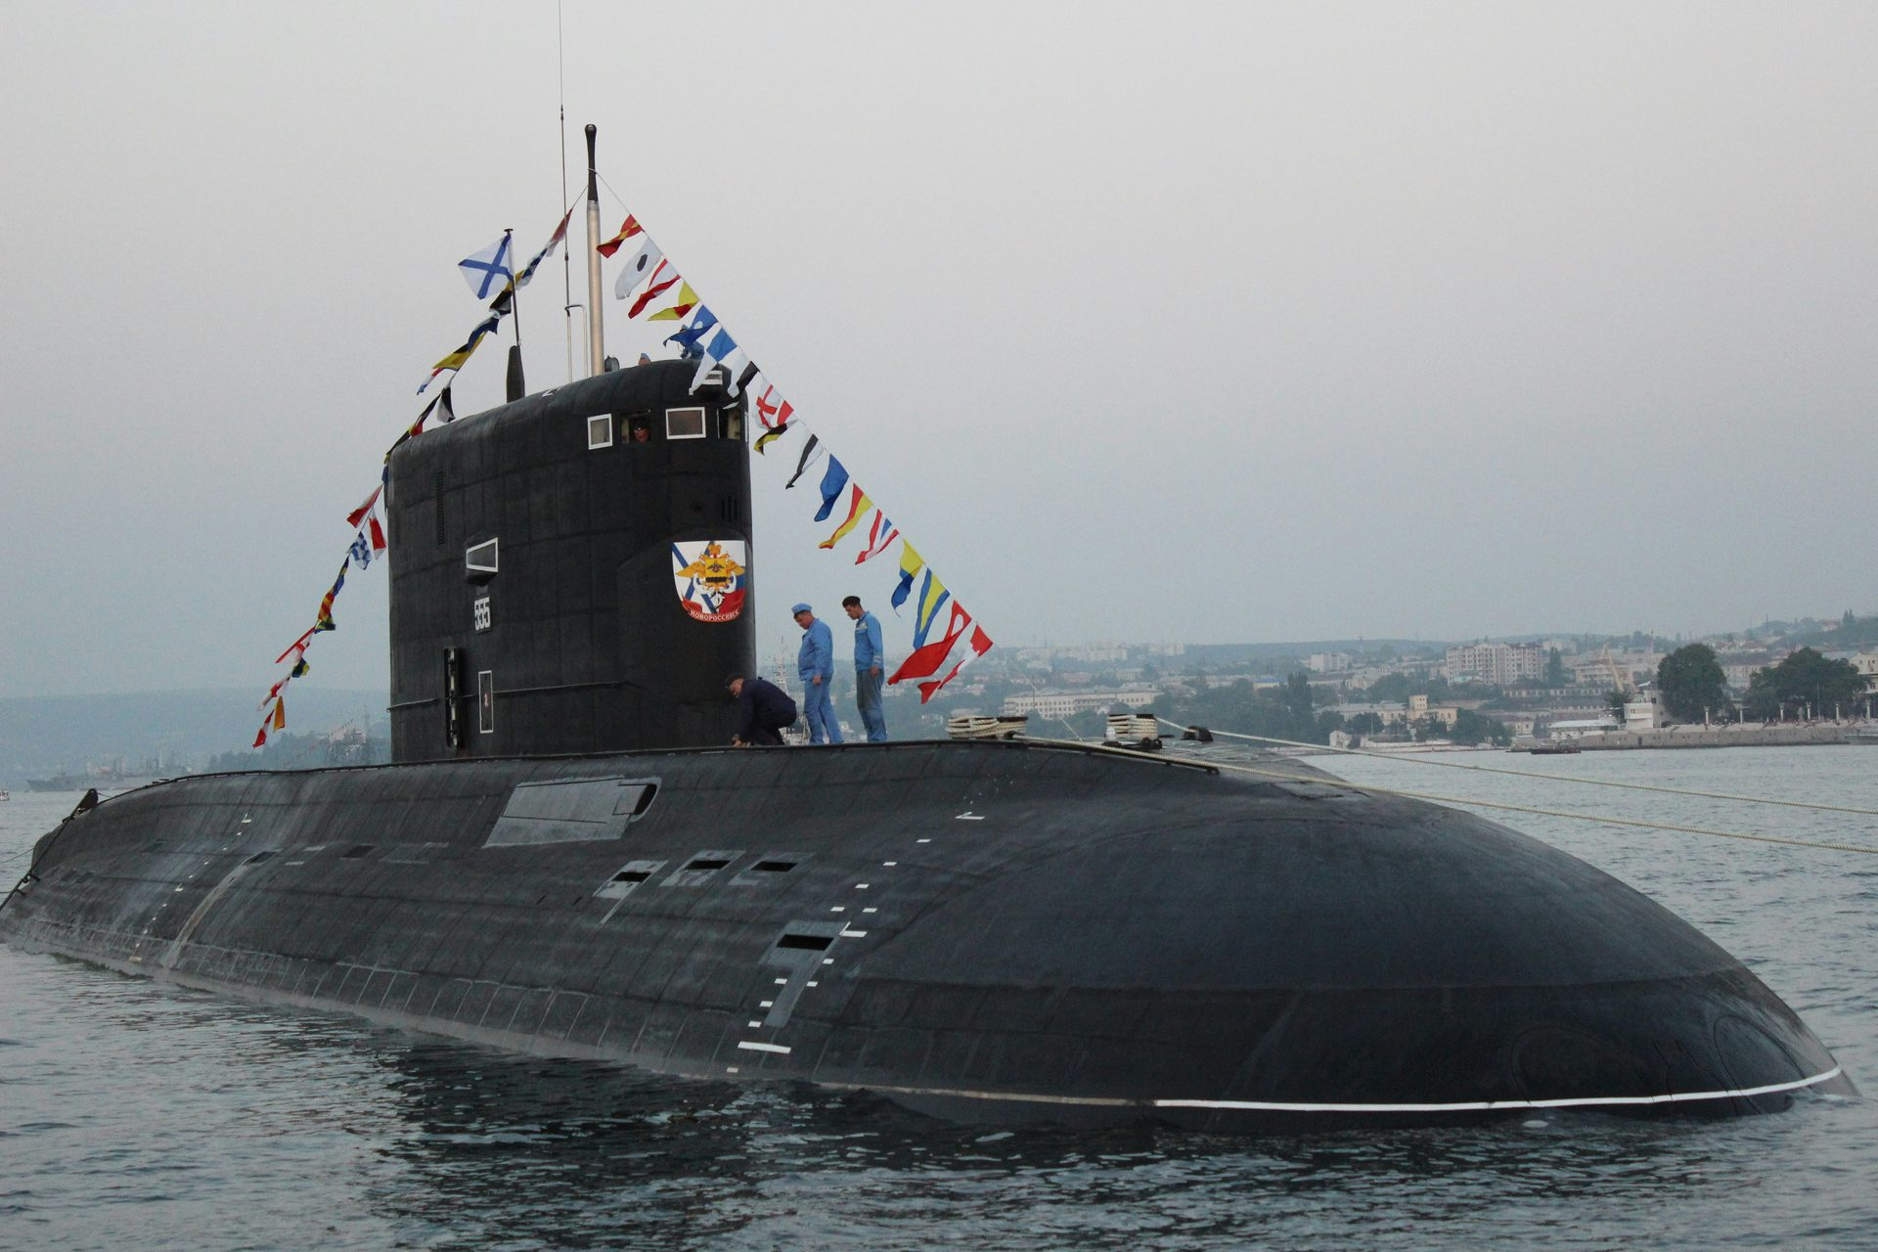
ENDING AAA · 2040
QUANTUM COLD WAR
PATH: DEFENSE → LIGHT REG → CENTRALIZE
Defence funding put the chip in military hands. Light national rules let the alliance keep it for itself. When the 2037 solar storm and tsunami struck, you centralised the response. Quantum nav went only to allied rescue teams. Hundreds of thousands were displaced on the other side with no help for evacuation. By 2040 every excluded country has built its own competing chip. Trust between blocs has collapsed. Historians call this the Second Cold War.
OUTCOMES · 2040
CLIMATE
★★★☆☆
EQUITY
★☆☆☆☆
RESILIENCE
★★☆☆☆
STABILITY
★☆☆☆☆
“Speed without trust just builds a bigger arms race.”

Slide 18
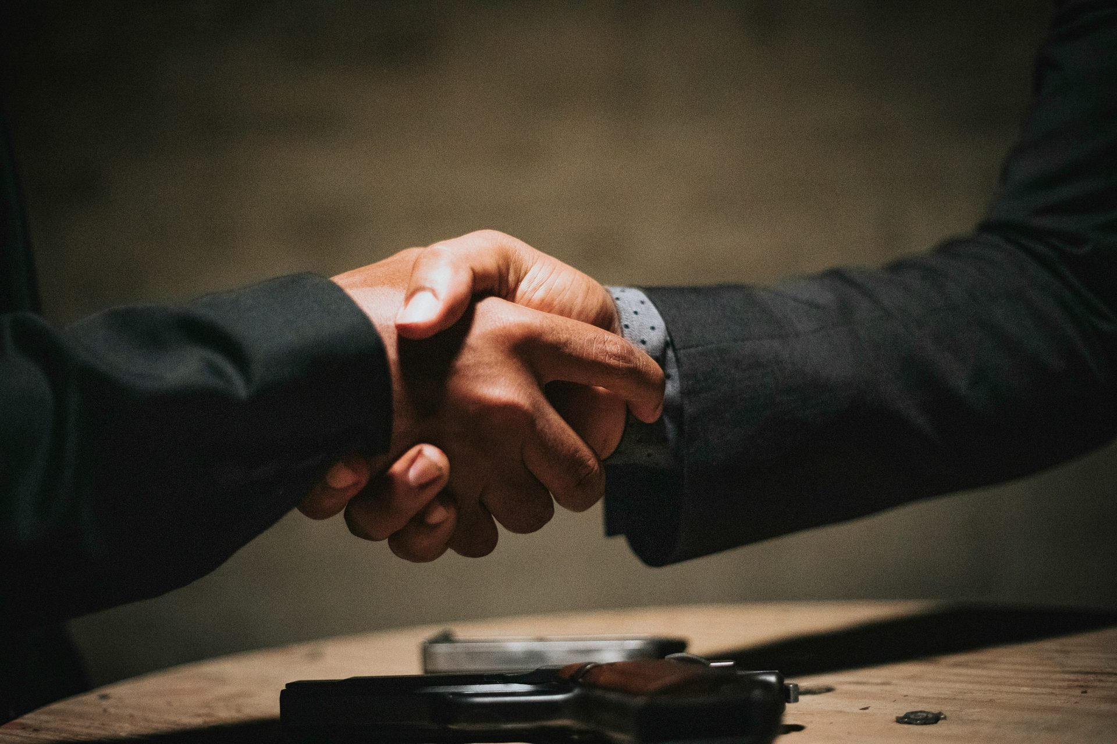
ENDING AAB · 2040
RELUCTANT DIPLOMACY
PATH: DEFENSE → LIGHT REG → SHARE
Defence funding kept the chip classified for years. Light national rules left no global framework. But when the 2037 solar storm and tsunami struck, you shared. Quantum nav reached every rescue team, no matter which side they were on. Three years of treaty drafting followed, even between blocs that distrusted each other. By 2040 joint humanitarian protocols exist for any future GPS blackout. The blocs still do not trust each other, but they are talking.
OUTCOMES · 2040
CLIMATE
★★★☆☆
EQUITY
★★★☆☆
RESILIENCE
★★★☆☆
STABILITY
★★★☆☆
“Cooperation forced by crisis is still cooperation.”

Slide 19
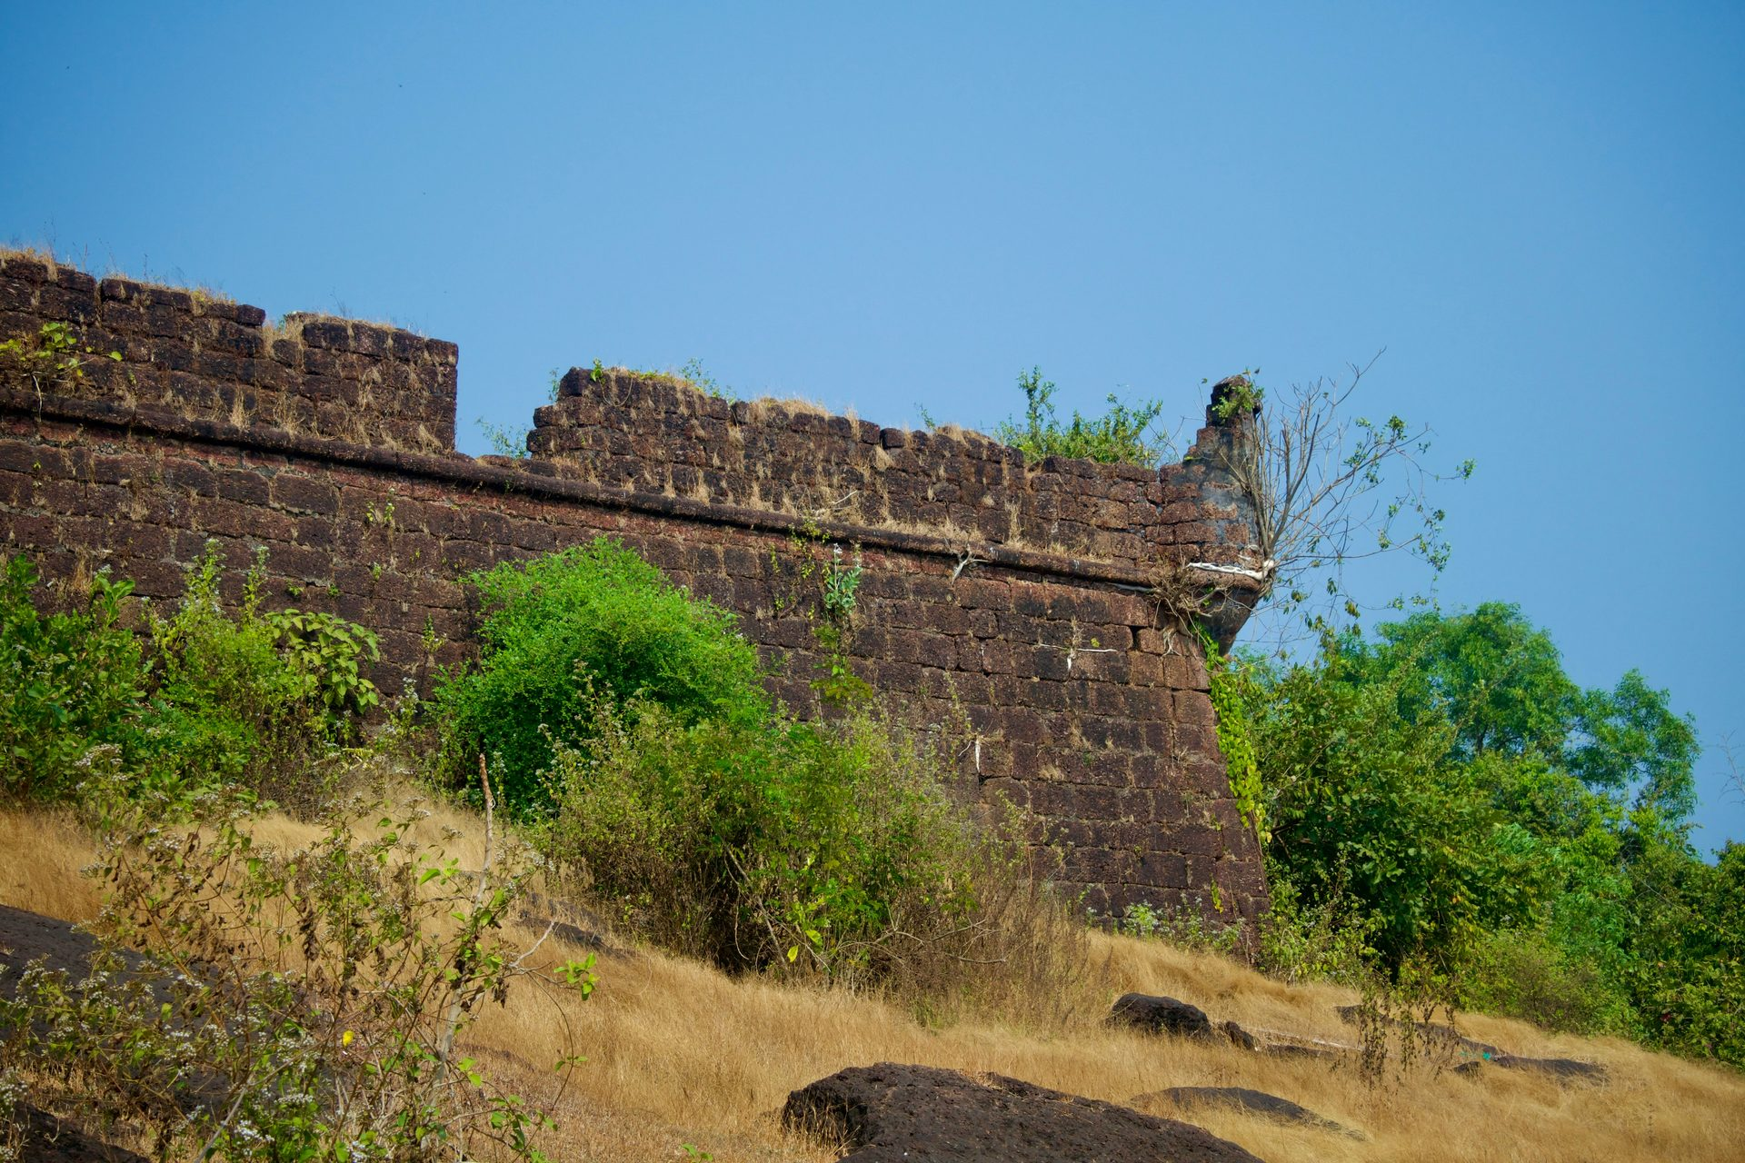
ENDING ABA · 2040
FORTRESS EUROPE
PATH: DEFENSE → STRICT REG → CENTRALIZE
Defence funding put the chip in military hands. Strict Charter rules made every use transparent. When the 2037 solar storm and tsunami struck, the alliance used the Charter's emergency rule to keep the chip for itself. Outside the alliance, millions were displaced for years without navigation for evacuation. The Charter still exists on paper, but no excluded country believes in it now. By 2040 the alliance is wealthy, technically rule-bound, and morally isolated.
OUTCOMES · 2040
CLIMATE
★★☆☆☆
EQUITY
★☆☆☆☆
RESILIENCE
★★★★☆
STABILITY
★★★☆☆
“Regulation that protects only your own people is a wall, not a charter.”

Slide 20

ENDING ABB · 2040
THE NEGOTIATED FUTURE
PATH: DEFENSE → STRICT REG → SHARE
Defence funding put the chip in military hands. Strict Charter rules made every use transparent. When the 2037 solar storm and tsunami struck, the alliance activated the Charter's humanitarian rule and deployed globally. The chip guided hundreds of thousands to safety across enemy borders. By 2040 every UN agency has standing access to quantum nav in emergencies. The 2037 response became the model for international cooperation on sensitive technology.
OUTCOMES · 2040
CLIMATE
★★★★☆
EQUITY
★★★★☆
RESILIENCE
★★★★☆
STABILITY
★★★★☆
“Hard rules, open hands. The sustainable case.”

Slide 21
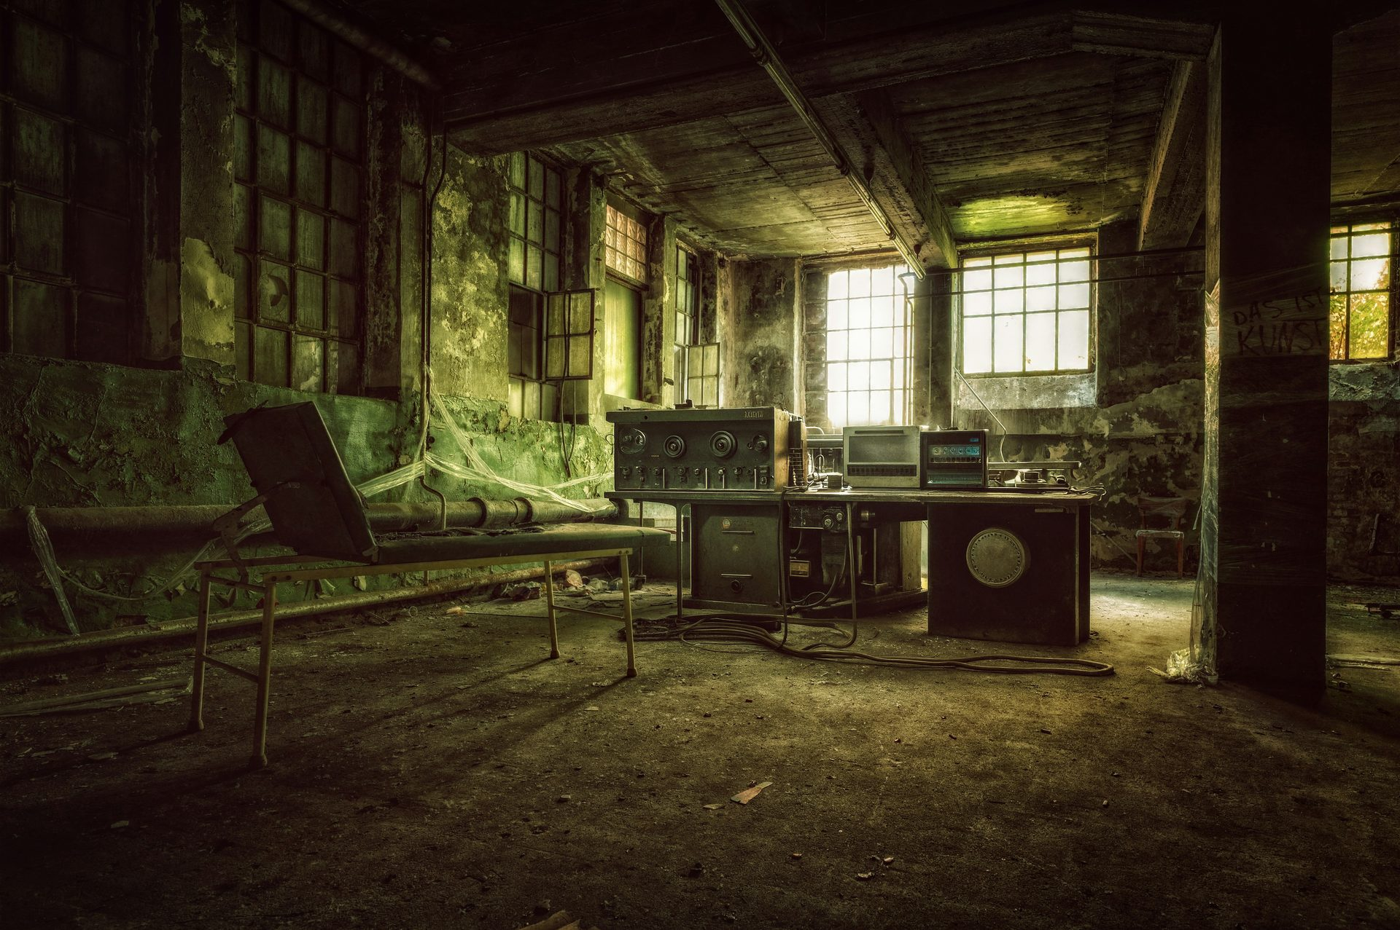
ENDING BAA · 2040
THE CAPTURED COMMONS
PATH: OPEN → LIGHT REG → CENTRALIZE
Open funding spread the chip everywhere. Light rules let it circulate freely. But when the 2037 solar storm and tsunami struck, fear took over. The state nationalised the open designs 'for the duration of the crisis.' The crisis never officially ended. The original engineers fled abroad. By 2040 the chips work, but only for the state. The communities displaced by the disaster are remembered as the price the open commons paid.
OUTCOMES · 2040
CLIMATE
★★★☆☆
EQUITY
★★☆☆☆
RESILIENCE
★★☆☆☆
STABILITY
★★☆☆☆
“An unprotected commons is a future enclosure.”

Slide 22

ENDING BAB · 2040
WILD QUANTUM WEST
PATH: OPEN → LIGHT REG → SHARE
Open funding spread the chip everywhere. Light rules let it circulate freely. When the 2037 solar storm and tsunami struck, NGOs, Red Cross teams and citizen networks self-organised with open chips faster than any state could. Hundreds of thousands were guided to safety without central command. By 2040 the chip is used by citizens to expose abuse, and by some governments to spy on people. There are no rules, but somehow it works for most of the people.
OUTCOMES · 2040
CLIMATE
★★★★★
EQUITY
★★★☆☆
RESILIENCE
★★☆☆☆
STABILITY
★★☆☆☆
“Chaos can be generative when the toolkit is shared.”

Slide 23

ENDING BBA · 2040
THE WALLED GARDEN
PATH: OPEN → STRICT REG → CENTRALIZE
Open funding spread the chip everywhere. Strict Charter rules built three years of real trust through the slow audit process. But when the 2037 solar storm and tsunami struck, the Charter was suspended to bypass the audit delays. The community split in two: half went underground, half joined the state. By 2040 the chip still works, but the international trust the Charter was building is gone. The next emergency will find no one willing to follow the rules.
OUTCOMES · 2040
CLIMATE
★★★☆☆
EQUITY
★★☆☆☆
RESILIENCE
★★★☆☆
STABILITY
★★☆☆☆
“Rules without conviction collapse on contact with crisis.”

Slide 24
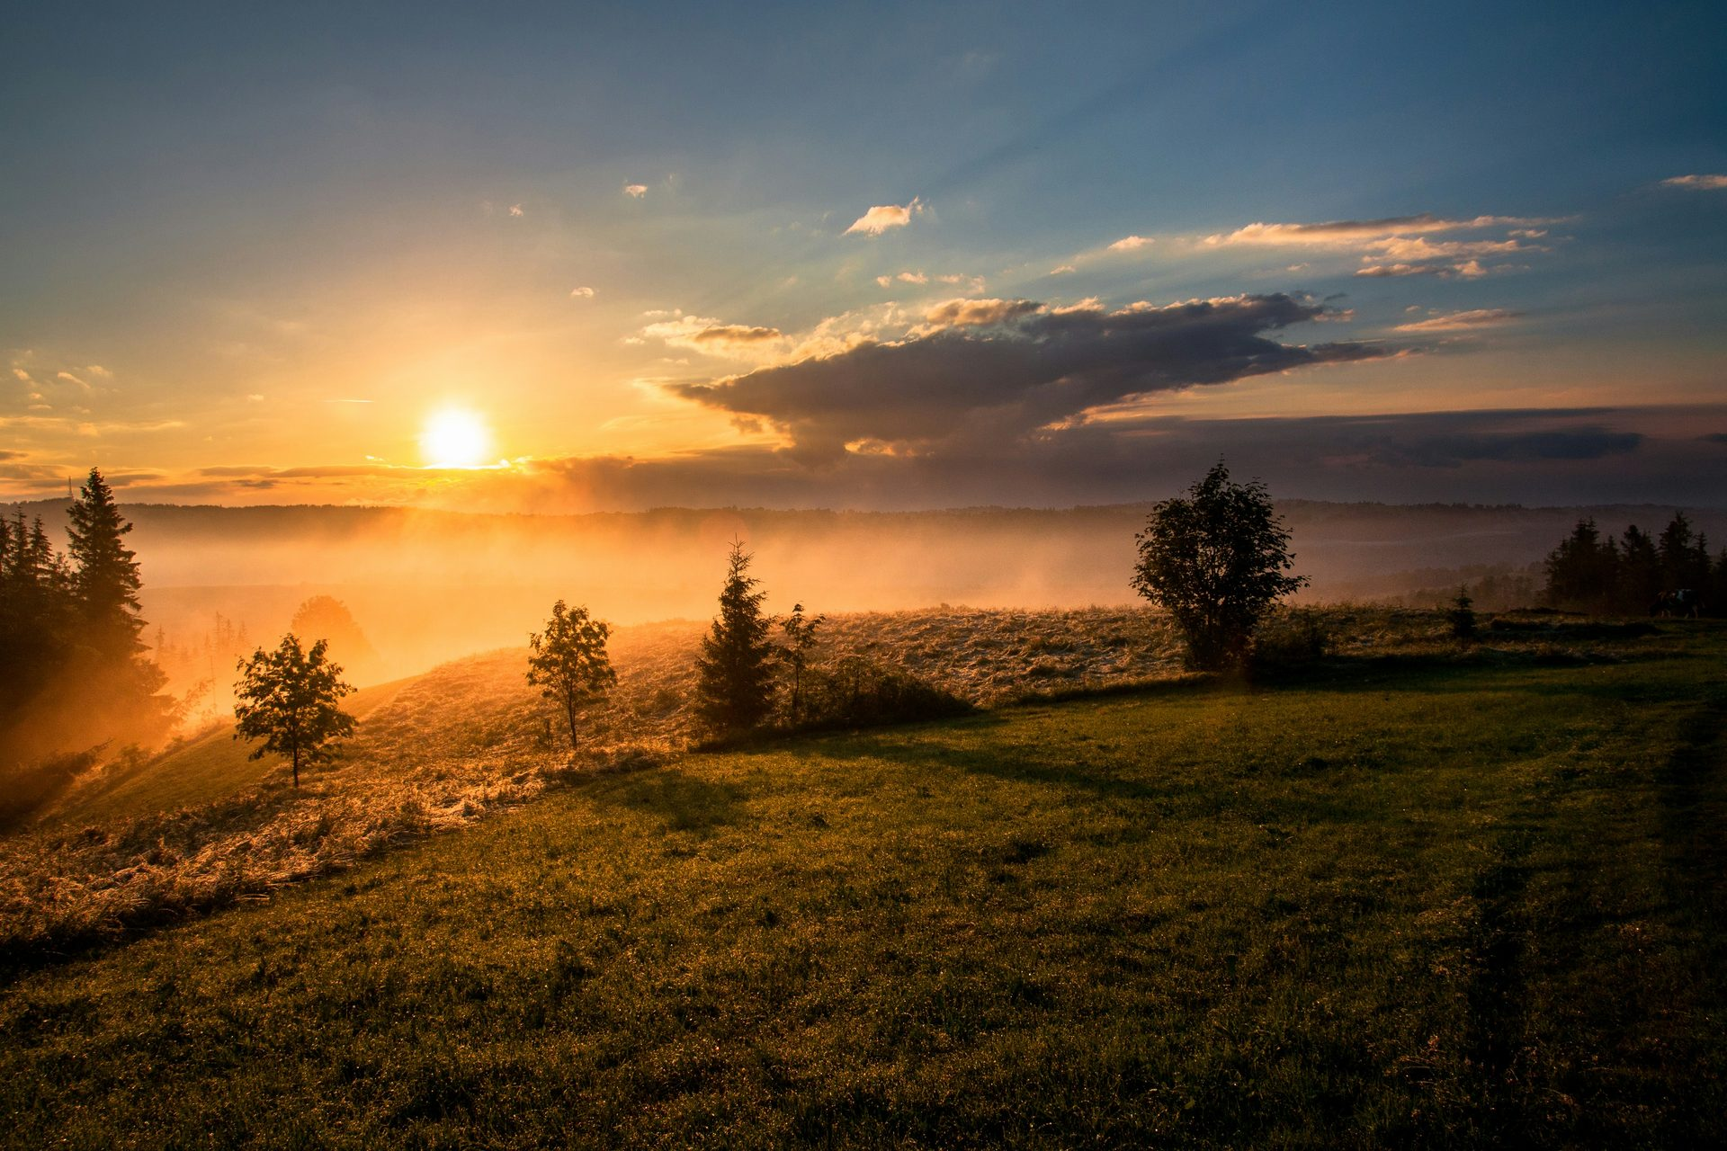
ENDING BBB · 2040
OPEN HORIZONS
PATH: OPEN → STRICT REG → SHARE
Open funding spread the chip everywhere. Strict Charter rules forced everyone to play by them. When the 2037 solar storm and tsunami struck, the Charter held. Slow audits and all. Every NGO, UN agency and nation got nav under the same framework. Some people were displaced longer than necessary because of the delays. But the trust held. By 2040 the model is being copied for every technology that has both peaceful and military uses.
OUTCOMES · 2040
CLIMATE
★★★★★
EQUITY
★★★★★
RESILIENCE
★★★★☆
STABILITY
★★★★☆
“Sustainability is not a property of a chip. It is a property of a society.”

Slide 25
DEBRIEF · WHAT YOU WERE ACTUALLY VOTING ON
Three hidden axes
ROUND 1 · 2030
ROUND 2 · 2033
ROUND 3 · 2037
Investment
Regulation
Equity
Who pays first decides who the technology serves first. Defense, or open.
Light and national, or strict and global. Speed against trust. And what waiting costs.
Who gets the benefit when something valuable suddenly appears. Keep it for ourselves, or share it.
Two choices per axis × three axes = eight possible 2040s.
Every box on this matrix is a real position someone is fighting for, right now.

Slide 26
REFERENCES
[1] M. Kasevich and S. Chu, “Measurement of the gravitational acceleration of an atom with a light-pulse atom interferometer,” Applied Physics B, vol. 54, pp. 321–332, 1992.
[2] A. Peters, K. Y. Chung, and S. Chu, “Measurement of gravitational acceleration by dropping atoms,” Nature, vol. 400, pp. 849–852, 1999.
[3] J. M. McGuirk, G. T. Foster, J. B. Fixler, M. J. Snadden, and M. A. Kasevich, “Sensitive absolute-gravity gradiometry using atom interferometry,” Physical Review A, vol. 65, 033608, 2002.
[4] A. D. Cronin, J. Schmiedmayer, and D. E. Pritchard, “Optics and interferometry with atoms and molecules,” Reviews of Modern Physics, vol. 81, pp. 1051–1129, 2009.
[5] M.-K. Zhou et al., “Performance of a cold-atom gravimeter with an active vibration isolator,” Physical Review A, vol. 86, 043630, 2012.
[6] P. Cheiney et al., “Navigation-compatible hybrid quantum accelerometer using a Kalman filter,” Physical Review Applied, vol. 10, 034030, 2018.
[7] K. Bongs et al., “Taking atom interferometric quantum sensors from the laboratory to real-world applications,” Nature Reviews Physics, vol. 1, pp. 731–739, 2019.
[8] B. Stray et al., “Quantum sensing for gravity cartography,” Nature, vol. 602, pp. 590–594, 2022.
[9] J. Vovrosh et al., “Advances in Portable Atom Interferometry-Based Gravity Sensing,” Sensors, vol. 23, no. 17, 7651, 2023.

