Slide 1


Final Challenge
MICRO 515 – Evolutionary Robotics
VENUE & DATE
MICRO 515 – Final Challenge
2026
PRESENTED BY
Team member 1,
Team member 2

Slide 2
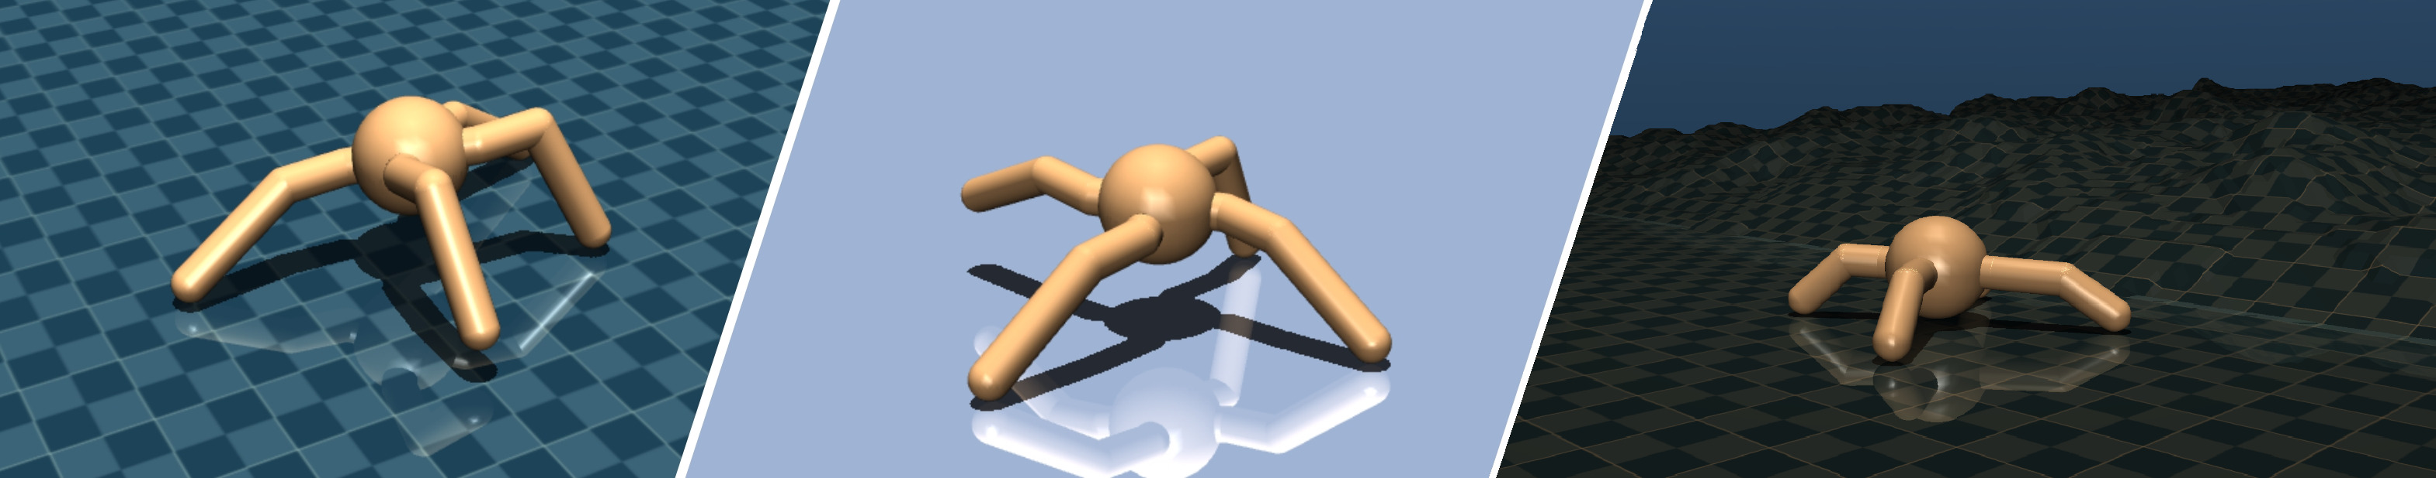
General information
Duration for each team: 10 min presentation + 5 min Questions and Answers
Date: 28.05.2026 from 9:15 to 13:00
Grading criteria for final project:
  Technical and methodological soundness of the approach (25%)
  Completeness of experimentation (25%)
  Quality of result analysis: repeated experiments, statistical data, comparisons, etc. (25%)
  Clarity of presentation (25%)
Attendance of the final presentations is mandatory. Please contact fuda.vandiggelen@epfl.ch in case you cannot attend.

Slide 3
Presentation Tips
Content & Clarity
No walls of text – Use bullet points, keywords, and visuals. Slides support your talk, not replace it.
One main idea per slide – Helps audience follow your story.
Show the big picture first – Start with motivation and high-level question, then dive into details.
Figures & Results
Label axes clearly – Include variable names and units (e.g., Fitness, Generations, Time (s), Velocity (m/s)).
Add error bars – Show standard deviation, standard error, or confidence intervals, especially for stochastic evolutionary runs.
Use legends – Explain lines/colors (e.g., different controllers, environments, selection methods).
Don’t just show best run – Report statistics over multiple independent runs (median, IQR, etc.).
Include relevant baselines – Compare against random search, hand-coded controller, or simpler EA.

Slide 4
Presentation Tips
Content & Clarity
Describe the genotype-to-phenotype mapping clearly (e.g., neural network weights, topology, parameters).
Show the fitness function – What is being optimized? Any multi-objective aspects?
Mention key evolutionary parameters – Population size, generations, mutation rate, crossover, selection method.
Visualize behaviors – Trajectories, sensor readings over time, or a short “best individual” video.
References & Credits
Cite all papers, code libraries, simulator and datasets – Use a consistent format (e.g., Author, Year, Venue)
Presenting
Practice – Know what you’ll say for each slide
Explain figures – Don’t just point. Say: “On the left is… The key takeaway is…”
Keep to time – Respect the limit. Better to cut one analysis than rush everything.

Slide 5
Introduction
Give a short introduction on the problem addressed by the final challenge.
What makes the problem challenging? How is it different from the Exercises?

Slide 6
Method
The lecture and exercises as well as in the research literature present a boquet of concepts. Which concept or combination of concepts do you think is most promising to solve the challenge? Define a hypothesis.
Describe your proposed method to address the final challenge. This may contain the following:
  Control type and architecture (fully connected neural network, oscillatory controller, SO2, Actor-Critic, …). Show your control architecture with sensor inputs and actuation outputs.
  Evolutionary algorithm (GA, ES, CMA-ES, NSGA, Diffusion ES, …)
  What do you evolve? Neural controller only? Morphology + Neural Controller? What is your genetic encoding? Illustrate in figures, tables, …
  Training curriculum: fitness function(s), training phases, simulation hyperparameters, environment randomizations, …)
  Do you use inductive biases (e.g., controller initializations, actuation ranges, morphology encodings, symmetries, …)
Define a set of parameter or configurations for experiments. Compare how changes in the configurations affect performance and behavior of the robot, e.g. modifications in the the neural architecture; hyperparameters of the EA; different sensor information; …

Slide 7
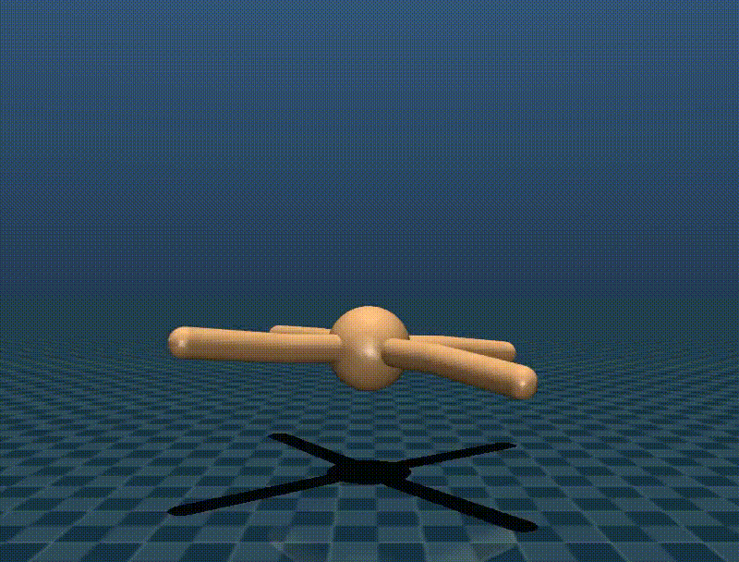
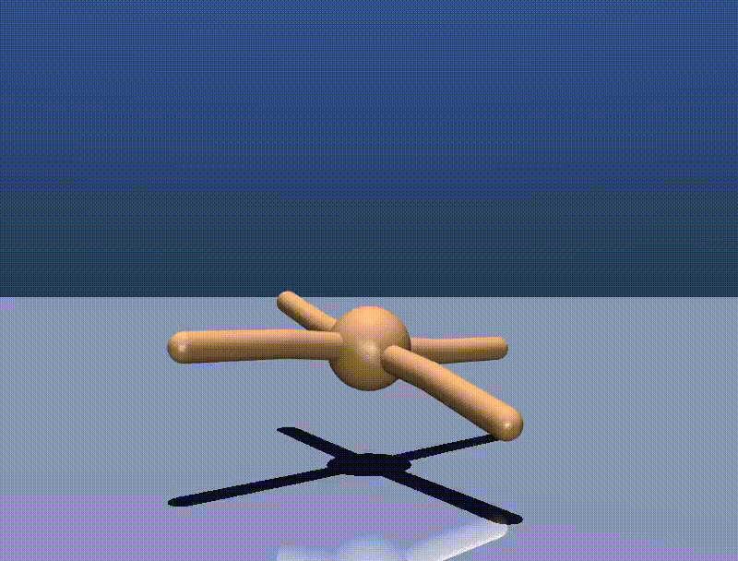
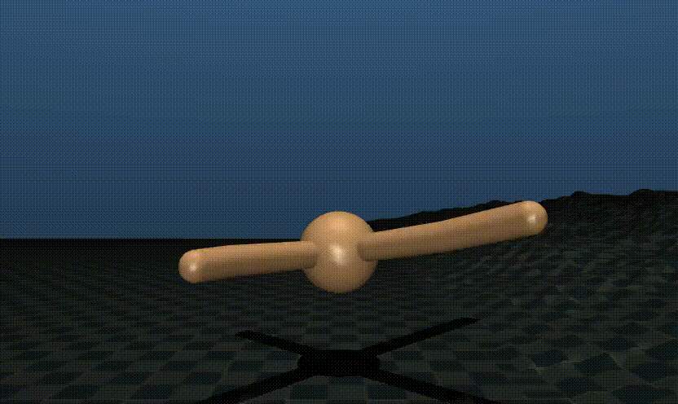
Results in training environments
Flat terrain locomotion
Ice terrain locomotion
Hilly terrain locomotion
Bridge traversal
?
How does your method perform on the training environments? Provide fitness graphs and videos. Add sufficient statistics for your experimentation settings.
How does evolution affect your phenotype? How do different configuration settings affect fitness and phenotype?

Slide 8
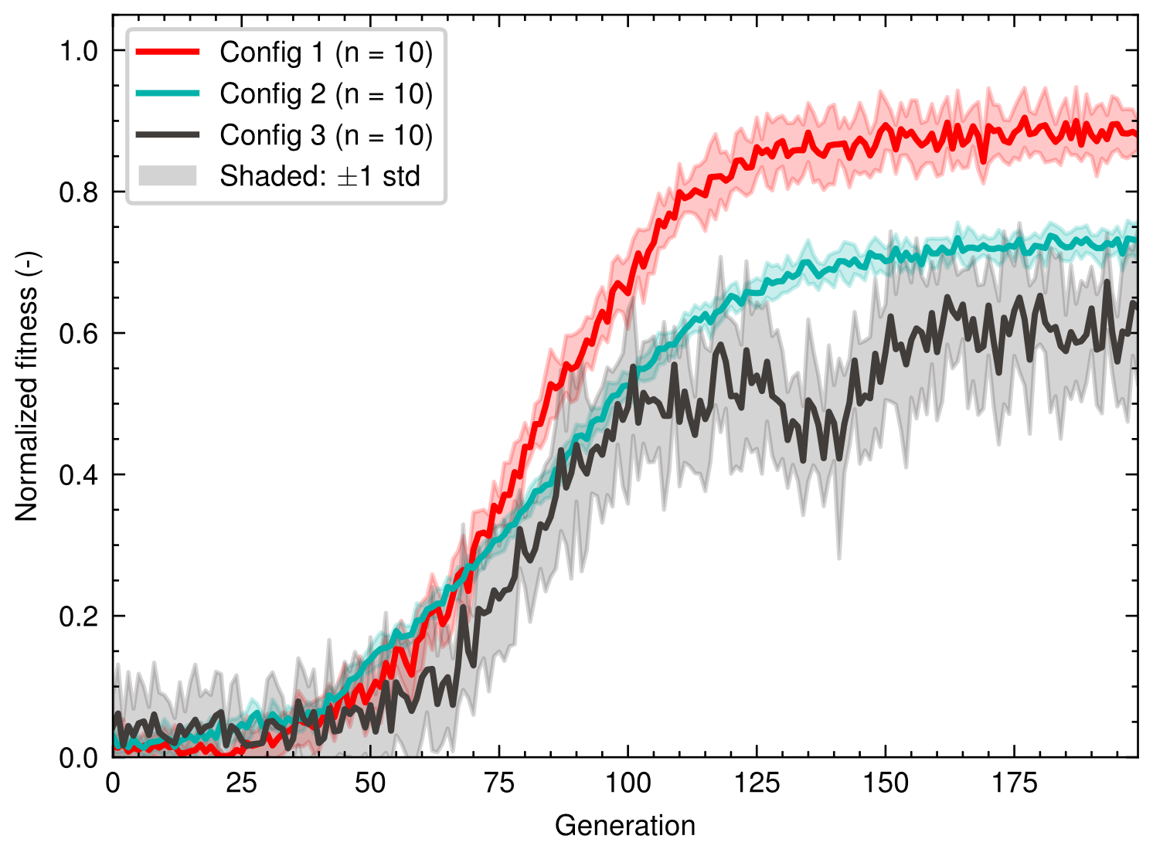
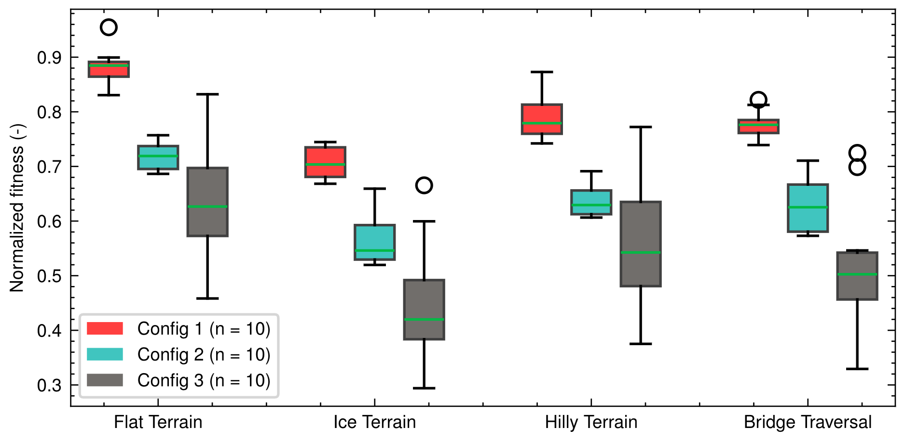
Results in training environments
Fig: Fitness curve (Example figure)
Fig: Performance in training environments (Example figure)

Slide 9
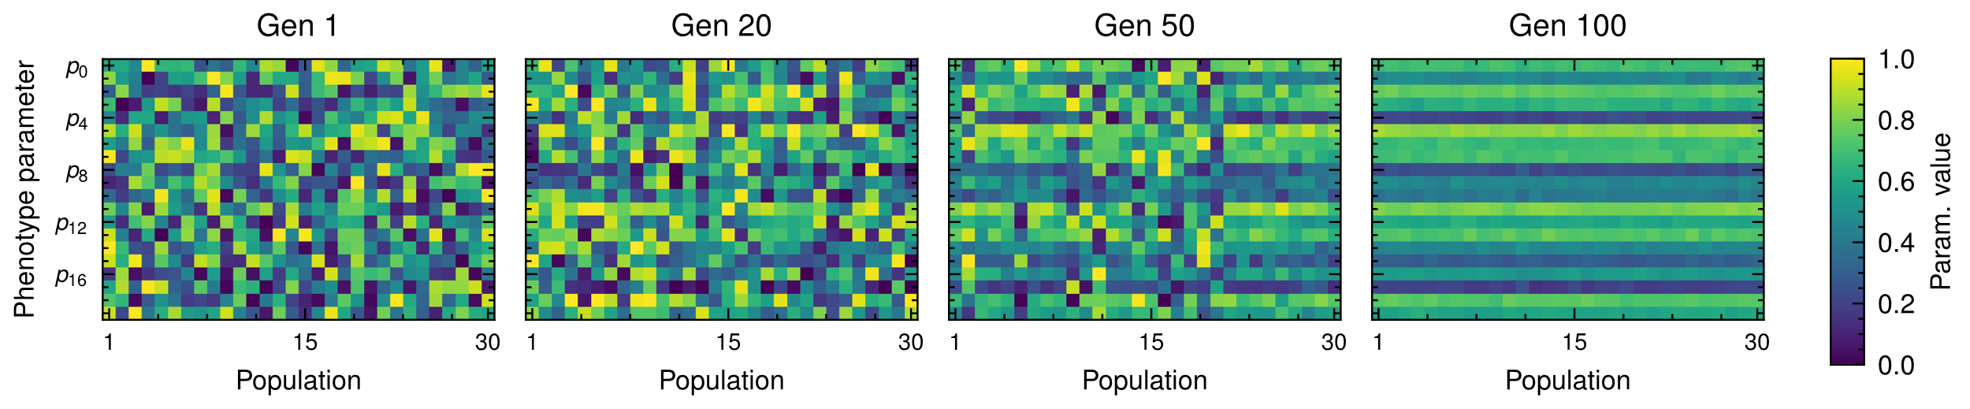
Results in training environments
Fig: Evolution of phenotype diversity (Example figure)

Slide 10
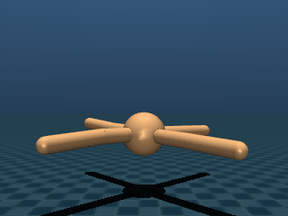
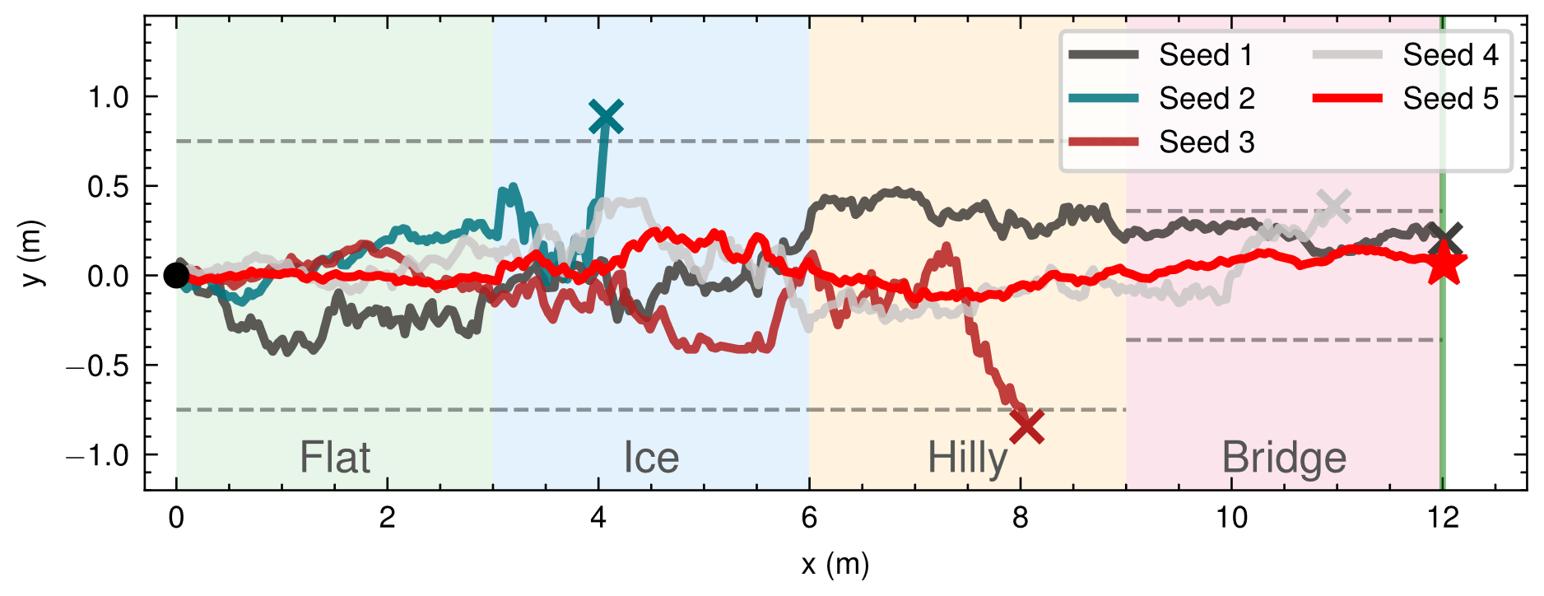
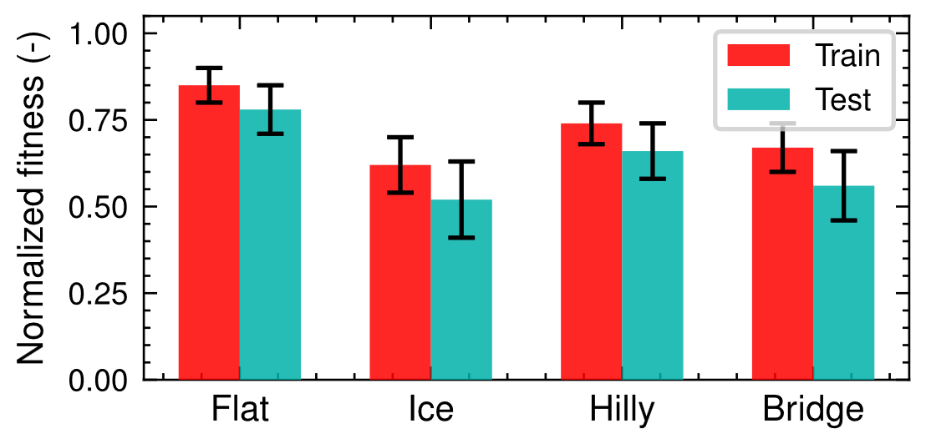
Results in test environment
Provide a video of your robot performing in the test environment.
Analyse the performance of your robot in the final test environment!
Does the performance in the test environment differs from the performance in the training environment? Show a graph comparing training in test performance.
How did your method help to increase robustness in the test environment? If it did not help, why?
Fig: Robot trajectory over 5 seeds (Example figure)
Fig: Training – Test Evaluation (Example figure)

Slide 11
Discussion and Conclusions
Summarize your results! Was your hypothesis correct? If not, what is your assumption why it is incorrect?
Which limitations does your approach have? If results are not what you expected, explain why
What changes do you suggest for future work based on your findings?

Slide 12
Workload Distribution
Task | Student 1 | Student 2
Task 1
Task 2
Task 3

Slide 13

Thank you for your attention !
MICRO 515 – Evolutionary Robotics
PRESENTED BY
Speaker
Title

