Slide 1
Results Challenge 3

Slide 2
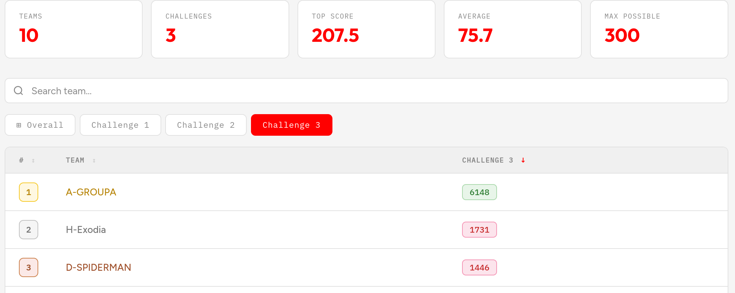
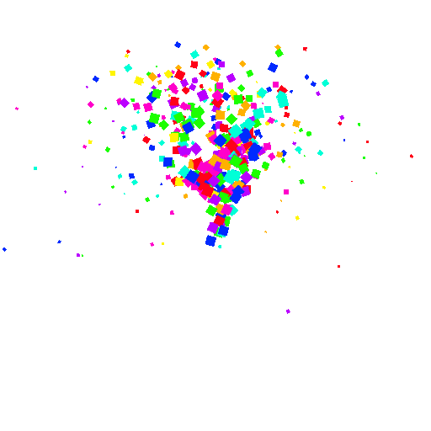
Final project bonus:
+0.25

Slide 3
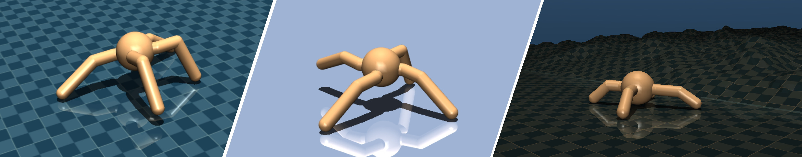
Introduction into Final Project

Slide 4



Project setup
Training set:
We will provide 3 training environments
Test set:
Final test environment TBA
Use your codebase of previous Challenges

Slide 5
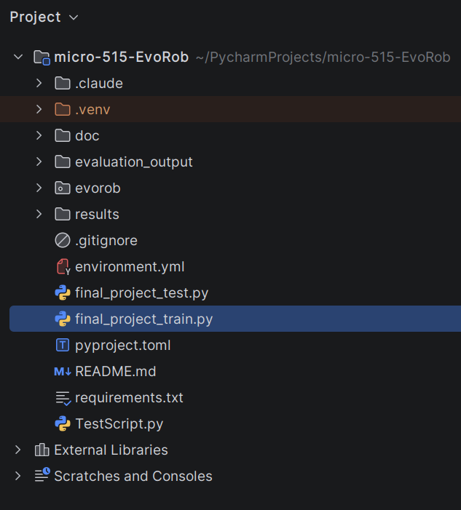
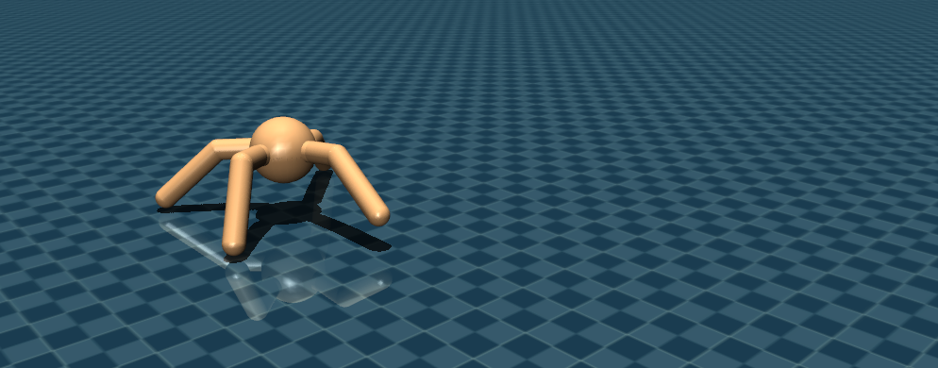

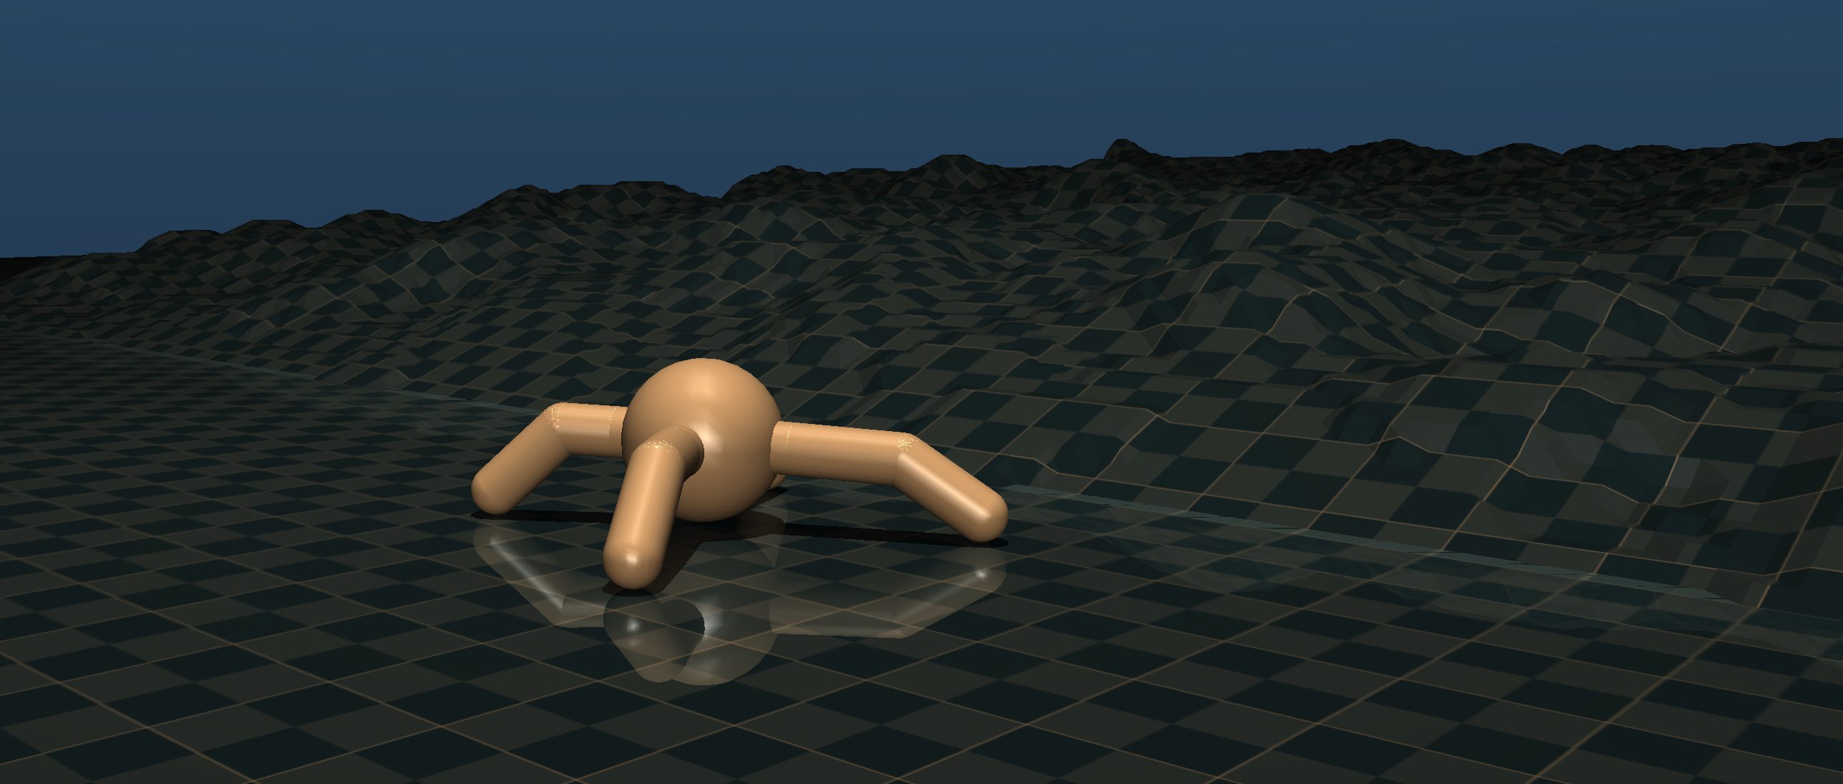
How to use the training set
We provide a default setup
final_project_train.py
Final_world class:
evaluate_individual (Introduction)
MLP (Challenge 1)
Tree based representation (Challenge 3)
NSGA-II (Challenge 2)
Ask/tell interface

Slide 6
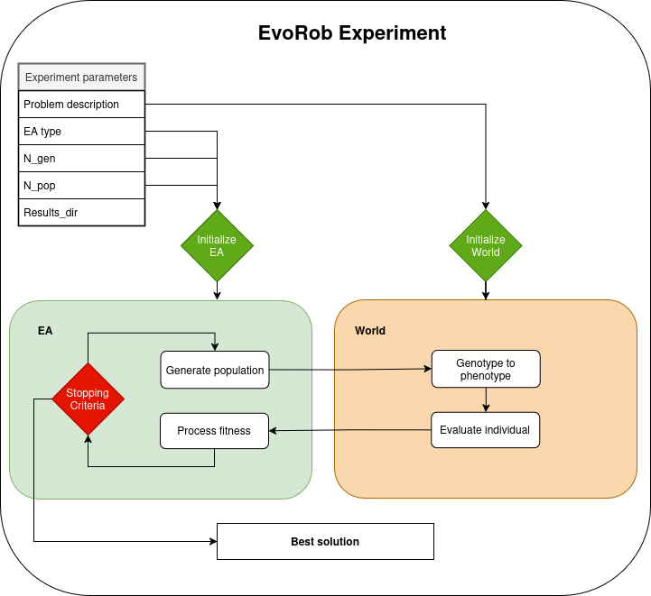
Final project goal [Focus on one idea]
Evolve a complete robot for all environments:
Evolutionary algorithm
  MAP-elites
  Viability evolution
Robot representation
  Full body evolution
  Change in architecture
Controller design
  Adaptation/Hebbian
  Hierarchical control
  Meta learning

Slide 7
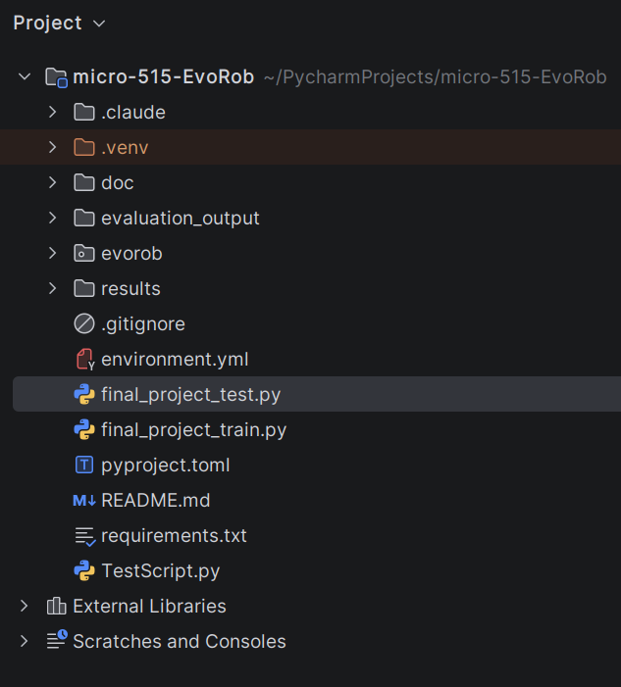
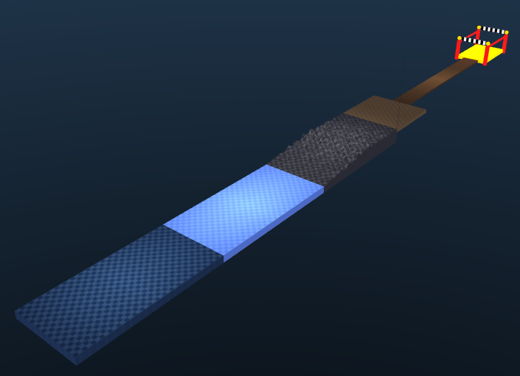
How to use the test set
We provide a test function to
check your solution
final_project_test.py
Searches your result directory:
--best_dir_path results/final_project
EvalWorld class:
Loads your best genome
Loads your best robot xml

Slide 8






Poster session
[21-5-2026] You will submit your solution on
    Code: Your final_project_train.py, <your_controller>.py
    Data: Your best evolved genotype as x_best.npy, <your_robot>.xml
    Any other file necessary to run
    README: special instruction if needed
[28-5-2026] Poster session
Project grade = Poster grade + bonus points [max. 6]
Notes:
This is a general overview of the practicals during the course. At the start there is an emphasis on theory (i.e. lectures) but slowly we will focus more on hands-on experience of EC. At the end we expect a report on a evolutionary robotics experiment around the same time the exam period starts.

Slide 9

My next steps
1
# Pull from upstream Final Project files
git remote add upstream <lis-git> # if not done yet
git pull upstream final_project
# Checkout final project branch
git checkout final_project
# Start with Final Project
Read the description of the assignment doc/final.md
Make a plan before starting
Take your time understanding
() final_project_train.py # where you implement your code
() final_project_test.py # where you test your result
2
3

