Slide 1
Results Challenge 2

Slide 2
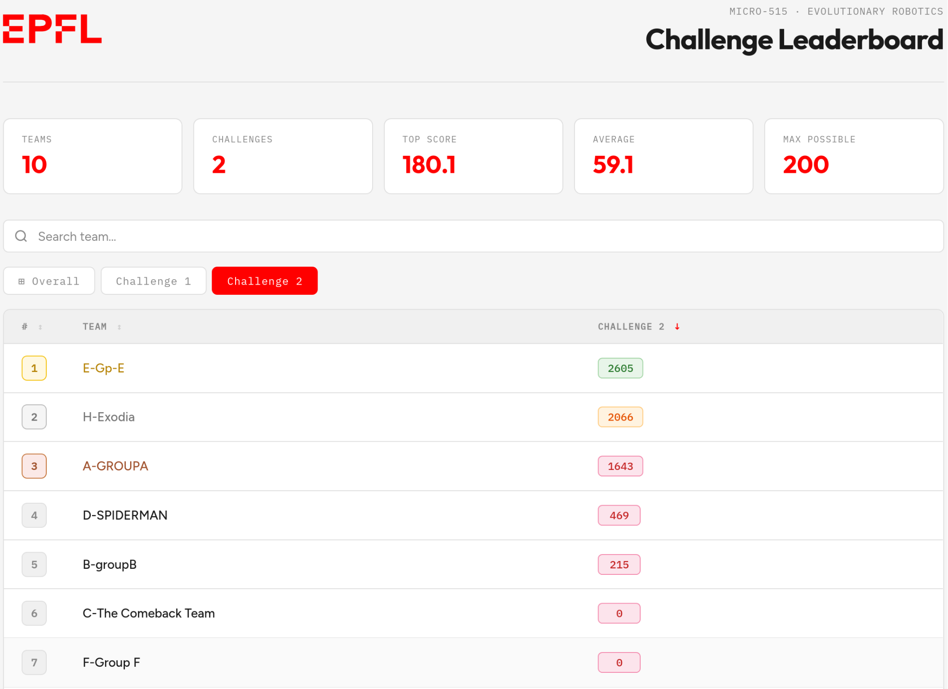

Slide 3
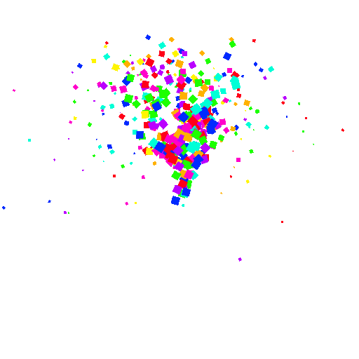
Final project bonus:
+0.25

Slide 4
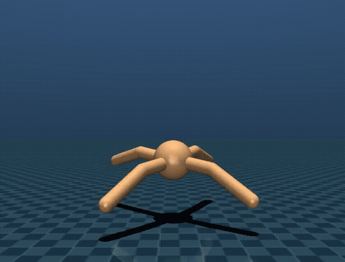
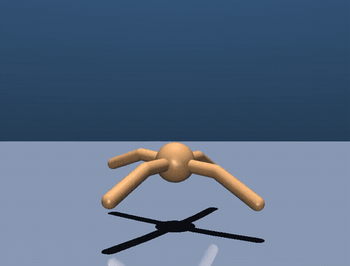

Slide 5
Some insights from the top 3
NSGA was used
Pop size: 64-400
Mutation prob: 0.3
Crossover prob: 0.7
Generation: 400-2000
Warm-start from Previous Challenge
Reducing search space
Rewards tuning:
Penalty for tumbling
Reward scheduling (make the task more complex along generations)

Slide 6
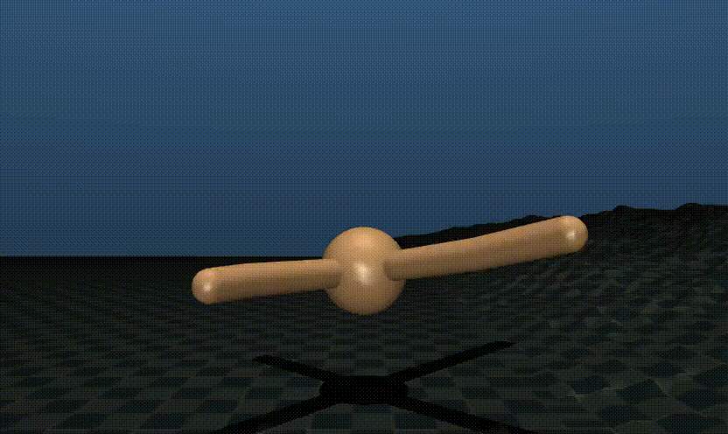
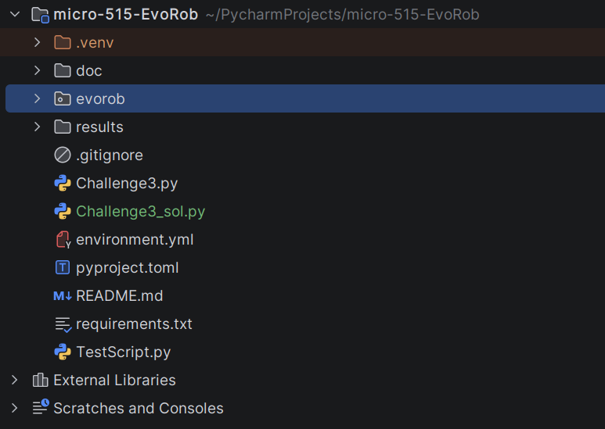
Challenge 3

Slide 7
My next steps
1
# Pull from upstream solution files
git remote add upstream <lis-git> # if not done yet
git pull upstream challenge3
git push # push your implementation to your fork
# Submit challenge3 today
Follow the submission instruction in doc/challenge3.md
2

Slide 8
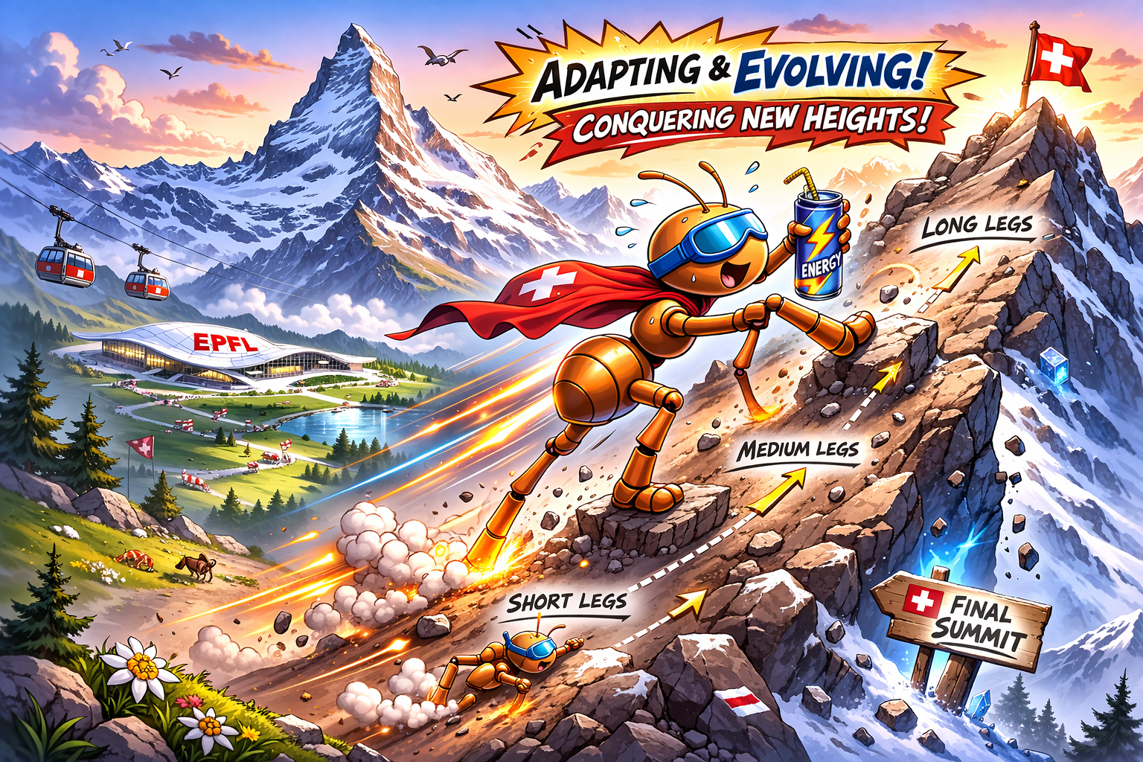
Challenge 3 submission details
Code of your best final controller and the corresponding evolved weights (important: your controller needs be compatable with the controller interface)
Video rendering of your best “specialist” on flat / ice terrain and the best “generalist” on flat / ice terrain
Fitness graph showing the evolution of fitness over generations and the pareto-front over both fitness
README.md describing shortly the selected algorithm, environment design and controller (max. 300 words)
txt files generated by the evaluate_checkpoint function.
Submit these documents in a single zipped folder to Moodle at Submission - Challenge 3 with the following naming convention:
2026_micro_515_TEAMNAME_LASTNAME1_LASTNAME2.zip
One submission per team is sufficient.

