Slide 1
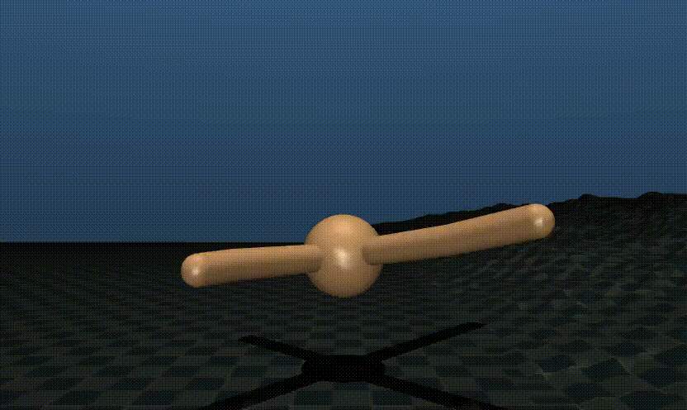


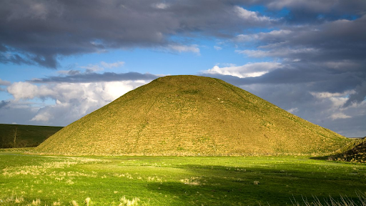

Challenge 3: Hill terrain
Exam
Poster
Practical
Introduction
Challenge 1
Challenge 2
Challenge 3
Final Project
Deadline: 02.04.2026

Slide 2
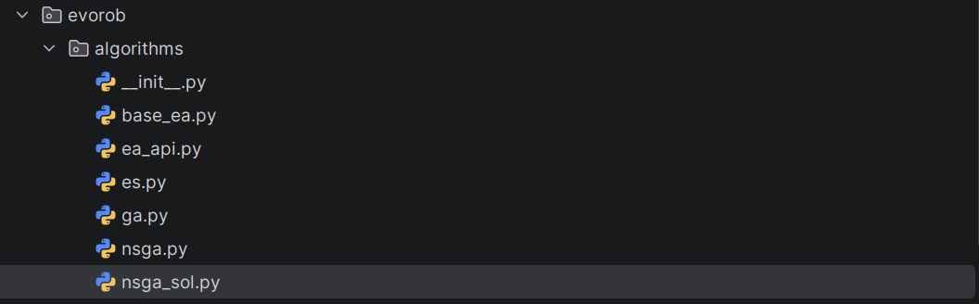
Challenge 2 NSGA-II solution online
1
# Pull from upstream solution file for NSGA-II
git remote add upstream <lis-git> # if not done yet
git pull upstream challenge2
git push # push your implementation to your fork

Slide 3
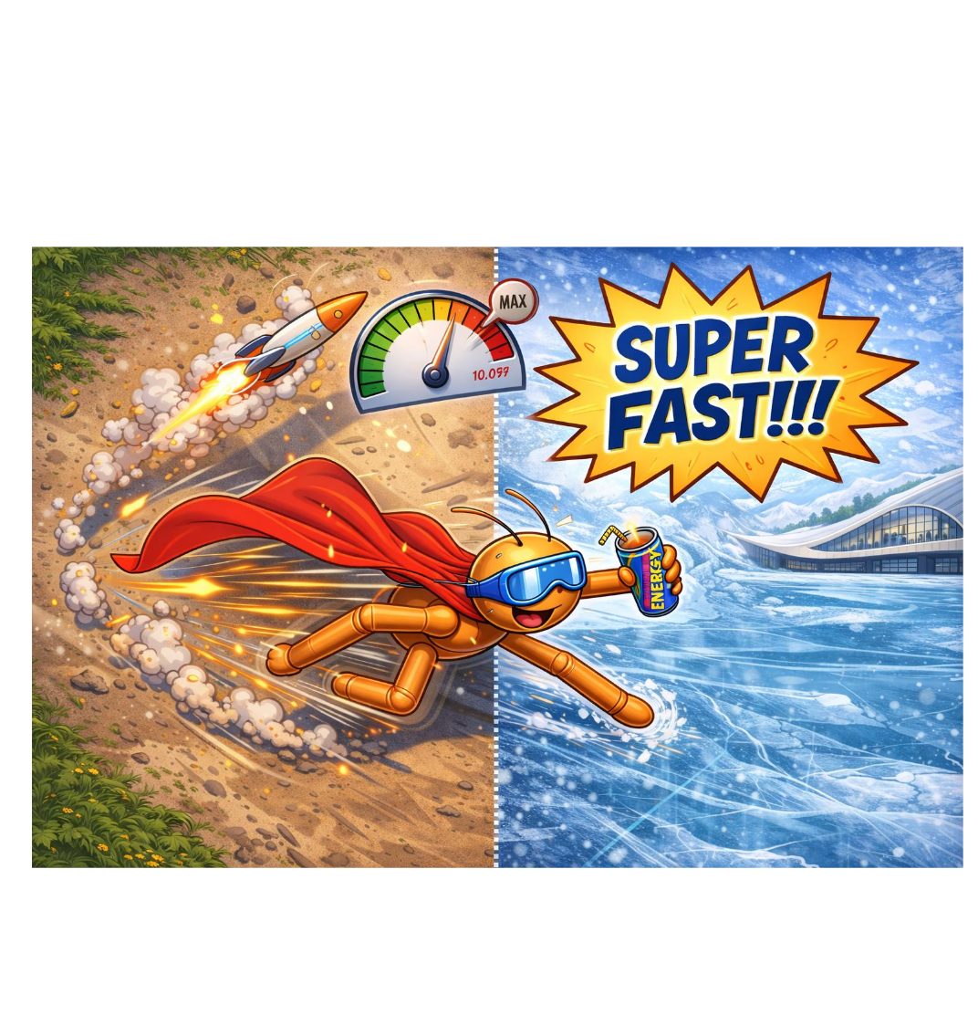
Challenge 2 submission details
Code of your final controllers and the corresponding evolved weights (important: your controller needs be compatable with the controller interface)
Video rendering of your best “specialist” on flat / ice terrain and the best “generalist” on flat / ice terrain
Fitness graph showing the evolution of fitness over generations and the pareto-front over fitness on flat terrain and fitness on ice terrain
README.md describing shortly the selected algorithm, environment design and controller (max. 300 words)
evolution_score.txt file generated by the evaluate_checkpoint function.
Submit these documents in a single zipped folder to Moodle at Submission - Challenge 2 with the following naming convention:
2026_micro_515_TEAMNAME_LASTNAME1_LASTNAME2.zip
One submission per team is sufficient.

Slide 4
My next steps
1
# Pull from upstream solution file for NSGA-II
git remote add upstream <lis-git> # if not done yet
git pull upstream challenge2
git push # push your implementation to your fork
# Submit challenge2 today
Follow the submission instruction in doc/challenge2.md
2

Slide 5
Challenge 3: Hill terrain
Exam
Poster
Practical
Introduction
Challenge 1
Challenge 2
Challenge 3
Final Project

Slide 6
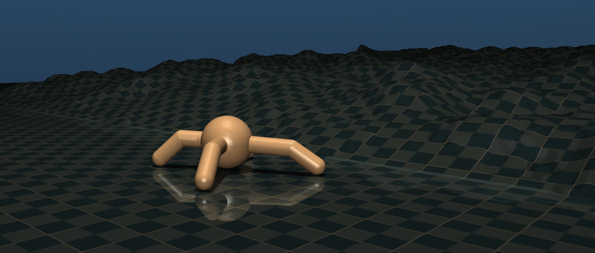

Hill terrain

Slide 7
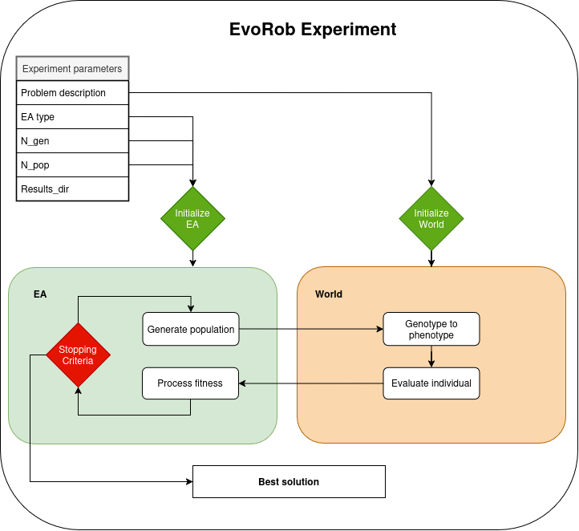
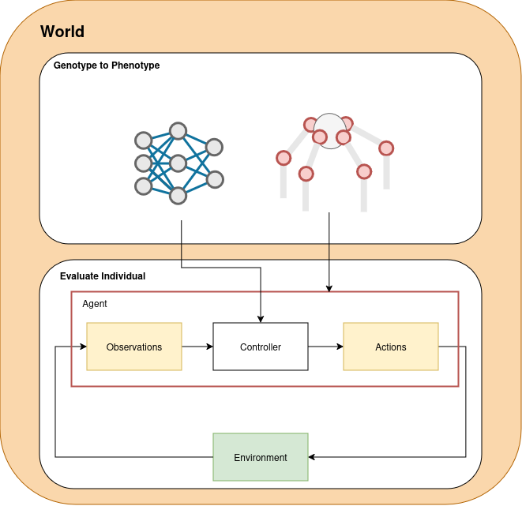


Focus on the world

Slide 8
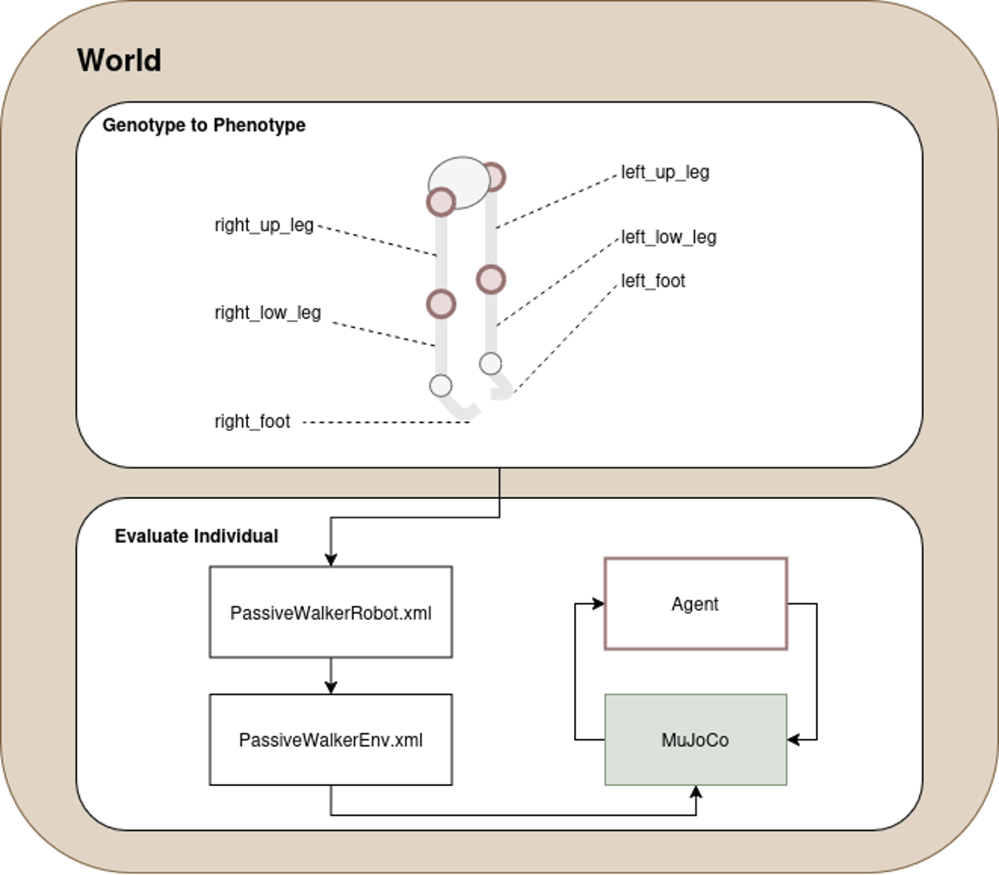
Co-evolving morphology and brain
Controller and Body evolution
Controller parameters
NN weights
Oscillatory network
Body segment lengths

Slide 9
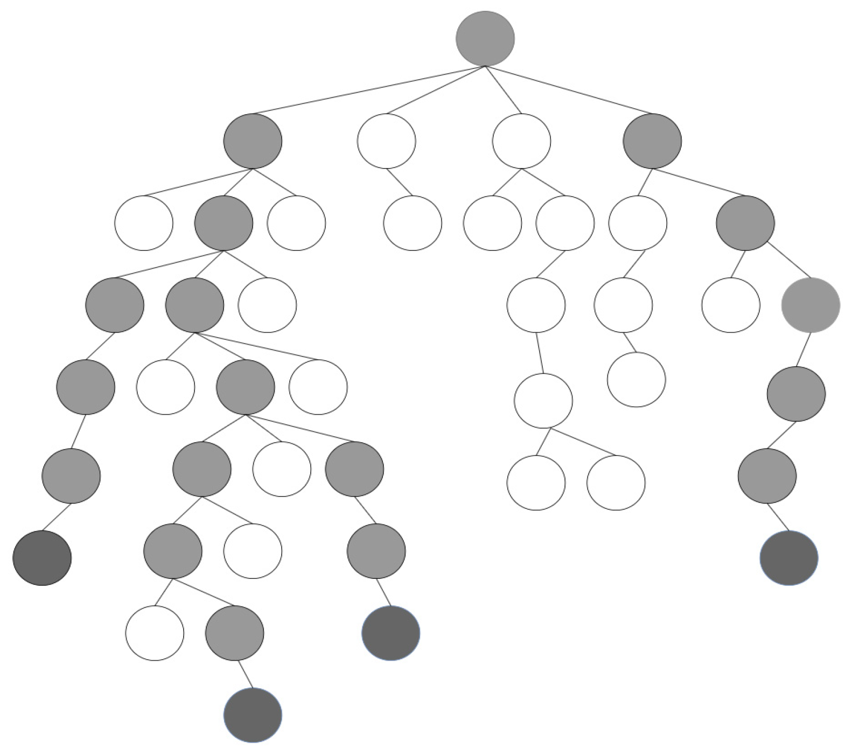
Refresher body representation
Tree-based representation

Slide 10
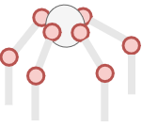
Joint position vector (Nx3)
Joint1 = (x₁,y₁,z₁)
Joint2 = (x₂,y₂,z₂)
...
Joint1
Joint2
JointN
points

Slide 11
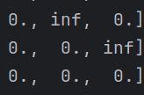
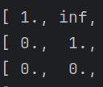
Connectivity matrix (NxN)
Joint1
Joint1 = (x₁,y₁,z₁)
Joint2
Joint2 = (x₂,y₂,z₂)
...
Joint3
Joint1
Joint2
Joint1
Joint2
JointN
Joint3
points
Connectivity_mat

Slide 12
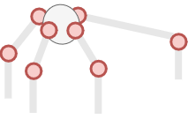
Body genotype
Joint1 = (x₁,y₁,z₁)
Joint2 = (x₂,y₂,z₂)
...
Joint1
Segment length
Joint2
JointN
points

Slide 13
Body genotype
Joint1 = (x₁,y₁,z₁)
Joint2 = (x₂,y₂,z₂)
...
Joint1
Segment length
Joint2
JointN
points

Slide 14
My next steps
1
# Pull from upstream solution file for NSGA-II
git remote add upstream <lis-git> # if not done yet
git pull upstream challenge2
git push # push your implementation to your fork
# Submit challenge2 today
Follow the submission instruction in doc/challenge2.md
# Start with challenge 3
git pull upstream challenge3
git checkout challenge3
Follow the instruction in doc/challenge3.md
2
3

