Slide 1
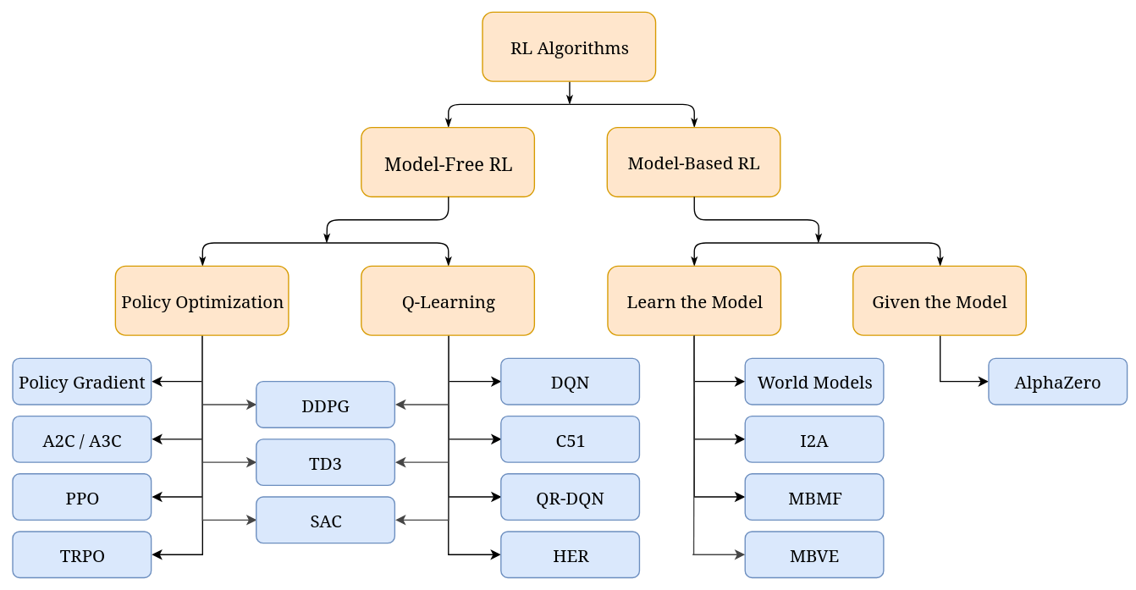
Introduction into PPO

Slide 2

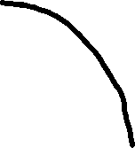




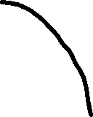
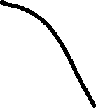
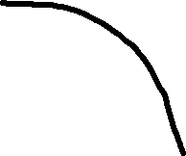

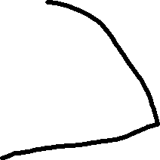
Policy Optimisation Training Loop
Policy Gradient Loop
1. Initialize weights θ of the policy π(s; θ)
While not done:
2. Run the policy until termination (rollout)
Record triplets (sₜ, aₜ, rₜ)
3. Compute total discounted return Rₜ
For N epochs
4. Compute gradient:
Δw = ∇ log P(aₜ | sₜ) · Rₜ
5. Update: θ ← θ + α Δw
Epoch N
Epoch 1
⚠ Problem: step size α can cause
catastrophically large updates →
training instability
PPO solves exactly this instability problem

Slide 3
The Policy Update Problem
Too large a step
Just right
Too small a step
Old policy π_old and new policy π_new become very different.
Estimated gradient was computed under π_old → it is no longer valid for the new policy.
Performance collapses.
New policy stays close enough to old policy.
Gradient estimate remains valid.
Steady, stable improvement.
Policy barely changes.
Learning is extremely slow.
May never reach good performance.
Key insight: we need to keep π_new close to π_old — measured by the probability ratio rₜ(θ) = π(aₜ|sₜ; θ) / π_old(aₜ|sₜ)

Slide 4
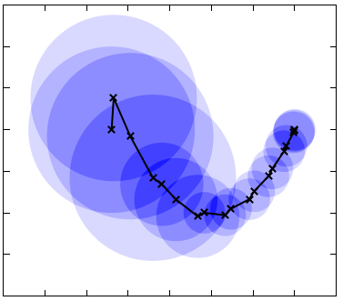
TRPO
TRPO (2015)
Trust Region Policy Optimization Idea: maximize policy improvement subject to a KL-divergence constraint: max L(θ) s.t. 𝔼[KL(π_old ‖ π_new)] ≤ δ ✔ Theoretically guarantees monotonic improvement
✘ Requires 2nd-order optimization (conjugate gradients)
✘ Incompatible with architectures that share parameters
✘ Very complex to implement
Limit update range

Slide 5
PPO Architecture & Training Loop
Actor-Critic Network
PPO
State sₜ
Idea: replace the hard constraint with a clipped objective — no complex loss needed. ✔ Simple 1st-order gradient descent (Adam)
✔ Compatible with shared actor-critic networks
✔ Works with mini-batches & multiple epochs
✔ State-of-the-art performance
✔ Default algorithm in OpenAI Gym benchmarks
Shared backbone
↙
↘
ACTOR
π(s; θ_π)
→ P(a|s)
CRITIC
V(s; θ_V)
→ scalar
Full loss: L = L^CLIP − c₁·(V − Vᵗᵃʳ)² + c₂·entropy

Slide 6
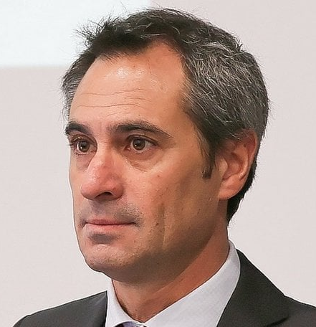
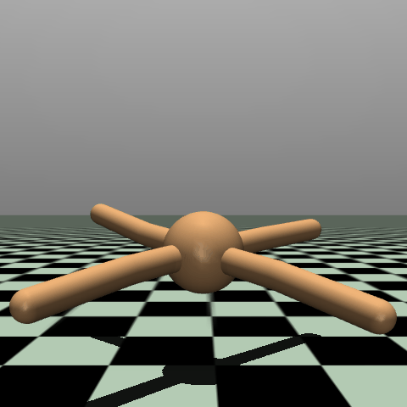

Challenge1: Evolving Neural controllers with Gym

Slide 7
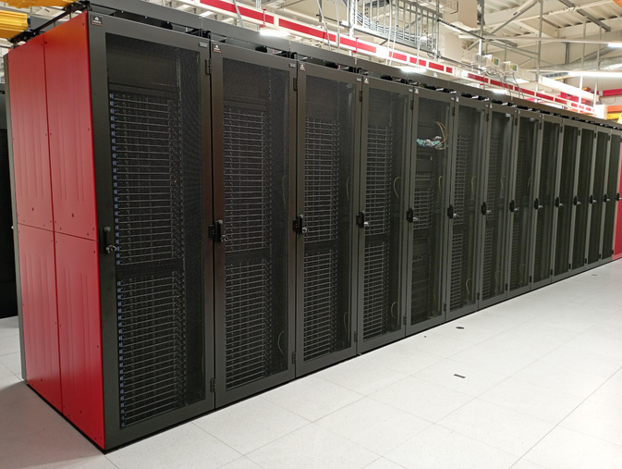
Setting up the cluster
1
# Make your git ready for cluster usage
git remote add upstream <lis-git> # if not done yet
git pull upstream challenge1
git push # push your implementation to your fork
# Setup your account on HPC-cluster
ssh -l <username> jed.hpc.epfl.ch
module purge # prepare your python environment
module load gcc python py-virtualenv
mkdir ER_course cd ER_course git clone <your_fork_url> cd micro-515-EvoRob
Git checkout challenge1 python3.11 -m venv .venv source .venv/bin/activate pip install -r requirements.txt # Install your fork
2

Slide 8
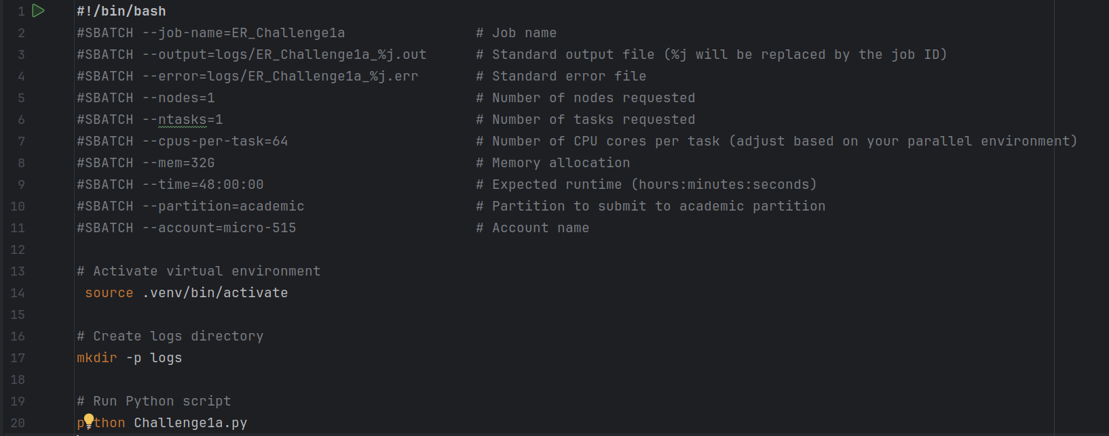
Running on the cluster
3
# Run inside your project
sbatch run_challenge1a.sh sbatch run_challenge1b.sh sbatch run_challenge1c.sh

Slide 9
Setting up the cluster
1
# Make your git ready for cluster usage
git remote add upstream <lis-git> # if not done yet
git pull upstream challenge1
git push # push your implementation to your fork
# Setup your account on HPC-cluster
ssh -l <username> jed.hpc.epfl.ch
module purge # prepare your python environment
module load gcc python py-virtualenv
mkdir ER_course cd ER_course git clone <your_fork_url> cd micro-515-EvoRob
Git checkout challenge1 python3.11 -m venv .venv source .venv/bin/activate pip install -r requirements.txt # Install your fork
2
Step-by-step guidance: https://github.com/lis-epfl/micro-515-EvoRob/blob/challenge1/doc/jed_cluster_guide.md

