Slide 1
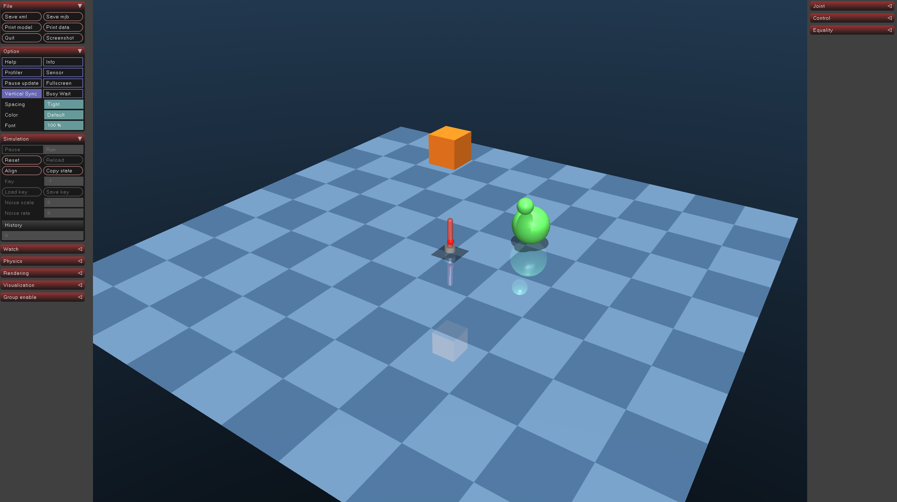
Introduction0a

Slide 2
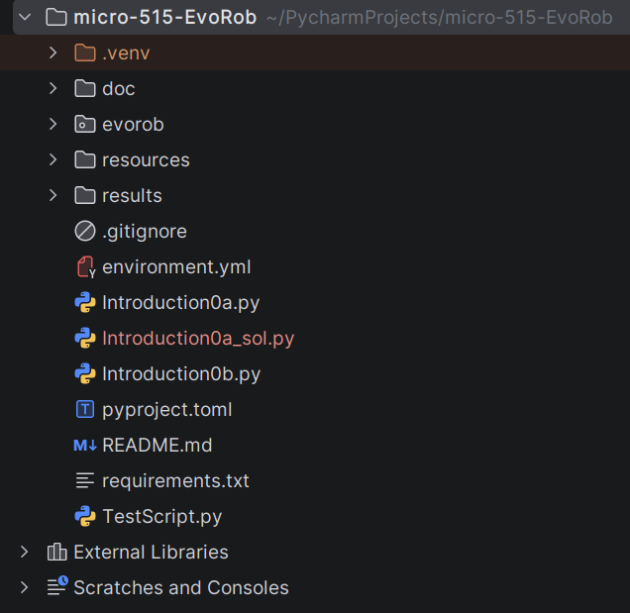
Introduction0a
Solution of previous exercise is now available:
https://github.com/lis-epfl/micro-515-EvoRob/tree/introduction0

Slide 3





Introduction0a
Solution of previous exercise is now available:
https://github.com/lis-epfl/micro-515-EvoRob/tree/introduction0

Slide 4
Introduction0a
Solution of previous exercise is now available:
https://github.com/lis-epfl/micro-515-EvoRob/tree/introduction0
git pull upstream introduction0

Slide 5
Introduction0a
Solution of previous exercise is now available:
https://github.com/lis-epfl/micro-515-EvoRob/tree/introduction0
git pull upstream introduction0
git push

Slide 6
Introduction0b: Custom ES for body evolution in MuJoCo
https://www.youtube.com/watch?v=s_oczXN5hdg

Slide 7
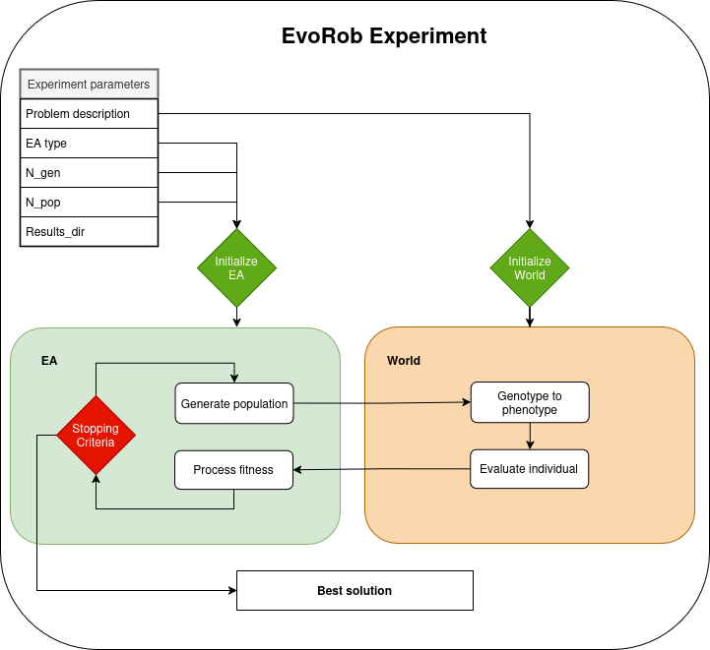
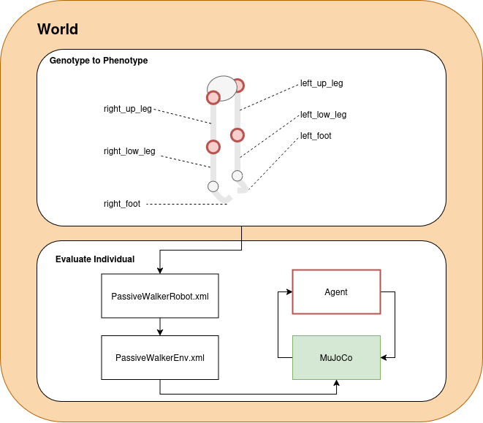
Introduction0b: Custom ES for body evolution in MuJoCo

Slide 8
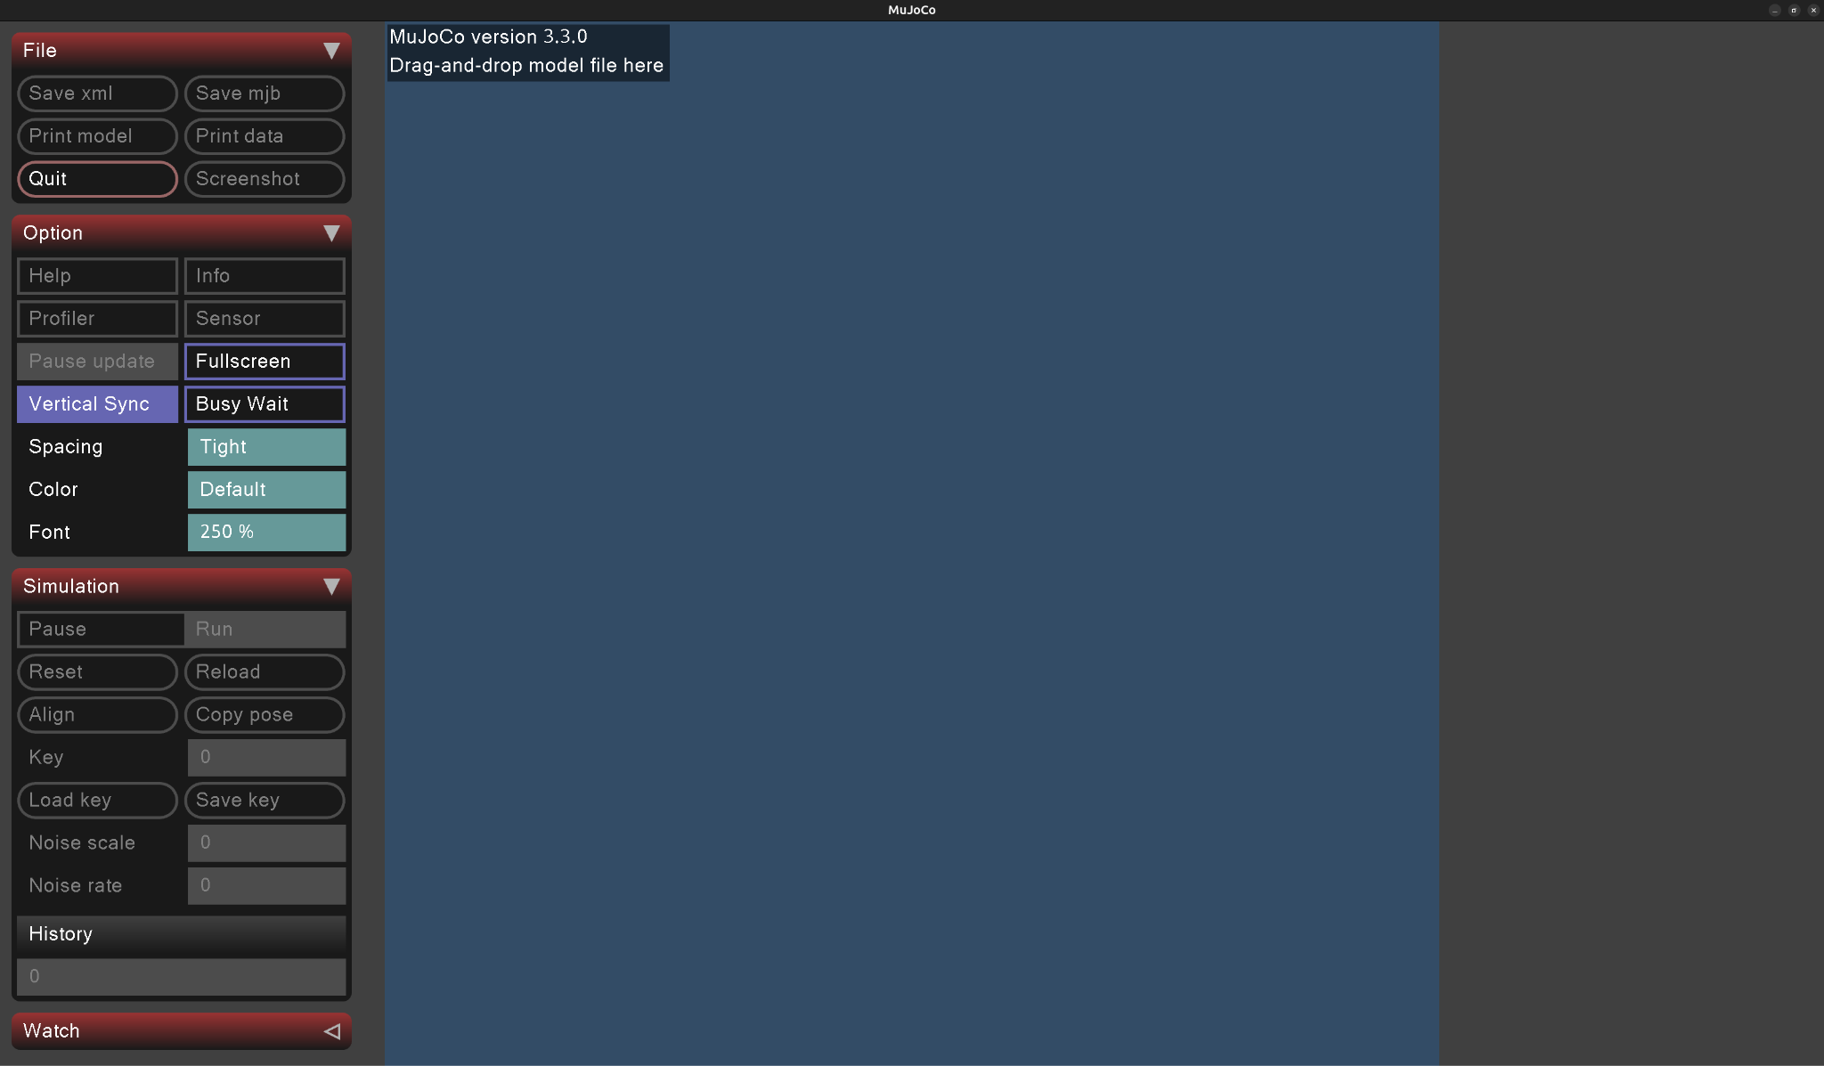

Passive dynamic walker environment
PassiveWalkerWorld.xml

Slide 9
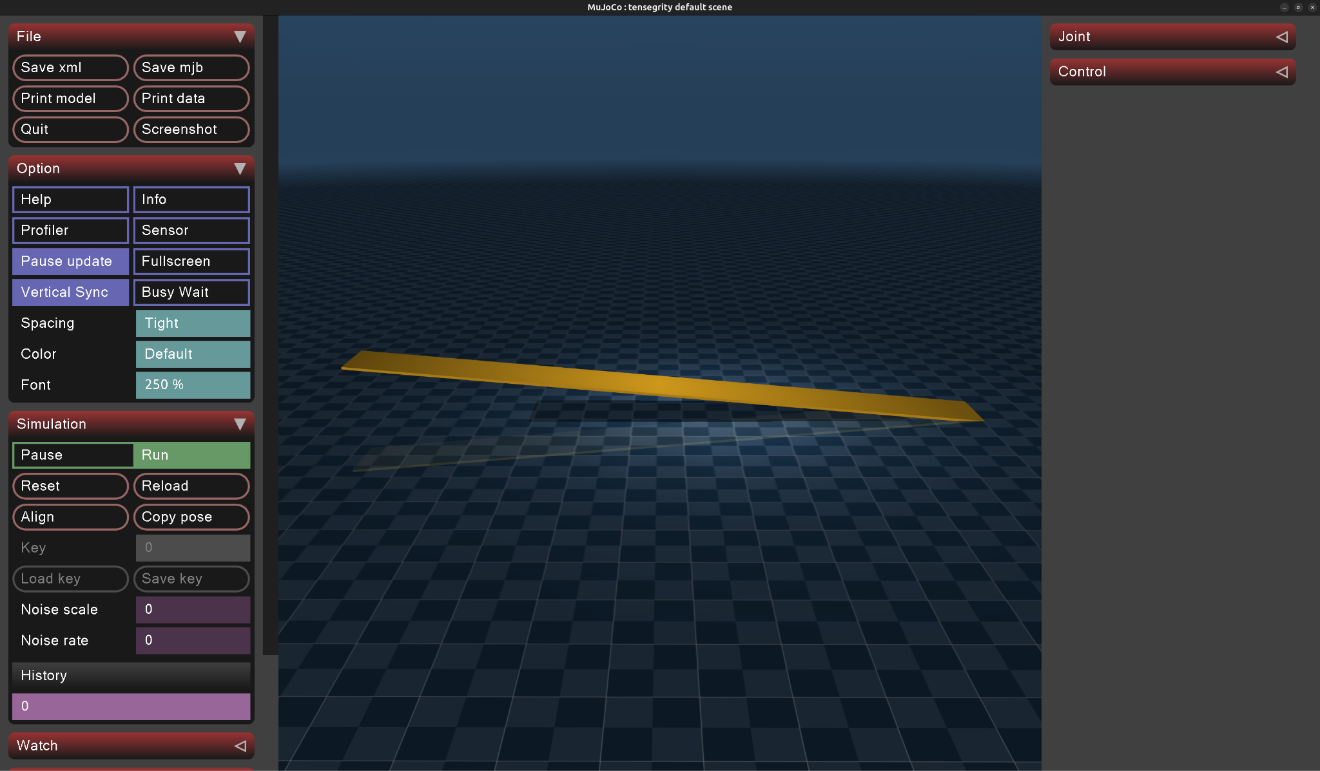
Passive dynamic walker environment
PassiveWalkerWorld.xml

Slide 10


Passive dynamic walker environment
Geno2Pheno
EA
PassiveWalkerRobot.xml
PassiveWalkerWorld.xml
PassiveWalkerEnv.xml

Slide 11
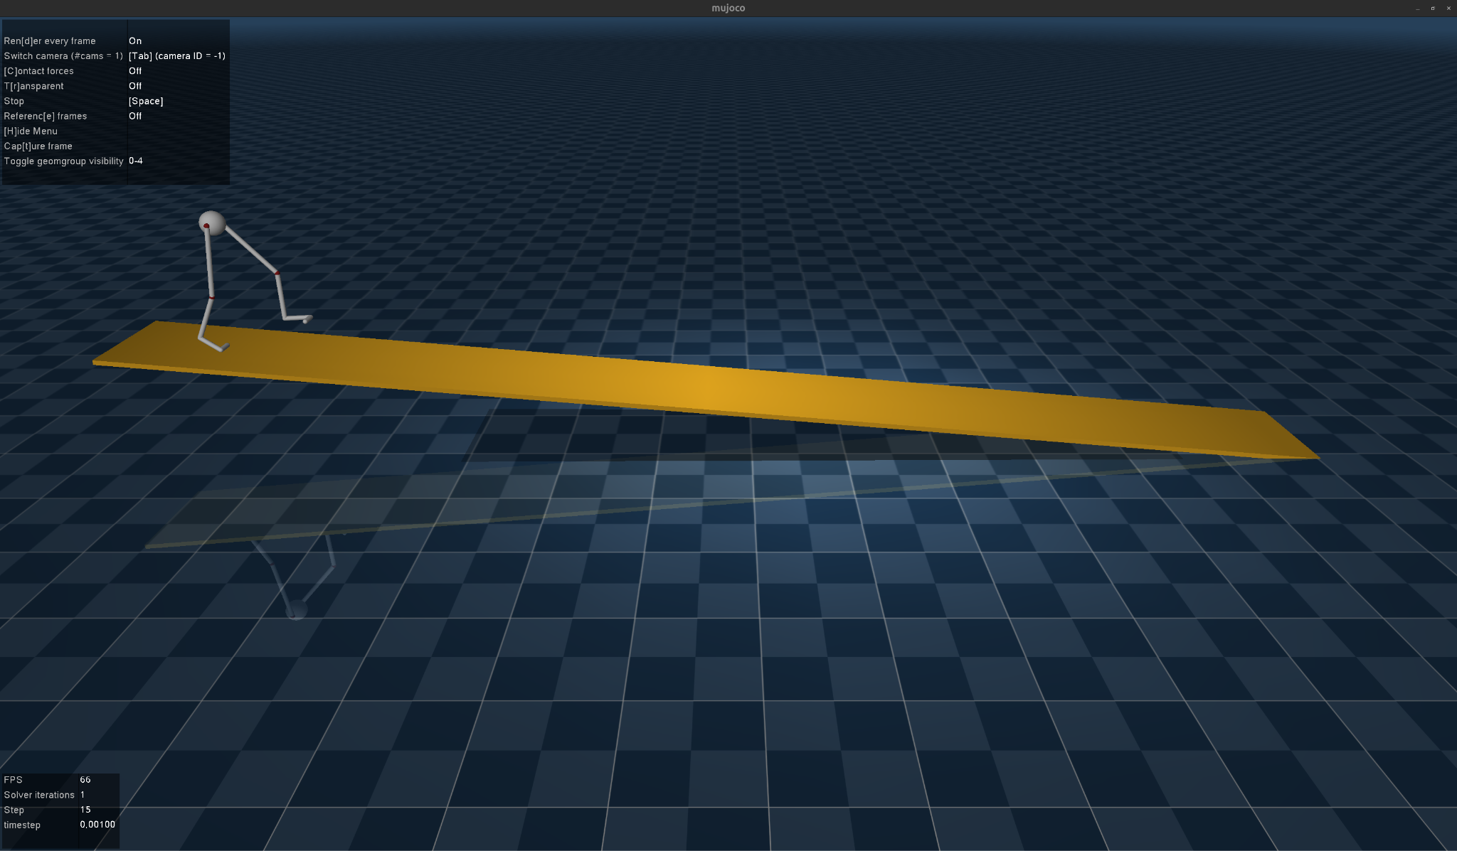
Passive dynamic walker environment
PassiveWalkerEnv.xml

Slide 12
Introduction0b: Passive dynamic walker representation

Slide 13
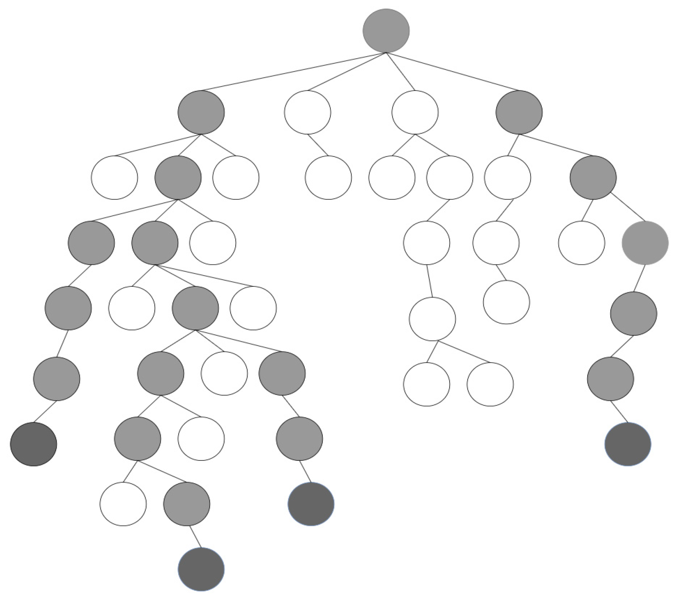
Introduction0b: Passive dynamic walker representation
Tree-based representation

Slide 14
Introduction0b: Passive dynamic walker representation
Tree-based representation
Joint1 = (x₁,y₁,z₁)
Joint2 = (x₂,y₂,z₂)
Joint3 = (x₃,y₃,z₃)
points

Slide 15
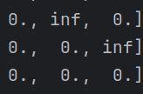
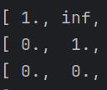
Introduction0b: Passive dynamic walker representation
Joint1
Tree-based representation
Joint2
Joint3
Joint1
Joint2
Joint3
points
Connectivity_mat

Slide 16
Introduction0b: Passive dynamic walker representation
Tree-based representation
points
Connectivity_mat

Slide 17
Introduction0b: Passive dynamic walker representation
Tree-based representation
Fixed architecture!
points
Connectivity_mat

Slide 18
Introduction0b: Passive dynamic walker representation
Tree-based representation
Fixed architecture!
Only need to define segment length
(i.e. points)
points
Connectivity_mat

Slide 19
Introduction0b: Passive dynamic walker representation
Tree-based representation
Segment length encoding (genotype)

Slide 20
Introduction0b: Custom ES for body evolution in MuJoCo
Tree-based representation
Segment length encoding (genotype)
Evolutionary Strategy optimises segment lengths
ES -> Genotype 2 Phenotype -> Evaluate Individual -> Fitness -> ES

Slide 21
Introduction0b: Custom ES for body evolution in MuJoCo
git remote add upstream <lis-git> git pull upstream introduction0
Check your answers introduction0a_sol.py
Update your fork: git push
Start second part of introduction0
https://github.com/lis-epfl/micro-515-EvoRob/tree/introduction0

Slide 22
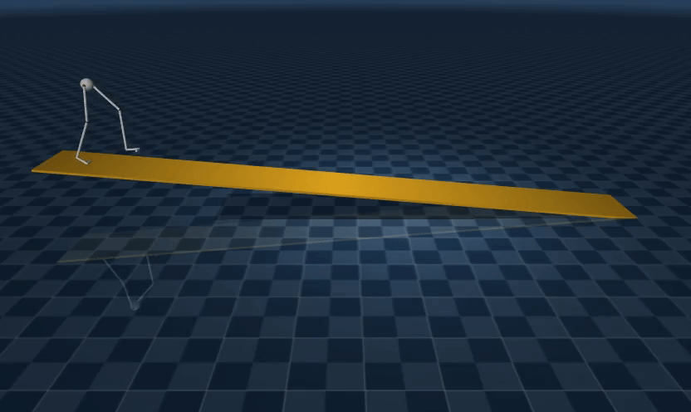
Introduction0b: Custom ES for body evolution in MuJoCo

