Slide 1
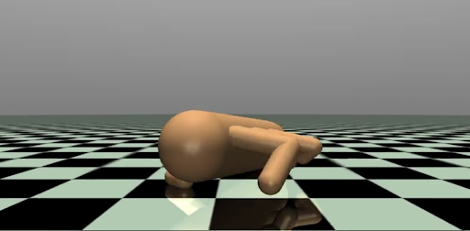
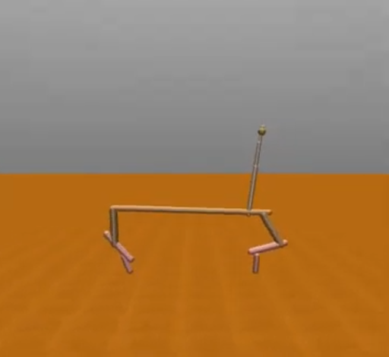
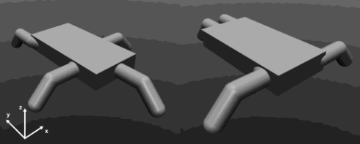
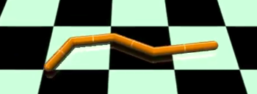
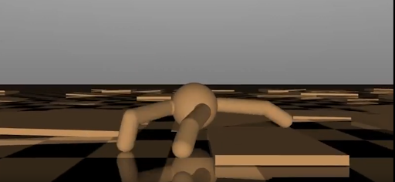
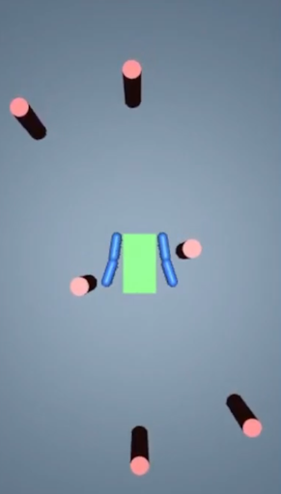
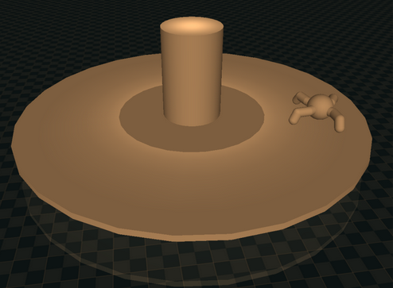
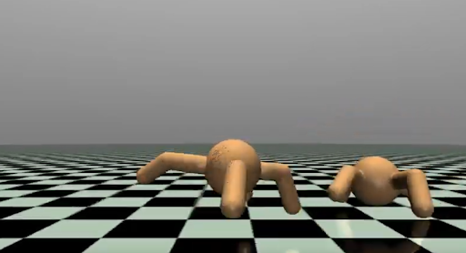
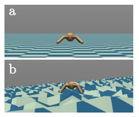

Slide 2

Practical: Overview
All practical sessions use: https://github.com/lis-epfl/micro-515-EvoRob
Exam
Poster
Lectures
Practical
Introduction
Challenge 1
Challenge 2
Challenge 3
Final Project
Notes:
This is a general overview of the practicals during the course. At the start there is an emphasis on theory (i.e. lectures) but slowly we will focus more on hands-on experience of EC. At the end we expect a report on a evolutionary robotics experiment around the same time the exam period starts.

Slide 3
Practical: Overview
All practical sessions use: https://github.com/lis-epfl/micro-515-EvoRob
Introduction [wk 1-2]
Exam
Poster
Lectures
Practical
Introduction
Challenge 1
Challenge 2
Challenge 3
Final Project
Notes:
This is a general overview of the practicals during the course. At the start there is an emphasis on theory (i.e. lectures) but slowly we will focus more on hands-on experience of EC. At the end we expect a report on a evolutionary robotics experiment around the same time the exam period starts.

Slide 4
Practical: Overview
All practical sessions use: https://github.com/lis-epfl/micro-515-EvoRob
Introduction [wk 1-2]
  Install software
  Introduction exercises
  Form groups of 2
Exam
Poster
Lectures
Practical
Introduction
Challenge 1
Challenge 2
Challenge 3
Final Project
Notes:
This is a general overview of the practicals during the course. At the start there is an emphasis on theory (i.e. lectures) but slowly we will focus more on hands-on experience of EC. At the end we expect a report on a evolutionary robotics experiment around the same time the exam period starts.

Slide 5
Practical: Overview
All practical sessions use: https://github.com/lis-epfl/micro-515-EvoRob
Introduction [wk 1-2]
Challenges [wk 3-9]
Exam
Poster
Lectures
Practical
Introduction
Challenge 1
Challenge 2
Challenge 3
Final Project
Notes:
This is a general overview of the practicals during the course. At the start there is an emphasis on theory (i.e. lectures) but slowly we will focus more on hands-on experience of EC. At the end we expect a report on a evolutionary robotics experiment around the same time the exam period starts.

Slide 6
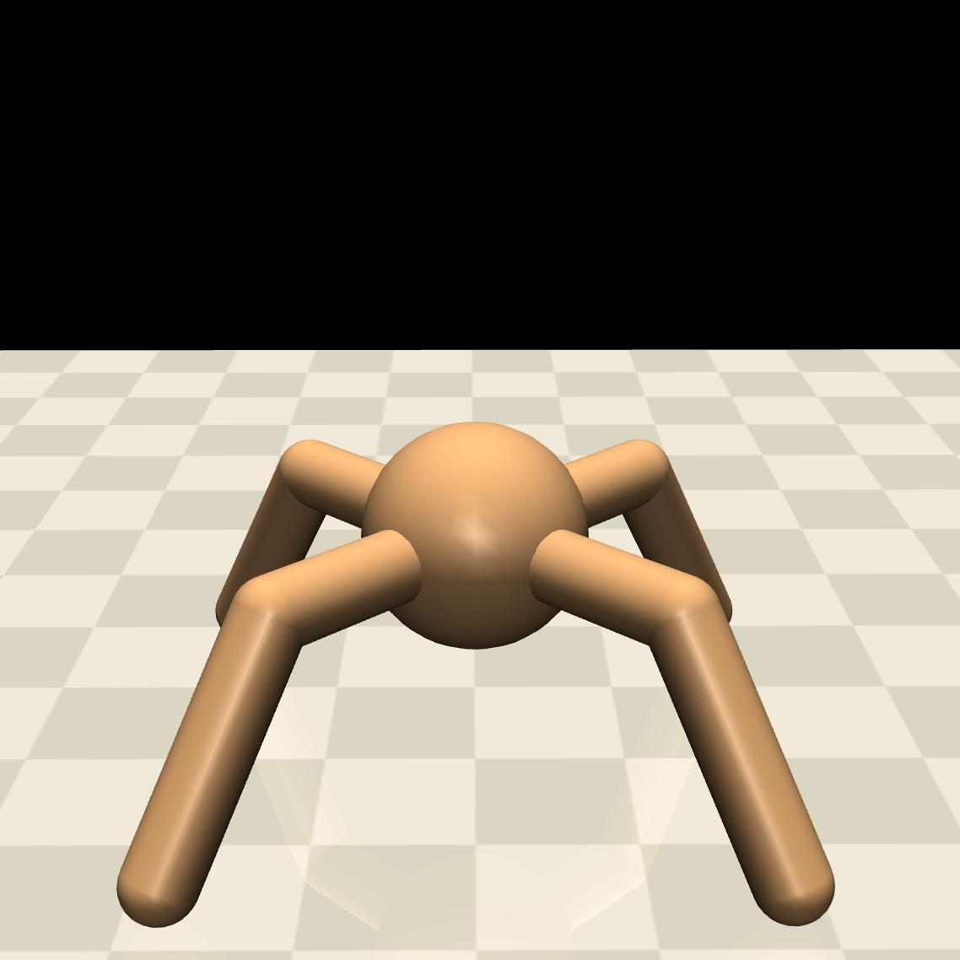
Practical: Overview
All practical sessions use: https://github.com/lis-epfl/micro-515-EvoRob
Introduction [wk 1-2]
Challenges [wk 3-9]
Exam
Poster
Lectures
Practical
Introduction
Challenge 1
Challenge 2
Challenge 3
Final Project
Notes:
This is a general overview of the practicals during the course. At the start there is an emphasis on theory (i.e. lectures) but slowly we will focus more on hands-on experience of EC. At the end we expect a report on a evolutionary robotics experiment around the same time the exam period starts.

Slide 7



Practical: Overview
All practical sessions use: https://github.com/lis-epfl/micro-515-EvoRob
Introduction [wk 1-2]
Challenges [wk 3-9]
Each challenge has different biomes
Notes:
This is a general overview of the practicals during the course. At the start there is an emphasis on theory (i.e. lectures) but slowly we will focus more on hands-on experience of EC. At the end we expect a report on a evolutionary robotics experiment around the same time the exam period starts.

Slide 8
Practical: Overview
All practical sessions use: https://github.com/lis-epfl/micro-515-EvoRob
Introduction [wk 1-2]
Challenges [wk 3-9]
Each challenge has different biomes
- Evolve and submit
Notes:
This is a general overview of the practicals during the course. At the start there is an emphasis on theory (i.e. lectures) but slowly we will focus more on hands-on experience of EC. At the end we expect a report on a evolutionary robotics experiment around the same time the exam period starts.

Slide 9
Practical: Overview
All practical sessions use: https://github.com/lis-epfl/micro-515-EvoRob
Introduction [wk 1-2]
Challenges [wk 3-9]
Each challenge has different biomes
- Evolve and submit
- We evaluate each biome
Notes:
This is a general overview of the practicals during the course. At the start there is an emphasis on theory (i.e. lectures) but slowly we will focus more on hands-on experience of EC. At the end we expect a report on a evolutionary robotics experiment around the same time the exam period starts.

Slide 10
Practical: Overview
All practical sessions use: https://github.com/lis-epfl/micro-515-EvoRob
Introduction [wk 1-2]
Challenges [wk 3-9]
Each challenge has different biomes
- Evolve and submit
- We evaluate each biome
At the end of a challenge
Top 3 → 0.25 Bonus points/biome [final project]
Notes:
This is a general overview of the practicals during the course. At the start there is an emphasis on theory (i.e. lectures) but slowly we will focus more on hands-on experience of EC. At the end we expect a report on a evolutionary robotics experiment around the same time the exam period starts.

Slide 11
Practical: Overview
All practical sessions use: https://github.com/lis-epfl/micro-515-EvoRob
Introduction [wk 1-2]
Challenges [wk 3-9] → Bonus points
Final Project [wk 10-15]
Exam
Poster
Lectures
Practical
Introduction
Challenge 1
Challenge 2
Challenge 3
Final Project
Notes:
This is a general overview of the practicals during the course. At the start there is an emphasis on theory (i.e. lectures) but slowly we will focus more on hands-on experience of EC. At the end we expect a report on a evolutionary robotics experiment around the same time the exam period starts.

Slide 12
Practical: Overview
All practical sessions use: https://github.com/lis-epfl/micro-515-EvoRob
Introduction [wk 1-2]
Challenges [wk 3-9] → Bonus points
Final Project [wk 10-15]
?
Notes:
This is a general overview of the practicals during the course. At the start there is an emphasis on theory (i.e. lectures) but slowly we will focus more on hands-on experience of EC. At the end we expect a report on a evolutionary robotics experiment around the same time the exam period starts.

Slide 13






Practical: Overview
All practical sessions use: https://github.com/lis-epfl/micro-515-EvoRob
Introduction [wk 1-2]
Challenges [wk 3-9] → Bonus points
Final Project [wk 10-15] → Graded poster session
Final project is graded during a poster session [28-5]
Notes:
This is a general overview of the practicals during the course. At the start there is an emphasis on theory (i.e. lectures) but slowly we will focus more on hands-on experience of EC. At the end we expect a report on a evolutionary robotics experiment around the same time the exam period starts.

Slide 14
Practical: Overview
All practical sessions use: https://github.com/lis-epfl/micro-515-EvoRob
Introduction [wk 1-2]
Challenges [wk 3-9] → Bonus points
Final Project [wk 10-15] → Graded poster session
Final project is graded during a poster session [28-5]
Project grade = Poster grade + bonus points [max. 6]
Notes:
This is a general overview of the practicals during the course. At the start there is an emphasis on theory (i.e. lectures) but slowly we will focus more on hands-on experience of EC. At the end we expect a report on a evolutionary robotics experiment around the same time the exam period starts.

Slide 15
Practical: Overview
All practical sessions use: https://github.com/lis-epfl/micro-515-EvoRob
Introduction [wk 1-2]
Challenges [wk 3-9] → Bonus points
Final Project [wk 10-15] → Graded poster session
  Project grade = Poster grade + bonus points [max. 6]
Exam
Poster
Final grade = (Project grade + Exam grade) / 2
Lectures
Practical
Introduction
Challenge 1
Challenge 2
Challenge 3
Final Project
Notes:
This is a general overview of the practicals during the course. At the start there is an emphasis on theory (i.e. lectures) but slowly we will focus more on hands-on experience of EC. At the end we expect a report on a evolutionary robotics experiment around the same time the exam period starts.

Slide 16

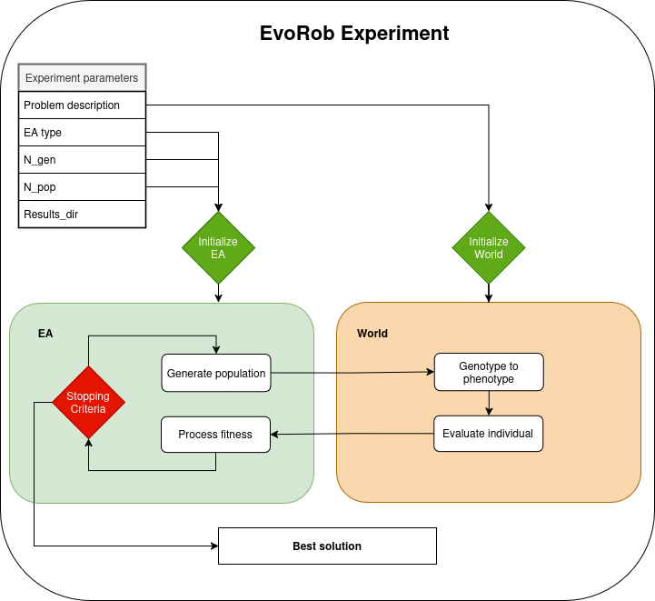
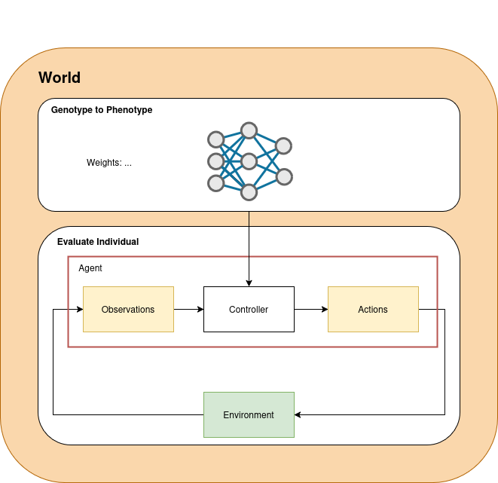

EvoRob
Notes:
Zooming in on the software framework we see that we will use many tools that rely on eachother

Slide 17
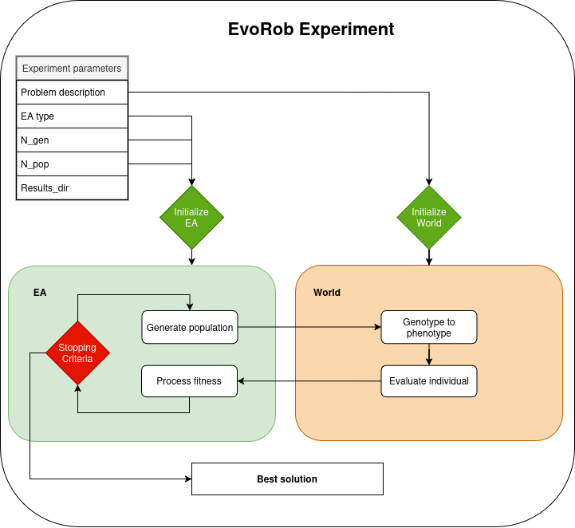
EvoRob
Notes:
The main focus of the exercises is on the understanding of this software architecture (a evolutionary robotics experiment pipeline).

Slide 18
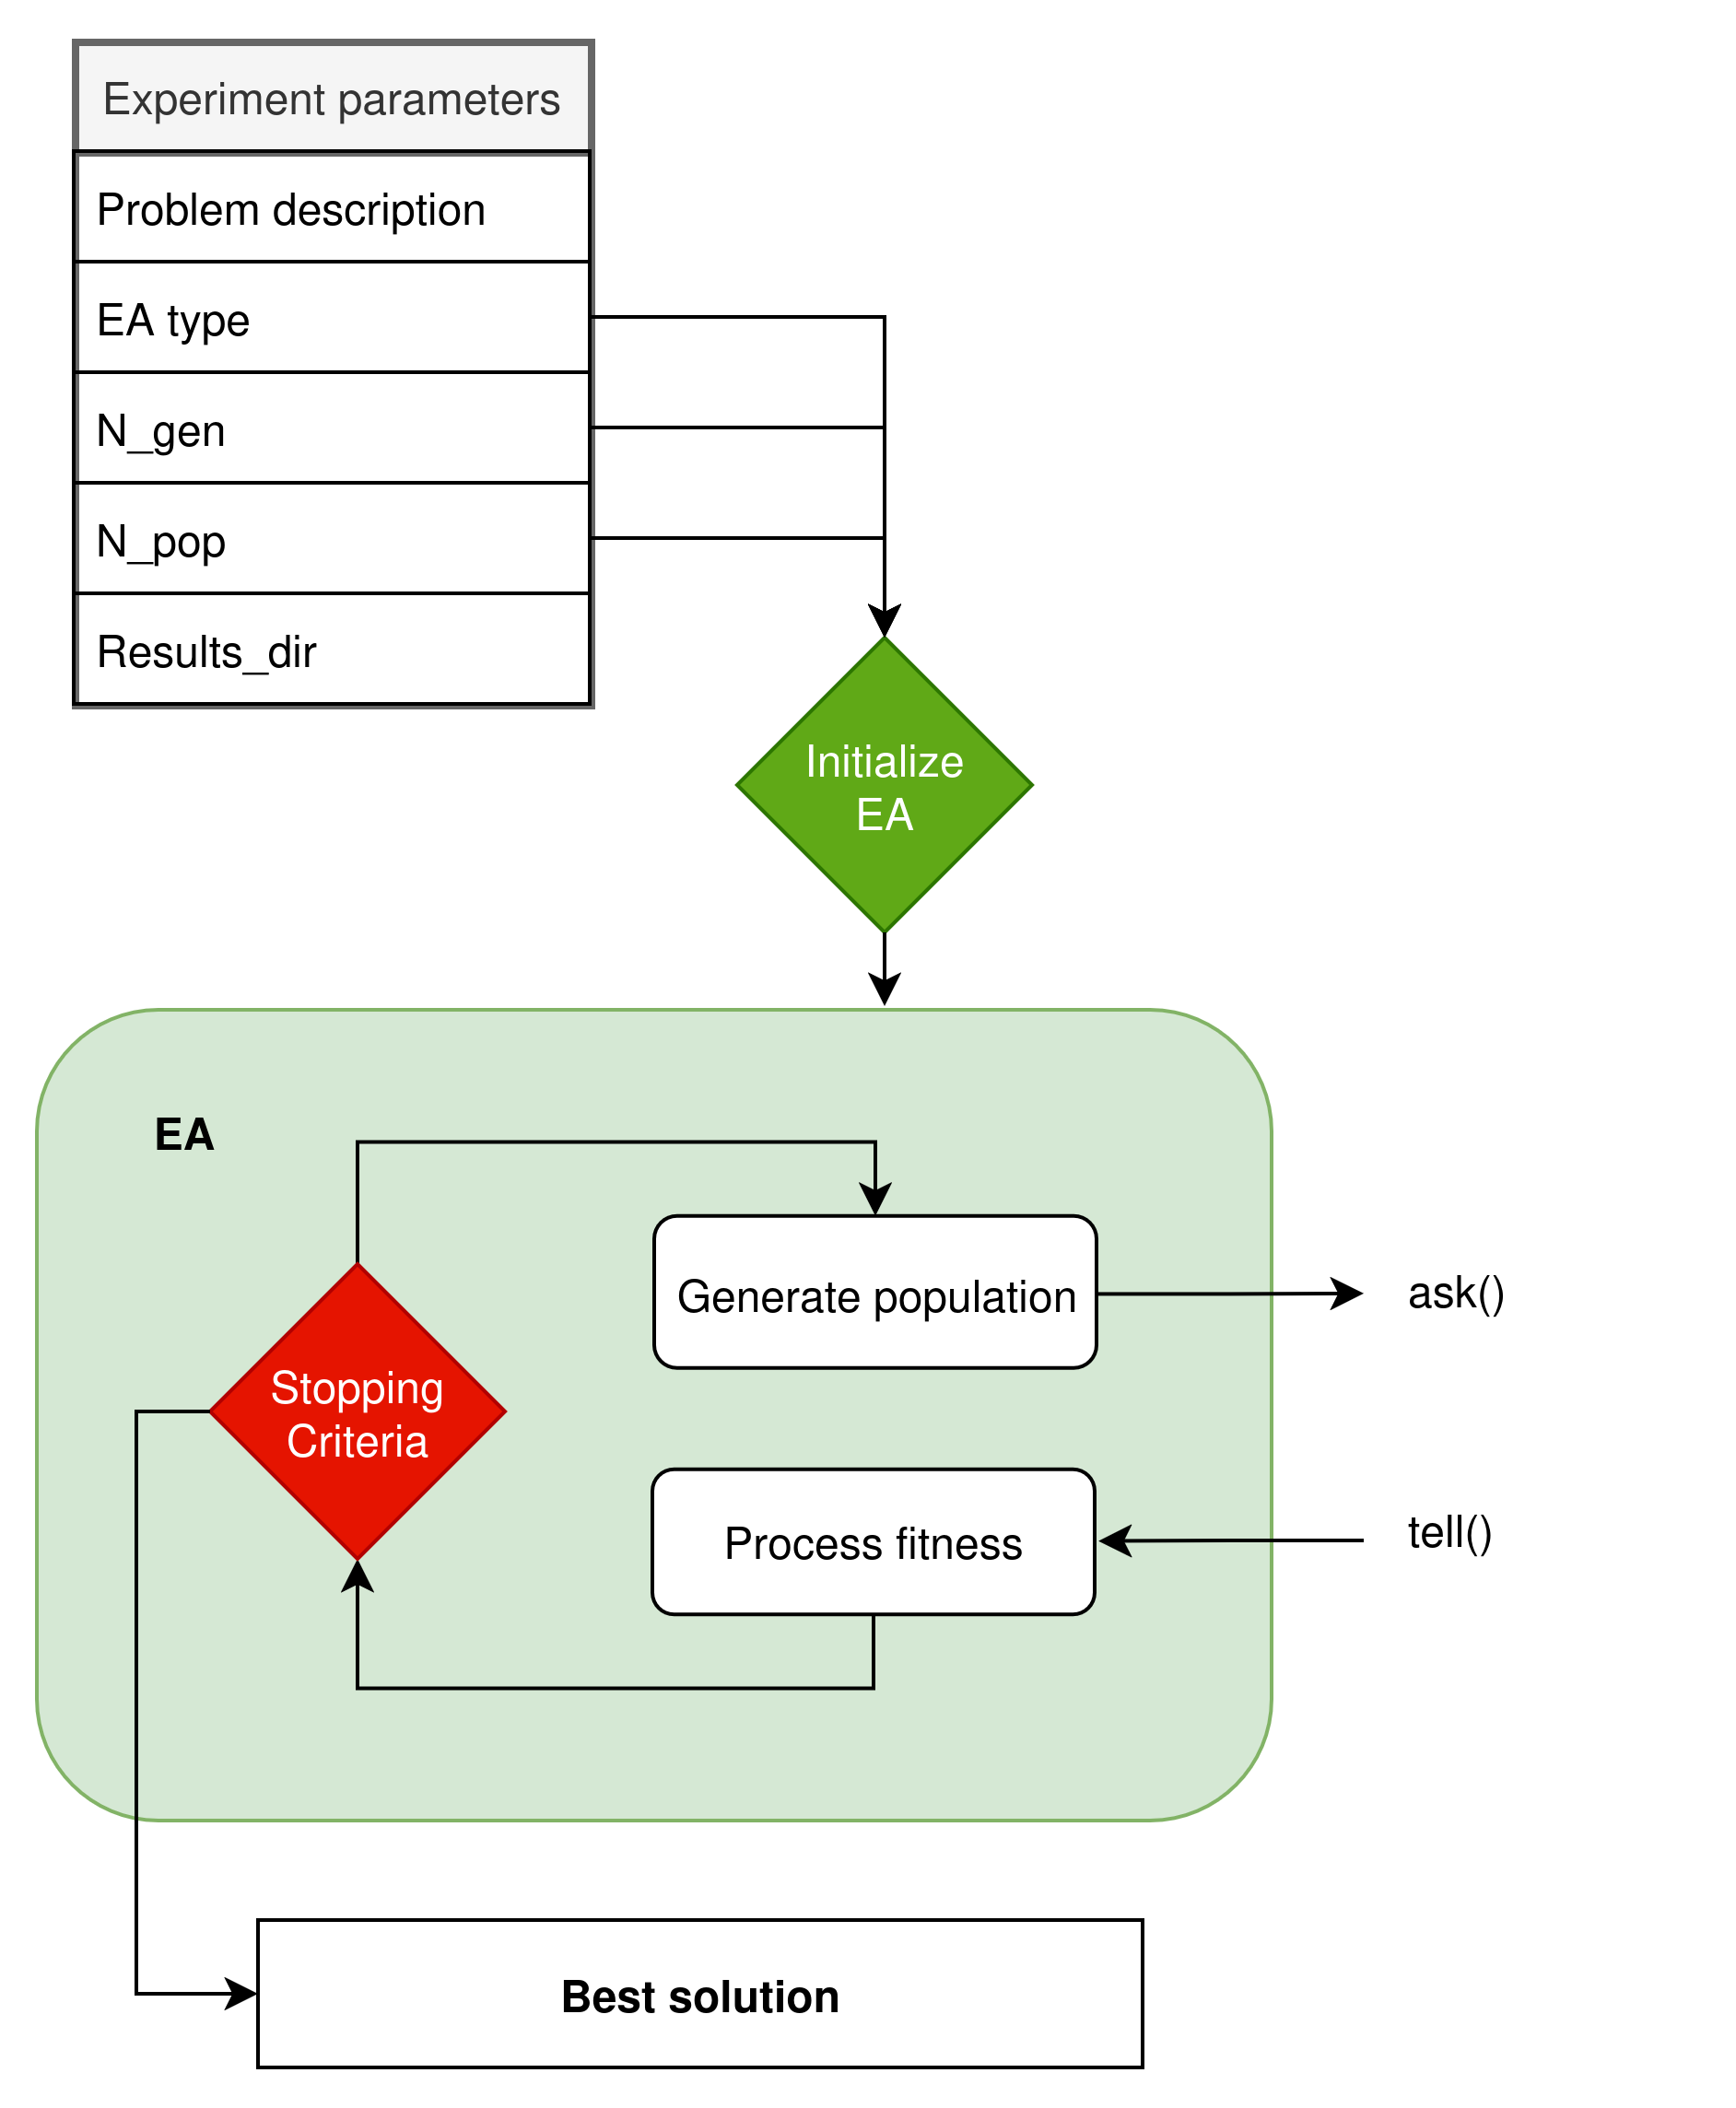
EvoRob: EA
Evolutionary Algorithm
Implement our own EA with Ask/Tell interface
  ES
  NSGA-II
How to use state-of-the art libraries
  Pyribs
  OpenAI-ES
Notes:
The main focus of the exercises is on the understanding of this software architecture (a evolutionary robotics experiment pipeline).

Slide 19
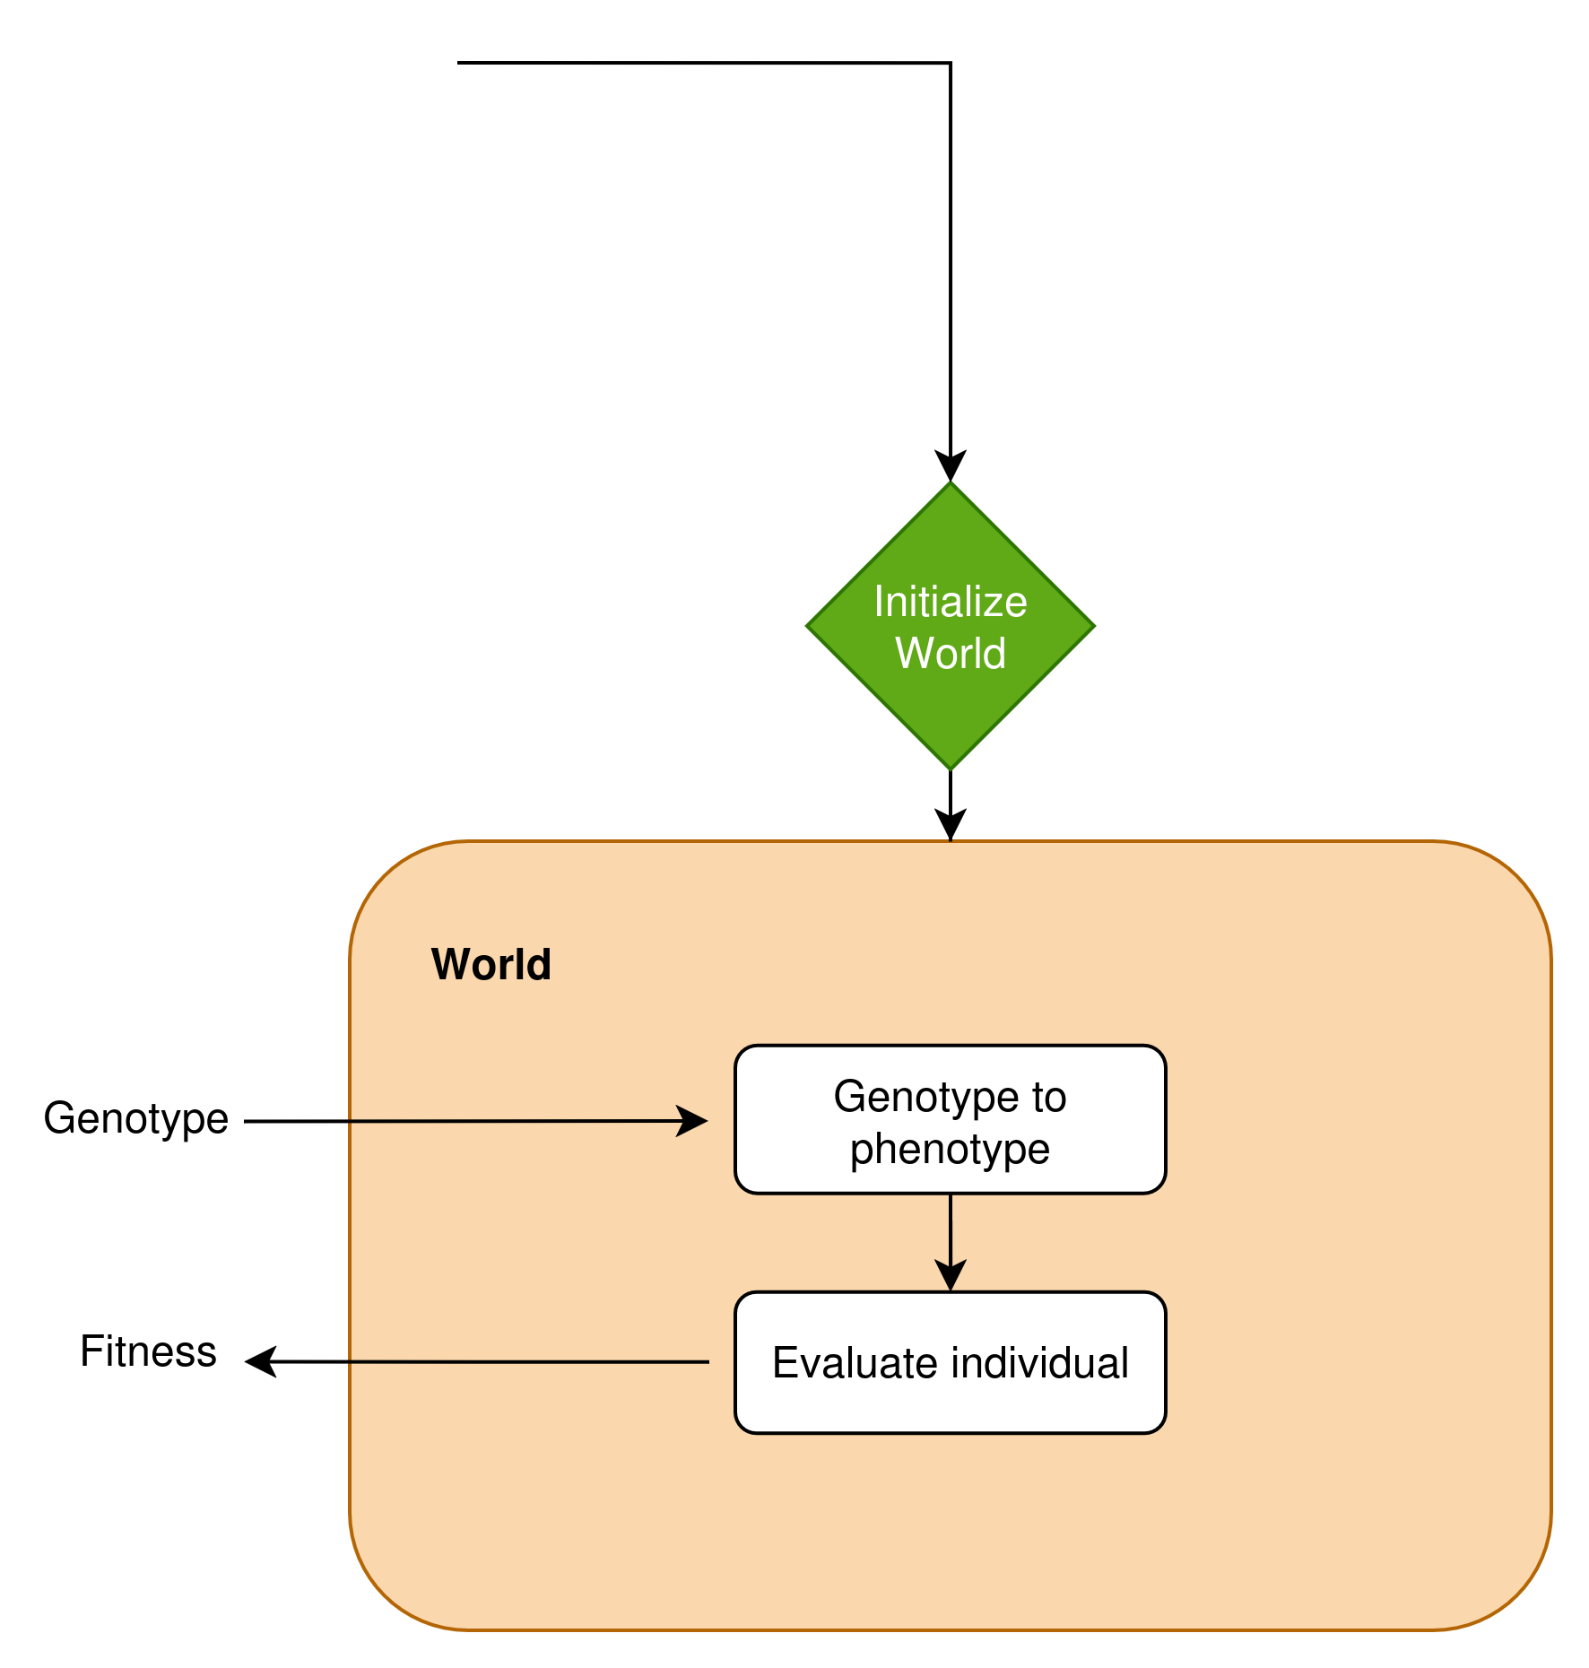
EvoRob: World
World
Genotype translates into a phenotype
Evaluate the fitness of the phenotype
Notes:
We start making our problems harder and more complex using SOTA software

Slide 20
EvoRob: World
Translate genomes → robots → fitnesses
We need:
Simulation environment
Physics engine
Notes:
We start making our problems harder and more complex using SOTA software

Slide 21
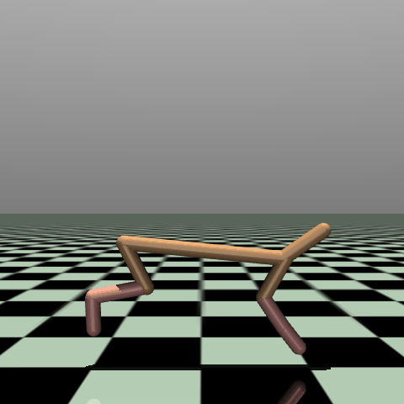
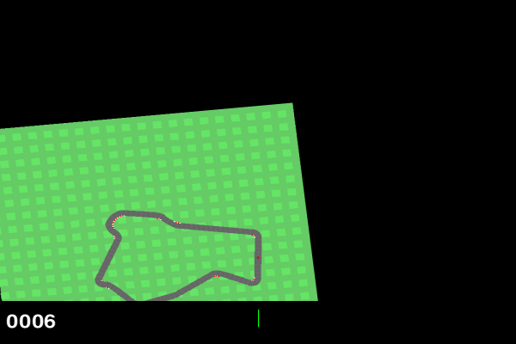
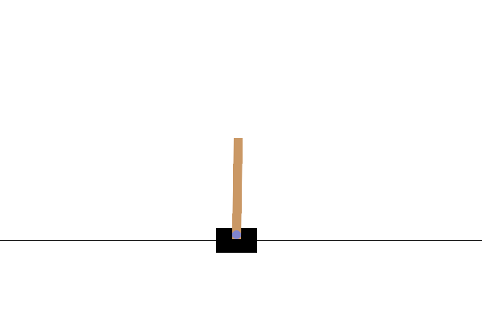

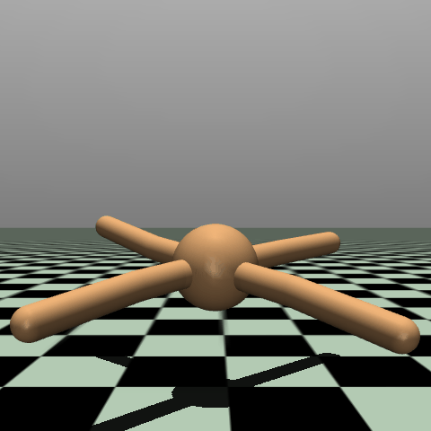

Gym environments
(OpenAI) Gym: simulation environment
Notes:
OpenAI gym is a set of dynamic testing environments that ‘ready-to-go’. They are widely used in robot learning because of their simple interface

Slide 22
Gym environments
Translate genomes → robots → fitnesses
We need:
Simulation environment (gym)
  Interface any gym environment
  Customize our own
  Off-the-shelve algorithms
    PPO (reinforcement learning)
    Stable baselines
Physics engine
Notes:
We start making our problems harder and more complex using SOTA software

Slide 23
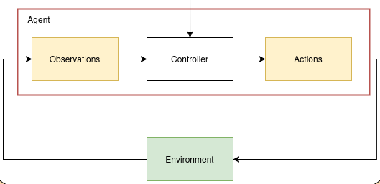
MuJoCo
Translate genomes → robots → fitnesses
We need:
Simulation environment (gym)
Physics engine (MuJoCo)
  Change physics interaction
  Customize environments
  Understand speed-accuracy trade-offs
Notes:
OpenAI gym environments often use high-end physics engines to update the environment.
In our exercises we will use the same MuJoCo physics engine to create a custom environment suitable for robot evolution

Slide 24
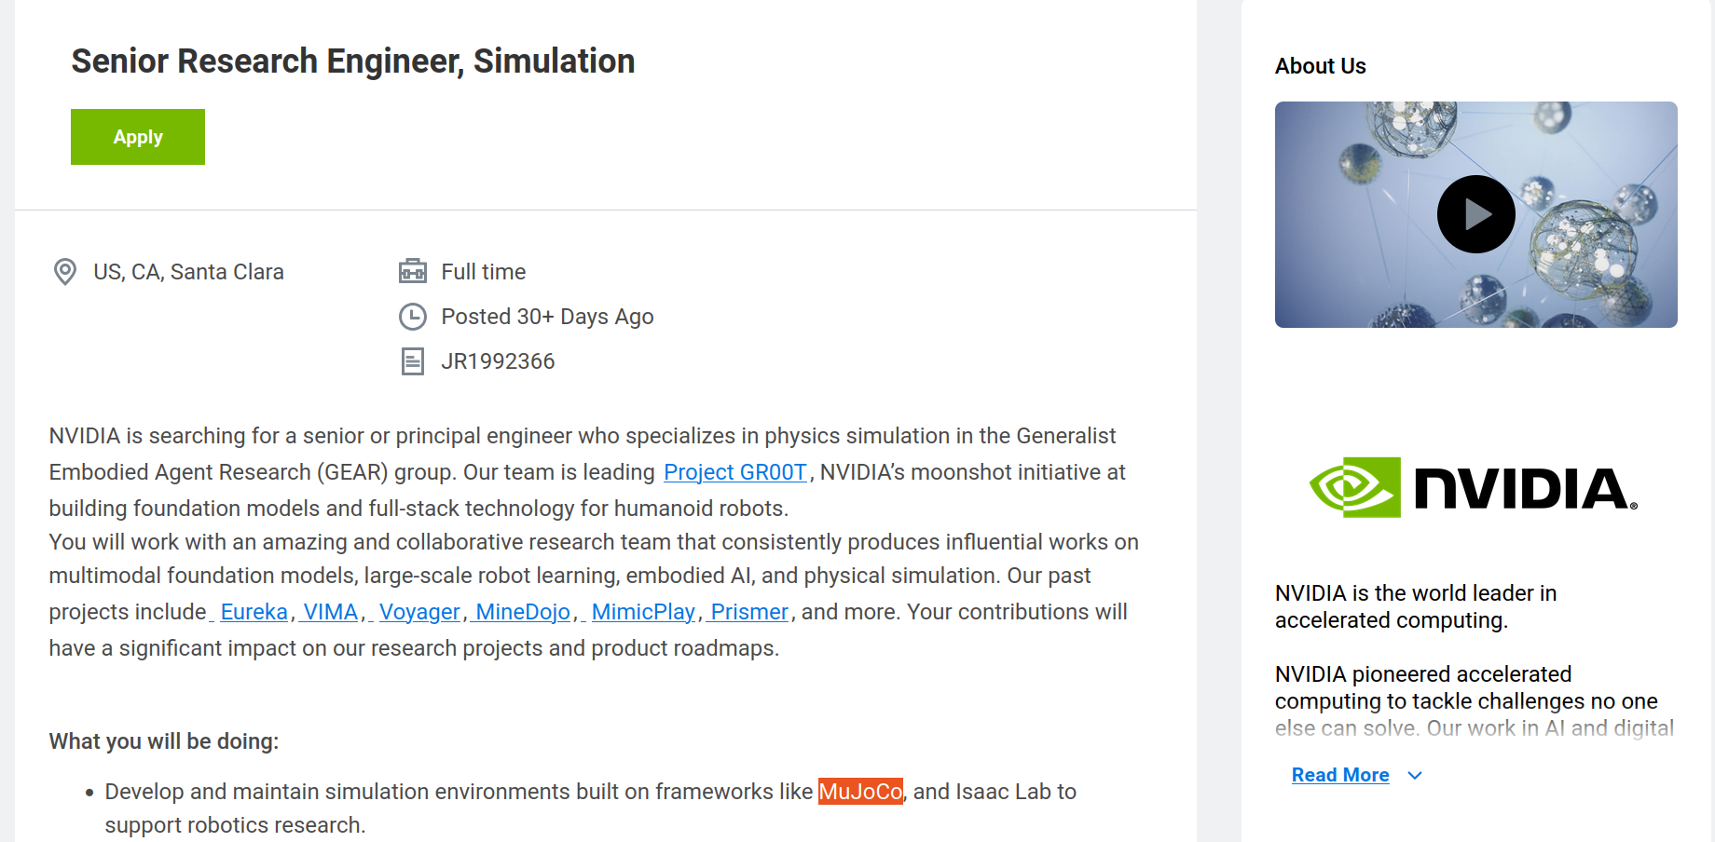
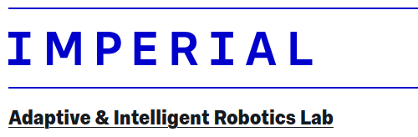
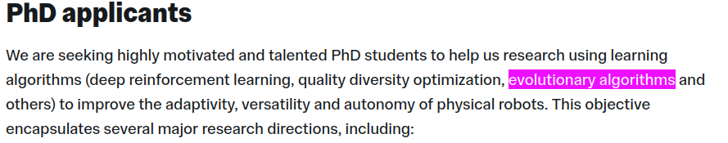
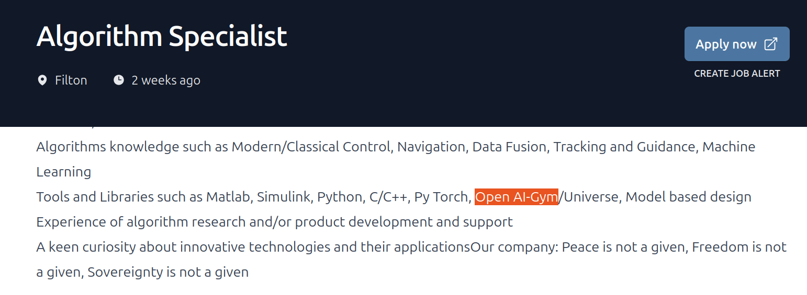
Notes:
It is good to get experience with these tools
We hope that the exercises provide a good basis for you as a project that you can put on github, or some skills that add value to your CV

Slide 25


Installation and general workflow
Notes:
Zooming in on the software framework we see that we will use many tools that rely on eachother

Slide 26



Installation and general workflow
All practical sessions use: https://github.com/lis-epfl/micro-515-EvoRob
https://github.com/lis-epfl/micro-515-EvoRob

Slide 27
Installation and general workflow
All practical sessions use: https://github.com/lis-epfl/micro-515-EvoRob
https://github.com/lis-epfl/micro-515-EvoRob
  Fork → https://github.com/<your_username>/micro-515-EvoRob

Slide 28

Installation and general workflow
All practical sessions use: https://github.com/lis-epfl/micro-515-EvoRob
https://github.com/lis-epfl/micro-515-EvoRob
  Fork → https://github.com/<your_username>/micro-515-EvoRob
  git clone <your_fork>

Slide 29

Installation and general workflow
All practical sessions use: https://github.com/lis-epfl/micro-515-EvoRob
https://github.com/lis-epfl/micro-515-EvoRob
  Fork → https://github.com/<your_username>/micro-515-EvoRob
  git clone <your_fork>

Slide 30
Installation and general workflow
All practical sessions use: https://github.com/lis-epfl/micro-515-EvoRob
https://github.com/lis-epfl/micro-515-EvoRob
  Fork → https://github.com/<your_username>/micro-515-EvoRob
  git clone <your_fork>

