Slide 1
Advanced Photonics / Advanced Micro-/Nano- Manufacturing
Dr. François Courvoisier / Prof. Yves Bellouard
FEMTO-ST / Galatea Lab, STI/IEM, EPFL

Slide 2
Part I / Introduction & Laser-fabrication based on linear absorption

Slide 3


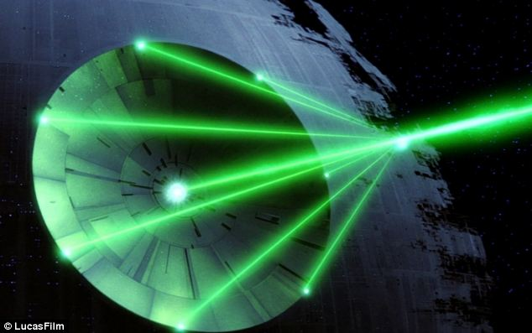
What does laser mean to you?

Slide 4
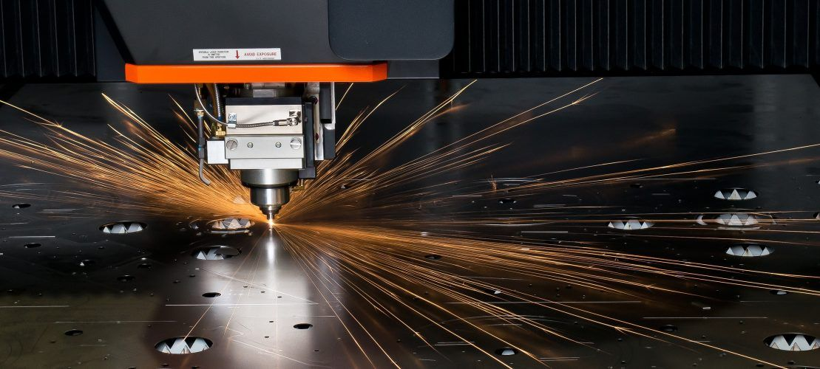
... May be this?

Slide 5
Lectures: Overall learning objectives
An introduction to some basic concepts in optics and light-matter interaction
Key concepts
  Absorption and refractive index
  Transferring energy to a material with a laser
  How material responds
Linear versus non-linear absorption
How it is used in the context of micro/nano- technology
Future directions

Slide 6
Laser in micro-/nano- manufacturing
Removing material… (cutting, ablating, etc.)
Transforming material… (annealing, polymerizing, etc.)
Growing material… (Promoting Chemical Vapor Deposition, Pulse laser deposition, etc.)
Joining materials… (welding)
Surface treatment… (Oxidizing, hardening, etc.)
Surface texturing…
Transfering materials...
Notes:
Laser are present in a considerable number of manufacturing sectors where they fulfil various tasks:
1/ Removing materials, which is what most people are aware of when discussing manufacturing with lasers. We will see during the lecture that removing materials using lasers can be done in different manners. One is to melt locally materials that is latter ‘blown away’ from the solid part. Another one is to ablate materials. In such case, the transformation of matter is more complex and limited or no liquid phase is formed. Finally, two-step processes involving a laser exposure, followed by post-treatment steps (annealing, polymerization, etching, etc.) are also often used, in particular in the context of 3D micro-manufacturing.
2/ Transforming materials. Lasers are very used in multiple processes where the objective is to transform the structure of a material. For instance, laser are used for annealing thin films or materials locally. They are also used for inducing polymerization reactions, localized densification in glass or to create a certain stress field in the bulk of the material.
3/ Joining materials. Laser are widely used for welding or brazing two materials together. This is one of the most important industrial applications.
4/ Surface treatment and surface texturing. Their, they are used for inducing localized oxidation reaction, for hardening surfaces (‘laser-shot peening’) or for texturing surfaces, eventually with nanoscale features.

Slide 7
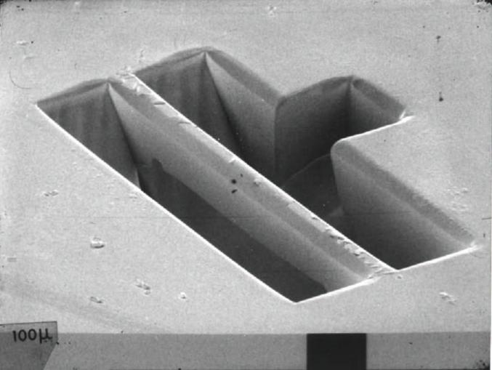
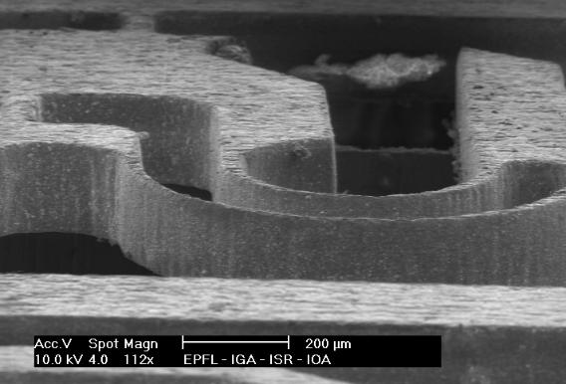
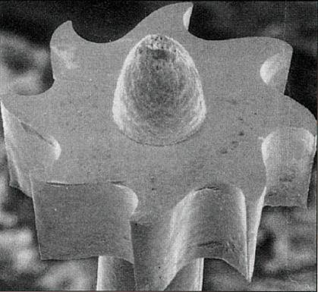
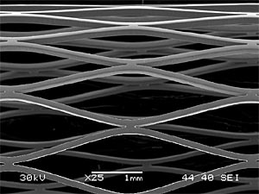
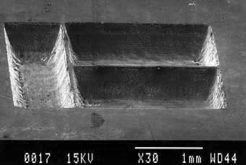
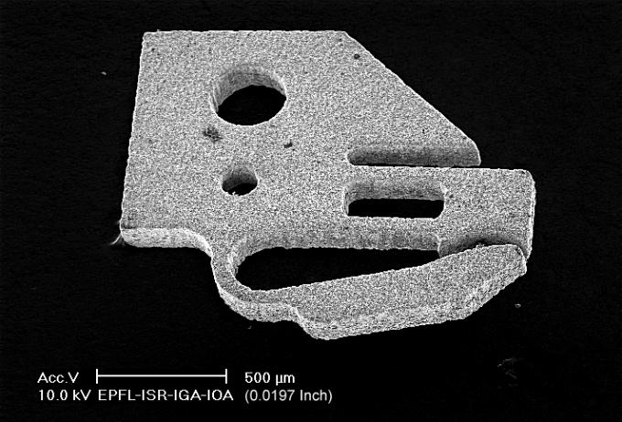
Laser Micromachining...
.. the classics... (back to the 90s)
Notes:
The pictures above are just a few illustrative examples of micromachined components. From top to bottom:
Top left and right: microgripper done at EPFL in 1998. It was machined using a Nd-YAG nanoseconds pulse laser. The microgripper is made of a shape memory alloys (Ni-Ti Alloy).
Middle left: tubular structures (here a medical product - a stent) machined with a pulsed laser out of a metal.
Middle-center: micro-gear machined using an excimer laser.
Middle-right: channels made in a polymer
Bottom-left: waveguides written in the bulk of glass using a femtosecond lasers. Notice the three-d structure.
Bottom-center: cuvettes obtained by ablating the surface of a metal realized using a pulsed-nanosecond laser.
Bottom-right: branching fluidic channels made by femtosecond laser exposure followed by a chemical etching step.

Slide 8
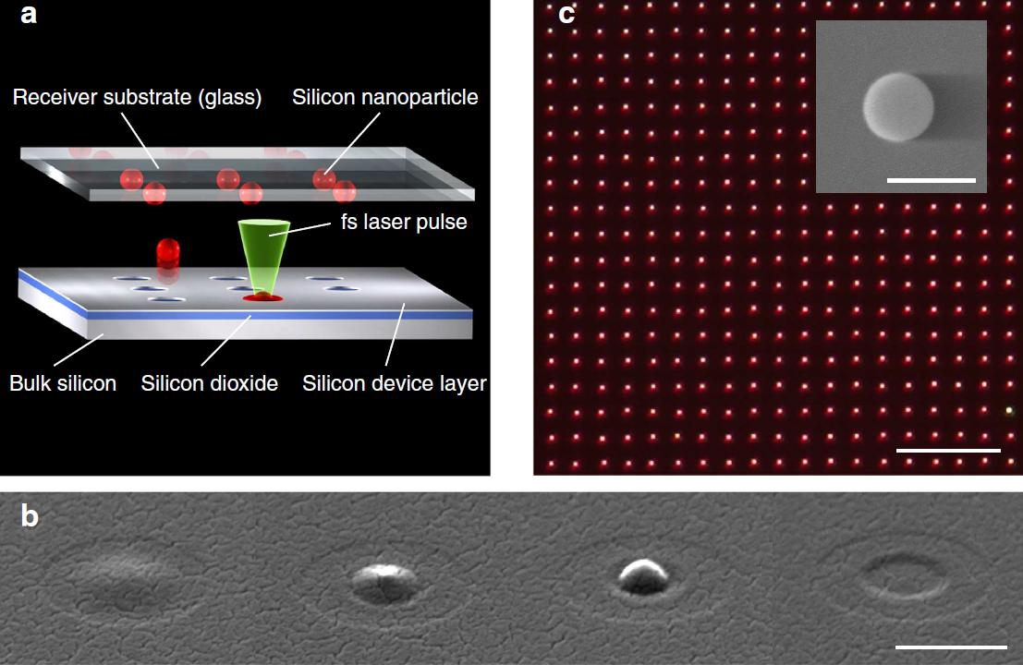
Chichkov, Nature Comm. (2015)

Slide 9
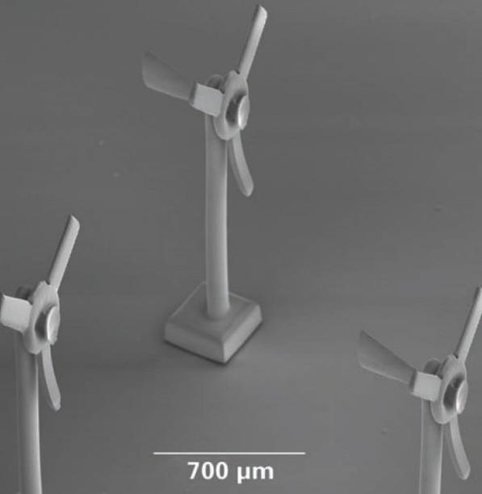
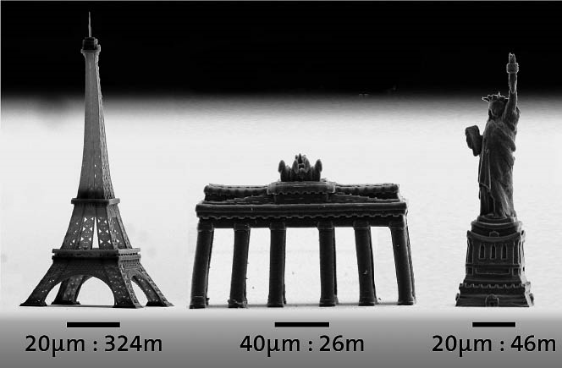
(source Nanoscribe)

Slide 10
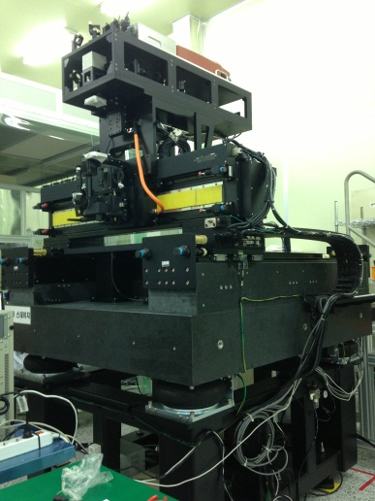
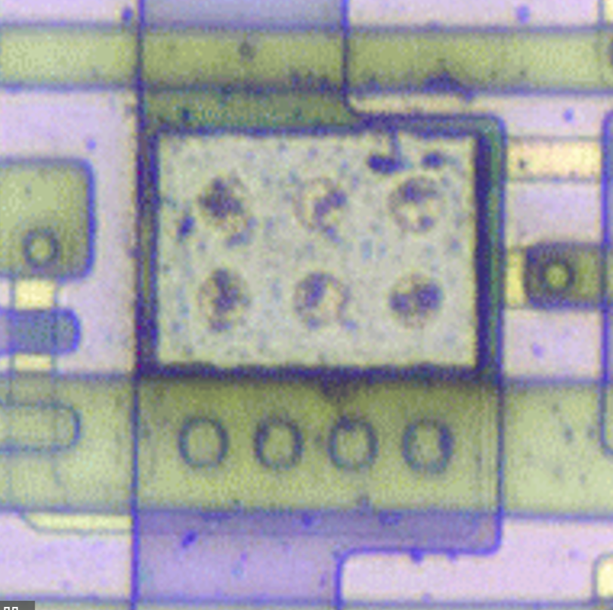
(source Amplitude lasers / KIMM – Corée)
Notes:
The video illustrates the selective removal of a layer covering other electronics layers. Just one layer is removed, without affecting the layers underneath.

Slide 11
So, what can I learn about laser micromaching?
Notes:
The little bunny has been made using three-dimensional localized laser-induced polymerization.
This is obtained using so-called ‘non-linear absorption’ processes that we will describe later in this lecture. The picture on the left illustrates the achievable resolution of laser machining processes.
The spectacles fitted on a fly are similar polymeric structures made using non-linear processes.
Let us now discuss about some aspects of light-matter interaction, starting from the basics.

Slide 12
Questions?
Why so many different types of lasers ? i.e. Role of the wavelength?
Pulsed or not pulsed?
Short or long pulse?
How can we selectively remove matter?
Work material inside their volume?
Notes:
As we have seen in the various examples, there are a large number of applications for laser technologies. Equally numerous are the different types of lasers with different wavelengths, different pulse characteristics, duration, etc.
Key questions are therefore to understand on one can make an educated choice between different wavelengths, to appreciate in which situation long or short pulses are needed, to further understand why it is possible to work in the volume of the part to be machined, etc.
In the following pages, we will provide some insights for answering these questions.

Slide 13
What all this process have in common?
Light…
Transfer energy to the material…
‘Material absorbs the incoming energy’
Notes:
Lasers generates optical waves to transfer energy or to pass energy through a material.
All or part of this energy is eventually absorbed in the material according different modalities that may induce different types of material responses.
In manufacturing, we are concerned with the fundamental transformations occurring in the material and how they can be used of fabricating particular shapes or for transforming materials.
Optical waves generated by lasers have particular properties that we will summarize in the following slides.

Slide 14
Schematic of laser-matter interaction
I(x,y)
Plume
(Ejected material)
x
Laser affected zone (LAZ)
Transfer of energy (heat, stress, etc.)
Absorption
depth
Material
Deposited energy
Transmitted light if any
Notes:
The schematic above describes a very generic scenario when laser light penetrates in a material and when linear absorption phenomenon are taking place.
Typically the light is focused on or within the material. As it penetrates through, a portion or all of the incoming light gets gradually absorbed. This ‘deposited energy’ is then dissipated in various ways. Some of this deposited energy may be converted into heat that may vaporize the material to generate a plume (or ejecta). This energy may also dissipate in the form of mechanical energy, eventually creating stress wave.
The broad region in which the effect of the laser can be seen is called the ‘Laser Affected Zone’ (LAZ). Note that this zone can be smaller or larger than the zone under optical exposure. In classical linear-absorption regime laser machining, the LAZ is typically broader than the zone that was exposed to the light emitted by the laser.
As it will be seen in the following slide, the laser distribution of energy around a laser spot has a Gaussian intensity profile in most cases. It is maximum in the middle and decays following a Gaussian law on the edges.
Note that in the scenario where some of the material is vaporized and ejected away from the substrate, the laser beam itself passes through this ejecta (that resembles a ‘cloud’ of particles) and may further interact with this cloud. It is therefore a dynamical process where the laser interacts with the byproduct of its own interaction with the material surface.

Slide 15
Laser-matter interaction
A dynamical process: “how the energy deposited by the laser is ‘digested’ by the material”
Heat transfer to the material (phonons for dielectrics, electrons for metals)
Pressure wave
Molecular bond breaking (Ionization)
Stress
Melting
Plastic deformation
Ablation
Fracture
Vaporization
Notes:
Laser-matter interaction can therefore be seen as a dynamical process in which the incoming energy provided by the laser is ‘digested’ in the material according various scenarii that we will discuss in the sequel.
Three cases that represent the majority of scenarii in laser manufacturing will be considered in this lecture.
Before analyzing them one-by-one, let us first go through some basics about optical waves and linear absorption mechanism.

Slide 16
Essence of laser micromachining?
Too players: Light and Matter
some basics in optics
some primer about the structure of matter and how light interacts with it
Notes:
Laser-matter interaction is multidisciplinary discipline that includes optics and materials science.
Here we will focus on some basic aspects of optics and linear absorption mechanism in materials and how the absorbed energy is ‘digested’ by the material.

Slide 17

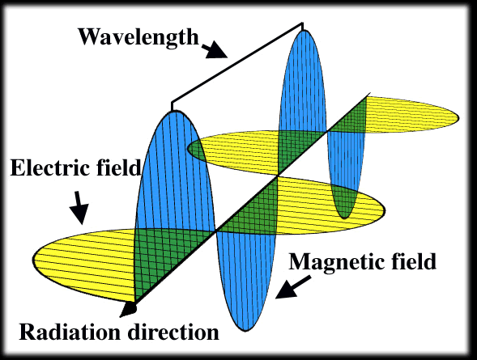
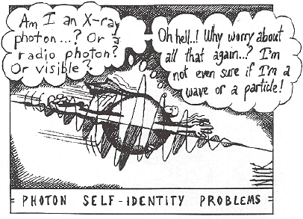
Light is…
An Electro-Magnetic wave…
A particle...
(Source Quantiki)
Notes:
From optics lectures, we know that light can be seen either as an electromagnetic wave (the ‘electromagnetism’ description) or as a particle and a wave, in the quantum description (the duality particle-wave description).

Slide 18
Quantum description: photons… (the ‘light particles’)
Pulsation
Propagation speed
Mass less…
No charge
Energy
Wavelength
Planck constants
The shortest the wavelength, the highest the photon energy!
Notes:
In the quantum mechanics description, the light particle transporting energy are called photons. These particles have no mass and no charge, but carries energy.
The quantized amount of energy carried by a photon is proportional to the angular frequency, and therefore, to the ratio of the propagation speed in the medium and the wavelength of the light beam.
The proportionality constant is the Planck constant: h = 6.62607015×10⁻³⁴ J⋅s.
As a direct consequence, light wave of shorter wavelength have more energetic photons than light of longer wavelength, since the photon energy is inversely proportional to the wavelength.

Slide 19
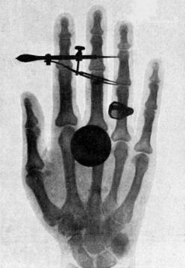
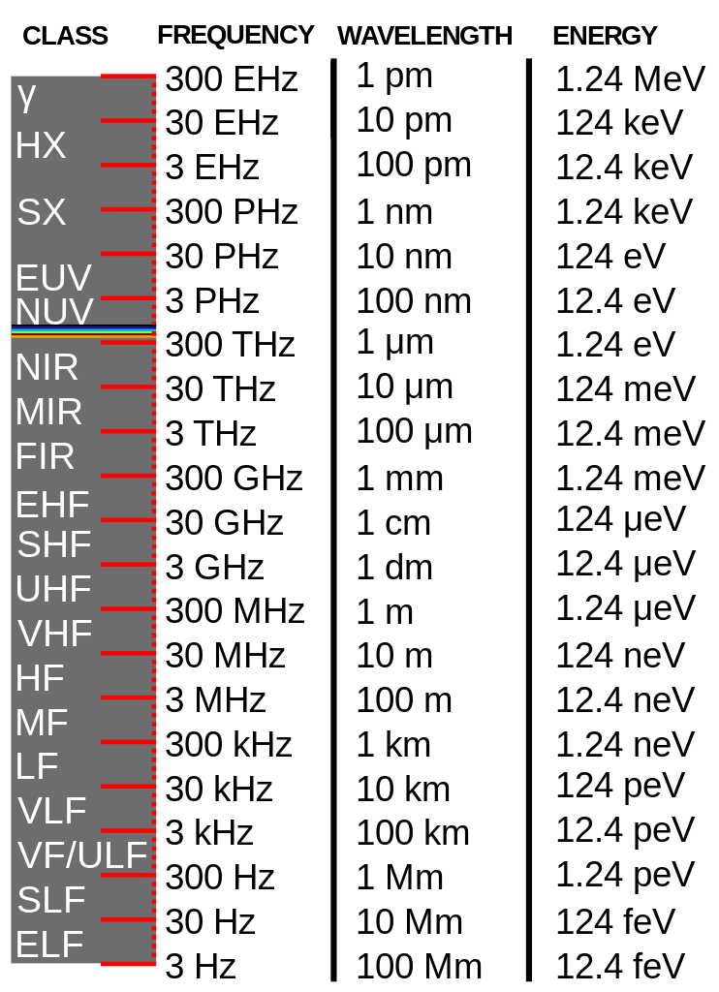


(credit: Wilhelm Conrad Röntgen)
Energy to ionize atom or molecule | >10 to 1000 eV
Binding energy of a tightly bound molecule | 10 eV
Energy between outer electron shells in atoms | 1 eV
Binding energy of a weakly bound molecule | 1 eV
Vibrational energies of molecules | 0.1 eV
Rotational energies of molecules | 10 ⁻ ⁵ eV
‘Photons
Laser’

Slide 20
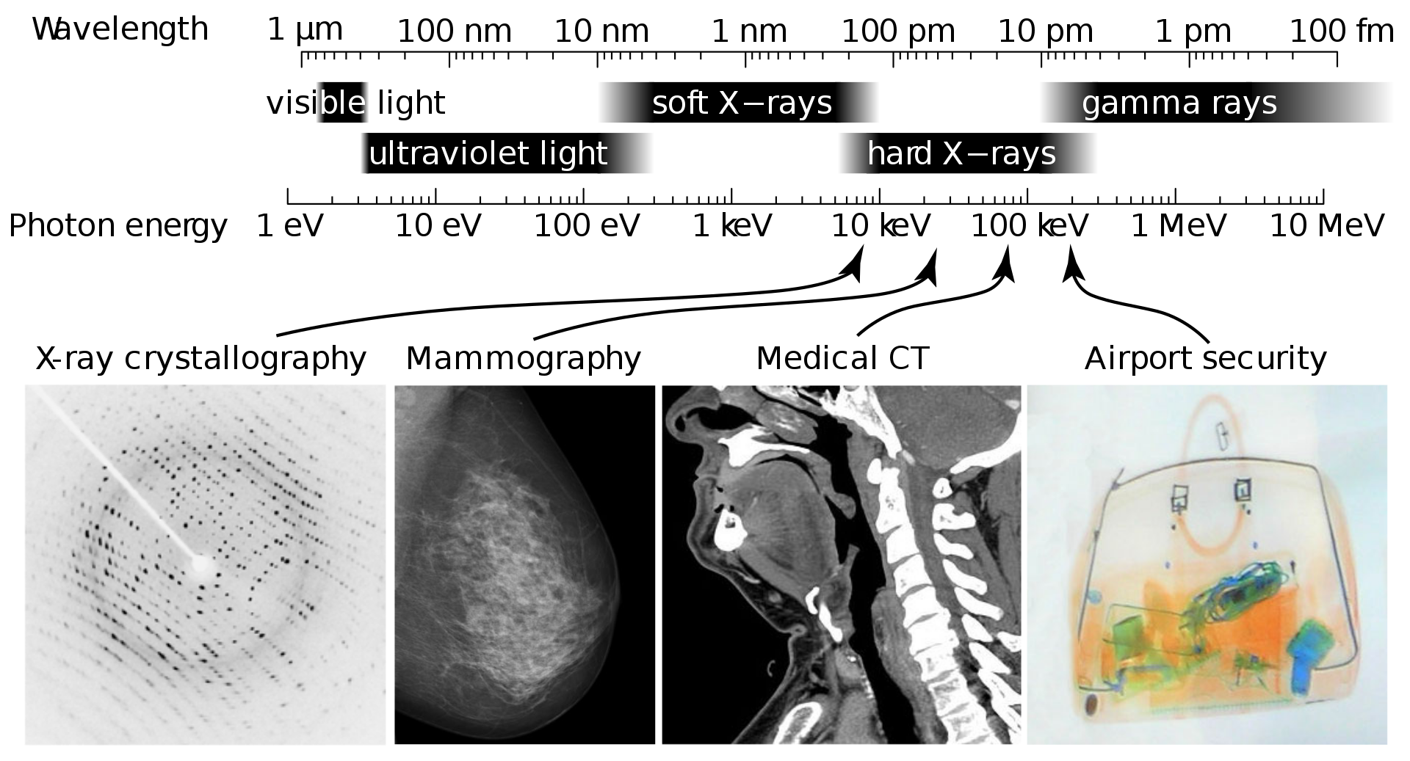
Laser
(source Wiki)

Slide 21
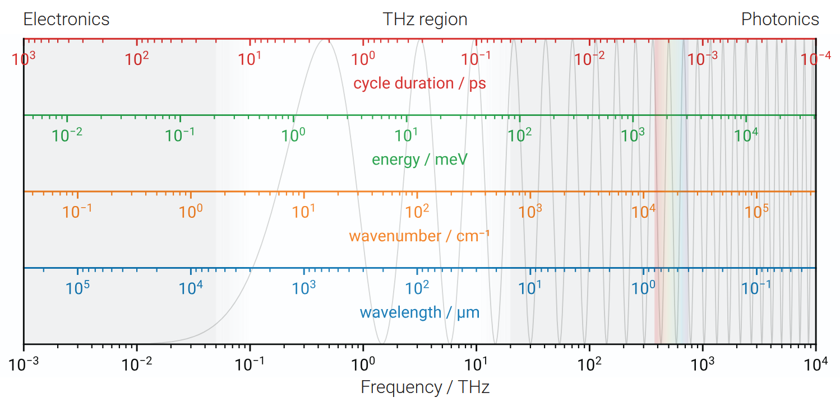
Equivalences: Wavelength, wavenumber, energy, cycle duration…
(Source: Clara Saraceno, Univ. Bochum)

Slide 22
How to describe optical phenomena?
Geometrical optics
    Snell-Descartes laws / Newton’s corpuscule of light / Fermat’s principle
Wave optics
    Description using waves propagating through different medium (scalar waves) / Huygens-Fresnel
Electromagnetic optics
    Waves as EM fields (Maxwell)
Quantum optics
    Photons, Quantum Electrodynamics
Light-matter interaction
Notes:
There are various approaches to describe optical phenomena, following the historical understanding of optics.
The simplest approach is geometrical optics, where light is seen as a set of rays that can be bent, deform or reflected by media of various densities (we will see later the concept of refractive index). Snell-Descartes law were first derived from light beam seen as ‘rays’.
This approach is sufficient to describe some aspect of image formations in a set of lenses or mirrors, but cannot describe diffraction phenomena.
The second approach is to see optics as waves. There, light is seen as a series of waves emitted by point-like sources. This approach is successful for describing phenomena like interferences effects.
The third approach is the electromagnetic description. There, propagation phenomena can be explained as well as the effects of polarization.
Finally, the last layer is the quantum description, building-up on the duality wave-particles.
In what follows, we will limit our effort to the electromagnetic description.

Slide 23
Maxwell equations
Electric field : Gauss’s law
1)
(in the presence of stationary charges)
James Clerk Maxwell (1831-1879)
(in vacuum)
Magnetic field
Propagation equations
2)
3)
Faraday’s law:
4)
Ampère’s law:
Notes:
In the electromagnetic (EM) description, the behavior of a light wave is described using the four equations of Maxwell that encapsulates all electromagnetic theory.
Combining these four equations in the case of vacuum (i.e. no charge present), we can express them in the form of two partial differential equations, expressed separately in term of electrostatic or magnetic field.
In what follows, we focus only on the equation that described the electrostatic field behavior in vacuum.

Slide 24
3D wave equation for a light-wave electric field
B
E
k
A wave's wave-fronts sweep along at the speed of light.
wave-fronts
Defines a plane wave.
Notes:
One solution of the partial derivative equation (PDE) is a electrostatic field with an exponential component carrying a propagating component and a time varying one.
The k vector describes the direction of propagation.

Slide 25
Polarization of a lightwave
Polarization is defined with respect to a fixed coordinate frame
B
X
Electrostatic field
E
k
E
Magnetic field
B
φ
Y
k
Z
Polarization angle
of light
Notes:
The vectors (k, E, B) form a triad, perpendicular, one to another. E and B vectors are in a plane perpendicular to the direction of propagation.
The electrostatic vector is the most important to consider in our case as it interacts with the electrons in the matter.
One important parameter is the polarization of light. It is defined by the orientation of the E vector with respect to a fixed coordinate frame (X, Y, Z) as illustrated above.
Various polarization states exist. A linear polarization state means that the E vector does not move with a fixed reference frame and keep the same direction.
In other polarization state, the E vector moves in time in a fixed coordinate frame, as the EM wave propagates.

Slide 26
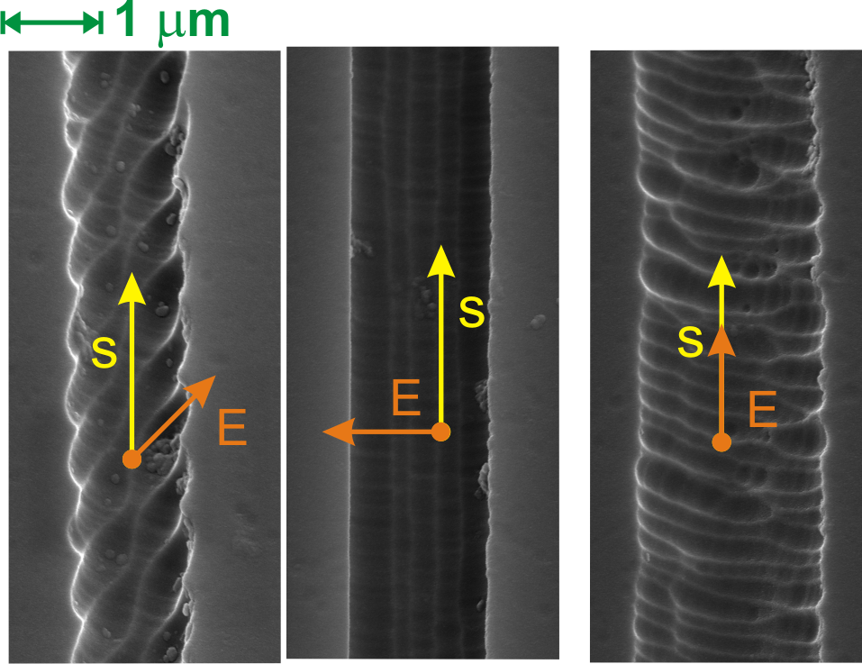
Example how the polarization may affect a micro-machining morphology
The same energy is used in all three cases.
Notes:
The polarization state can have a strong influence on the laser-matter interaction.
The illustration above shows some micromachining done in a glass (fused silica). In this process, the laser is used to modify the material such that when it is etched after in an acid bath (HF), the exposed regions with the laser are dissolved faster than the rest of the material.
In the example above, the same beam parameters are used in term of energy and energy deposited in the material. Lines are written along the surface. A top view of the material morphology after etching is shown.
The only parameter that was changed is the polarization state of the beam, and here, how the electrostatic field is oriented with respect to the laser writing direction, denoted here with a s vector. Three examples are shown. In the left case, the E field is oriented at 45 deg from the writing direction s. In the middle, the E field is oriented perpendicular to the writing direction and finally, on the far right, it is oriented parallel to the writing direction.
The different of morphologies are evident, illustrating the importance of the polarization of the laser beam on the process.
It is often the case that in laser manufacturing, the polarization has a strong influence on the end-result.

Slide 27
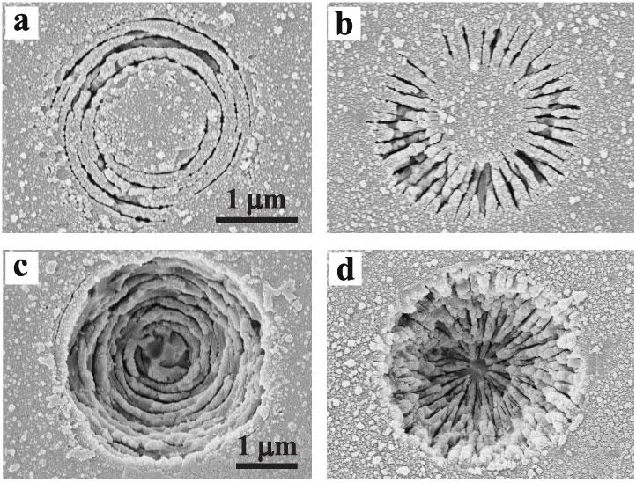
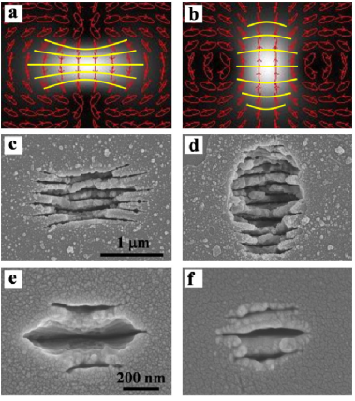
More complex light polarization states
Circular
Azimuthal
Radial, etc.
(source : C. Hnatovsky, et al., Physical Review Letters 106, (2011).)

Slide 28
Motion in atoms and molecules: ‘Everything vibrates!’
Electrons vibrate in their motion around nuclei
High frequency
~10¹⁴ - 10¹⁷ cycles per second.
Nuclei in molecules vibrate
with respect to each other
Intermediate frequency:
~10¹¹ - 10¹³ cycles per second.
Nuclei in molecules rotate
Low frequency
~10⁹ - 10¹⁰ cycles per second.
(adapted from R. Trebino, Giorgia Tech.)
Notes:
Let us now discuss how an EM wave may interact with matter.
The first observation is that everything oscillates within atoms and molecules.
Electrons constantly vibrate around the nuclei of an atom.
Nuclei in molecules moves one with respect to another.
Finally, nuclei in molecules may also rotate.
These vibrations have different time scale.
We have now to consider what happens when a EM wave comes into interaction with charges that are vibrating.
One approach is to describe these vibrations modes as many oscillators in motion, responding to a force excitation resulting from the EM wave that propagates through the matter.

Slide 29
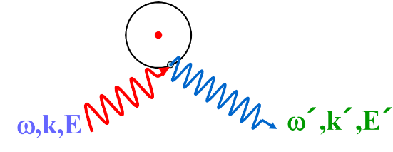
Light-matter interaction
Essentially induced dipole radiation
E small
Linear oscillator
Non-linear response, higher harmonic generation
E stronger

Slide 30
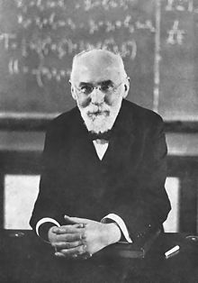
How to model the material response to an incoming EM wave?
(Lorentz dispersion model)
In a first approximation, it can be modelled by an oscillator
Hendrik Antoon Lorentz
(1858-1928)
Notes:
Having made these comments about quantum mechanics descriptions, let us go back to the more classical approach.
In what follows, we consider the Lorentz dispersion model to describe how light will interact with matter. This model was proposed by the Dutch scientist, Hendrik Lorentz.
The basic idea is to consider the vibration of the electron cloud around the atom as a classical harmonic oscillator that is forced by the incoming oscillating electrostatic field provided by the laser beam.

Slide 31
Light excites atoms, which emit light that adds (or subtracts) with the input light...
When light of frequency ω excites an atom with resonant frequency ω₀:
Electric field at atom
Electron cloud
Emitted field
Incident light
+
Emitted light
=
Transmitted light
On resonance (ω = ω₀)
An excited atom vibrates at the frequency of the light that excited it and re-emits the energy as light of that frequency.
Notes:
Our problem (illustrated above) can be defined as follows:
An atom is put in an oscillating field provided by the incoming light beam.
The electron cloud of the atoms also vibrates and is further excited by the incoming electrostatic field.
In this model, the excited atom reemits light at the same frequency than the excitation, but at a different amplitude.

Slide 32
The Damped Forced Oscillator
Interaction between light and electrons can be modeled by an harmonic oscillator experiencing a sinusoidal force and viscous damping term.
Excitation pulsation
Excitation field (light)
Electron charge
Electron mass
Position of the
Electron as a function
of time
Excitation
field
Resonant pulsation
Damping coefficient
The electron oscillates at a finite an amplitude at the light frequency and with a potential phase shift.
Notes:
Under these assumptions, the electron cloud motion (x_{e}) can be seen as a classical damped harmonic oscillator, much like a spring with a mass attached to it, the mass being the mass of an electron.
One particular solution of this equation is:
In which the various parameters are described above and E(t) is the excitation field, i.e. the incoming propagating light.

Slide 33
The Complex Lorentzian function
Real part
Imaginary part
ω₀
ω
ω
ω₀
Notes:
The complex Lorentz function, can be decomposed into a real and an imaginary part as shown above.

Slide 34
Refractive index and Absorption coefficient
ω₀
Frequency, ω
Notes:
The imaginary part describes the absorptivity of the material. The full expression using this model is:
It peaks at the resonant frequency w₀ for the atom.
The real part is the propagative part and is described a property in materials, known as the refractive index.

Slide 35
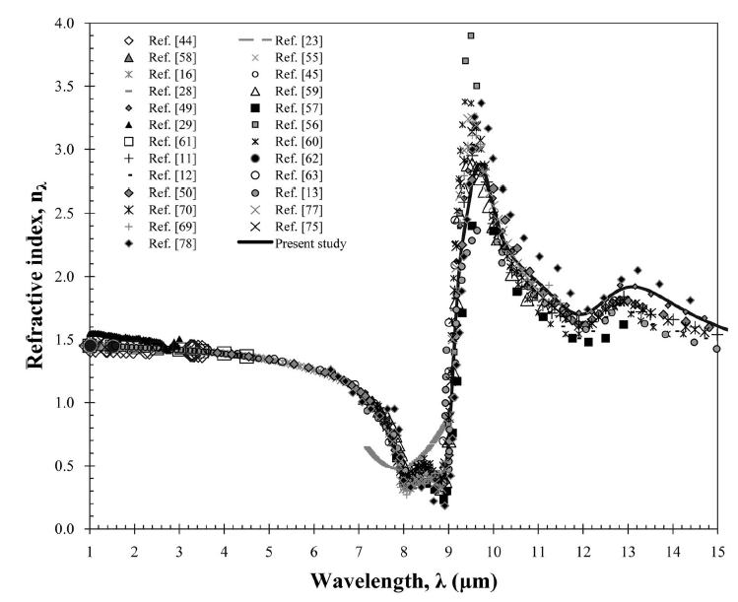
Example: silica
Notes:
As an illustration, the curve above describes the measured refractive index as a function of the wavelength for fused silica (a glass) as a function of the wavelength.

Slide 36
The electromagnetic wave in a medium
Absorption Refractive index
attenuates the field changes the k-vector
Notes:
The two expressions before give us a means to describe how an EM wave will propagate in a given material.
The first part contains the attenuation of the EM wave as it penetrates inside the material. It is an exponential decay along the propagation axis that describes the progressive absorption of the incoming light beam.
The second part of the expression is the propagating element, which like before describes how the wave propagates further in the material.
Note that k vector is multiply by the refractive index and therefore the wavelength gets divided by the refractive index.
Recalling the expression of the velocity of the propagating wave. It means that the wave ‘slow’ down as it penetrates inside the material.

Slide 37
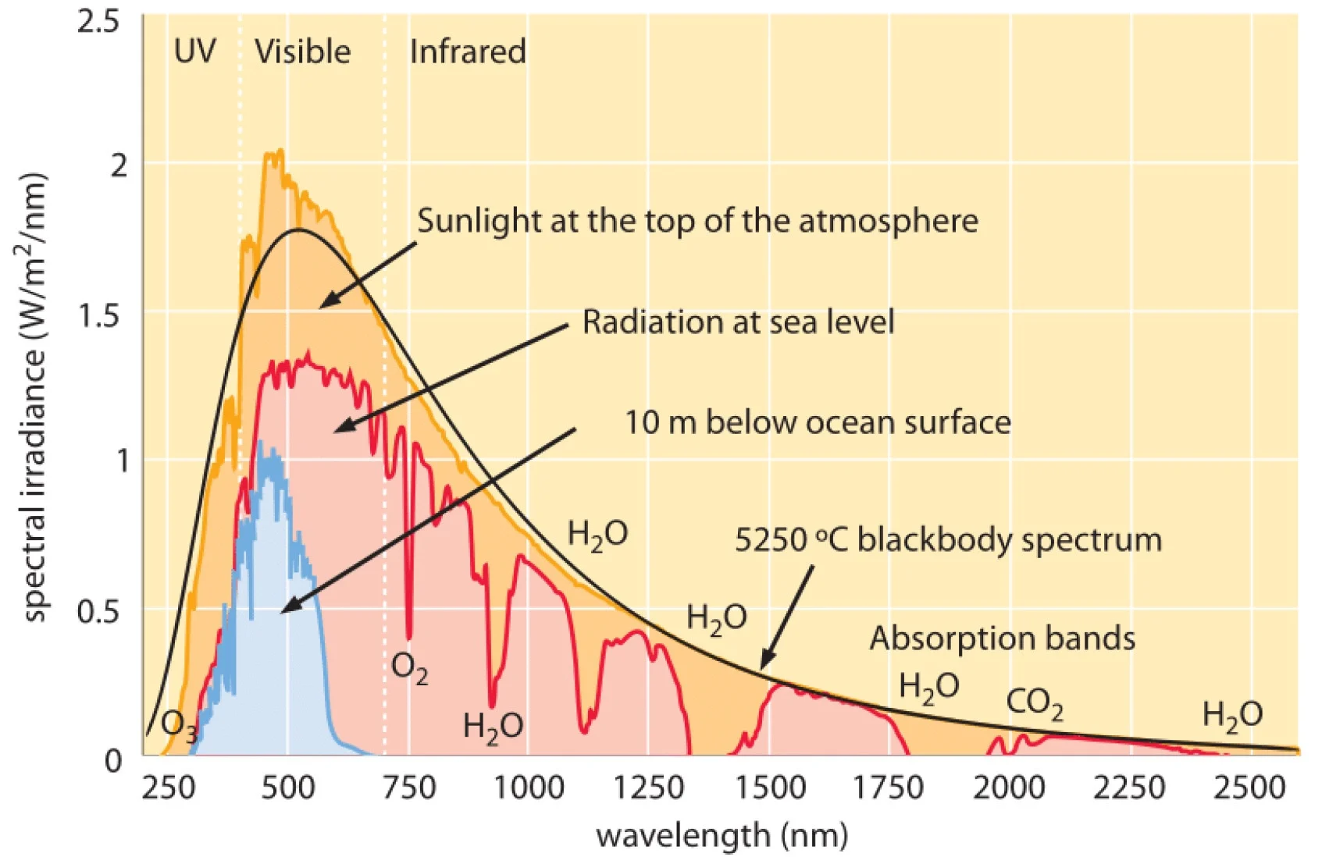
Solar light from the sky to the ground and the sea
(source OceanOptics)

Slide 38
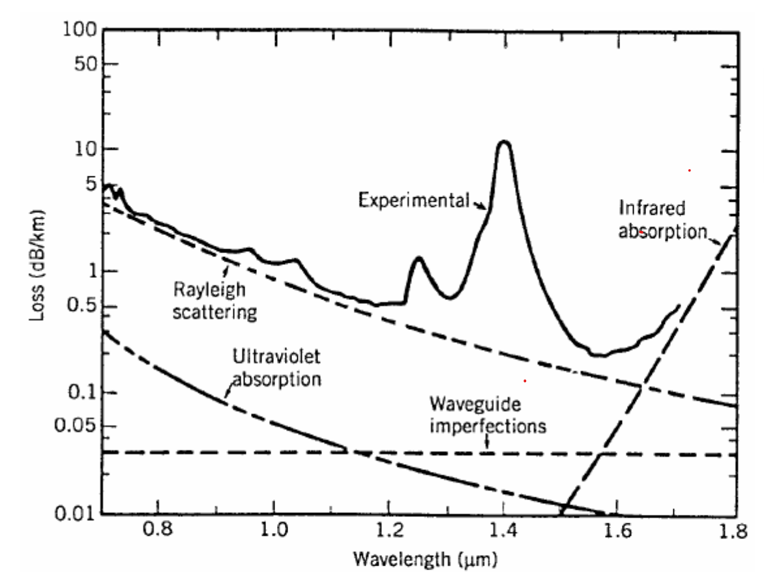
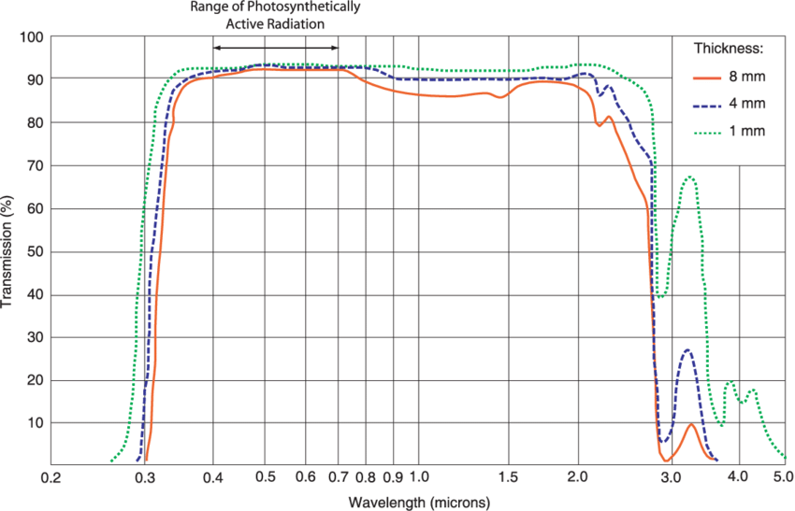

From fundamental to application: why Telecom wavelength are at 1550 nm mostly?
Transmission = 1 - Absorption
1300 nm
1550 nm
Telecom fibers

Slide 39
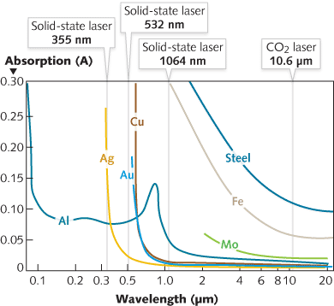
Absorption of some metals...
(source Trumpf)
Notes:
Another example, more related to manufacturing, this time about common metals.
Above are indicated typical wavelengths of industrial/commercial lasers used in manufacturing.
Let us consider for instance the case of silver. As one can see, it absorbs nearly nothing above 500 nm is highly reflective. Therefore, it would be particularly difficult to machine as only a very small amount of the incoming energy would be absorbed.
Note that not absorbing, does not mean that the material is transparent. Silver does reflect very well without absorbing.
In this particular illustration to more efficiently get light energy absorbed in the material, when would have to consider a laser emitting at 355 nm.

Slide 40
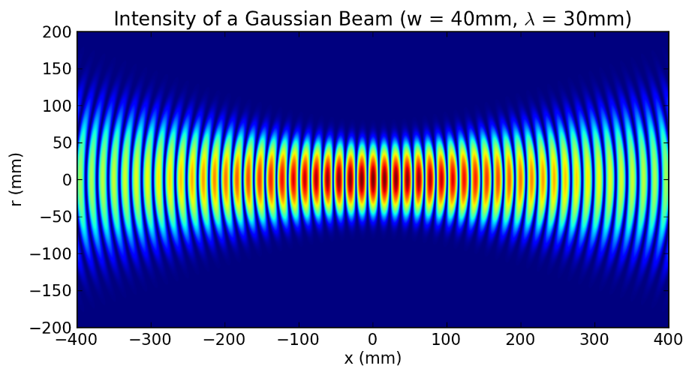
Fundamental aspects about lasers
Monochromatic (= one wavelength)
Coherent source (spatial/temporal)
Emits Gaussian beams (i.e. Intensity follows a Gaussian distribution)
High density of photons

Slide 41
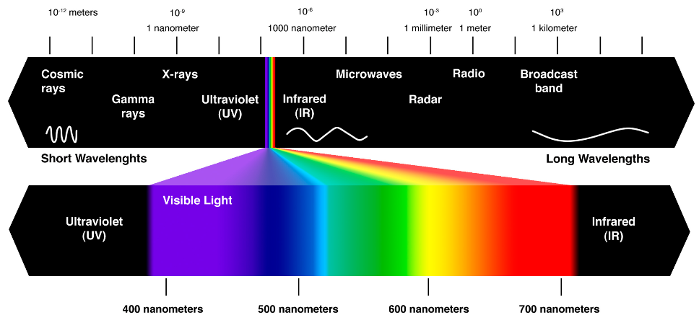
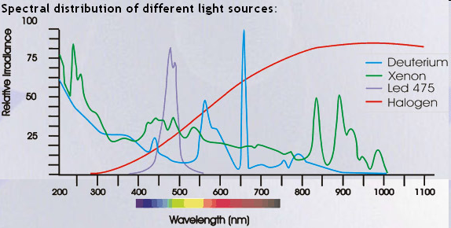
Emission spectra of a light source
(source: http://www.theskepticsguide.org/)
HeNe laser
Largeur spectrale
Xenon / Halogen
LED
Un laser est quasi-monochromatique!
> 1 μm
~ 100-150 nm
< 10 nm

Slide 42
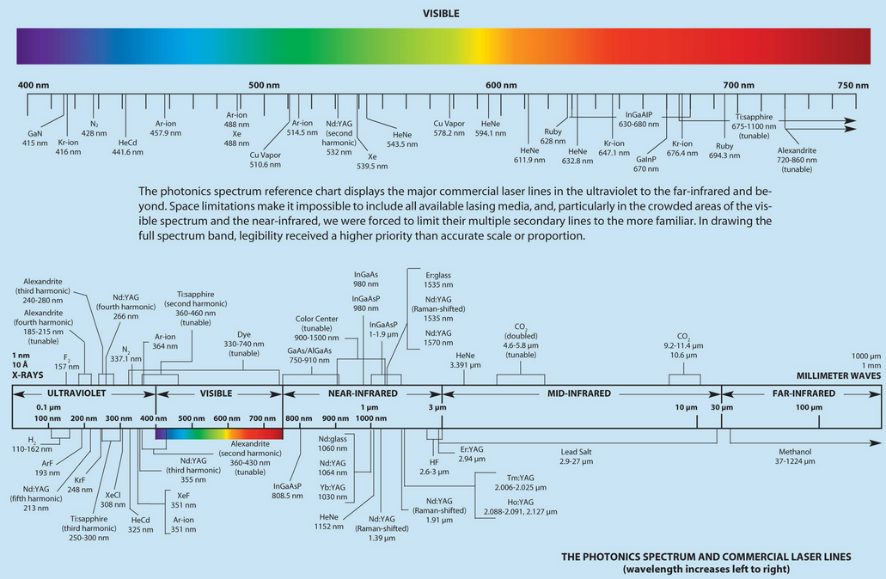
The laser fauna
Crystal
Diode lasers (semi-conductors)
Gas
Crystals
(source: Photonics Spectra)
Excimers lasers (gas)

Slide 43
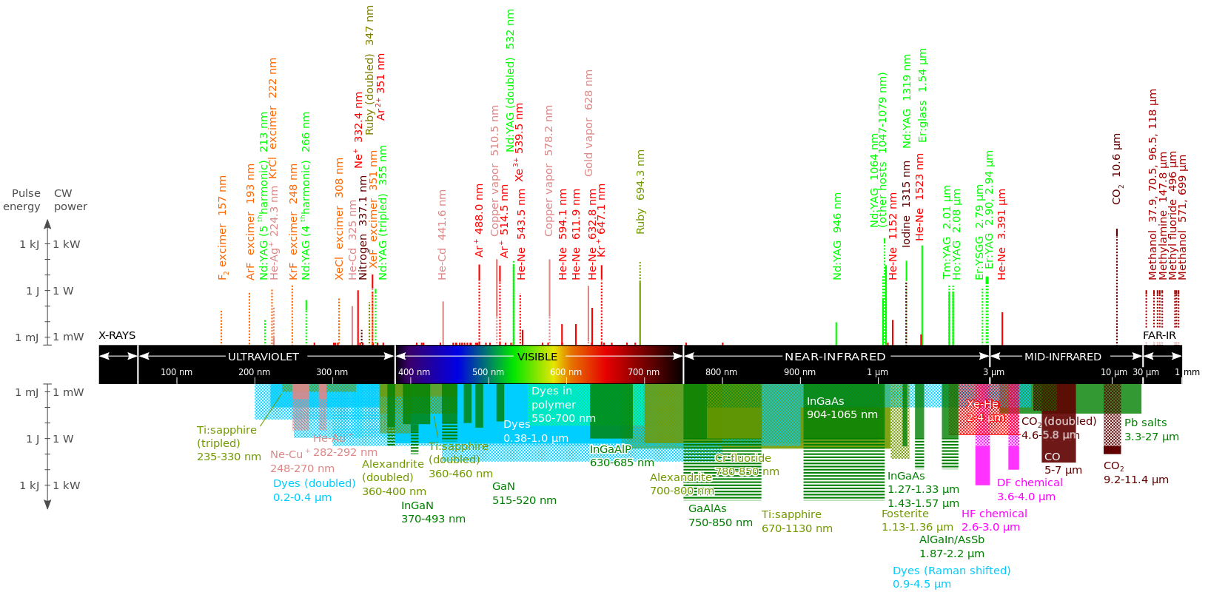
The laser fauna…

Slide 44
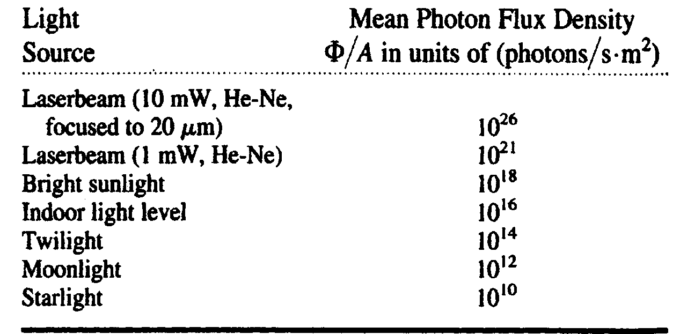
Mean Photons flux density for various sources
One photon of visible light = 10⁻¹⁹ Joules
F is the photon flux, or the number of photons/sec in a beam.
(R. Trebino)

Slide 45
Beams (localized plane waves in space)
A plane wave has flat wave-fronts throughout
all space. It also has infinite energy… Does not exist!
Real waves are localized spatially.
Example of a localized wave: A Gaussian beam
exp(-x²)
z
w
y
x
Localized wave-fronts
Laser beam spot on wall
x

Slide 46
Laser pulses (localized waves in time)
exp(-t²)
E
t
t

Slide 47
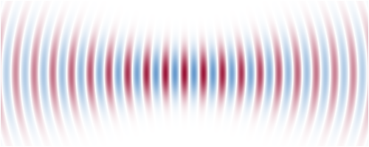
Propagating Gaussian beam
(electrostatic field distribution)
Waist envelop – w(z)
Wave front
(adapté de RP Photonics)

Slide 48
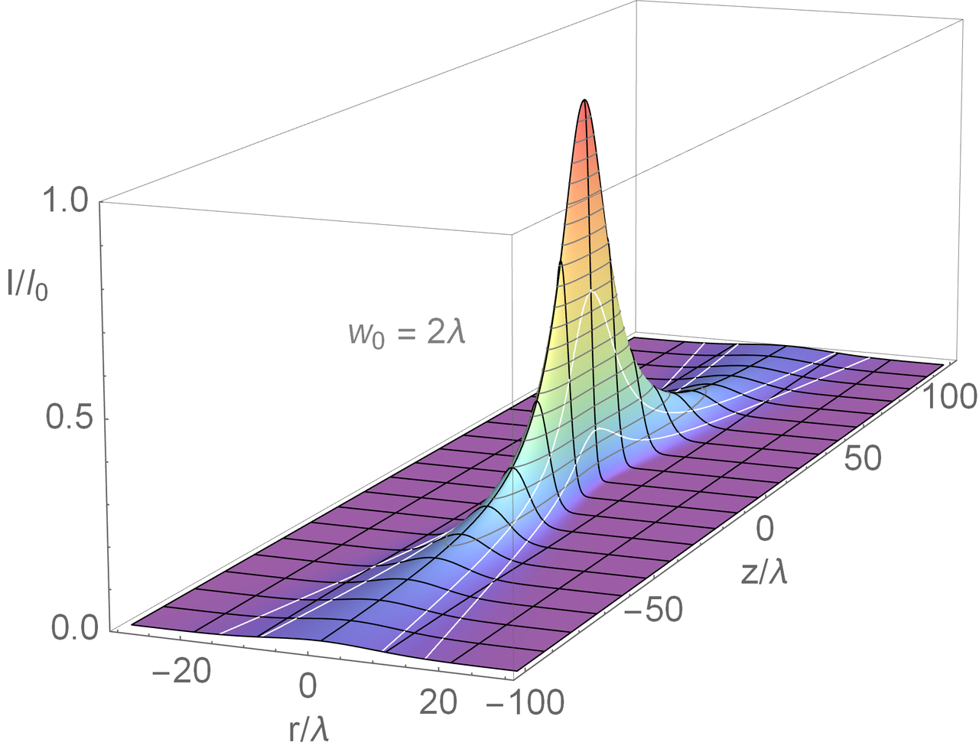
Relative intensity in 3D

Slide 49
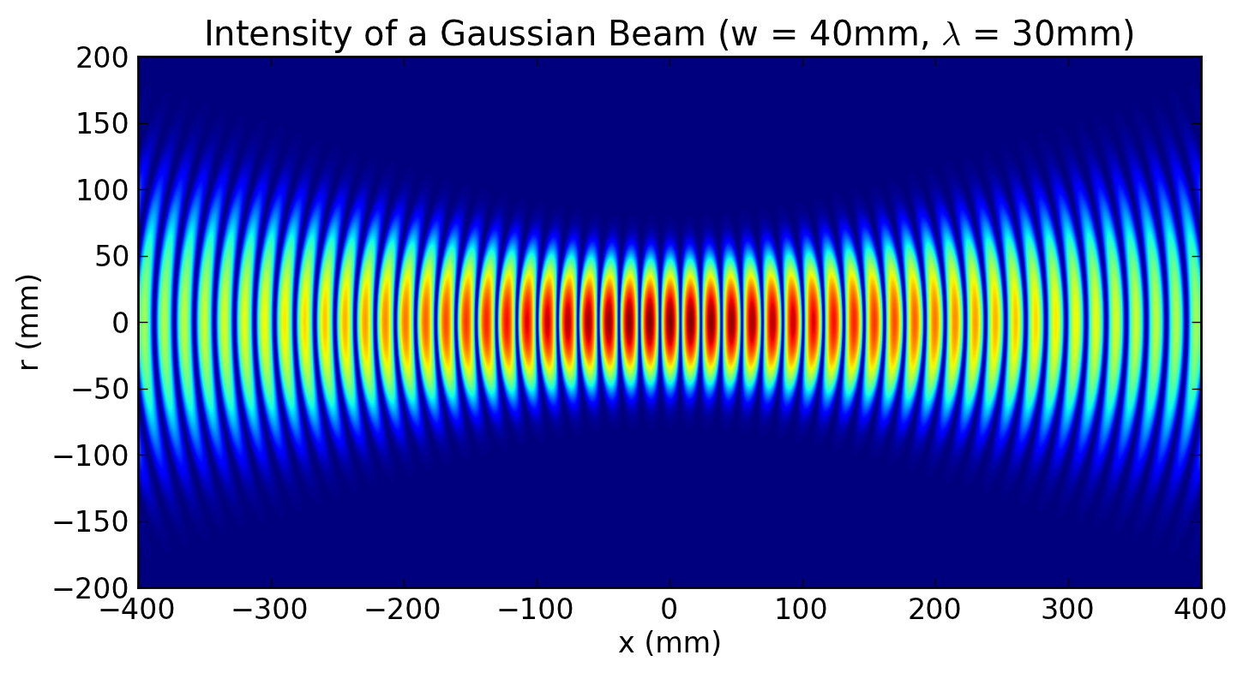
(illustration Wikipedia)

Slide 50
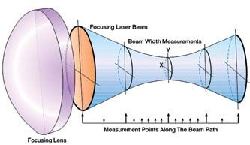
In reality…
The optical wave emitted by the laser is not perfectly Gaussian…
It is common to define M² as a metric on how different it is from a real Gaussian. M>=1
M factor measurement (source: Spiricon)

Slide 51
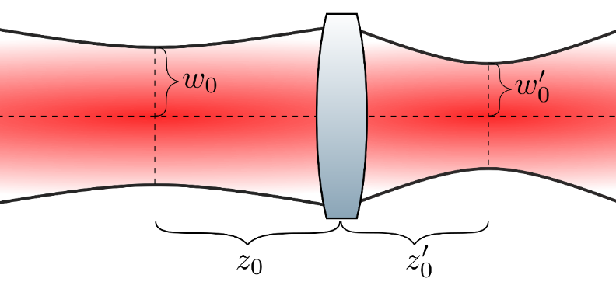
Useful formula: Laser-light going through a lens…
Simplified case: (if z₀ >> f)

Slide 52
Key process parameters definition in laser
Used for both pulsed and continuous lasers
J/cm²
Net fluence
  ‘How much energy is sent per unit surface’ - ‘Exposure dose’
Average power
  ‘Energy exposure per unit of time per surface unit’
Peak power
  ‘How much temporal-density of energy is contained in one pulse’ – How intense is the pulse
Energy per impulsion
  ‘Energy contained in on single pulse’
Pulse duration
Repetition rates
  ‘Frequency at which pulses are fired’
in Watt (i.e. J/s) per cm² W/cm²
in W/cm²
in J
Used for pulsed lasers
in s
in Hz

Slide 53
Part II – Laser-manufacturing modalities

Slide 54
Laser-matter interaction
A dynamical process: “how the energy deposited by the laser is ‘digested’ by the material”
Heat transfer to the material (phonons for dielectrics, electrons for metals)
Pressure wave
Molecular bond breaking (Ionization)
Stress
Ablation
Melting
Plastic deformation
Fracture
Vaporization

Slide 55
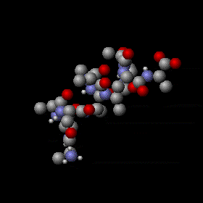
Interpretation of specific heat capacities
A metric on how much energy is stored in vibrational/rotational energy
Each degree of freedom ‘absorbs’ a certain quantity of energy (equipartition theorem)
Vibration of a complex protein, source: wikipedia

Slide 56
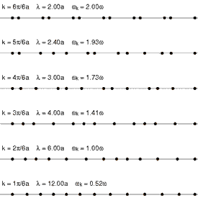
Different means of heat conductions: Phonons vs electrons
Phonon = Quanta of atomic vibrations
Non-conductive materials
Usually a not so efficient heat conduction mechanism
Laser excites molecule vibrations / ionization
(source, R. Lacheaume, 2005)

Slide 57
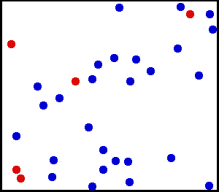
Interaction with metals…
In metals, there are ‘free’ electrons to move. (not bonded to an atom)
Energy
transfer
Laser beam
Electrons
Energy
transfer
Lattice
Two different time
constants

Slide 58
Thermal transfer: heat equation
Thermal conductivity
Thermal load
(on a given domain and for a given time)
Temperature spatial
distribution
Time dependant
evolution
If k is constant,
Thermal diffusivity

Slide 59
Heat equation
‘A function describing the temperature distribution in space and time’
x,y
Heat load: laser energy absorbed in the material
‘How fast the heat diffuses’
Time dependent, boundary conditions of the equation (together with the geometrical definition of the problem)

Slide 60
Thermal load from a laser
Focused fluence
(W/cm²) – Cylindrical coordinates
Laser power (W)
Absorption coefficient at a given wavelength
Thermal load:
Laser beam waist
Laser beam
(Gaussian distribution)
Reflected light (R)
r
x,y
Absorbed light (A)
Transmitted light (T)
Energy conservation:
A, T, R are unitless (< 1) = ‘ratio of energy absorbed, transmitted, or reflected’

Slide 61
Illustrations of a pure thermal process

Slide 62
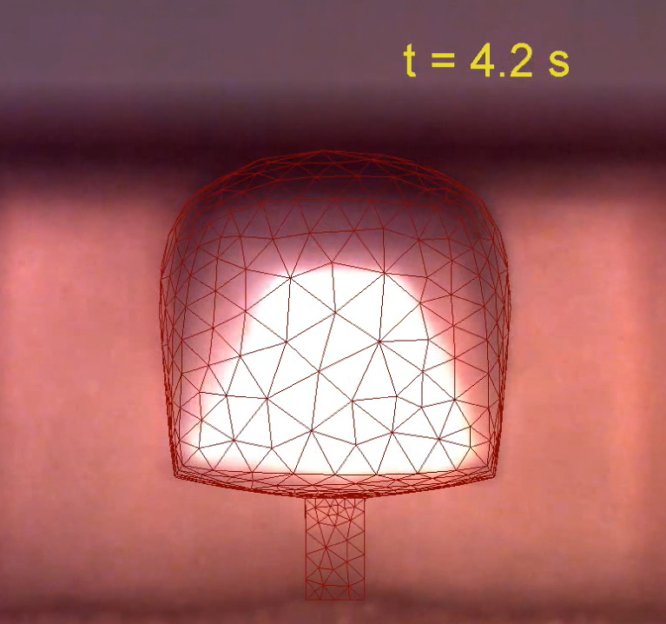
Illustration laser-based morphing...

Slide 63
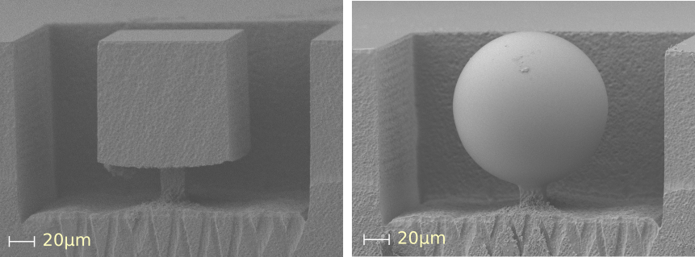
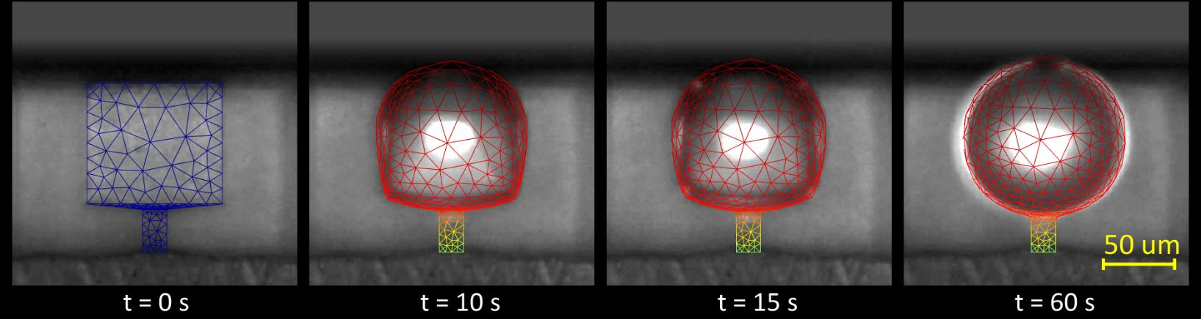
‘Morphing’ laser ...
Final shape is governed by surface tension
Jakub Drs, Tetsuo Kishi, Yves Bellouard, Optics Express (2015)

Slide 64
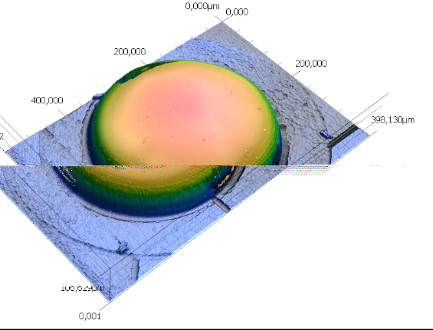
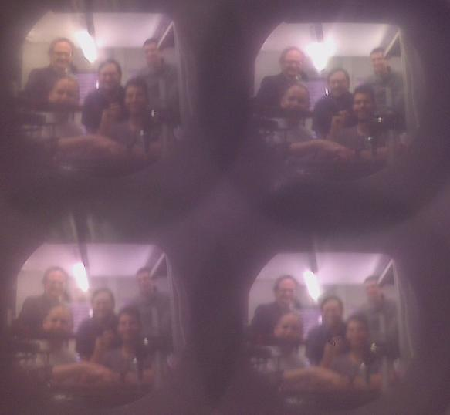
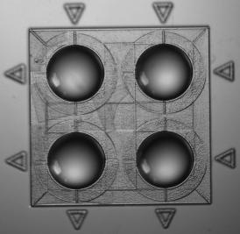
Micro-lenses array
Micro-lens array through 3D-femtosecond
machining and laser reflow.
‘sub-millimeter selfie image’
~1 m
300 µm
CMOS
Object
MLA

Slide 65
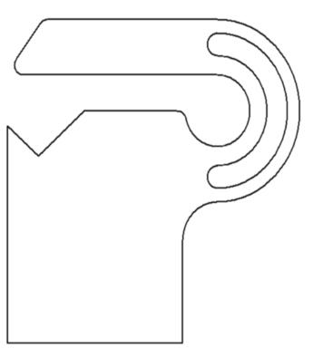


Laser-heat treatment // laser annealing
Laser is only used to transfer energy at a fast rate
Mechanical behavior after cold-forming
Loading
Mechanical after annealing
Unloading

Slide 66

Laser annealing of thin films
Hottest point
Coldest point
Temperature
Notes:
`

Slide 67




Illustration: Marking
Coloring by lasers annealing (Source Trumpf)
Coloring in steel
(Source Raycus)
Oxidation by lasers (Source Trumpf)

Slide 68

Illustration: Local hardening through local lasers heating

Slide 69

Laser cladding

Slide 70
Laser-matter interaction
A dynamical process: “how the energy deposited by the laser is ‘digested’ by the material”
Heat transfer to the material (phonons for dielectrics, electrons for metals)
Pressure wave
Molecular bond breaking (Ionization)
Stress
Melting
Ablation
Plastic deformation
Vaporization
Fracture

Slide 71

Phases during laser micro-machining involving solid-liquid phase transformation
Incident light
1) Laser energy is absorbed in the volume where light penetrates and then diffuses away
Reflected light
1)
Absorbed light
2) Material starts to melt and the surface is modified
2)
Vapor phase
Molten material
Liquid phase
3) Liquid may turn into a saturated vapor phase (‘plume’) that may absorbs itself light.
3)
Time (~ ns)

Slide 72

Industrial laser (Machining head): how it works in practice?
Laser beam
Laser head and specimen moves relatively one to another
The cutting gas pushes the molten liquid away from the cut
Cooling water
Cooling water
Focussing lens
Cutting gas
Laser head
Nozzle
Ejected material
(blown with the gas)
Specimen

Slide 73
Illustrations of ablation/cutting processes

Slide 74

Mitsubishi

Slide 75


LIBS- Laser Induced Breakdown Spectroscopy
After laser/target interaction, a plasma is formed. The radiation spectrum of the plasma (expanding in air) reveals the target composition.
De Giacomo et al, Spectrochimica Acta
Part B 65, 385 (2010)
www.spectroscopyonline.com

Slide 76

LIBS- Laser Induced Breakdown Spectroscopy
After laser/target interaction, a plasma is formed. The radiation spectrum of the plasma (expanding in air) reveals the target composition.

Slide 77
Laser-matter interaction
A dynamical process: “how the energy deposited by the laser is ‘digested’ by the material”
Heat transfer to the material (phonons for dielectrics, electrons for metals)
Pressure wave
Molecular bond breaking (Ionization)
Stress
Melting
Ablation
Plastic deformation
Vaporization
Fracture

Slide 78
Single photon process
Photon needs to be energetic enough to directly ionize the material
UV lasers (short wavelength)
Example: lasers / Frequency tripled Nd-YAG lasers
Conduction band
Single photon
hν = E₂-E₁
Typically λ < 200 nm for fused silica
Valence band

Slide 79


UV laser ablation
In this example, the beam is shaped using interferences
Polycarbonate
3 ns long pulse
Mezera et al, Nanomaterials 10, 1184 (2020)

Slide 80

Optimization
D. Bruneel, et al. , Optics and Lasers in Engineering, 48, 268-271 (2010)

Slide 81


‘Material Removal Rate’, example of an empirical law
Net fluence (W/mm²)
Penetration depth
Material removal rate
Optimal machining
Average power of the laser (W)
Absorption fluence threshold
B. Neuenschwander, et al., Phys. Procedia 56, 1047–1058 (2014).

Slide 82
Laser-matter interaction
A dynamical process: “how the energy deposited by the laser is ‘digested’ by the material”
Heat transfer to the material (phonons for dielectrics, electrons for metals)
Pressure wave
Molecular bond breaking (Ionization)
Stress
Melting
Plastic deformation
Ablation
Vaporization
Fracture

Slide 83

Shockwaves
Rapid absorption of energy
Rapid expansion of the zone under laser exposure
(source: M. Boustie, et al. Laser Ultrasonics, Montréal 2008)

Slide 84


Illustration of selective laser melting (Lab. Prof Logé)
Selective Laser Melting (SLM) + Laser shock peening (LSP) = 3D LSP
LSP surface
grain boundaries
LSP Treated surface
Compressive
Tensile
SP
100 μm
Strain energy map
After LSP
SLM
LSP
3D LSP
Conventional shot peening (SP)
Stress profiles

Slide 85
Part II / Ultrafast laser-materials processing

Slide 86


Ultrafast laser pulse
Ultrafast laser pulses are extremely short flashes of light and –when amplified- extremely intense.
Characteristic times
Power
Molecular periods:
Rotation : 10 - 100 ps
Vibration : 10 - 100 fs
Femtosecond pulses:
50 - 500 fs
Power density
Lightning:
10⁹ - 10¹² W/cm²
Fs laser pulse:
10¹² to 10¹⁵ W/cm²
Time
Ratio 1 fs / 1 s = 1 s / 32 million years

Slide 87

How are they produced?
Superposition of modes in a laser cavity
Random phases
No Interference
Δ ω= π c/ L

Slide 88

How are they produced?
Superposition of modes in a laser cavity
"locked" phases (mode-locked)
Δ ω= π c/ L
Power
2Δ τ
Time
© R. Trebino ultrafast optics textbook

Slide 89


CPA-chirped pulse amplification

Slide 90

Absorption in dielectrics
The nonlinear absorption confines the interaction
E_{gap} <hν
Linear absorption
Non-linear absorption
Pas d’absorption
Impulsion longue
ou faible Intensité
B. Amos, Stowers Institute

Slide 91
Ultrafast laser ablation/modification of materials
Timescales of the physical phenomena occurring after laser illumination
Pulse propagation
Gatass,R and Mazur,E. Nature Photonics,2,219 (2008)

Slide 92
Ultrafast laser ablation/modification of materials
Timescales of the physical phenomena occurring after laser illumination
Energy deposition
Time
Non-linear ionization
Laser-plasma
interaction
Coupling to lattice
+
phase changes
Heat diffusion
Long-lasting modifications

Slide 93
Why is "ultrashort" important?
Let's follow the flow of energy
Laser pulse
Laser pulse
workpiece
Free electrons
Lattice
Lattice outside the focal region

Slide 94
Why is "ultrashort" important?
Let's follow the flow of energy
Long pulse
Laser pulse
workpiece
Free electrons
Lattice
Lattice outside the focal region

Slide 95
Why is "ultrashort" important?
Let's follow the flow of energy
Ultrashort pulse
Laser pulse
workpiece
Free electrons
Lattice
Lattice outside the focal region

Slide 96




Why is "ultrashort" important?
Ultrashort pulses produce stronger thermodynamical gradients
In fact, it is the "hottest" ablation !
Almost no energy remains in the workpiece
200 fs
3 ns
B. Chichkov et al, Appl. Phys. A. 63, 109 (1996)
Energy density
Energy density
Vapor
Solid
Vapor
Liquid
Solid

Slide 97



Ultrafast machining of metals
(Images: Trumpf, M. Mielke)

Slide 98


Safe fs-pulse cutting of explosives and propellants confirms that absorbed energy is removed with ejecta.
Double-base propellant - HPC-95
Composition: Nitrocellulose - 78%, Nitroglycerin - 21%, other - 1%
Comp B, high explosive
Otherwise, these guys might not be here to tell us about it!
From E. Roos, LLNL

Slide 99


Application to LASIK
Generation of an array of micro-voids inside a transparent medium to lever the flap

Slide 100

Threshold effect
In practice, ultrafast laser ablation shows a strong threshold effect
Linear scale
Log scale
Electron density
Time
Or Intensity
Mao et al, Appl. Phys. A 2004

Slide 101


Application of the threshold effect
The threshold is highly material-dependent.
Example of the processing of a solar cell:
Threshold ZnO: 0.4 J/cm²
Threshold Mo : 0.7 J/cm²
ZnO
CuInSe₂
ZnO (type p)
Mo layer
CuInSe₂
(CIS, type n)
Mo
glass
Huber et al, proc. SPIE 6881, 688117 (2008)
We see the absence of melted regions (favourable for the chemistry of the cell)

Slide 102




Application of threshold effect
Laser-Induced Forward Transfer (LIFT)
Difference of ablation threshold between substrate and material ejected
http://www.e-lift-project.eu

Slide 103

Lift at an industrial scale... Flat panel displays production
(Source: Coherent)

Slide 104

(source: Prof. Yoshio Hayasaki, Univ. of Utsunomiya, Japan)

Slide 105


Light fairy tale... (Hayasaki lab)

Slide 106


Subwavelength writing
Koch et al, Opt. Eng. 4, 5 (2005)

Slide 107




Subwavelength writing
Chirped Pulse Amplification : 1991
First nano-hole: 1994
Extremely localized energy deposition:
15 nm diameter hole
Kuznetsov et al, Appl. Phys. A 94, 221 (2008)
Joglekar et al, Appl. Phys. B 77, 25 (2003)

Slide 108


Subwavelength writing
Application to cellular transfection
Meunier ‘s group, Ecole Polytechnique Montreal

Slide 109


Examples of NL-based microfabrication
Nonlinear photopolymerization
Sugioka et al, Light Sci. Appl. 3, e149 (2014)
Sugioka, Nanophotonics 6,393–413, (2017)

Slide 110
Case study I

Slide 111
Case study I: beam shaping for high-speed glass cutting
The pulse propagation inside the medium can be important
Energy deposition
Time
Non-linear ionization
Laser-plasma
interaction
Coupling to lattice
+
phase changes
Heat diffusion
Long-lasting modifications

Slide 112


A fs-laser pulse in glass
Strong distorsions occur
Self-focusing
Kerr effect : n=n₀+n₂I
Δn > 0
Sudrie et al, Phys. Rev. Lett. 89, 186601 (2002)
Plasma defocusing
Δn < 0

Slide 113



A nice solution, Bessel beams
Bessel beams are "diffraction – free". Kerr effect can be negligible.

Slide 114

The Bessel beam is a kind of laser sword

Slide 115


Single shot ablation with Bessel beams
Through-channel drilling with a single pulse
High aspect ratio void enclosed within sapphire
Bhuyan et al, Appl. Phys. Lett., 97, 081102 (2010)
30 µm
300 nm
Rapp et al, Sci. Reports 6, 34286 (2016)

Slide 116




High-speed transparent materials cutting with "stealth-dicing" technology
Side by side nanochannel drilling allows for cleaving with very high speed (1m/s)
8 mm
Meyer et al, Appl. Phys. Lett. 114, 201105 (2019)

Slide 117


High-speed transparent materials cutting with "stealth-dicing" technology
Side by side nanochannel drilling allows for cleaving with very high speed (1m/s)

Slide 118





Process and timescales
?

Slide 119


Comparison fs-ps regimes in sapphire
140 fs
3 ps
Rapp et al, Scientific Reports 6, 34286 (2016)

Slide 120

Increasing the efficiency with double pulses
Warm dense matter : highly absorbing
Falk, K. (2018)

Slide 121


Increasing the efficiency with double pulses
Warm dense matter : highly absorbing
Single pulse
Energy density
Split pulses
Energy density

Slide 122

Increasing the efficiency with double pulses
J. Hoyo et al, Nanophotonics 10, 1089 (2021)

Slide 123







Playing with the beam shape
(circularly-symmetric)
Bessel beam
Elliptical Bessel beam
R. Meyer et al, Opt. Lett. 42, 4307-4310 (2017)

Slide 124



Playing with the beam shape
(circularly-symmetric)
Bessel beam
Elliptical Bessel beam
Sample
Vacuum
R. Meyer et al, Opt. Lett. 42, 4307-4310 (2017)

Slide 125
Ongoing questions
Why is the energy so concentrated in this case?
What is the actual plasma diameter?

Slide 126














Laser- nanoplasma interaction
$$∇×E=−∂_{t}B$$
Interpolation of E:B fields at the positions of the particles
$$∇×B=\frac{1}{c^{2}}∂_{t}E+μ_{0}J$$
500 millions particules
24 hours on 4096 cores
$$E_{y}$$
$$B_{z}$$
$$i^{+}$$
$$E_{x}$$
$$e^{−}$$
Weighting of particles in the mesh points to compute $ρ,J$
$$\frac{dr}{dt}=v$$
$$m\frac{dγv}{dt}=q(E+\frac{v}{c}×B)$$

Slide 127
Case study II: Tuning materials properties and fine adjustment with lasers

Slide 128





Materials science point-of-view
Type II
‘Self-organized
nanogratings’
Type I
‘Continuous
homogeneous
zone’
Y. Shimotsuma, P. Kazansky, et al.
PRL (2003)
K. M. Davis, et al. Opt. Lett. 21, 1729–1731 (1996).
Highly confined
(high NA)
‘micro-explosion’
‘Type X’
P. Kazansky, LSA (2020)
E. Glezer, E. Mazur, APL (1997) / S. Juodkazis, et al., PRL (2006).
Other types?
Femtosecond lasers induce a rich taxonomy of transformations in materials!
High repetition
rate
‘Bulk heating’
Research questions: understand how materials change under strong electric field exposure

Slide 129








Functional integration point of view
(Translume)
Waveguides, Gratings, ...
‘Homogeneous’
Nanogratings
Cumulative regime
Nano-explosion
More?
3D machining,
Controlled birefringence,
Memory storage…
(FEMTOprint)
Welding,…
(P. Kazansky)
(Watanabe et al.)
Seeds for nano-scale patterning, …
Research question: how to relate laser-induced transformations with applications?

Slide 130

‘Optical circuit’: writing waveguides
(Source Translume)
Notes:
This example illustrates waveguides written in the bulk of a glass substrates. The waveguide can be seen as ‘light pipe’ that guides an optical wave.
Waveguides can be combined to form complex functions. The one above makes two beams interfering.

Slide 131


Optical components
(ORC, Univ. Of Southampton, Prof. P. Kazansky’s group)
APL 2011, 2012
(Mémoire optique)
Notes:
In this example, a laser is used to encode information directly in a glass substrate. This is done using femtosecond laser to create micro-size structures having the size of a micron.
Every pixel consist of structure formed of self-organized nano-planes (see in the top left) that create local polarization properties. These pixels can be combined for engraving complex optical devices or recording data, like illustrated with the portraits of Maxwell and Newton. The portraits are about 100 microns.

Slide 132


Eternal memory
Source:
Peter
Kazansky
Univ. de
Southampton
Notes:
Some further illustration of the use of this principle for recording data. The substrate has the size of a five franks coin.
The books of Newton are recorded into the three little disk, around the label ‘Newton opticks’.

Slide 133












Key aspects of femtosecond laser processing
Ulysse Nardin
Pure silver micro-casted
Classroom (with Andreas Mortensen)
Non-linear process
3D structuring beyond the diffraction limit > nanoscale resolution
Ultra high-aspect ratio (>1:300 and beyond) when combined with selective etching
Arbitrary 3D shapes
In volume, direct-write photonics (waveguides, gratings, etc.)
9 µm
2 mm
Translume
FEMTOprint

Slide 134
Illustrative examples from research…

Slide 135




From photonics components: direct write waveguide writing, micro-lenses, etc.
Single-mode
laser-written
waveguide
(@630 nm)
Micro-lens array through 3D-femtosecond
machining and laser reflow.
‘sub-millimeter selfie image’
~1 m
300 µm
CMOS
Object
MLA

Slide 136






… to algae population monitoring
Optofluidics chip

Slide 137




From laser-induced crystallization: laser-induced elemental tellurium in tellurite glass
near-IR
fs-laser
G. Torun, T. Kishi, D. Pugliese, D. Milanese and Y. Bellouard, Advanced Materials (2023).

Slide 138





… to functional device: single-material direct-write photoconductors
Tellurite glass locally transformed into tellurium
Arbitrary shape and dimensions from µm-scale
Local modifications and transformation
Without addition/subtraction of any materials
270 fs; 1030 nm; 1 MHz
0.0066 to 263 J/mm²
near-IR
fs-laser
~0.004 Ω·m
1.4·10¹⁸ Ω·m
t-Te nanocrystals
10K₂O-10WO₃-80TeO₂ (mol%)
G. Torun, et al., Phys. Rev. Applied 21, 014008 (2024).

Slide 139







From micro/nanoscale mechanics…
X 10⁻²
Micro-hinge for fracture mechanics
Regime I
‘Densification’
Regime II
‘Nanogratings’
Tailored stress states in
silica
Y. Bellouard, A. Champion, B. McMillen, S. Mukherjee, et al., Optica 3, 1285 (2016).

Slide 140






… to optical bench on a glass chip
Components mounting and aligning
Laser all mounted on one piece of glass

Slide 141

All-glass GHz femtosecond laser oscillator
A femtosecond laser making a femtosecond laser!
A. Delgoffe, S. Nazir, S. Hakobyan, C. Hönninger, and Y. Bellouard, Optica 10, 1269 (2023).

Slide 142


1 mm
40 um

Slide 143
Thank you!

